Slide 1
Electronic Structure of Condensed Matter
Fudan University - April 2010
Lecture 6, Part 2: Methods Using Plane Waves:
Pseudopotentials, APW, PAW
Instructor: Richard M. Martin
University of Illinois
Stanford University
rmartin@illinois.edu
and
rmartin42@gmail.com

Slide 2
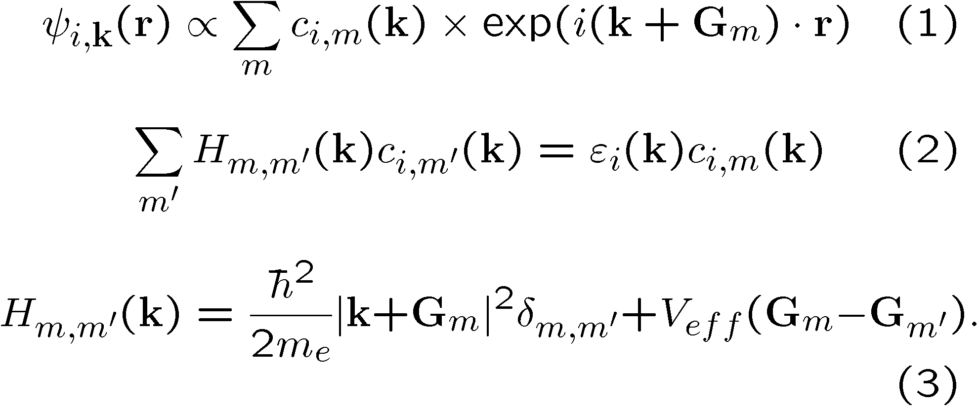
Plane Waves
A general approach with many advantages
Kohn-Sham
Equations
in a crystal
Kohn-Sham
Equations
in a crystal
The problem is the atoms! High Fourier components!

Slide 3
Why not use plane waves directly?
Basic problem - many electrons in the presence of the nuclei
Core states – strongly bound to nuclei – atomic-like
Valence states – change in the material – determine the bonding, electronic and optical properties, magnetism, …..

Slide 4
Basic Methods with plane waves
Pseudopotentials
  Replace cores by smooth pseudopotentials
  Then use Fourier Expansions directly
  The speed of Fast Fourier Transforms
Augmentation method 1 (APW)
  Define spheres around atoms
  Solve with plane waves outside, spherical harmonics inside
  Most general form – (L)APW - linearization very important for simplifying calculations
Augmentation method 2(PAW)
  Add core-like functions to plane wanes – do not use spheres
  Can consider as a combination of the ideas form pseudopotentials and APW

Slide 5
Augmentation -APW
(L)APW method
Augmentation: represent the wave function inside each sphere in spherical harmonics
  “Best of both worlds”
  calculate both core and valence states
  But requires matching inside and outside functions
  Most general form – can approach arbitrarily precision
Difficult – non-linear
Made much more useful
by linearization

Slide 6
Pseudopotentials
Pseudopotential Method – replace each potential
solid
2
Pseudopotential
atom
1
Generate Pseudopotential in atom (spherical) – use in solid
Pseudopotential can be constructed to be weak
  Can be chosen to be smooth
  Solve Kohn-Sham equations in solid directly in Fourier space
1
2

Slide 7
Ideas behind pseudopotentials
Near the nucleus the wavefunctions vary rapidly, but far from the nucleus (outside some core region of radius R_{c}) the wavefunctions are smooth
The valence properties of atoms (bonding, valence electron excitations, etc.) are determined primarily by the wavefunctions outside the core.
Pseudopotential
This is done
in APW
What is the effect of the core? It provides a boundary condition
on the wavefunctions outside the core region.
The wavefunctions outside are exactly the same if we invent a pseudopotential that gives the same boundary conditions

Slide 8
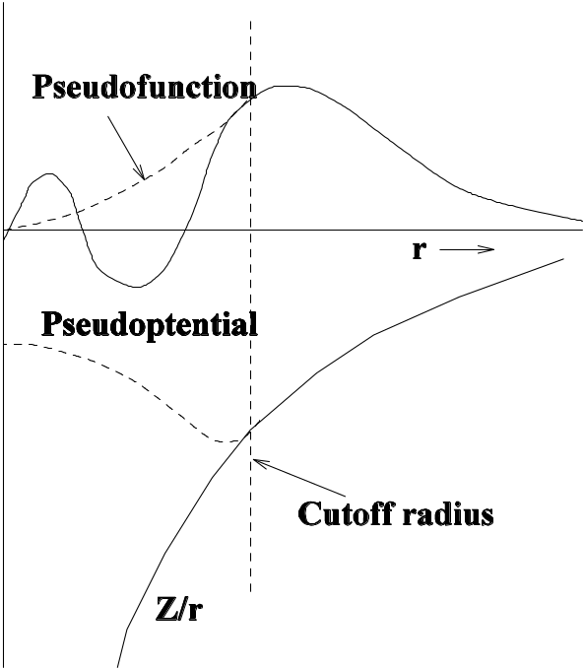
Norm-Conserving Pseudopotentials
Norm-Conserving Pseudopotential (NCPP)
  Hamann, Schluter, Chaing
Pseudopotential
Generate weak pseudopotential in atom
with same scattering properties for valence
states as the strong all-electron potential
Conditions
  Potential same for r > R_{c}
  Pseudofunction “norm-conserving” for r < R_{c}
Codes available for generating potentials

Slide 9
Norm-Conserving Pseudopotentials I
Summary of the theory and steps in constructing a NCPP
1. DFT calculations for the all-electron atom – find the valence eigenvalues and eigenfunctions for each angular momentum L
2. Construct a pseudofunction that is the same outside Rc and is continued inside smoothly
3. Require “norm conservation” which means the function is normalized. This is satisfied if the integral over the core region is the same as for the original valence function.
4. Find the pseudopotential by inverting the Schrodinger equation:
V(r) ψ(r) = εψ(r) + (h²/2m) [(2/r) (dψ/dr) + (d²ψ/dr²)]
  This must be done separately for each ang. mom. L

Slide 10
Norm-Conserving Pseudopotentials
Summary of the properties of a NCPP
Properties of a NCPP
The potential is “non-local” – it is not simply a function of position – the potential for each angular momentum is different
An elegant proof (see section 11.4) shows that if the pseudopotential is norm-conserving, then it also has the property that the logarithmic derivative is not only correct at the given energy ε, but also correct to linear order for energies ε + Δε
The last point is the feature that makes the potentials more “transferable” from the atom to the molecule or solid where the energies change.
Different for
different angular
momenta

Slide 11
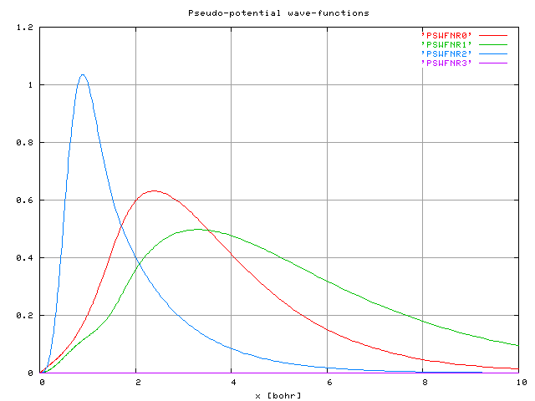
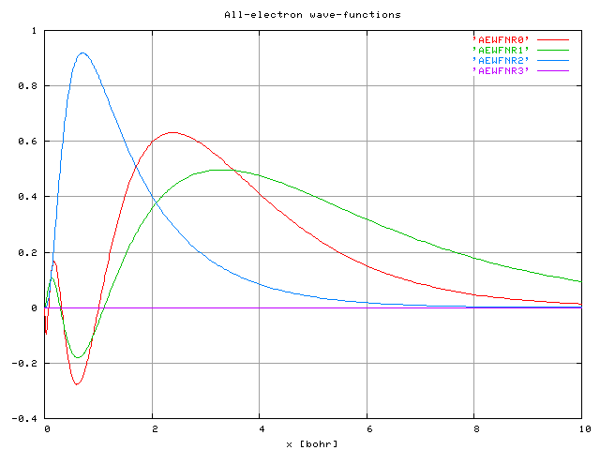
Example -Fe – s,p,d valence wavefunctions – r ^{ψ}(r)
All electron functions
Pseudo functions
Wavefunctions are identical
outside the core region
0
0
r (Bohr)
10
0
r (Bohr)
10
From http://www.tddft.org/

Slide 12
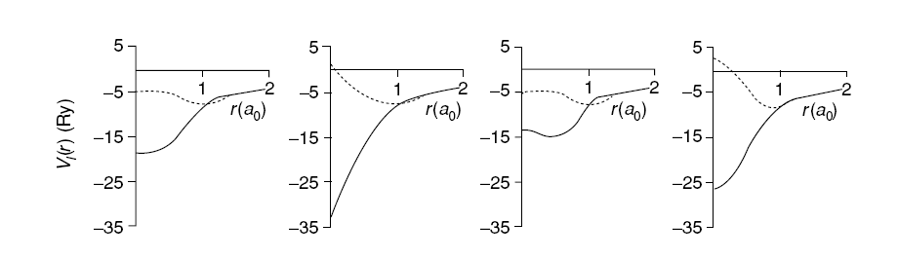
Examples of pseudopotentials
All these pseudopotentials give essentially the same results
in a calculation on a solid!
Figure 11.5 in the book
Key points:
The potentials are “non-local” – different for different angular momenta. A complication but it can be done by projecting plane waves onto spherical harmonics
Many different potentials can give the same wavefunctions outside the core region – and essentially the same results in a solid

Slide 13
Augmentation - PAW
PAW – add core functions in core region
Planes extend throughout crystal – like pseudopotentials
Add core functions in core regions – like APW (where the full equations for core and valence states are solved inside sphere
Great advantage – can use FFTs as in pseudopotentials

Slide 14
Summary of Methods to use plane waves
Pseudopotentials
  Cores are replced by pseudopotentials
  Calculations are very fast
  Simple algoriths - FFTs
  This is the reason why this method is the
  basis for so much work
Augmentation (APW)
  More difficult – solves core and valence problems together
  Most general form – (L)APW - best to use for transition metals |where d and f states are localized` but are also valence states
Augmentation (PAW)
  Can consider as a combination of the ideas form pseudopotentials and APW

Slide 15
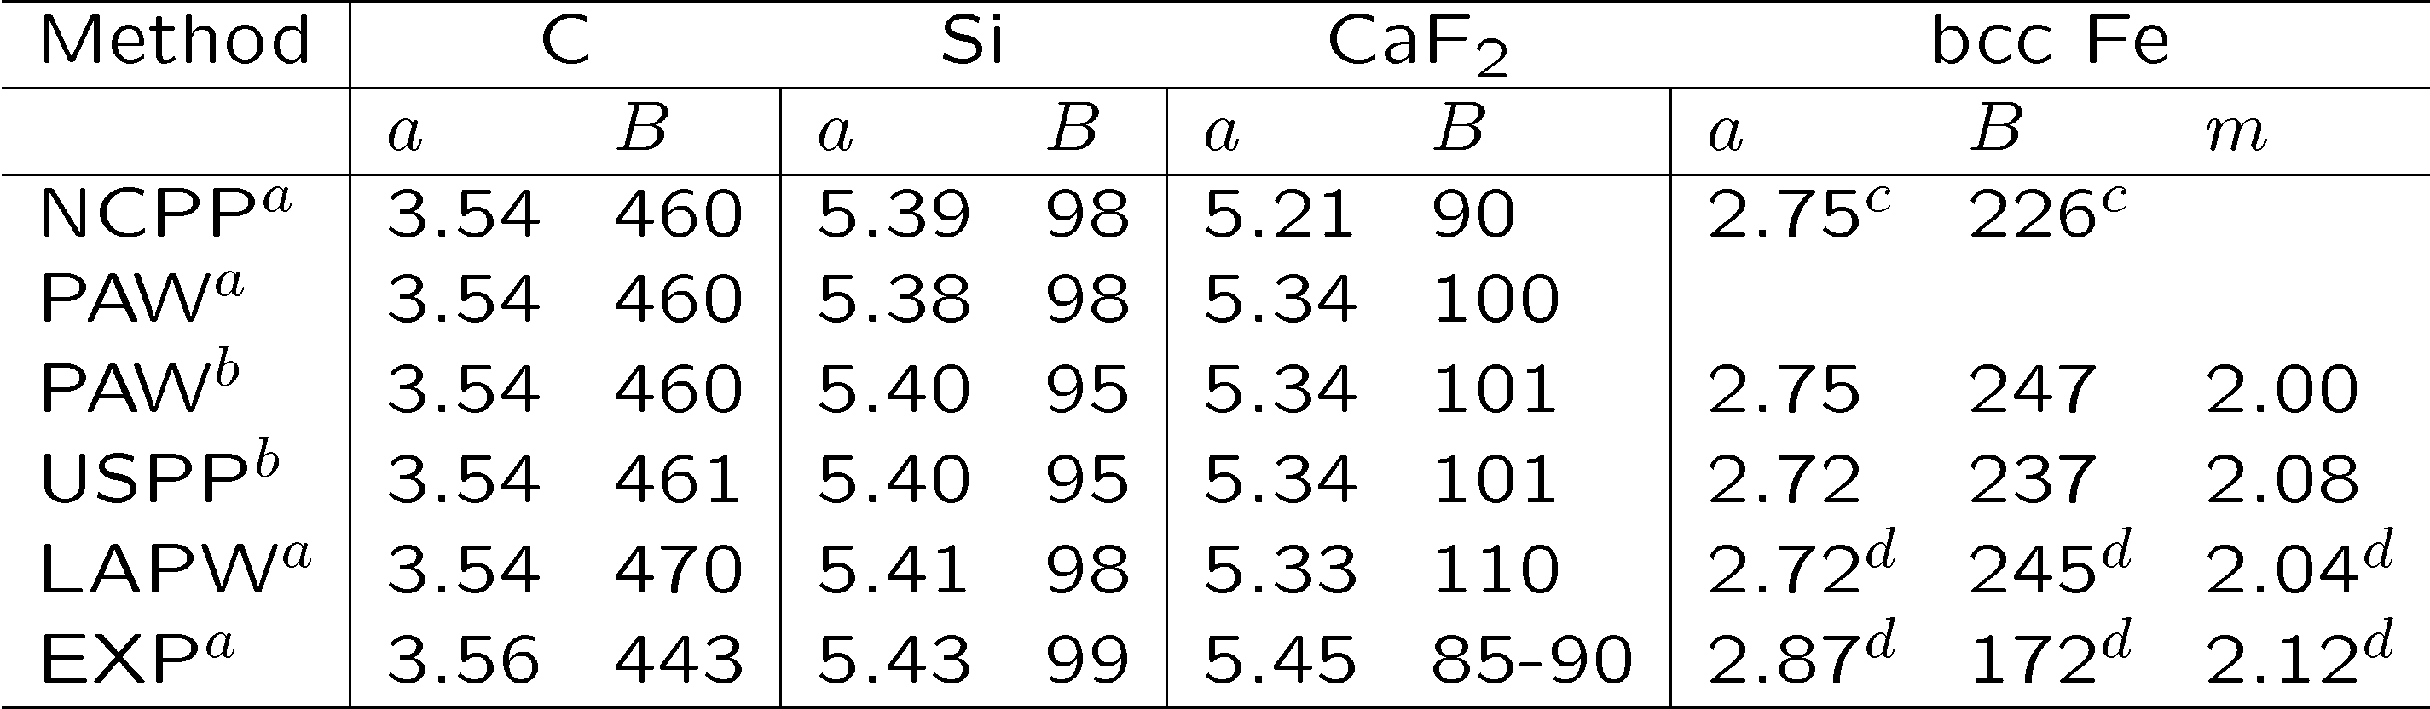
Comparisons – LAPW – PAW -
- Pseudopotentials (VASP code)
a – lattice constant; B – bulk modulus; m – magnetization
ªHolzwarth , et al.; ^{b}Kresse & Joubert; ^{c}Cho & Scheffler; ^{d}Stizrude, et al.

Slide 16
Conclusions
APW is the most direct, exact method, but it is difficult to use.
Pseudopotentials greatly greatly simply electronic calculations by replacing the effects of core electrons with a potential. They have made possible many of the important advancements of the last years in electronic structure
PAW is in some wayes analogous to a combination of the above
Recent advances (discussed next time) in algorithms have made plane waves + pseudopotentials very efficient and the basis for many other advances.
Most important -- understand what you are doing!
  Errors if pseudopotentials are used that are not accurate
  Care to use codes properly
  Care to test all the convergences
Other developments and applications next time

