Slide 1
Electronic Structure of Condensed Matter
Fudan University - April 2010
DFT-II - Kohn-Sham-DFT
What is E_{xc} – Approximations for E_{xc}
Instructor: Richard M. Martin
University of Illinois
Stanford University
rmartin@illinois.edu
and
Rmartin42@gmail.com

Slide 2
Functional E_{xc}[n] in Kohn-Sham Eqs.
First: What is the basic relation of E_{xc} to exchange and correlation
  Requires information on the many-body system of interacting electrons
Next: Examples of approximate functionals E_{xc}[n]
Local Density Approximation - LDA
  Assume the functional is the same as a model problem –
  the homogeneous electron gas
  E_{xc} has been calculated as a function of density
  using quantum Monte Carlo methods (Ceperley & Alder)
Improvements: Gradient approximations - GGA
  Various theoretical improvements for electron density
  that is varies in space
Orbital functionals – Van der Waals functionals

Slide 3
Relation of E_{xc}[n] to exchange and correlation I
Exchange and correlation denote the correlation among the electrons
Around each electron there is a “hole” - depletion of other electrons
described by the density reduction n_{xc}(r )
For parallel spins , there is exclusion due to the Pauli exclusion principle
Also correlation tends to push other electrons away
For opposite spins correlation is a depletion of other electrons due to repulsion (a larger correlation effect than for parallel spins )
  Requires information on the many-body system of interacting electrons

Slide 4
Relation of E_{xc}[n] to exchange and correlation II
E_{xc} is the reduction in the energy due to exchange and correlation
The energy is insensitive to the shape of the xc hole n_{xc(}r )
E_{xc} depends only upon the spherical aaverage of the xc density
  Requires information on the many-body system of interacting electrons
  But only the spherical average – a great simplification
E_{xc} = 4 π ∫ dr r² (1/r) n_{xc}(r )

Slide 5
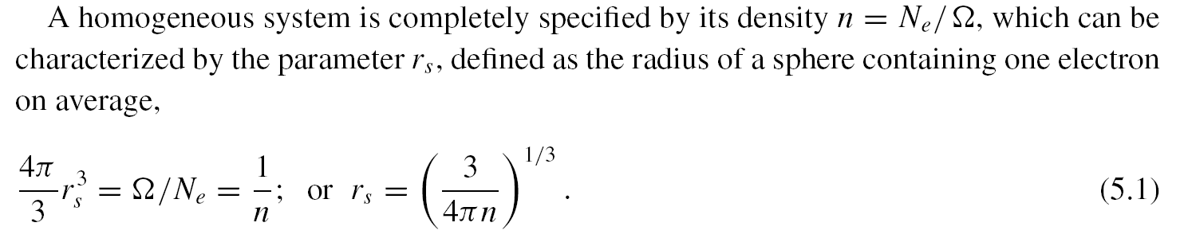
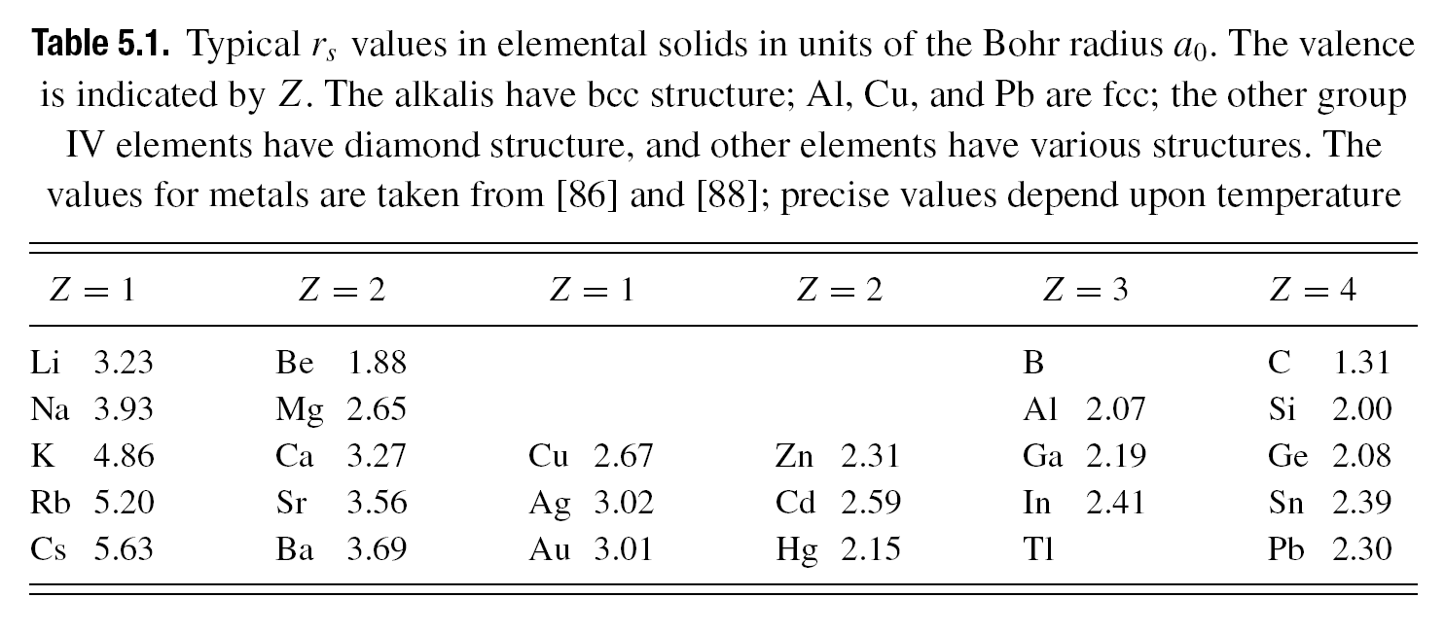
Homogeneous Gas – Basic definitions
Interacting electron problem – with no external potential
(a constant V is just a shift in the energy)

Slide 6
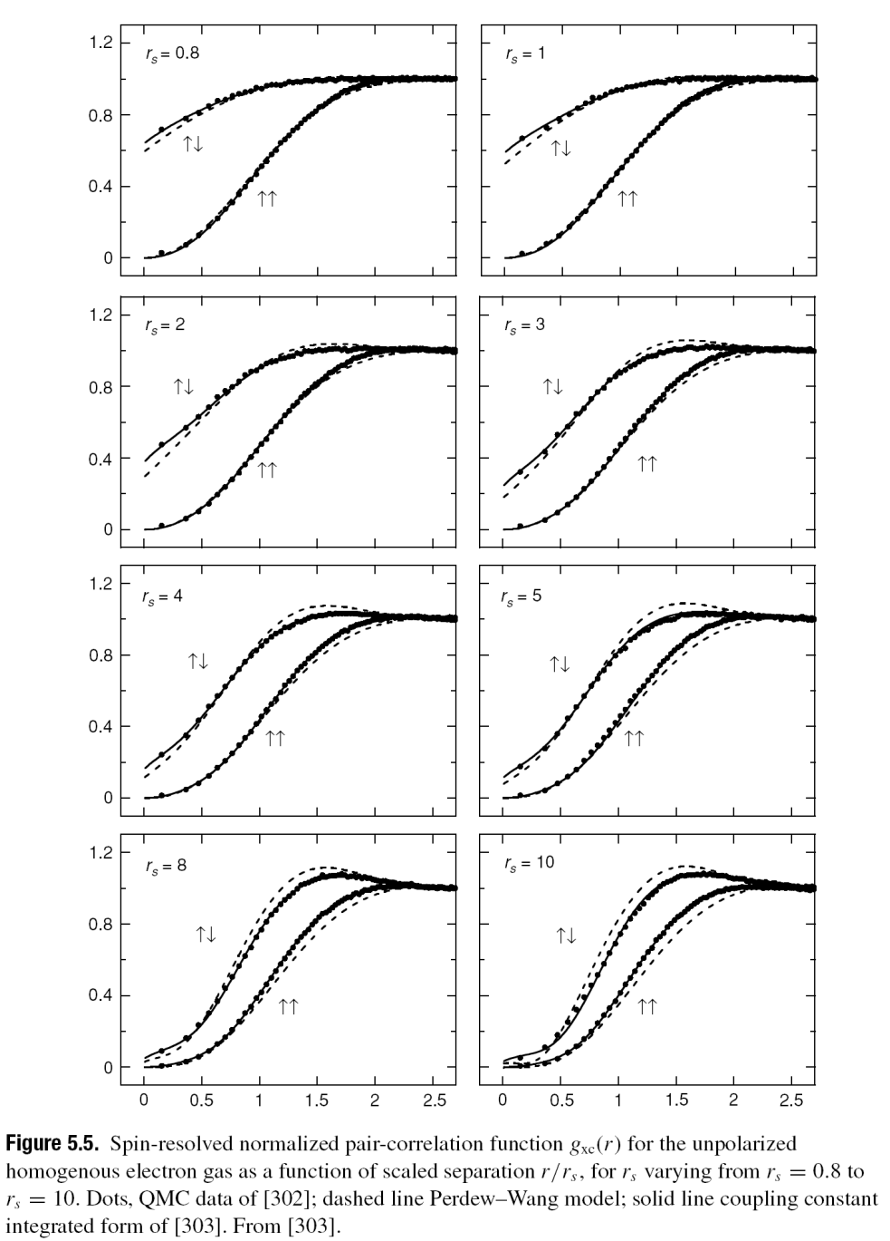
Hole due to Exchange and Correlation
Results from
quantum Monte Carlo
Calculations
Opposite spin
Parallel spin
Key point – the xc hole
is rather localized –
extentds to ~ 2 r_{s} ~ distance
to neighboring electrons

Slide 7
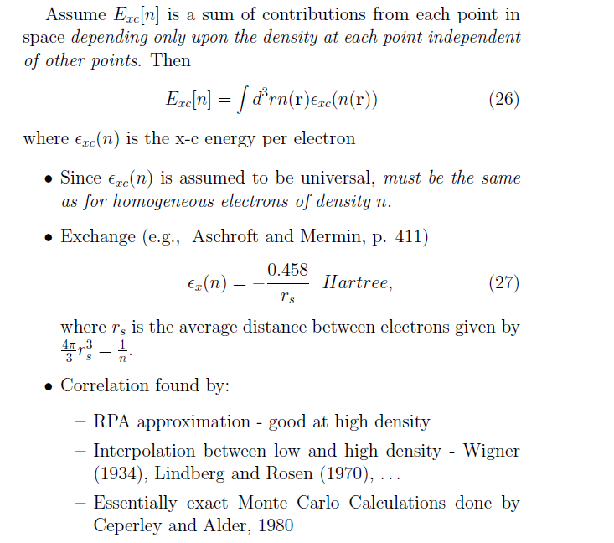
Local Density Approximation

Slide 8
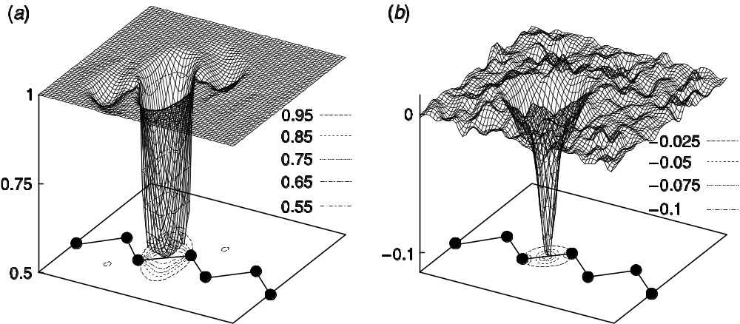
Exchange-correlation (x-c) hole in silicon
Calculated by Monte Carlo methods
Exchange
Correlation
Note this is on
a smaller scale
Hole is reasonably well localized near the electron
Supports a local approximation
Fig. 7.3 - Hood, et. al. [349]

Slide 9
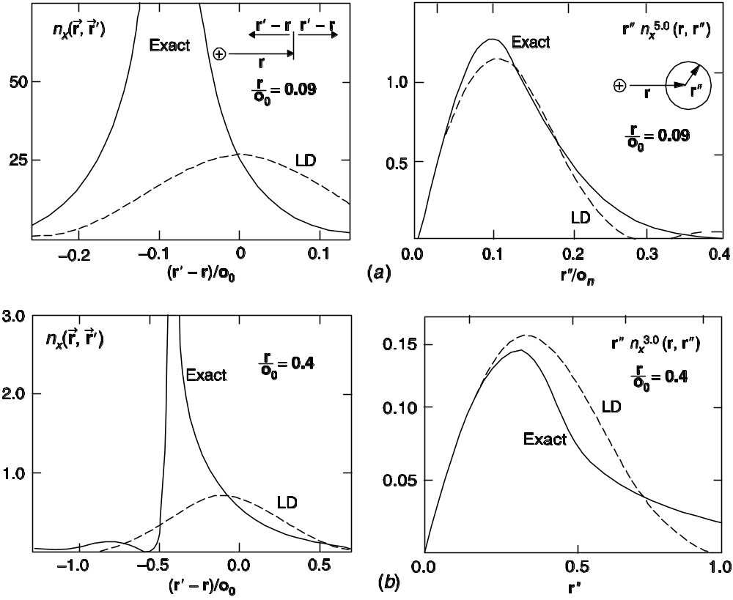
Exchange and Correlation in an atom
Exchange and correlation → around each electron, other electrons tend to be excluded – “x-c hole”
E_{xc}is the interaction of the electron with the “hole” –
which involves only a spherical average
Exchange hole in Ne atom
electron
nucleus
Is the local density approximation a good approximation?

Slide 10
Note that Exc[n] includes both Exchange and Correlation
Exchange and correlation → around each electron, other electrons tend to be excluded – “x-c hole”
E_{xc}is the interaction of the electron with the “hole” –
which involves only a spherical average
Exchange hole in Ne atom
Spherical average
electron
nucleus
Supports the local density approximation!
( Gunnarsson, et. al.)

Slide 11
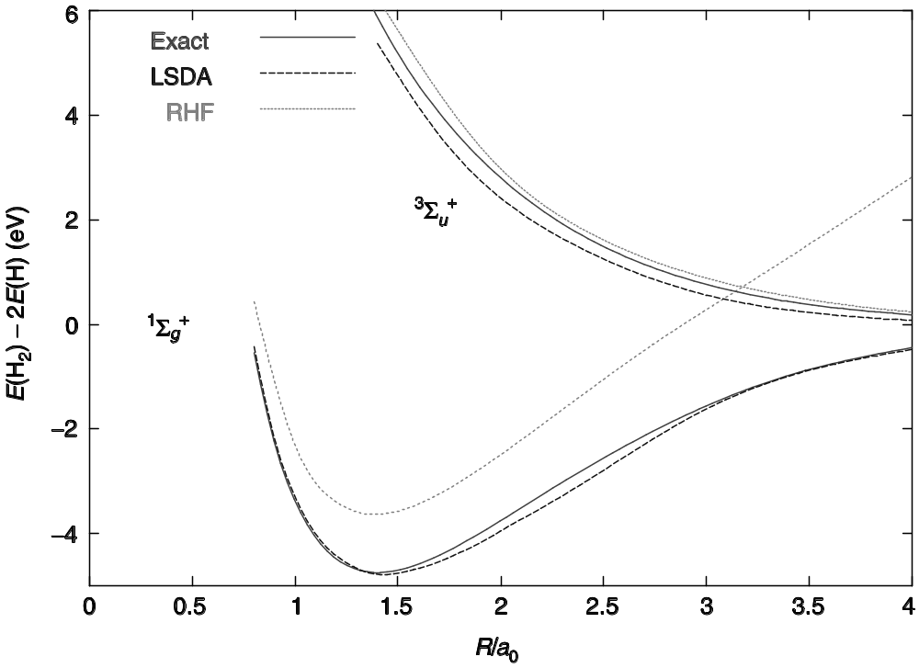
Example of H₂ Molecule
It seems ridiculous to approximate the correlation of the two electrons by the LDA derived from the homogeneous gas!
How good
are the results?
Very Good!
Supports a local approximation – exact is the homogeneous limit
and amazingly good for the H₂ molecule!

Slide 12
Reasons L(S)DA is so successful
It is remarkable that the local approximation – based on the homogeneous gas is so good for inhomogeneous systems
Why is it so good? Rationalizations:
  Only the spherical average matters for the energy
  It can be terrible for the actual non-spherical
  correlation !
  It works for Ne and H2 (no one knows why!
  It is based upon an actaul system, so it obeys sum rules,
  unlike many attempts at improvements
But it is really NOT so good when examined closely!
  It does not give “chemical accuracy”
  Next slide – improvements!

Slide 13
Generalized Gradient Approximations
Why are there many GGAs whereas there is only one LDA
(we ignore the small differences in the way the LDA is parametrized)
Why is it “generalized”?
  The direct expansion is a disaster -- if it is correct
  for small gradients it increases much too much for
  large gradients
The various GGAs differ mainly in how the expansion
is cut off for large gradients
Next slides
  Definition of terms
  Behavior of GGAs as a function of the magnitude of
  the gradient

Slide 14
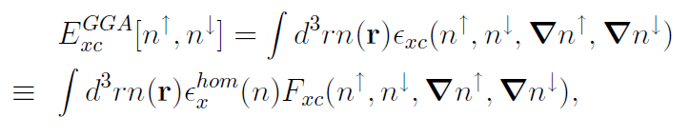
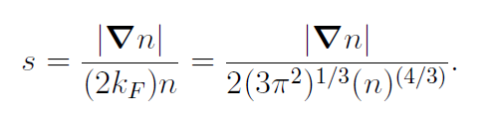
Generalized Gradient Approximations
Useful way to define a GGA
F_{x} = F_{c} = 1 for LDA, F_{x} > 1, F_{c} < 1
Why?
Normalized gradient

Slide 15
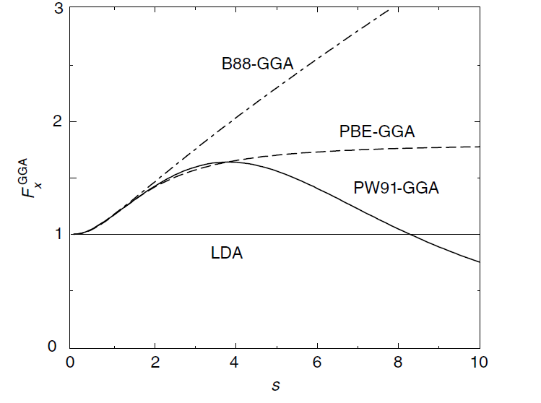
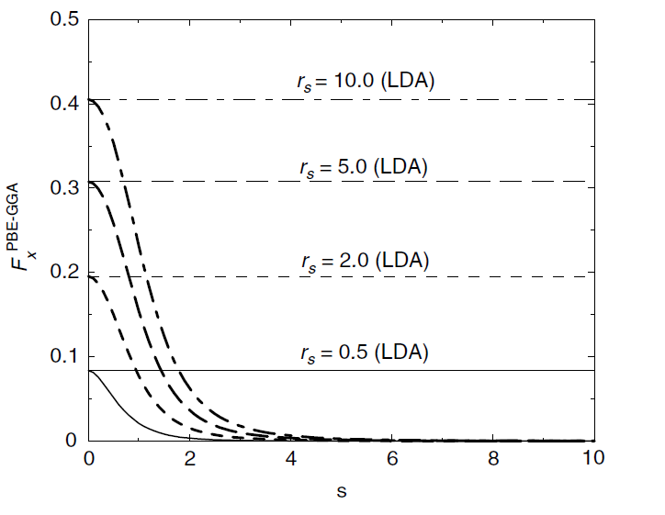
Generalized Gradient Approximations
Examples of Functionals
(I like PBE because it has a simple derivation – no free parameters)
See text
Exchange
Correlation (PBE)
Correct form
Typical solid
Normalized gradient s
Normalized gradient s

Slide 16
What is improved by GGAs
Strongly bound solids (Si, C, ….) not a large effect
  Often slightly worse than LDA
The large is for localized systems – atoms, molecules
  The normalized gradient is large in the outer regions where the density is small
  Often a very large effect – much closer to experiment
This is why DFT is used so much in chemistry!
  For large molecules
  This is why Kohn got the Nobel prize in chemistry!
  Much work to have “chemical accuracy”

Slide 17
The main challenges for GGAs
The main challenge is make a GGA that is accurate for both:
  Extended states in solids - small but important gradients
  Localized`states in molecules, atoms
Examples:
  Surfaces have both types of regions
  Adsorption, catalysts, ……
Examples of construction
  PBE – defines correlation first! Finds exchange term that cancels an error in correlation
  Empirical – many functions defined in chemistry literature that are fit the sets of molecules
See Ch. 8, App. B

Slide 18
Other functionals: Hybrid, Orbital dependent
Hybrid – mixed Hartree-Fock and DFT
  Main improvement is in the excitation energies
  Important for many problems – especially when typical GGAs give the wrong ground state
Orbital dependent
  General idea: Kohn-Sham introduced orbitals for the kinetic energy – the next step is orbitals in E_{xc} E_{xc}[ψ_{i}]
  Can be large improvement if there are both localized and delocalized localized functions
  Example – localized 3d states of transition metals
    “LDA+U” adds extra repulsive interaction for
    3d states
See Ch. 8

Slide 19
Other functionals: Van der Waals (VdW)
Lower energy
Higher energy
Van der Waals – very recent
  General idea: include the non-local correlated quantum fluctutations of the dipoles`that give 1/r⁶ interaction. This depends upon the polarizabilities χ
Why was it difficult to find a good VdW functional
  Difficult to find good expressions for χ[n] as a functional of the density
  Difficult to find a form that goes continuously from the VdW limit to strongly bonded cases where GGA works
Not in book
Reference: Langreth, et al

Slide 20
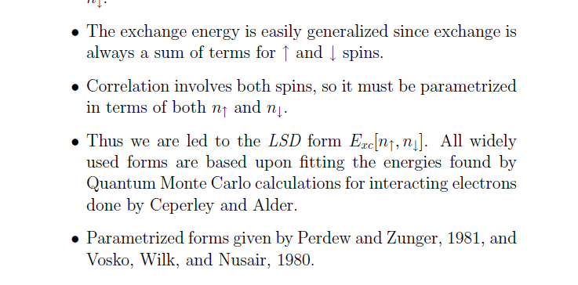
Magnetic Systems
Local Spin Density Approximation
In principle, in Hohenberg-Kohn the density is enough
But in Kohn-Sham one must put in a spin dependent E_{xc}
Why?

Slide 21
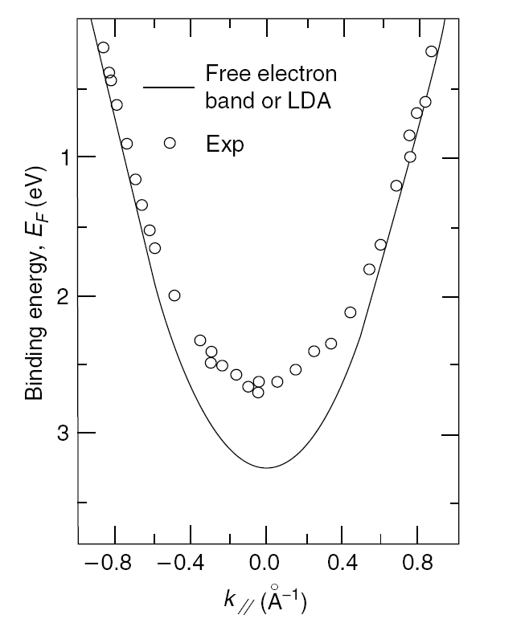
Experimental bands in Na – approximate gas
In principle, in Hohenberg-Kohn the density is enough
Back to the basic question:
Are eigenvalues from KS calculations
of any use?
Why do people often interpret them
as approximate bands?
Test on the homogeneous gas
The KS bands MUST always be just the
simple kinetic energy ~ k²
Lets compare with real bands - Na
Not so bad!
Supports the idea that in systems not too different from the homogeneous gas the bands will be reasonable
C, Si, alkali metals, the s-p bands in transition metals (NOT the d bands), . . .

