Slide 1
Electronic Structure of Condensed Matter
Fudan University - April 2010
Lecture 7: Iterative methods
Efficient Plane Wave and Grid Calculations Molecular Dynamics with Forces from the Electrons
Instructor: Richard M. Martin
University of Illinois
Stanford University
rmartin@illinois.edu
and
rmartin42@gmail.com

Slide 2
Iterative methods
Efficient Plane Wave and Grid Calculations Molecular Dynamics with Forces from the Electrons
OUTLINE
Brief outline of classical molecular dynamics (MD), relaxation of
atom positions
Methods for MD and for minimization
The Car-Parrinello advance
Unified MD algorithm for nuclei and electrons
“Fictitious dynamics” of the electrons – hard to use
General forms for iterative algorithms for K-S Eqs.
Easier to understand than CP algorithm
Algorithmic advances – iterative methods, FFT, . . .
Expressions using plane waves
Examples
Liquid carbon, Water, . . .

Slide 3

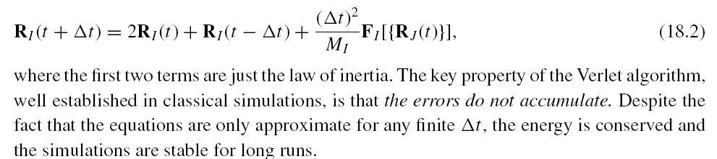
Classical Molecular Dynamics (MD)
Solve Newton’s equations of motion for a complicated system
Verlet algorithm: advance position of each atom in time steps Δt
Typical MD uses forces derived from a force model – force F a simple function of positions of neighbors
Simulations with 100’s, 1000’s, 1,000,000’s of atoms can describe liquids, solids at high temperature, phase transitions, diffusion, vibrational excitations, thermal behavior, solutions, disordered systems, . . . .
Typical calculation - many atoms in a cell with periodic boundary conditions

Slide 4
Relaxation of atomic positions to find stable structure
Do NOT want to conserve energy – want to lose energy as fast as possible to reach the lowest energy state
Simplest algorithm: Move atoms along the direction of the force by a magnitude proportional to the force. At sep n, move atoms to the positions at the next step, n+1
R_{I}^{n+1} = R_{I}^{n} + α F_{I}^{n}
This is called “Steepest descent” because the coordinates are displaced along the direction of the gradient (F = - dE/dr)
In this algorithm the positions always move in the “downhill” direction.
Problems: As shown in the figure on the next slide, this can be very inefficient, walking back and forth toward the minimum – but never
actually arriving at the minimum!

Slide 5
Steepest Descent
Energy contours around the minimum
Minimum
x
This is called “Steepest descent” because the coordinates are displaced along the direction of the gradient (F = - dE/dr)
In this algorithm the positions always move in the “downhill” direction.
Problems: As shown in the figure, this can be very inefficient, walking back and forth toward the minimum – but never
actually arriving at the minimum!

Slide 6
Conjugate Gradients (CG)
Energy contours around the minimum
For quadratic function of
2 variables – exact solution in 2 steps
Minimum
x
In the conjugate gradient method the energy is minimized along the direction of displacement – line minimization.
1. The first direction is along the gradient – same as steepest descent – except that one finds the minimum along that line.
2. The second direction is orthogonal – and there is a formula for following directions to be “conjugate” to all previous steps!
For a quadratic function of N variables, CG is guaranteed to reach the minimum in N steps. Very efficient for equations that are not quadratic

Slide 7
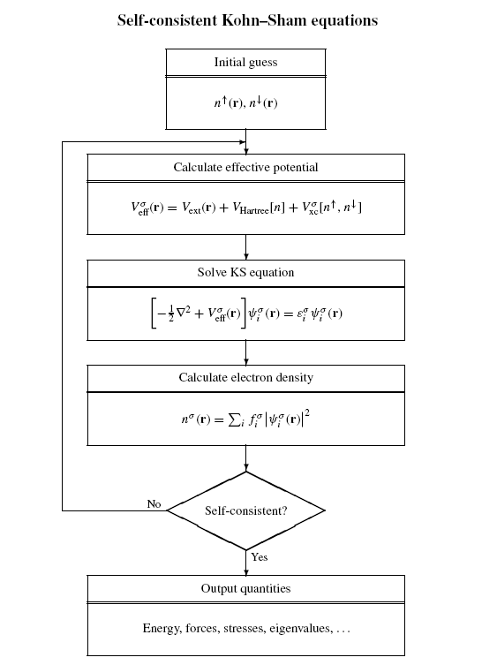
Usual approach to the Kohn-Sham problem
See Chapter 9 – Solving
the Kohn-Sham Eqs.
Self-consistent Equations
Solve equations with many
cycles of iteration to get
accurate solution - then
calculate forces

Slide 8
The textbook method for quantum mechanics
-- Diagonalize Matrices
Two numerical problems:
1. Diagonalize matrix – find eigenvalues, vectors
2. Iterate to self-consistency – this is a minimization
problem – minimize with respect to n(r)
Diagonalization – computer time scales as N_{B}³
N_{B}³ is size of basis
Efficient for small basis – LCAO, etc., for small problems
NOT efficient for large bases – Plane waves!
Iterate to self-consistency –
This is a minimization problem
Minimize total energy with respect to n(r)
(Recall - this is how the Kohn-Sham equations were derived!)
The iterations are a numerical way to reach the minimum
Can use Steepest Descent, Conjugate Gradient , . . .

Slide 9
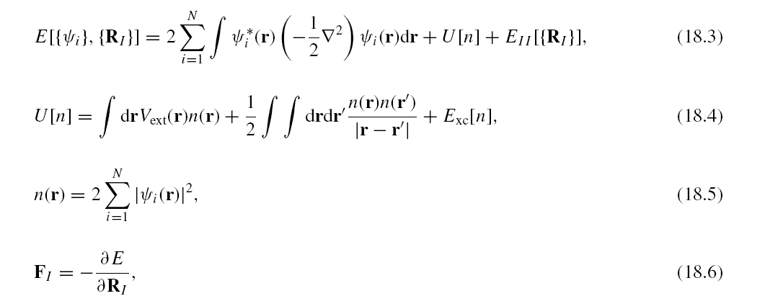
“Ab initio” “First principles” Molecular Dynamics and Relaxation of the structure
Calculate forces from the electrons using the force theorem
In principle, the Kohn-Sham approach gives exact forces
In practice, many examples show the forces are very accurate – tested by comparison with experiment in simple systems
The only problem – how to calculate forces on many atoms for thousands of time steps

Slide 10
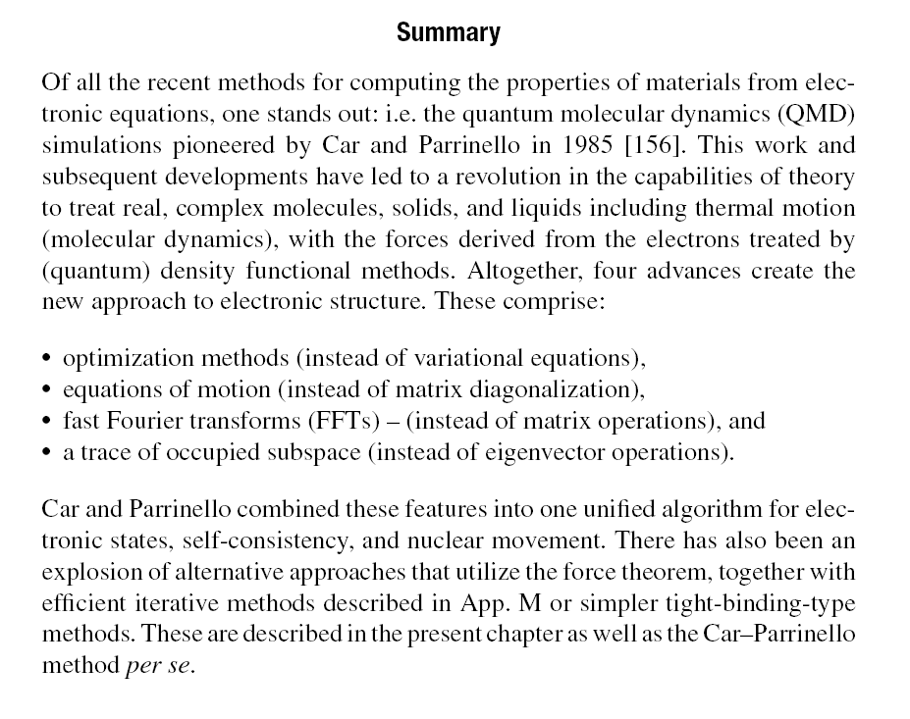
The Car-Parrinello Advance

Slide 11
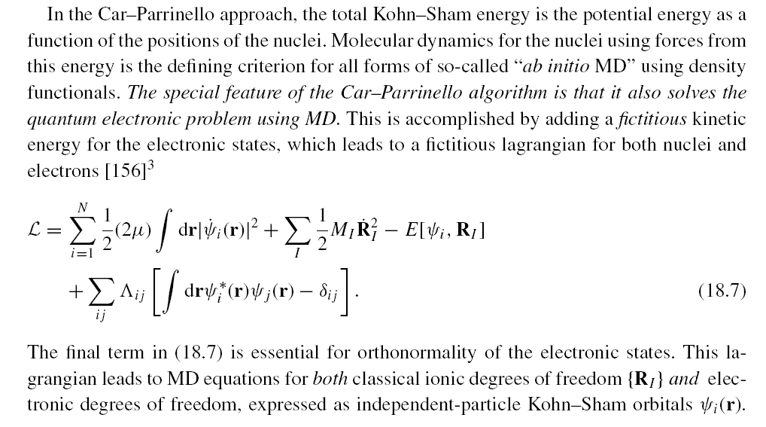
The Car-Parrinello (CP) Algorithm
Treated briefly
Very clever! But hard to
understand and to use –
We will emphasize the
other approaches that were
stimulated by the CP work

Slide 12
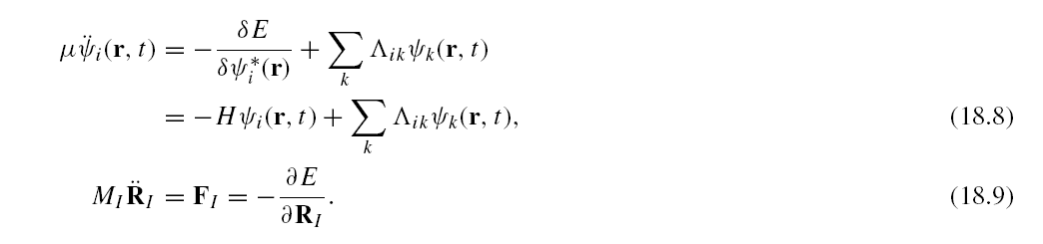
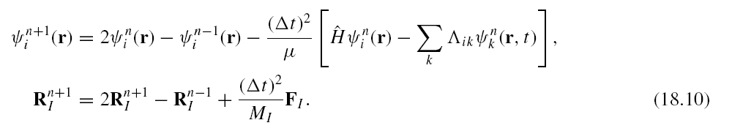
The Car-Parrinello Unified Equations of Motion
Treated briefly
The reason this is so clever
is that energy is conserved
using the Verlet algorithm –
For other methods (see later)
much effort is required to
conserve energy.
Verlet algorithm: advance position of each atom and the Kohn-Sham wavefunctions for the electrons in time steps Δt
Evolves nuclei and electrons conserving energy --- if the constraint of orthonormalization is applied in a “holonomic” (energy conserving) manner – SHAKE algorithm

Slide 13
Problems with Car-Parrinello Unified Algorithm
Basic problems:
Must adjust carefully the fictitious mass” to make calculation efficient and avoid errors
If states change occupation, this gives extraordinary changes in the fictitious KE – energy transfer to the fictitious degrees of freedom – can be a very large problem in metals
Allows solutions, but requires expertise!

Slide 14
What are the key ideas from Car and Parrinello?
The steps that lead to very general iterative methods
The entire Kohn-Sham problem is a way to find the ground state n(r ) and Energy -- Can be solved by minimization methods!
The variables in the Kohn-Sham approach are the wavefuntions -ψ_{i} Iterative minimization methods for the wavefunctions instead of diagonalization
The K-S hamiltonian H is really the gradient of the energy with respect to the wavefunctions – plays the role of a” force” in the iterations
The central step is always the operation H ψ_{i}
FFTs make this operation very efficient
(All other steps apply with any basis (LCAO, APW, . . .).This step applies only to plane waves -- the key reason why plane waves are so efficient!)
Need only sum over the occupied states – do not need individual eignevectors!

Slide 15
Alternatives to Car-Parrinello Unified Algorithm
Basic idea: Use the iterative methods (pioneered by Car and Parrinello) in the “usual approach”
Solve electronic equations by iterative methods
Calculate forces on atoms
Move atoms
Recalculate electrons using the previous density and wavefunctions to generate good starting trial vectors
Go to step 1 - continue in MD steps
With advances over the years, can be roughly as efficient as the original Car-Parrinello unified method
Great advantage – straightforward – easy to understand -no major problem for metals – can have efficeint methods the find occupied eigenstates or others that do not.
Can be used with all methods – tight-binding, LCAO, . . .

Slide 16
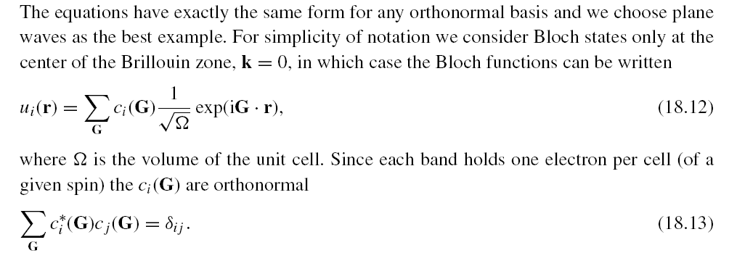
Iterative Algorithms in Planes Waves I
How do we update the wavefunctions in an iteration?
We always consider the wavefunctions expanded in a basis
ψ_{i} = c_{ij} φ_{j}
and we evolve the values of the coefficients c_{ij} which The energy is a function of the coefficients. These can be considered as variables in a space with dimension (number of occupied states) x (number of basis states)

Slide 17
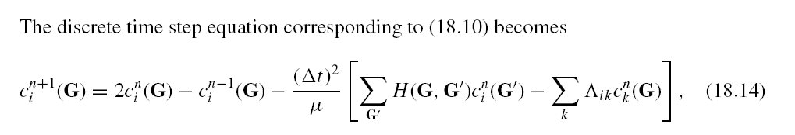
Iterative Algorithms in Planes Waves II
How do we update the wavefunctions in an iteration? Continued
α
A constant α corresponds to Steepest Descent
Improved algorithms include Conjugate Gradient, etc.
(This is the time step term in the CP algorithm)
Lagrange multiplier for orthonormalization
(There are` other approaches – see text)
ALL iterative methods involve the operation of H on the functions ψ
which can be done as a matrix multiply

Slide 18
Iterative Algorithms in Planes Waves III
How to carry out the calculations efficiently?
α
Do not actually do a matrix multiplication! – Kinetic energy is
Diagonal in G space --- FFT to real space – Apply potential which is diagonal in real space – inverse FFT back to G space
Update density and hamiltonian to solve self-consistency, update coefficients to solve Schrodinger-like equations for the electrons,
and move the nuclei all in one unified algorithm

Slide 19
FFTs instead of matrix multiplies
H = T + V
Work with each point k separately
In plane waves Tψ_{i}k,i= Σ_{m} ½ (k+ G_{m})² c_{k,i}(G_{m})
and Vψ_{k,i} = Σ_{n} V(r_{n})² c_{k,i}(r_{n})
No matrices! Only scalars (diagonal matrices)
Find coefficients in real space using FFT
Apply potential which is diagonal in real space
Inverse FFT back to G space
Add two parts of wavefunction to get the updated wavefunction in G space
The matrix multiply have been accomplished by two FFTs and two scalar
multiplications
MUCH more efficient for large numbers of plane waves!!
.

Slide 20
What is done in actual codes?
ABINIT
“Band-by-Band” CG minimization
Update bands one-by-one with each band forced to be orthogonal to all the ones calculated previously
Density updated at the same time – complete minimization of energy
VASP
Use a Jacobi-type scheme to find the eigenvector with eigenvalue closest to a chosen energy -- with clever schemes to be sure all eigenvectors are found (none are missing)
SIESTA
Localized orbitals - does not use FFTs
Uses algorithm like CP to update wavefunctions
In all cases:
If atoms are moved use the wavefunctions as starting point for the next step

Slide 21
What is the starting point in actual codes?
An example is:
Guess a potential (example -sum of atomic potentials)
Get starting eigenfunctions by diagonalizing a small matrix (needs to be done only once)

Slide 22
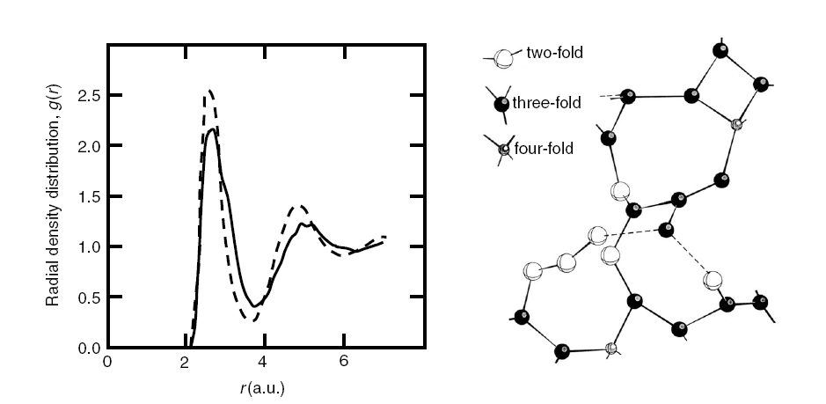
Unified MD – nuclei and electronic states
Example of Carbon
Previous ordinary calculations have shown the accuracy of DFT for cabon in crystalline diamond and graphite forms?
The Car-Parrinello method makes it possible to apply the same theory to liquid carbon, high pressure, . . . . Predictions . . .
Radial density distribution Snapshot
Galli, Martin, Car, Parrinello

Slide 23
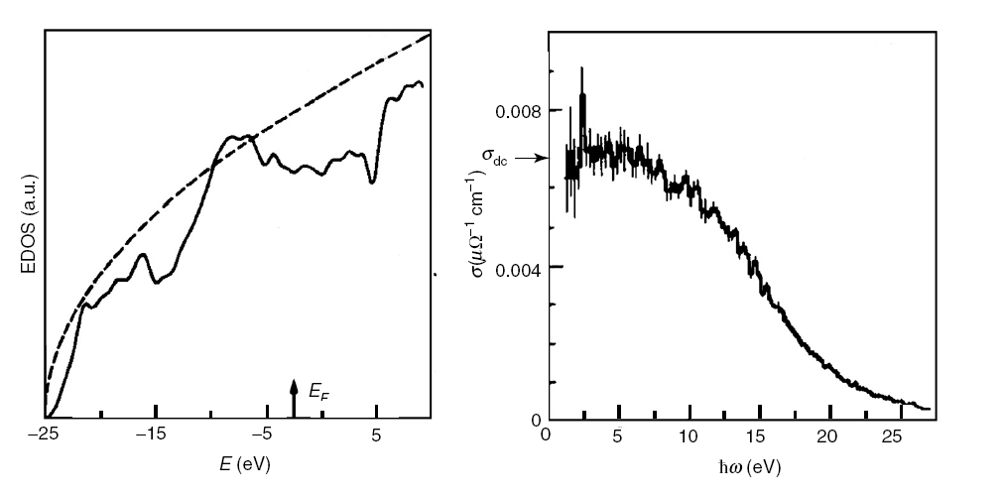
Unified MD – nuclei and electronic states
Example of Carbon
Electrical properties --- Is liquid carbon a metal or insulator?
Time averaged electronic canductivity - strong scattering leads to conductivity near the minimum (Mott) value for metals
Time averaged density of states
– like a metal
Galli, Martin, Car, Parrinello

Slide 24
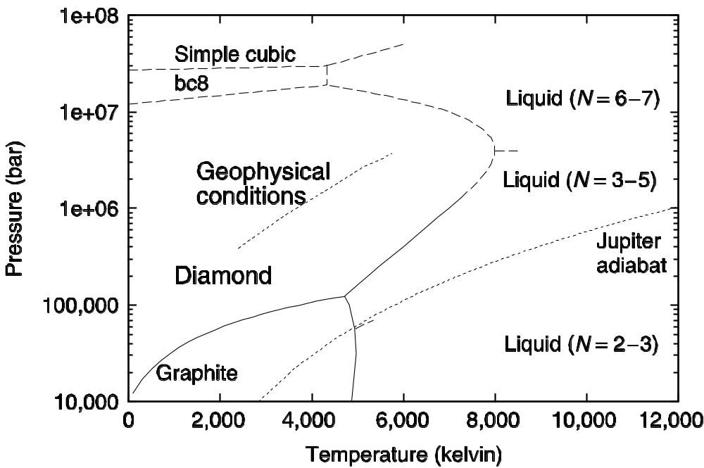
Unified MD – nuclei and electronic states
Example of Carbon
Melting of diamond at high pressure – other phases - geophysical, planetary physics
Grumbach, Galli, Martin

Slide 25
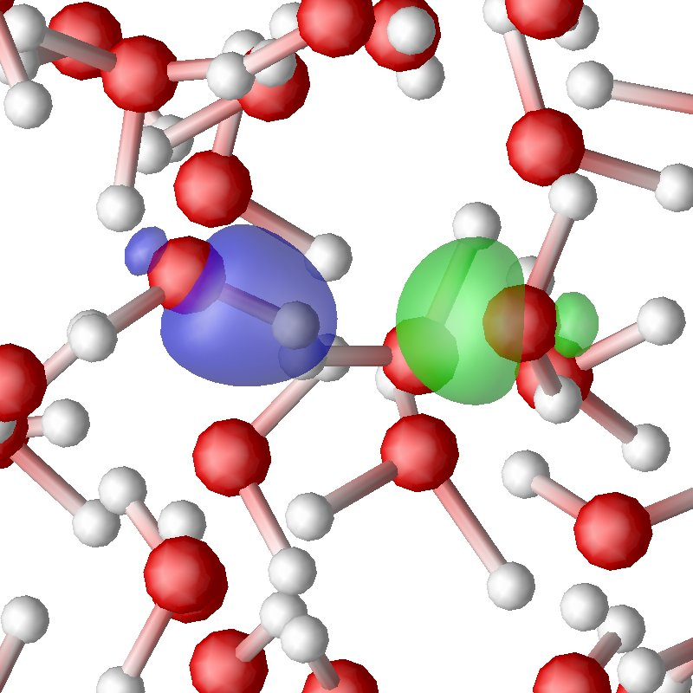
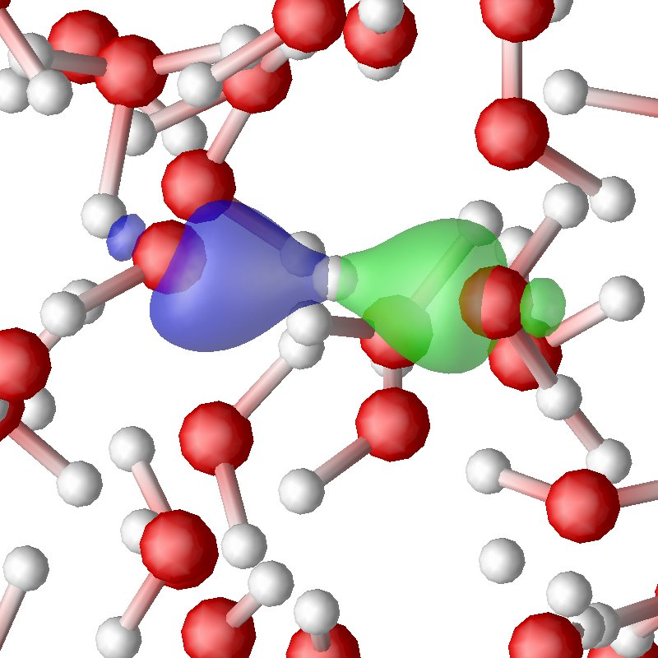
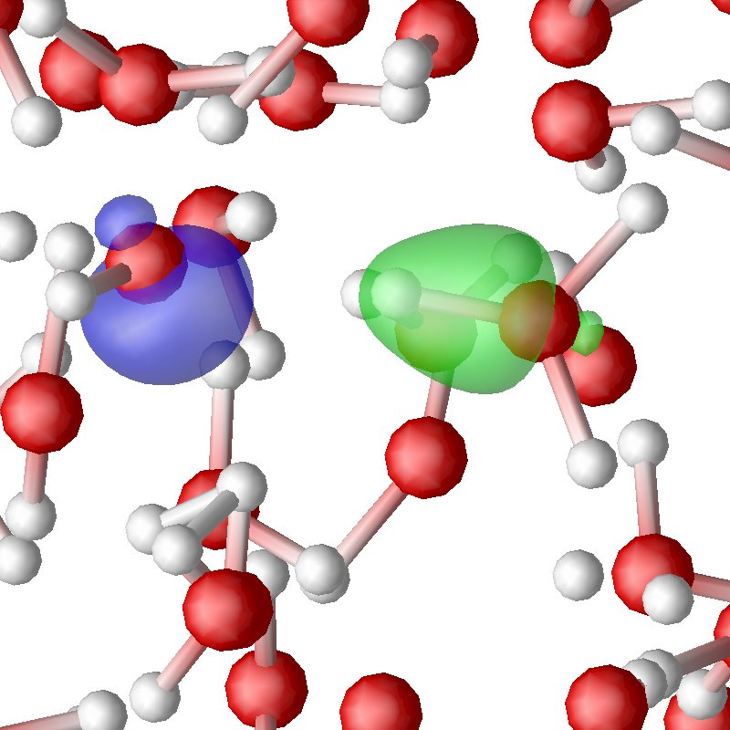
Unified MD using forces – nuclei and electronic states
Water
Simulation of water – many publications – widely-used GGA approximations good – but not good enough – prsent challenge
Snapshots of simulation of proton transfer – important process – study of how electrons are transferred as proton moves using localized Wannier functions (later)
Schwegler, Galli

Slide 26
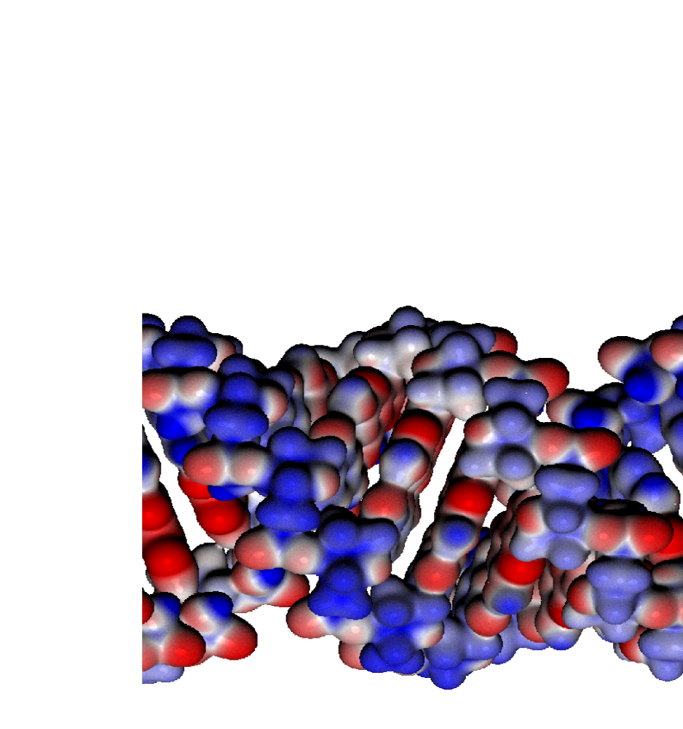
Simulations of DNA with the SIESTA code
Machado, Ordejon, Artacho, Sanchez-Portal, Soler (preprint)
Self-Consistent Local Orbital O(N) Code
Relaxation - ~15-60 min/step (~ 1 day with diagonalization)
Iso-density surfaces

Slide 27
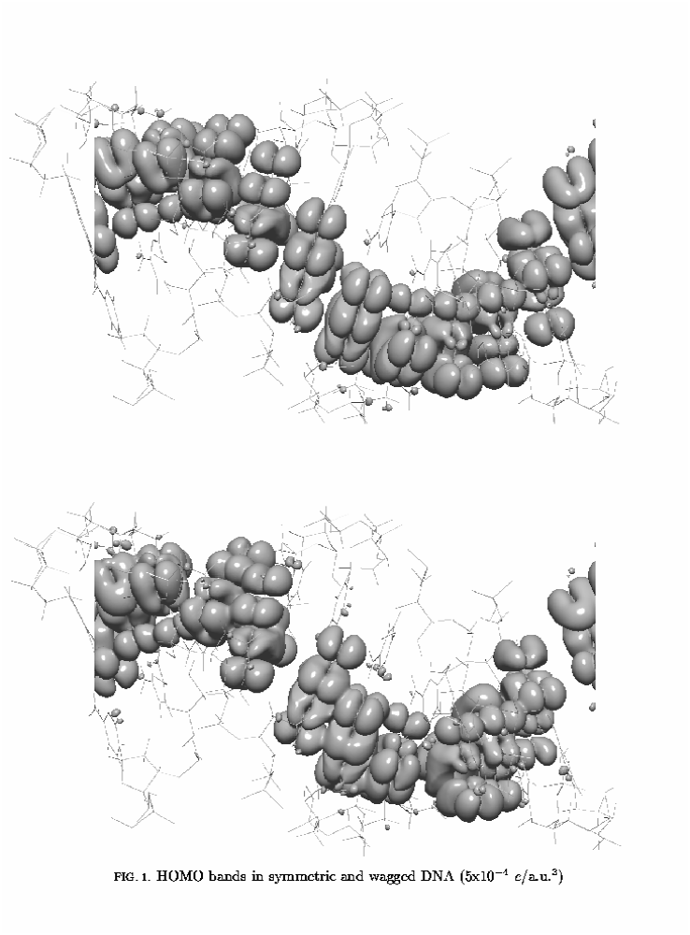
HOMO and LUMO in DNA (SIESTA code)
Eigenstates found by
N³ method after
relaxation
Could be O(N)
for each state

Slide 28
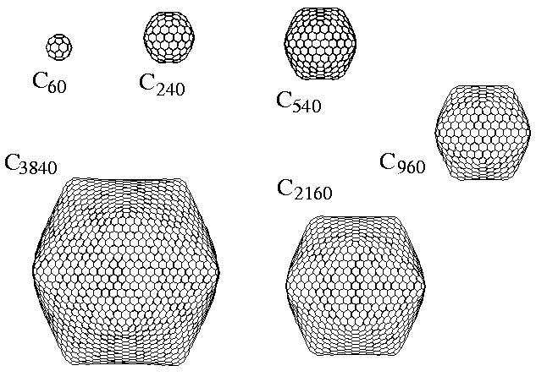
Example of Relaxation
Prediction of Shapes of Giant Fullerenes using SIESTA
S. Itoh, P. Ordejon, D. A. Drabold and R. M. Martin, Phys Rev B 53, 2132 (1996).
See also C. Xu and G. Scuceria, Chem. Phys. Lett. 262, 219 (1996).

Slide 29
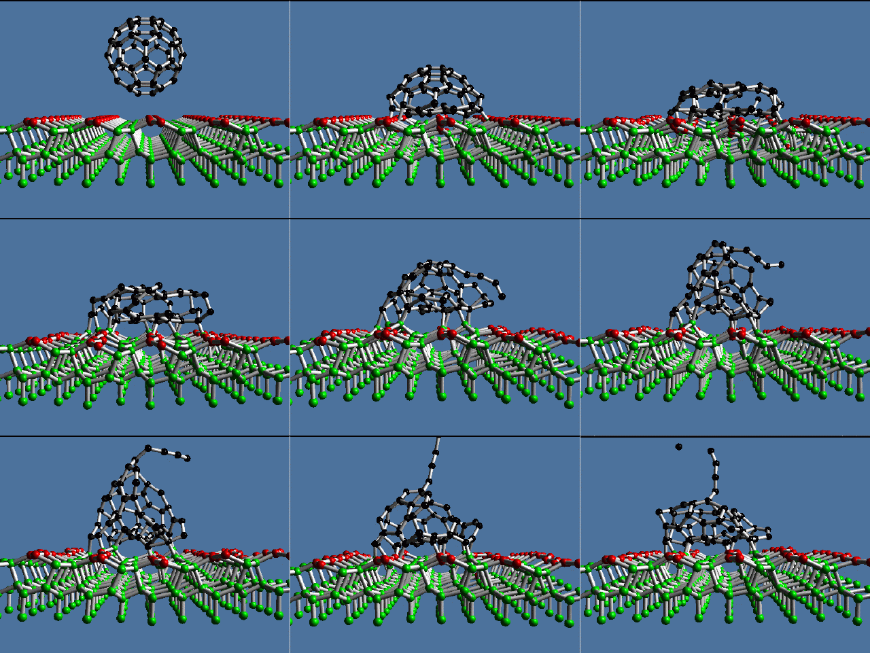
Collision of C₆₀ Buckyballs on Diamond
Using tight-binding
Galli and Mauri, PRL 73, 3471 (1994)

Slide 30
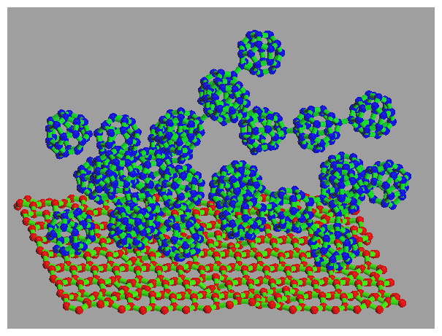
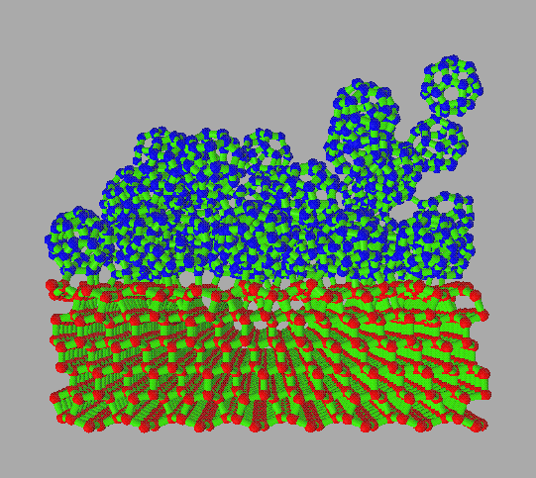
Deposition of C₂₈ Buckyballs on Diamond
Simulations with ~ 5000 atoms, TB Hamiltonian from Xu, et al.
( A. Canning, G.~Galli and J .Kim, Phys.Rev.Lett. 78, 4442 (1997).

Slide 31
Conclusions
Ideas for minimization and molecular dynamics are from
classical mechanic and well-known numerical algorithms
Conjugate gradient, . . .
The Car-Parrinello advance
The four ideas that transformed the way calculations are done
Minimization
Iteration
FFTs
Need only occupied states for n(r) and Energy
Examples
Liquid carbon, Water, . . .

