Slide 1
Electronic Structure of Condensed Matter
Fudan University - April 2010
Lecture 8
Summary and Conclusions
Instructor: Richard M. Martin
University of Illinois
Stanford University
RMartin@illinois.edu

Slide 2
Goal of Course
Last slide from Lect. 1
Understanding of the role of electrons in condensed matter
Practical, useful knowledge of methods that are working tools of theorists, experimentalists, and researchers in many fields
Without the burden of heavy math, many-body theory, …..
Appreciation for the real many-body problems presented by electrons in condensed matter
Understanding when to expect correlation to be important
The grand challenges of condensed matter physics today
For those who are interested
Practical, useful knowledge of many-body methods that are becoming more and more important for quantitative predictions and understanding the grand challenges in condensed matter

Slide 3
Basis of Most Modern Calculations
Density Functional Theory
Why is Density Functional Theory so widely used?
A new approach to the many-body interacting electron problem
  In principle DFT is exact
  Kohn and Sham introduced the idea of an auxiliary system that in principle gives the exact ground state density and energy - but NOT other properties.
  In practice, DFT allows useful approximations

Slide 4
The Car-Parrinello Advance
Car-Parrinello Method – 1985
  Simultaneous solution of Kohn-Sham equations for electrons and Newton’s equations for nuclei
A revolution in the power of the methods
  Relaxation of positions of nuclei to find structures
  “First principles” molecular dynamics simulations of solids and liquids with nuclei moving thermally
  Chemical reactions, . . .
Stimulated further developments . . . .

Slide 5
Contents of a typical solid state physics text
(Kittel, Ashcroft and Mermin, ….)
From Lect. 1
Structures of crystals
  Definitions of structures
  Typical bonding and structures
  Structural phase transitions
Mechanical Properties
  Lattice vibrations – phonons
  Elastic constants
  Piezoelectric constants
  Effective charges
Thermal Properties
  Heat capacity, heat conduction
Electronic properties
  Definition of bands
  Metals vs. insulators
  Conductivity, dielectric functions
  Magnetism
Properties that can be described without knowing anything about electrons
Did we answer the question:
Why are they a part of
electronic structure?
Properties that can only be
understood in terms of the electrons?

Slide 6
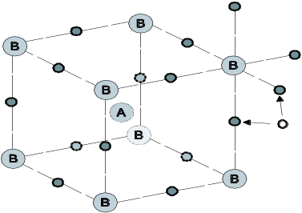
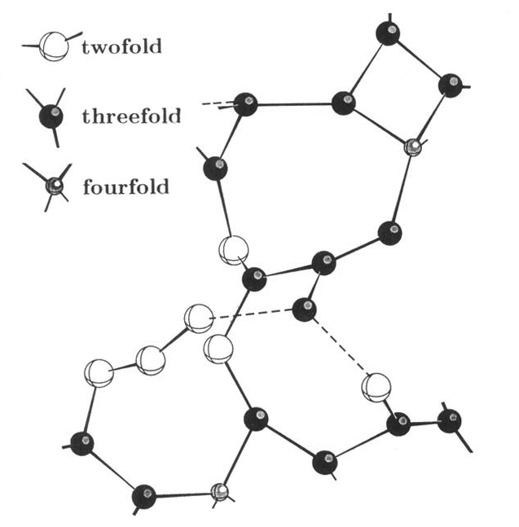
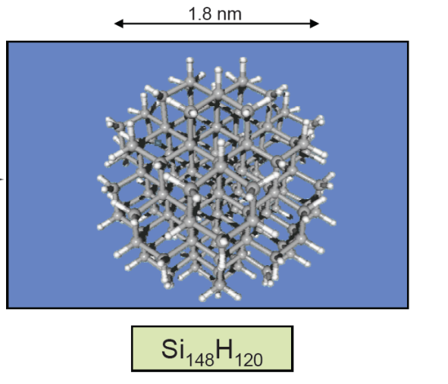
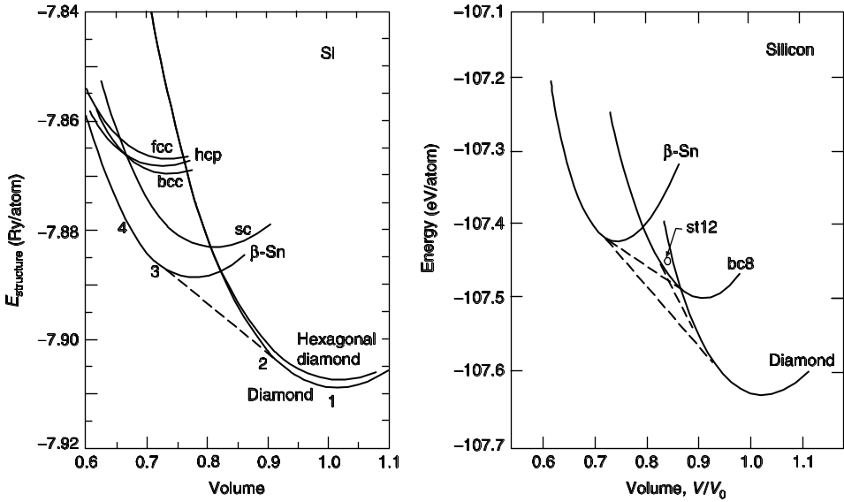
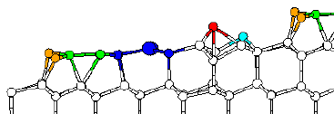
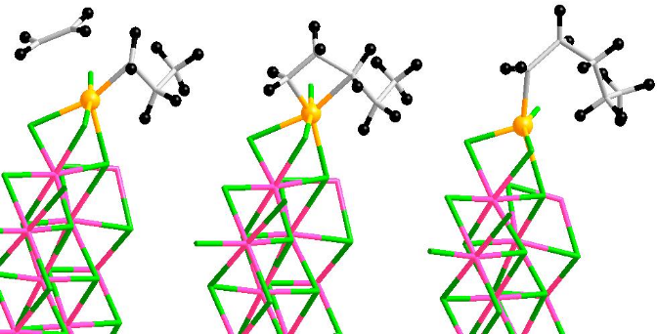
Useful!
From Lect. 1
modified
Treat many types of materials in a unified way from the basic equations
Calculate properties
of Crystals
Predict properties of
nanostructures
Simulation of Liquids –
example Carbon at high T
Predict crystal structures
Example – atomic positions
in a ferroelectric
“snapshot” of liquid
Reactions – catalysis at a surface
Structures of surfaces
Many other
examples!
Phase transitions
under pressure

Slide 7
So what is left to do?
Failures of present density functional approximations in important cases!
Electronic excitations
  The “band gap problem” . . .
Strongly interacting systems
  Magnetic insulators, metal-insulator transitions, . . .
Example of “Failure” that has been solved!
  Weak Van der Waals bonds
  Development of non-local functional has the right distance dependence and is accurate enough for real materials
Very brief presentation in special lectures

Slide 8
Not covered due to time constraint
Magnetism
Wannier functions – transformation from extended Bloch states to localized orbitals
Linear scaling methods – using Wannier functions
Electric polarization in solids – using Wannier functions (or Berry phases)
Excitations and time dependent density functional theory

Slide 9
Magnetism
Discussion is class
The good thing about magnetism
Simple models give the right qualitative understanding
Atom-like magnetic moments
Ordered for T < Tc -- disordered for T > Tc
Another good thing about magnetism
Simple models give the right qualitative understanding
Electrons in bands
Magnetic moment is n_{up} - n_{down}
1
2
The hard thing about
the theory of magnetism
To understand both these
pictures at the same time!
H
Transition & Rare Earth Elements
He
3
4
5
6
7
8
9
10
Li
Be
More localized states
With Partially Filled Shell
B
C
N
O
F
Ne
11
12
13
14
15
16
17
18
Na
Mg
Al
Si
P
S
Cl
Ar
19
20
21
22
23
24
25
26
27
28
29
30
31
32
33
34
35
36
K
Ca
Sc
Ti
V
Cr
Mn
Fe
Co
Ni
Cu
Zn
Ga
Ge
As
Se
Br
Kr
37
38
39
40
41
42
43
44
45
46
47
48
49
50
51
52
53
54
Rb
Sr
Y
Zr
Nb
Mo
Tc
Ru
Rh
Pd
Ag
Cd
In
Sn
Sb
Te
I
Xe
55
56
57
72
73
74
75
76
77
78
79
80
81
82
83
84
85
86
Cs
Ba
La
Hf
Ta
W
Re
Os
Ir
Pt
Au
Hg
Th
Pb
Bi
Po
At
Rn
87
88
89
Fr
Ra
Ac
58
59
60
61
62
63
64
65
66
67
68
69
70
71
Ce
Pr
Nd
Pm
Sm
Eu
Gd
Tb
Dy
Ho
Er
Tm
Yb
Lu
90
91
92
93
94
95
96
97
98
99
100
101
102
103
Th
Pa
U
Np
Pu
Am
Cm
Bk
Cf
Es
Fm
Md
No
Lw

Slide 10
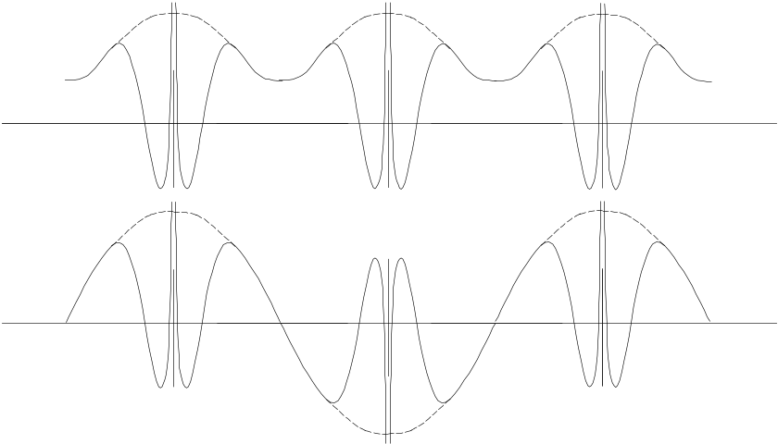
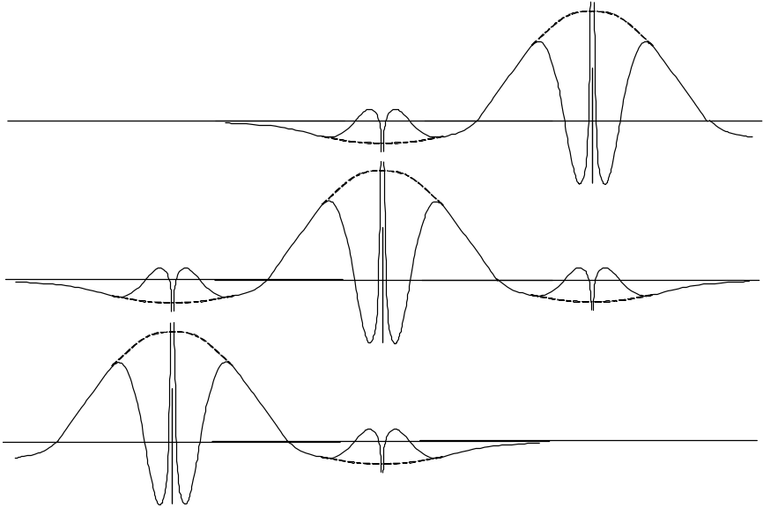
Wannier functions
Discussion is class
Transformation from an entire band of Bloch states
to a set of Wannier functions
Zone center
k = 0
Extended
Bloch
Eigenstates
Zone boundary
k = π/a
Wannier function
W(x- T₀) centered
in cell 0
Localized Wannier
functions
NOT eigenstates
Each function is
a linear combination
of eigenststes
Wannier function
W(x- T₋₁) centered
in cell -1

Slide 11
“Order N”
Discussion is class
Quantum Mechanics is not “local”
Eigenstates extend over entire system
Interference of states is essential to understanding quantum behavior
Effect in theoretical calculations for materials
Exact calculations - Computer time scales exponentially with N = number of electrons
In DFT – scales as N³ (The time to diagonalize a matrix)
Is it possible to do accurate calculations with computational time linear in N?

Slide 12
Not covered due to time constraint
Magnetism
Wannier functions – transformation from extended Bloch states to localized orbitals
Linear scaling methods – using Wannier functions
Electric polarization in solids – using Wannier functions (or Berry phases)
Excitations and time dependent density functional theory

Slide 13
Goal of Course
Last slide from Lect. 1 as the conclusion!
Understanding of the role of electrons in condensed matter
Practical, useful knowledge of methods that are working tools of theorists, experimentalists, and researchers in many fields
Without the burden of heavy math, many-body theory, …..
Appreciation for the real many-body problems presented by electrons in condensed matter
Understanding when to expect correlation to be important
The grand challenges of condensed matter physics today
For those who are interested
Practical, useful knowledge of many-body methods that are becoming more and more important for quantitative predictions and understanding the grand challenges in condensed matter

