Slide 1
Electronic Structure of Condensed Matter
Fudan University - April 2010
Lecture 2
Crystals, the Bloch Theorem, Bands
Understanding using different points of view
Instructor: Richard M. Martin
University of Illinois
Stanford University
RMartin@illinois.edu

Slide 2
Lecture 2: Periodic Crystals
Only key ideas and figures are given here for use in class
Material is in any basic text on solid state physics.
It is also in the text, Chapter 4, which is essentially the same
OUTLINE
Crystal Structure = Lattice + Basis
Translation symmetry
Reciprocal Lattice
Brillouin Zone (BZ)
Bloch Theorem
……
Types and Positions of atoms
Bloch Theorem for excitations in crystals
Proof by group theory
Proof by Fourier Expansion (later)
Applies to any excitations - phonons, electrons, etc.
Qualitative discussion of Bloch functions. Zone center, Zone boundary
The first qualitative estimates of band widths in solids

Slide 3
Ideal crystals are simple and relevant!
Real poly-
crystalline Solid
Ideal Crystalline Solid
Many solids are made of crystallites that are microscopic - but contain ~ 10²⁰ atoms!

Slide 4

Crystals
Each atom is identical
A crystal is a repeated array of atoms
Cubic (square)
hexagonal
General oblique
Two types of atoms
a₂
a₁
φ

Slide 5
Two Dimensional Crystals
a₂
a₁
φ
a₂
a₂
φ
φ
a₁
a₁
Crystal =
Lattice +
Basis
Called the Bravais Lattice
(Easier to draw in 2 dimensions – 3 dimensions later)

Slide 6
Lattices and Translations
a₂
a₂
a₂*
φ
φ∗
a₁
a₁
a₁
One possible Primitive Cell
Another choice
Wigner-Seitz Cell -- Unique
The entire infinite lattice is specified by 2 primitive vectors a₁ and a₂ (also a₃ in 3-d)
T(n₁,n₂,…) = n₁ a₁ + n₂ a₂ (+ n₃ a₃ in 3-d),
where the n’s are integers
Note: the primitive vectors are not unique different vectors a₁ and a₂ can define the same lattice
All primitive cells have same area (volume)
Wigner Seitz Cell is most compact, highest symmetry cell possible
Also same rules in 3 dimensions

Slide 7
Crystalline layers with >1 atom basis
a₂
a₂
O
τ₃
τ₃
τ₂
a₁
a₁
τ₂
Cu
Oxygen
Cu
O
CuO₂ Layer
Square Lattice
CuO₂ Basis
One CuO₂ layer in the High Tc superconductors
Square lattice
One basis unit on each site

Slide 8
Crystalline layers with >1 atom basis
a₂
a₂
τ₂
a₁
a₁
Basis
2 C atoms
or BN pair
Honeycomb Lattice
(graphene or BN layer)
Hexagonal Lattice
A single layer of graphitic carbon (graphene)
  The two atoms in the cell are both Carbon
A single layer of hexagonal boron nitride (BN)
  The two atoms in the cell are B and N

Slide 9
Three Dimensional Lattices
Simplest examples
a₃
a₃
a₁
a₂
a₁
a₂
Simple Orthorhombic Bravais Lattice
Hexagonal Bravais Lattice
Orthorhombic: angles 90 degrees, 3 lengths different
Tetragonal: 2 lengths same
Cubic: 3 lengths same
Hexagonal: a₃ different from a₁, a₂ by symmetry

Slide 10
Cubic Lattices
Length of each side - a
a₃
a
a₂
a
a₁
a
Simple Cubic
Body Centered Cubic (BCC)
Primitive lattice vectors
a₁ = (1,0,0) a
a₂ = (0,1,0) a
a₃ = (0,0,1) a
One atom per cell at position (0,0,0)
Conventional Cell with 2 atoms at positions
(000), (1/2,1/2,1/2) a
Primitive cell is one atom
8 neighbors

Slide 11
Cubic Lattices
Length of each side - a
a₃
a₃
a₂
a₂
a₁
a₁
Simple Cubic
Face Centered Cubic (FCC)
Primitive lattice vectors
a₁ = (1,0,0) a
a₂ = (0,1,0) a
a₃ = (0,0,1) a
One atom per cell at position (0,0,0)
Conventional Cell with 4 atoms at positions
(000 ), (0,1/2,1/2), (1/2,0,1/2), (1/2,1/2,0)a
Primitive cell is one atom
12 neighbors (cubic close-packed)

Slide 12
Face Centered Cubic
z
a₂
y
a₃
a₁
X
One Primitive Cell
Wigner-Seitz Cell
Primitive lattice vectors
a₁ = (1/2,1/2,0) a
a₂ = (1/2,0,1/2) a
a₃ = (0,1/2,1/2) a
One atom per cell at position (0,0,0)

Slide 13
Body Centered Cubic
z
a₃
a₁
y
a₂
X
One Primitive Cell
Wigner-Seitz Cell
Primitive lattice vectors
a₁ = (1/2,1/2,-1/2) a
a₂ = (1/2, -1/2,1/2) a
a₃ = (-1/2,1/2,1/2) a
One atom per cell at position (0,0,0)

Slide 14
Cubic crystals with a basis
z
y
X
ZnS Structure with
Face Centered Cubic Bravais Lattice
C, Si, Ge form diamond structure with
only one type of atom
NaCl Structure with
Face Centered Cubic Bravais Lattice

Slide 15
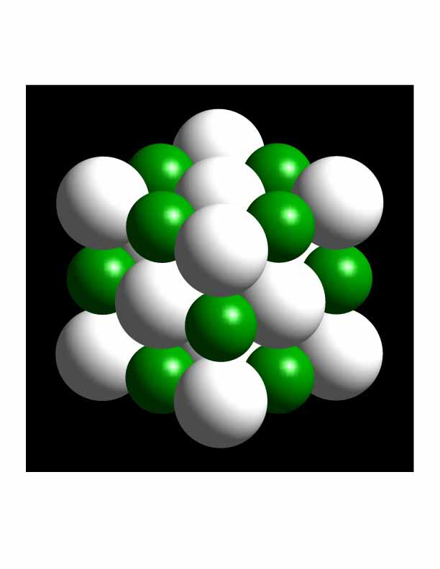
NaCl Structure
z
y
X
NaCl Structure with
Face Centered Cubic Bravais Lattice

Slide 16
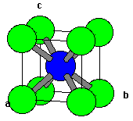
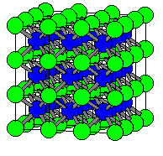
CsCl Structure
z
y
X
a₃
a₂
a₁
CsCl Structure
Simple Cubic Bravais Lattice
From http://www.ilpi.com/inorganic/structures/cscl/index.html

Slide 17
Characteristic types of binding
Ionic Binding
Structure depends upon radii of the two ions
– large cations are close packed
Closed-Shell Binding
Close packed
Covalent Binding
Open Structures
Metallic Binding
Close packed

Slide 18
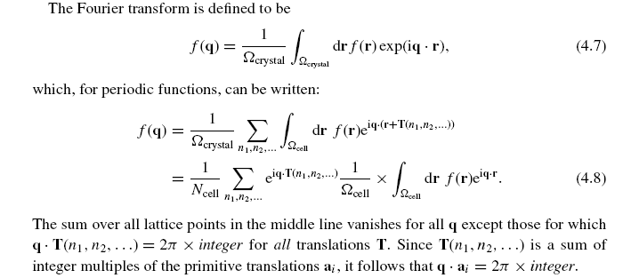
Reciprocal lattice and Brillouin zone (BZ)
Fourier Components of a periodic f(r) function in a crystal
The sum vanishes unless q●T = 2π x integer for all T -- Thus q●a_{i} = 2π x integer
This leads to the definition of the reciprocal lattice – next slide

Slide 19
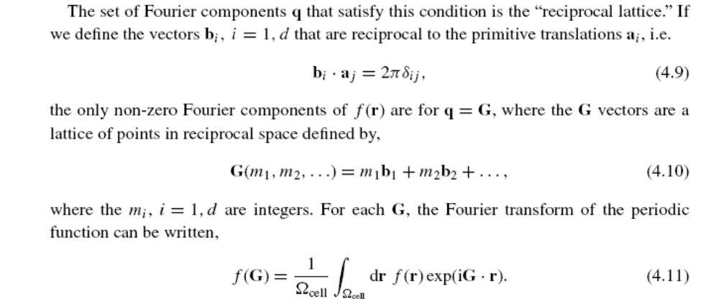
Reciprocal lattice and Brillouin zone (BZ)
The set of vectors q that satisfy the condition q ● a_{i} = 2π x integer form a lattice
This is the definition of the reciprocal lattice – examples on next slide

Slide 20
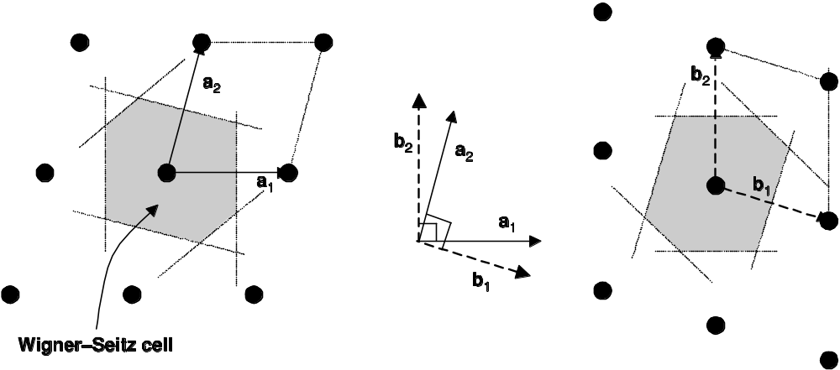
Brillouin Zone – example in 2 dimensions
Lattice in real space
Reciprocal lattice
In 2-dimensions
b₁ ● a₁ =2π, b₁ ● a₂ =0
b₂ ● a₁ =0, b₂ ● a₂ = 2π
Brillouin zone
Wigner-Sietz cell
of reciprocal lattice
Physical importance of BZ – For vectors k on the boundary of the BZ,
k = ½ G so that |k| = |k-G|. This is the condition for Bragg scattering, which
occurs only for k on the surface of the BZ.

Slide 21
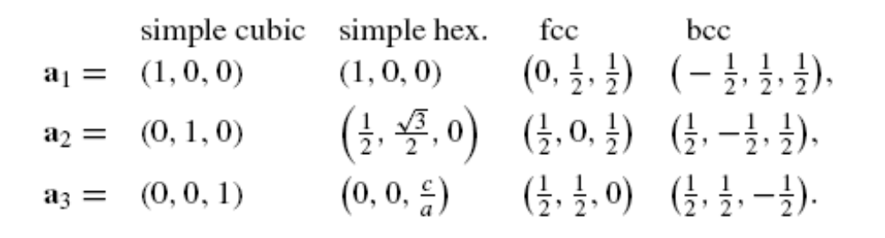
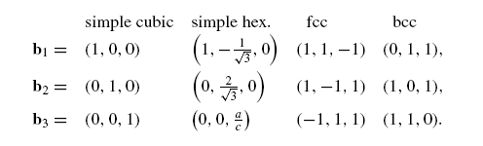
Reciprocal lattices - examples for cubic lattices
Primitive translation
vectors of lattice in real space in units of lattice constant a
Primitive translation
vectors of reciprocal lattice in units of 2π/a
Rotated
Fcc, bcc are reciprocal
to one another
Check it your self – Do the vectors obey the conditions?

Slide 22
Geometric Construction of
Diffraction Conditions
b₂
-k_{out}
G
k_{in}
Recall k_{in} – k_{out} = G
and |k_{in}| = |k_{out}|
Consequence of condition
| 2 k_{in}. G | = G²
The vector k_{in} (and k_{out}) lies along the per
Perpindicular bisector of a G vector
One example is shown
b₁

Slide 23
Diffraction and the
Brillouin Zone
b₂
-k_{out}
G
k_{in}
Brillouin Zone - (BZ) -
the Wigner-Seitz cell of
the reciprocal lattice
Formed by perpendicular
bisectors of G vectors
Special Role of Brillouin Zone
  Diffraction occurs only for k on
  surface of Brillouin Zone
  No diffraction occurs for any k
  inside the first Brillouin Zone
  Important later in course
b₁
Brillouin Zone

Slide 24
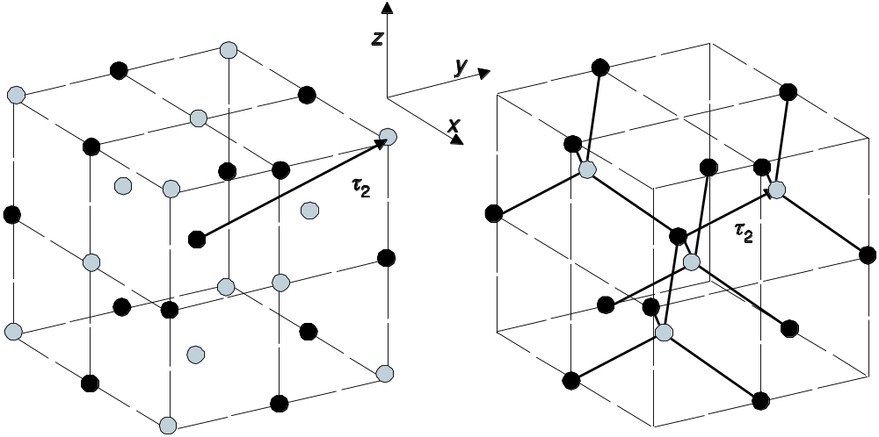
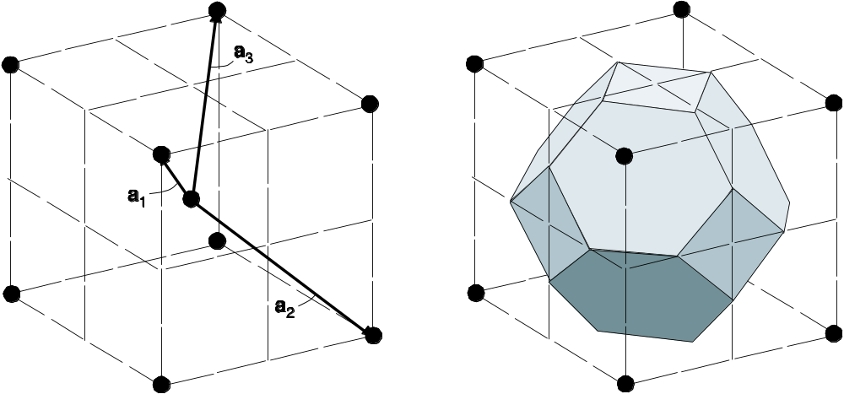
Example of FCC
Brillouin Zone
(Wigner-Seitz
cell for the
reciprocal
lattice)
ZnS (GaAs, …)
(Diamond if the two atoms
are the same element)
Reciprocal lattice – bcc
fcc lattice
Basis: Zn at (0,0,0)
S at (¼, ¼, ¼)
R. Martin - preschool - crystals

Slide 25
Conclusions
Crystal structure = lattice + basis
  Bravais lattice of translations – multiples of the primitive translations
  Basis specifies the atoms that are associated with each lattice point
Reciprocal lattice
  Set of vectors G in reciprocal space that are the Fourier components of periodic functions
Brillouin zone (BZ)
  Wigner-Seitz cell of the reciprocal lattice
  The surface of the BZ are the points where Bragg scattering occurs
  Will be important in the understanding of electron states
Often used examples
  Zinc-blende (diamond) – fcc lattice - basis of 2 atoms
  Reciprocal lattice is bcc
R. Martin - preschool - crystals

Slide 26
Electronic Structure of Condensed Matter
Fudan University - April 2010
Lecture 2
Crystals, the Bloch Theorem, Bands
Understanding using different points of view
Instructor: Richard M. Martin
University of Illinois
Stanford University
RMartin@illinois.edu

Slide 27
Schrodinger Equation
Basic equation of Quantum Mechanics
where
m = mass of particle
V(r) = potential energy at point r
² = (d²/dx² + d²/dy² + d²/dz²)
E = eigenvalue = energy of quantum state
Ψ (r) = wavefunction
n (r) = | Ψ (r) |² = probability density
[ - (h²/2m) ² + V(r) ] Ψ (r) = E Ψ (r)
Δ
Δ
Key Point for electrons in a crystal: The potential
V(r) has the periodicity of the crystal

Slide 28
Schrodinger Equation
How can we solve the Schrodinger Eq.
where V(r) has the periodicity of the crystal?
This is the key practical computational problem for the methods used in the electronic structure school
Here we consider simple cases as an introduction
One dimension
[ - (h²/2m) ² + V(r) ] Ψ (r) = E Ψ (r)
Δ

Slide 29
Consider 1 dimensional example
If the electrons can move freely on a line from 0 to L (with no potential),
Schrodinger Eq. In 1d with V = 0
- d²/dx² Ψ(x) = E Ψ(x)
If we have periodic boundary conditions (Ψ (0) = Ψ (L))
then the solution is:
Ψ(x) = L^{-1/2} exp( ikx), k = ± m (2π/L), m = 0,1,..
E(k) =
0
L
(h²/2m)
(h²/2m) | k |²

Slide 30
Electrons on a line
For electrons in a box, the energy is just the kinetic energy
E (k) =
Values of k fixed by the box, k = ± m (2π/L), m = 0, 1, . . .
(h²/2m) k²
E
Empty
states
E_{F}
Filled
states
k_{F}
k
k_{F}
Pauli Principle - The lowest energy state is for electrons is to fill the lowest states up to the Fermi energy E_{F} and Fermi momentum k_{F} – two electrons (spin up and down) in each state
This is a metal – the electrons can conduct electricity

Slide 31
Electrons on a line with potential V(x)
What happens if there is a potential V(x) that has the periodicity a of the crystal?
An electron wave with wavevector k can suffer Bragg diffraction to k ± G, with G any reciprocal lattice vector
Bragg Diffraction
occurs at
BZ boundary
E
State with k = π/a
diffracts to k = - π/a
and vice versa
G
k
−π/a
0
π/a

Slide 32
Interpretation of Standing waves at Brillouin Zone boundary
Bragg scattering at k = π/a leads to the two possible standing waves. Each is a combination of the right and left going waves exp( i πx/a) and exp(-i πx/a):
Ψ⁺(x) = exp( i πx/a) + exp(-i πx/a) = 2 cos(πx/a)
Ψ⁻(x) = exp( i πx/a) - exp(-i πx/a) = 2i sin(πx/a),
The density of electrons for each standing wave is:
|Ψ⁺(x)|² = 4 cos²(πx/a)
|Ψ⁻(x)|² = 4 sin²(πx/a)

Slide 33
Interpretation of Standing waves at Brillouin Zone boundary
|Ψ⁺(x)|² - high density at atoms
low energy
0
L
Ψ⁻(x)|² - low density at atoms
high energy
0
L
Atoms - attractive
(negative) potential
a

Slide 34
Electrons on a line with a periodic V(x)
Bands changed greatly only at zone boundary
Standing wave at zone boundary
Energy gap -- energies at which no waves can travel through crystal
Standing wave with low
density at atom positions
--high energy
E⁻
Energy
Gap
Energy
E⁺
Far from BZ boundary
wavefunctions and energies
approach free electron values
if the potential is weak
Standing wave with high
density at atom positions
--low energy
k
−π/a
0
π/a

Slide 35
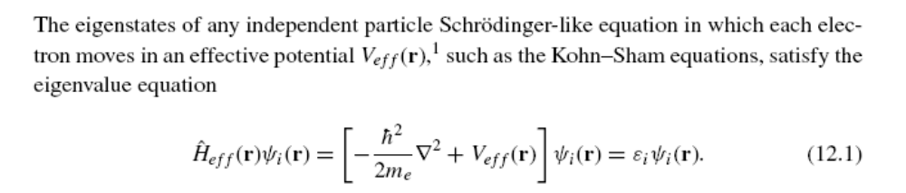
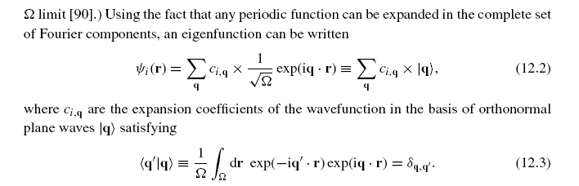
Independent electrons – Plane wave methods (1)
General theory -- From book –or Solid State Physics text
The independent-particle Schrodinger equation
Plane wave basis – always possible – it is Fourier analysis

Slide 36
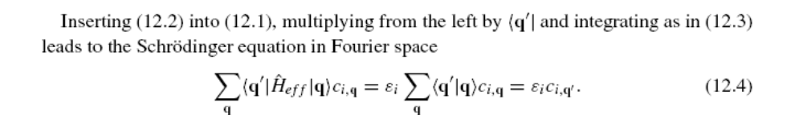

Independent electrons – Plane wave methods (2)
Expression for the Schr. Eq. in a plane wave basis
Kinetic energy is simple – easy to differentiate a plane wave!
Plane wave are eigenstates of K.E. – The only thing that mixes
the plane waves is the potential

Slide 37
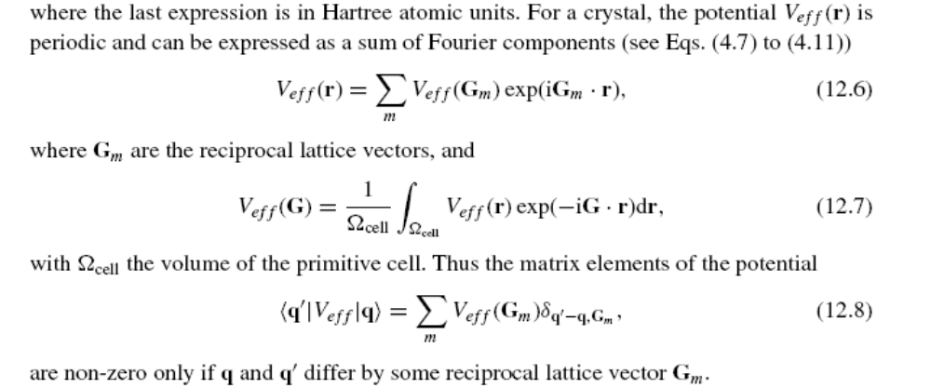
Independent electrons – Plane wave methods (3)
Fourier Components of the potential in a crystal
Key point: The potential only couples waves q and q’ if they
differ by a reciprocal lattice vector -- q – q’ = G_{m}

Slide 38
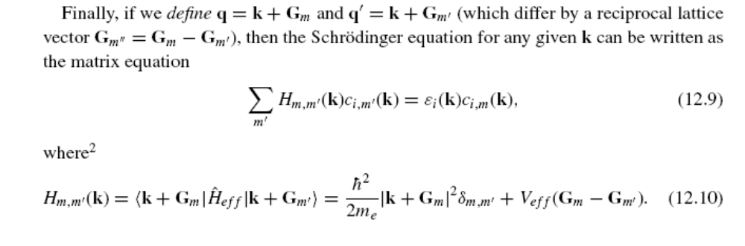
Independent electrons – Plane wave methods (4)
The hamiltonian matrix in a plane wave basis
k is defined to be in a primitive cell of the reciprocal lattice around k =0
Matrix eigenvalue equation
Note that k only appears in the kinetic energy!
(Actually V depends on k in pseudopotentials)
Key point: Each k is independent. The problem can be solved
at each k-point separately

Slide 39
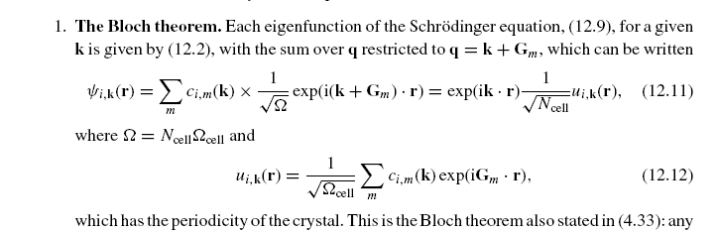
Bloch theorem
We have found that each eigenstate has a definite k and it is composed
of Fourier components k + G where G is any reciprocal lattice vector.
Therefore, ψ can always be written ψ_{k} = exp(ikr) u_{k}(r ) where u is periodic
1. The Bloch theorem
*
*
2. The solutions form bands of eigenvalues ε_{i}(k)
*
3. k is conserved – it is called crystal momentum which is like real momentum
except that it is only defined in the BZ – the solutions are periodic in k,
i.e., the same for k and k+G for any reciprocal lattice vector G

Slide 40
Role of the Brillouin Zone (BZ)
The BZ is the Wigner Seitz cell of the reciprocal lattice --
the most compact primitive cell
The BZ is unique among all primitive cells because its boundaries are the
bisecting planes of the G vectors where Bragg scattering occurs (see Sec. 4.2).
Inside the Brillouin zone there are no such boundaries:
the bands must be continuous and analytic inside the zone.
The boundaries are of special interest since every boundary point is a k vector
for which Bragg scattering can occur; this leads to special features, such as
zero group velocities due to Bragg scattering at the BZ boundary

Slide 41
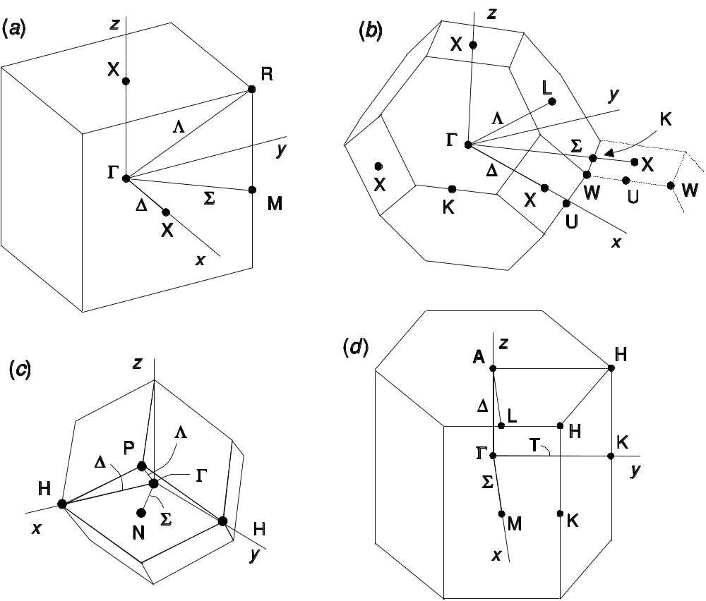
Brillouin Zone - Examples
BZ for FCC
real-space lattice
Simple cubic
BCC
hexagonal
Useful Web site
  BZ with labels for all 230 space groups
  http://www.cryst.ehu.es/cryst/get_kvec.html

Slide 42
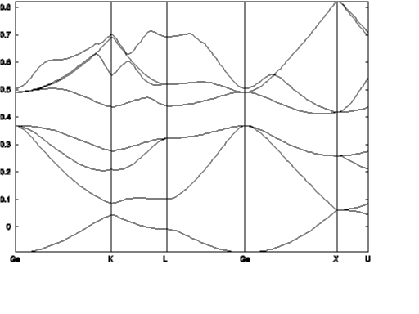
Electron Excitations - Bands
Understood since the 1920’s - independent electron theories
predict that electrons form bands of allowed eigenvalues, with
forbidden gaps
Lowest energy state is for bands filled to the Fermi level (exclusion principle)
Established by experimentally for states near the Fermi energy
Silicon
Extra added electrons
go in bottom of
conduction band
Empty Bands
Gap
Missing electrons
(holes) go in top of
valence band
Filled Bands
Universitat Autonoma Barcelona -- February 17, 2006

Slide 43
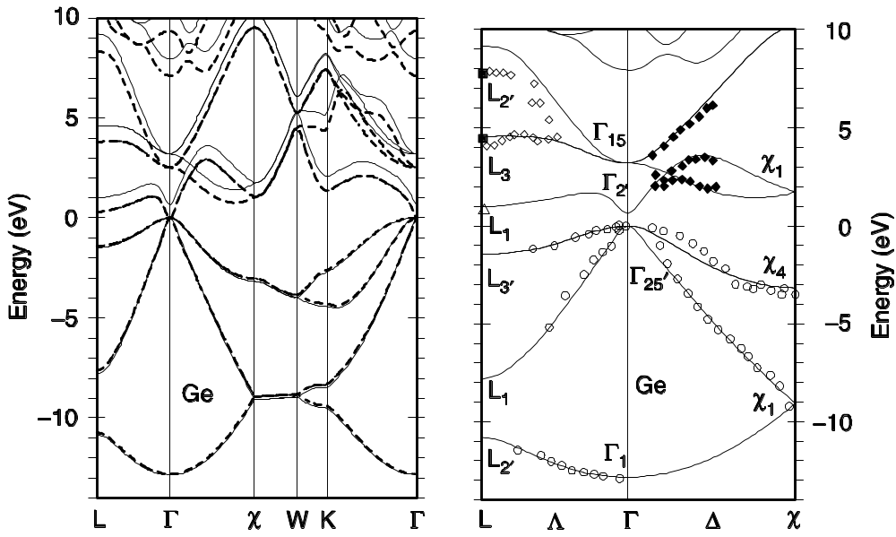
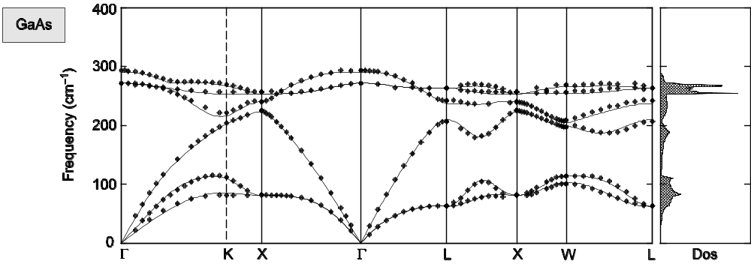
Examples of bands in fcc crystals
Electron bands, phonon bands in same BZ
GaAs – phonons – lattice vibrations
described by phonons with k vectors in the BZ
Germanium - electrons

Slide 44
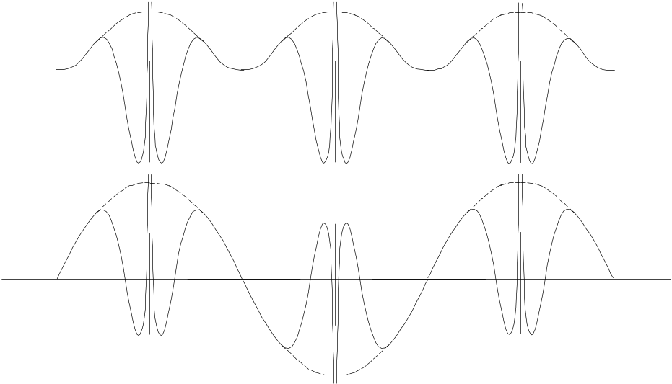
Nature of the Bloch functions
Zone center
k = 0
Atomic-like near each nucleus
Zone boundary
k = π/a
Fig. 4.11
Just by inspection of these two figures, one can see a way to make
qualitative (often quantitative!) estimates about energy bands
in solids!
Can you see the idea?

Slide 45
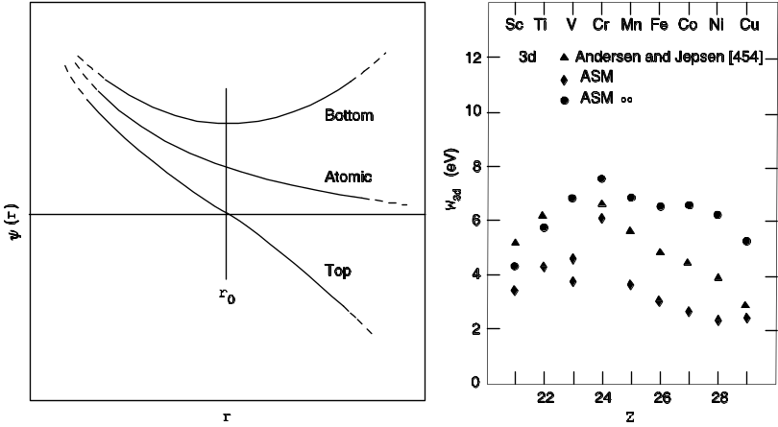
Estimates of band widths in solids
-- using only information from atoms! --
Atomic-like near each nucleus
Calculation on atom
with different
boundary conditions
Zone center
k = 0
Zone boundary
k = π/a
Fig. 4.11
Fig. 10.3
r₀ = ½ the nearest neighbor distance in the solid
The change in energy of the atomic state with boundary conditions
(ψ = 0 at the r = r₀ or dψ/dr = 0 at r=r₀ ) gives an estimate of the band
width in the solid!
This idea is close to the original work of Wigner and Seitz in 1933
and modern KKR and LMTO work! More later in course.

Slide 46
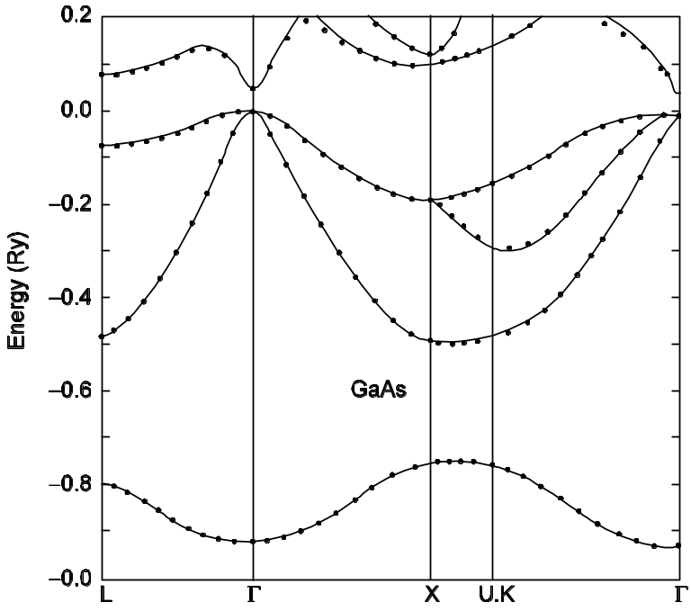
Example of bands plotted along lines in the BZ
Two fcc crystals
-1.0
Copper
GaAs

Slide 47
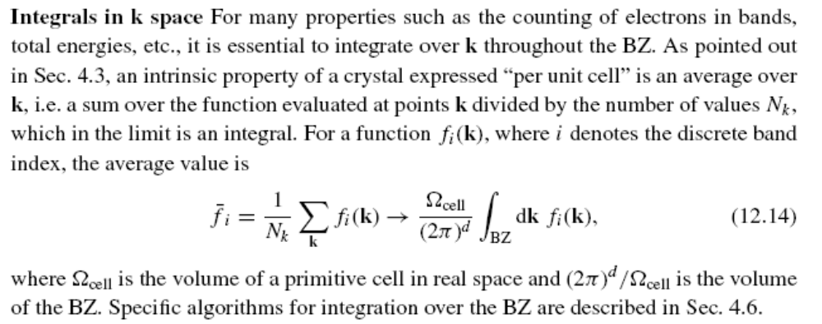
Integrals over the BZ
Integrated quantities like the density and the total energy are
always sums over all the occupied states. In a crystal this means
a sum over bands and an integral over the BZ
NOT in a standard `text – but needed for any total quantity-
energy, density, etc. are sums over all occupied states – in
Integrals over the BZ

Slide 48
Special k-points
“Special k-points” denotes a regular grid of point in the BZ chosen to be optimal for integrating a smooth periodic function
This is useful in crystals because the eigenvalues ε_{k} and eigenfunctions ψ_{k}(r) vary smoothly in the BZ for each band. Thus special points are useful for integrals such as the sum of eigenvalues of the occupied bands and the electron density.
Examples of special points in the BZ in units of π/a
-3/4
-1/4
1/4
3/4
x
x
x
x
-1
0
1
Key points: Any function g(k) that can be expended in Fourier components
up to 3π/a are integrated exactly by the sum at these points.
Only two points need to be calculated since k and –k are conjugate solutions.

Slide 49
Special k-points
“Special k-points” are even more useful in higher dimensions
Example - 2 dimensions
¾. ¾
x
¼, ¼
x
-1
0
1
Key points: Only 2 points are needed in 2 dimensions to get the same
accuracy as in one dimension described before
This also works in 3-d – two points can give an accurate result for the integral!

Slide 50
Conclusions
Plane waves solution for electronic states in crystals
  Hmiltoian matrix given simply in terms involving Fourier components of the potential
Bloch theorem – proved easily using plane waves
  ψ_{k}(r ) = exp(ikr)U_{k}(r ) where u_{k}(r ) is periodic
Electron bands
  Plotted along bands in the BZ
  Interpretation in terms of atomic-like states
  (LCAO defined more carefully later)
Integration over the BZ to find total properties
  Total energy, electron density, forces, . . .
  Special k points
These are the parts that enable actual Kohn-Sham calculations

