Slide 1
Electronic Structure of Condensed Matter
Fudan University - April 2010
Density Functional Theory (DFT) -I
Instructor: Richard M. Martin
University of Illinois
Stanford University
RMartin@illinois.edu

Slide 2
Basis of Most Modern Calculations
Density Functional Theory
Hohenberg-Kohn; Kohn-Sham – 1965
  A new approach to the interacting electron problem
  - using independent electron methods!
  Kohn & Sham proposed the LDA
  - the local density approximation - still widely used
Improved approximations for the density functionals
  Generalized Gradient Approximations, Orbital depndent functionals, van der Waals functionals, . .. .
Evolution of computer power
Car-Parrinello Method – 1985
Nobel Prize for Chemistry, 1998, Walter Kohn
1900
1920
1940
1960
1980
2000
2020

Slide 3
Basis of Most Modern Calculations
Density Functional Theory
Why is Density Functional Theory so widely used?
A new approach to the many-body interacting electron problem
  In principle DFT is exact
  Kohn and Sham introduced the idea of an auxiliary system that in principle gives the exact ground state density and energy - but NOT other properties.
  In practice, DFT allows useful approximations

Slide 4
First: What is needed to define the independent particle equation
From previous lecture:
[ - (h²/2m) ² + V(r) ] Ψ (r) = E Ψ (r)
Δ
where
m = mass of particle
V(r) = potential energy at point r² = (d²/dx² + d²/dy² + d²/dz²)
E = eigenvalue = energy of quantum state
Ψ (r) = wavefunction
n (r) = | Ψ (r) |² = probability density
What is needed to specify the equation?
m – fixed for electrons
Boundary conditions
V(r)
Consider m, boundary conditions to be given

Slide 5
First: What is needed to define the independent particle equation
How would you find V(r)?
[ - (h²/2m) ² + V(r) ] Ψ (r) = E Ψ (r)
Δ
This is the first problem - which V(r) corresponds to a given solid?
Some estimate – like V(r) = sum of atomic potentials . . . .
Need a variational principle
Must be based upon the energy of the system -- the real system including many-body interactions – to be relevant to the real problem

Slide 6
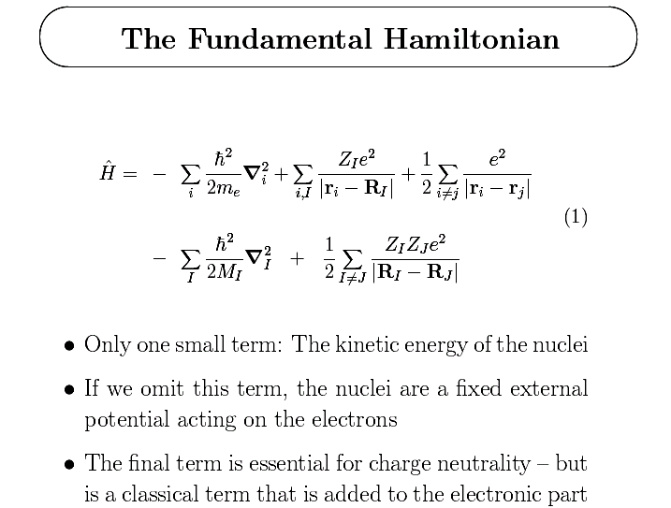
Interacting
electrons in an external potential
Not included in following derivations – must be added later

Slide 7
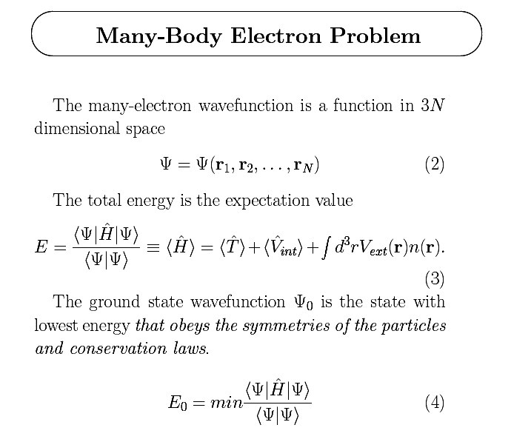
electron-electron
interactions
potential
due to nuclei,
other sources
“external” to
electrons

Slide 8
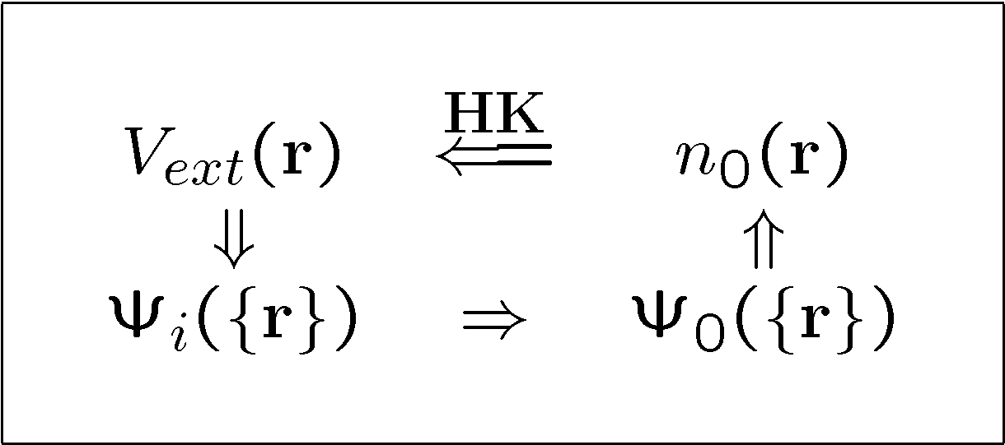
The Hohenberg-Kohn Theorem – I
Hohenberg-Kohn “theorem”(1964)
HK
Schrödinger
All properties of the many-body system are determined by the ground state density n₀(r)
Each property is a functional of the ground state density n₀(r) which is written as f [n₀]
A functional F [f(r)] maps a function to a result: f(r) → F

Slide 9
The Hohenberg-Kohn Theorem – Ia
First Step – definition of functional
What is a functional? A functional derivativative?
Examples
I[f] = ∫dx exp(f(x)), for example, I[f] = 1/a for f(x) =-a² x²
H[f,g] = ∫dx g(x) f(x)), δH/ δg(x) = ∫dx δ(x) f(x) = f(x)
δ = delta function

Slide 10
The Hohenberg-Kohn Theorem – Ib
Legendre Transformation - Example
The “theorem” is really only a Legendre transformation
Well-known example: thermodynamic equilibrium
  Consider a classical liquid – many interacting atoms in thermal motion
  Energy E(V), V = volume (where n = density = N/V)
  What is the equilibrium volume under pressure?
  This problem has the classic form of a Legendre transformation:
  Define the generalized function:
  F(P,V) = E(V) + PV + H(P)
  Minimization: ∂F/ ∂V = dE/dV +P =0 ⇒ P is the pressure P=-dE/dV
  ∂F/ ∂P = dH/dP +V =0 ⇒ V is the volume V=-dH/dP
  Thus the enthalpy H(P) = E(V) + PV where P is the pressure P=-dE/dV
  This is a Legendre transformation – a change of variables from V to P:
  Question for you: Show that H is a function of P and NOT a function of V

Slide 11
The Hohenberg-Kohn Theorem – Ic
Example of Liquid continued
So what is the functional for the classical liquid?
We want to find the state of thermodynamic equilibrium for classical liquid:
  The equilibrium state of the system at pressure P (an externally applied quantity) can be found by a two-step process
  1. Minimize the energy as a function of all internal variables
  (the many-body problem!) at fixed density n = N/V → function E(n),
  Note: E(n) is “universal” – it depends only on internal quantities
  2. Vary V ⇒ P(V) to find the minimum enthalpy H for fixed applied P_{ap}
  δΗ/δP = 0 ⇒ H(P) = E(V ₀) + P_{ap}V₀ (where V₀ =N/ n₀)
  (really very simple interpretation) P = -dE/dV = P_{ap}
Thus P → n₀ and n₀ → P → E and all properties!

Slide 12
The Hohenberg-Kohn Theorem – II
Density functional for electrons
More later on functional
So what is the functional for electrons?
Consider the Hohenberg-Kohn functional for quantum electrons:
E = T[V_{ext}] + Vint[V_{ext}] +∫ dr n(r ) V(r ) + F_{HK}[n]
  1. Minimize the energy as a function of density n(r)
  Function of internal variables -- internal variables
  - solving the many-body problem!) → V = V_{ext}(r )
  2. Leads to HK functional F[n(r)]
  Note: F[n(r)] is “universal” – it depends only on internal quantities
T= KE, V_{int} = Expectation
value of e-e interactions from
Schr. Eq with V_{ext}
Hohenberg- Kohn functional
Thus V_{ext}(r) → n₀(r) and n₀(r) → V_{ext}(r) → E and all properties!

Slide 13
A Nobel prize for a Legendre Transformation ??!!
This the first step made by Hohenberg and Kohn sets up the next step – even if it is just a Legendre transformation
It appears that we have gained nothing! We still have to solve the many body Schrodinger Eq. to get the density functional!
It is the next step by Kohn &Sham that is truly ingenious
:
The combination won the Nobel prize

Slide 14
The Hohenberg-Kohn Theorem – III
The Schrodinger Eq. gives all properties as functional of the potential.
Why is it a good idea to make a functional of the density instead of a functional of the potential ?
The hard part of the problem is the correlation energy
  Correlation means that the probability if finding two electrons at a distance r is reduced for small distances, since the interaction is repulsive
  This is intrinsically a function of the density and only a secondary effect of the potential
Thus the first step made by Hohenberg and Kohn sets up the next step – even if it is just a Legendre ttansformation
It is the next step by Kohn &Sham that makes DFT practical!

Slide 15
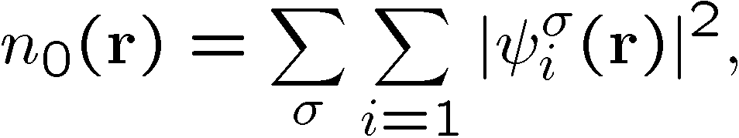
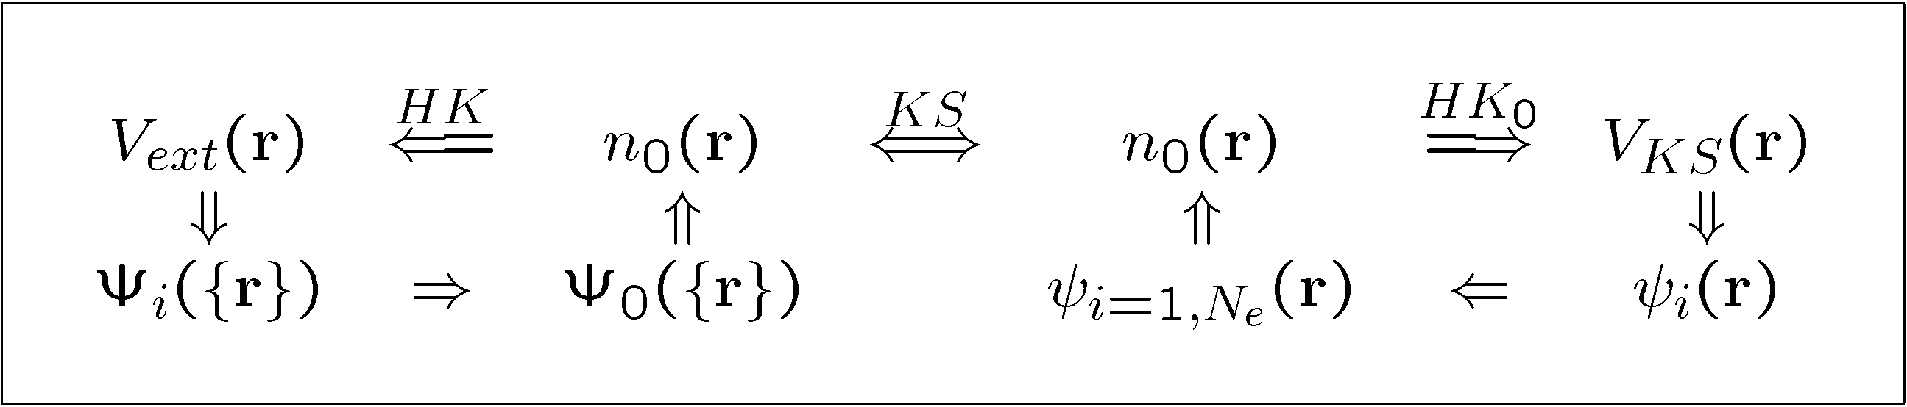
The Kohn-Sham Auxiliary System I
Kohn-Sham (1965) – Replace original many-body problem with an independent electron problem – that can be solved!
The ground state density is required to be the same as the exact density
HK
KS
HK⁰
Only the ground state density and energy are required
to be the same as in the original many-body system

Slide 16
The Kohn-Sham Auxiliary System II
From Hohenberg-Kohn the ground state energy is a functional of the density E₀[n], minimum at n = n₀
From Kohn-Sham
Good and Bad
– more later
Exchange-Correlation
Functional – Exact theory
but unknown functional!
Equations for independent
particles - soluble
The new paradigm for many-body problems
– Determine only the total energy and density, not other properties
- find useful, approximate functionals

Slide 17
The Kohn-Sham Auxiliary System III
Kohn-Sham is different from Hohenberg-Kohn
Kohn-Sham introduced the kinetic energy expressed as
a functional of wavefunctions of the independent- particle auxiliary system –
To be precise this is:
“Kohn-Sham Density Functional Theory”
This is one aspect makes KS-DFT practical :
The KE is very “non-local” --- Exc is much more local and it can be approximated much more easily the Hohenberg-Kohn functional F[n] which includes the total KE
The second is that KE, and Coulomb terms are all LARGE
These terms must be a good approximation or the method is useless

Slide 18
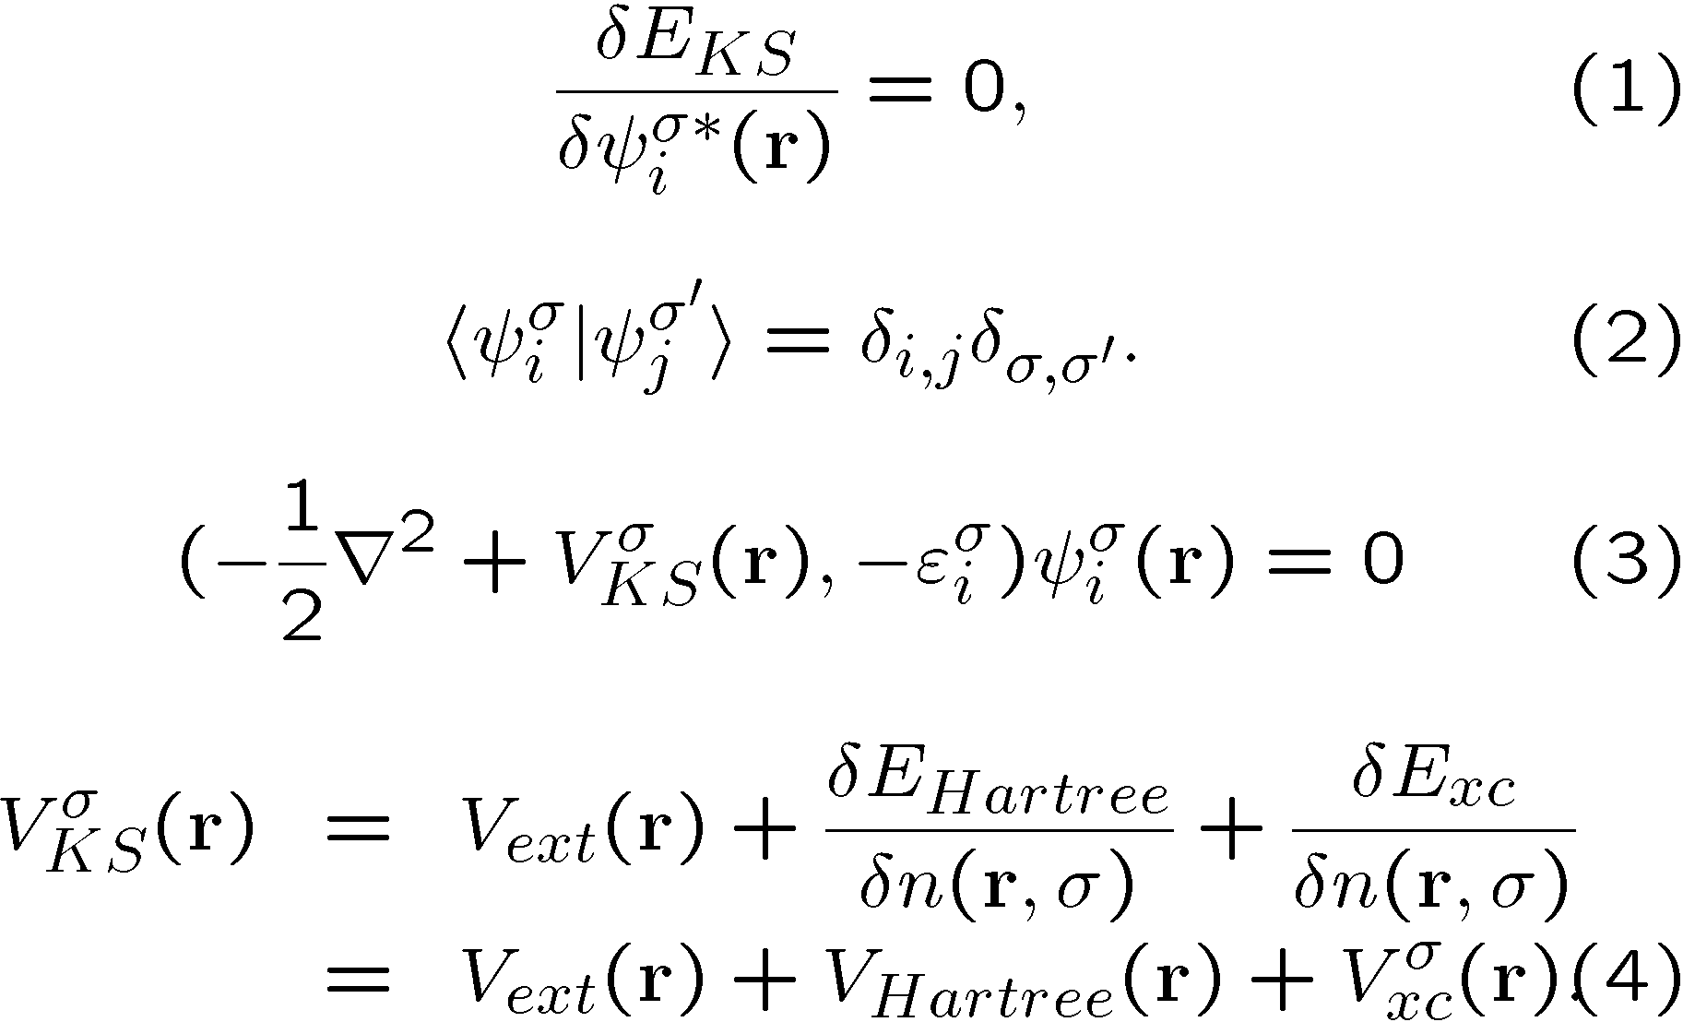
The Kohn-Sham Equations I
Assuming a form for E_{xc}[n]
Minimizing energy (with constraints) → Kohn-Sham Eqs.
Variational principle
Constraint
Exclusion principle for
independent particles
See Next Slide)

Slide 19
The Kohn-Sham Equations II
Eigenvalues are
approximation
to the energies to
add or subtract
electrons
–electron bands
More later
Kohn-Sham Self-Consistent Equations.
Assuming a form for E_{xc}[n]
Kohn-Sham Potential
Function position r
Functional of density
Uses Chain rule
dE/dψ = (dE/dn) (dn/dψ)
Result
Density, Energy

Slide 20
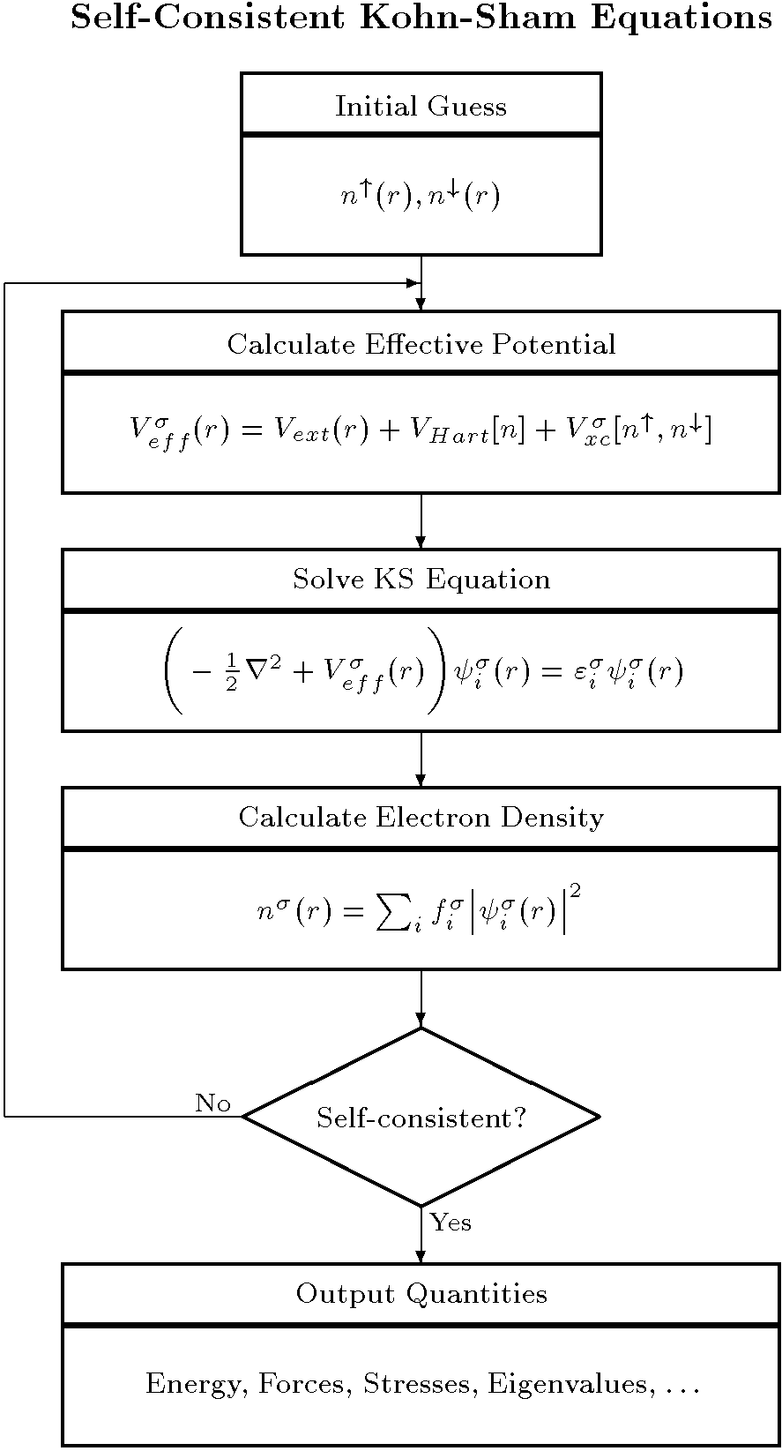
Solving Kohn-Sham Equations
Structure, types of atoms
Guess for input density or potential
Solve KS Eqs.
New Density and Potential
Self-consistent?
Output:
  Total energy, force, stress, ...
This is the numerically
intensive part
  KS Eigenvalues - Only parameters - NOT
  eigenvalues of original man-body system

Slide 21
Why are forces and stresses given correctly ?
The force on a nucleus F = -dE/dR is given by the “force theorem” also called the “Helmann-Feynman” theorem
  For a small perturbation dR, you might think this requires expansion in the excited` states
  Exercise for you – Prove that F is given strictly by the density including all many-body terms
Stress σ = - dE/dε (generalization of virial theorem)
  The same reasoning
Perhaps most surprising – second derivatives (and higher) are also exact in principle.
  Extension of above reasoning
  Different from textbook perturbation theory – Why?

