Slide 1
Electronic Structure of Condensed Matter
Fudan University - April 2010
Understanding electrons in solids
The three types of descriptions
Understanding electrons in solids
The three basic methods
Instructor: Richard M. Martin
University of Illinois
Stanford University
rmartin@illinois.edu
and
rmartin42@gmail.com

Slide 2
The three ideas and three methods
LCAO - Representation of the eigenfunctions as linear combination of atomic-ilke orbitals
  The dominant functions having the same s-p-d character as in the atom --- additional radial functions and higher angular momentum to improve the description
  Good way to understand bands – get simple approximations
Plane waves - Representation of the eigenfunctions in terms
of a general independent of the atoms
  Good way to describe nearly free electron bands
  Advantage for computation – very simple algorithms –
  the same for all problems
  BUT one must use pseudopotentials that put in the atoms
Augmented methods – expansion in spherical harmonics near the nucleus – smooth functions (e.g., plane waves) between the atoms
  The “best of both worlds” - atomic-like and band-like
  Good way to describe localized states like d electrons
  General algorithms, but difficult

Slide 3
Local atomic-like orbitals (LCAOs)
The good thing about LCAOs
They are atomic-like
  Incorporate the fact that states are atomic-like near each atom
The bad thing about LCAOs
They are atomic-like
  The “tail” of an orbital does not have the character of the molecular or solid state
The good thing about LCAOs
A very small basis is sufficient to give a semi-quantitative understanding of electronic states
A larger (but still small) carefully-chosen basis is very efficient for
accurate calculations of electronic states
The obvious basis for a molecule where the eigenstates are localized to the molecule - widely used in chemistry
Gaussians are not atomic-like but they are advantageous because all integrals are analytic

Slide 4
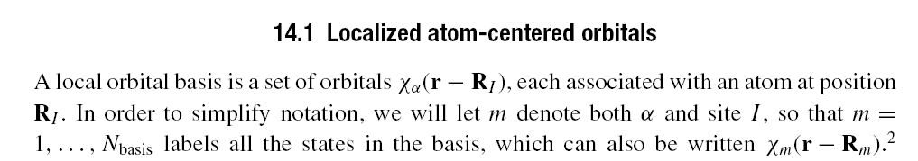
Independent-Particle Eqs in Localized Bases
Any state can be expressed as a linear combination of basis orbitals
ψ_{i} = Σ_{m} c_{im} χ_{m}(r- R_{m}) (LCAO)
Matrix elements H_{mm’} = <χ_{m}|H| χ_{m’}> = ∫χ_{m}( r - R_{m}) H χ_{m’} ( r – R_{m’})
S_{mm’} = <χ_{m} | χ_{m’}> = ∫χ_{m}( r - R_{m}) χ_{m’} ( r – R_{m’})
Leads to matrix equation: Σ_{m’} (H_{mm’} – ε _{i} S_{mm’} ) c_{im’} = c_{im}
Localized functions
are not orthogonal
The problem separates into two parts:
The Schrodinger equation is determined by the matrix elements
The actual form in real space is determined by the functions χ_{m}(r- R_{m})

Slide 5

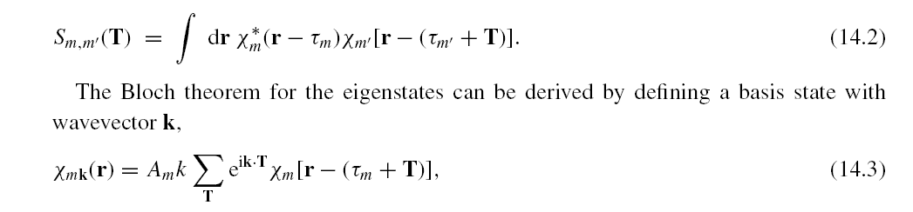
Expressions in a crystal
→
In a crystal, all matrix elements between states separated by T:
The following slides have many details. The parts that are most important are the secular equations on the previous slide, the form of the matrix elements. The Slater-Koster form is perhaps the simplest way in the entire course to understand bands qualitatively, and it will be used in exercises.

Slide 6
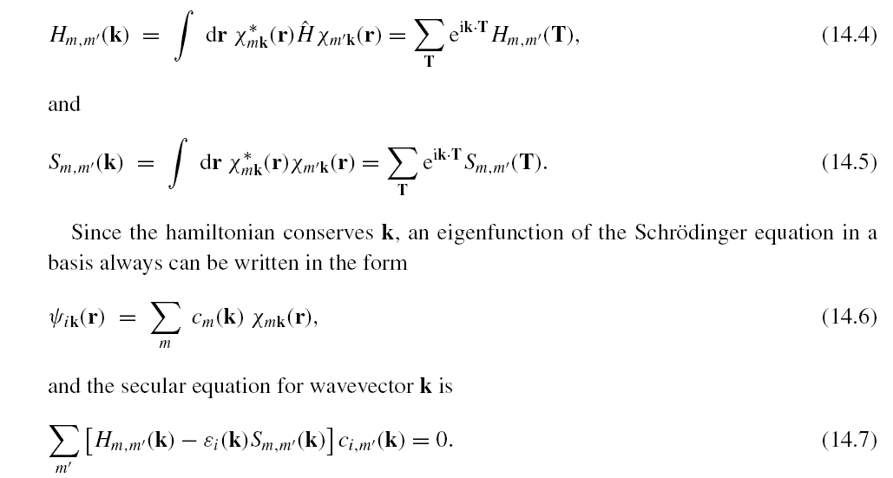
Expressions in a crystal - II
Thus the matrix elements and Schrodinger Eq can be written:

Slide 7
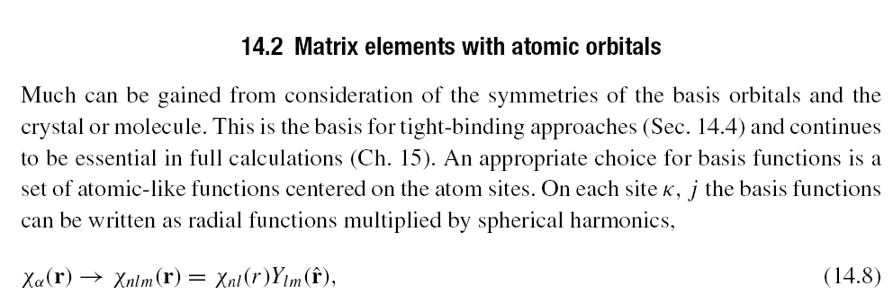
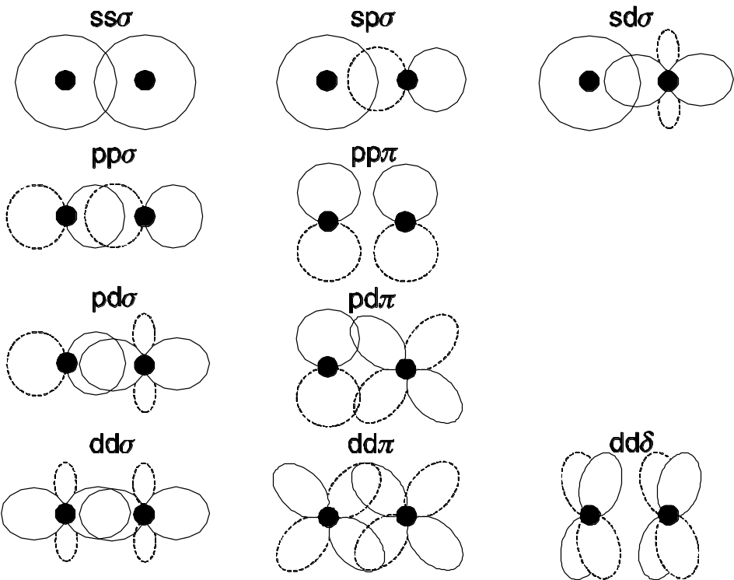
Atomic-like functions
Schematic pictures
of overlaps
and
2-center matrix elements
The figures are very useful for understanding the matrix elements

Slide 8
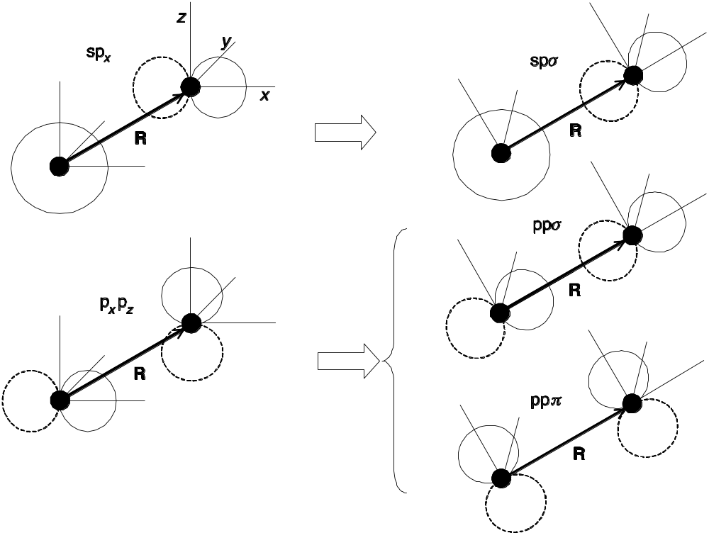
Two-center Matrix elements
2-center matrix elements can always be written in terms of direction cosines – prove by expressing matrix elements as sums of the basic forms on previous slide
Overlap
Kinetic energy
-1/2 ∫χ_{m}( r - R_{m}) ∆ χ_{m’} ( r – R_{m’})
Each matrix element can be expressed as simple functions of the angles multiplied by a function of the distance between the centers – next slide
Potential matrix elements in general more complicated – lower symmetry - often called “3-center”

Slide 9
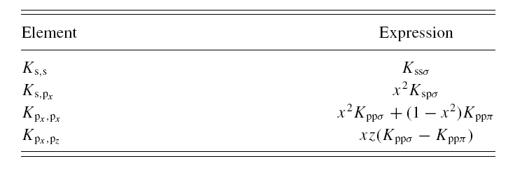

Two-center Matrix elements II
2-center matrix elements can always be written in terms of direction cosines – prove by expressing matrix elements as sums of the basic forms on previous slide
Overlap
Kinetic energy
-1/2 ∫χ_{m}( r - R_{m}) ∆ χ_{m’} ( r – R_{m’})

Slide 10
Two-center Matrix elements III
2-center matrix elements for H and S have the simple form
Functions of distance |R|
Each matrix element can be expressed as simple functions of the angles multiplied by a function of the distance between the centers
Potential matrix elements in general more complicated – lower symmetry - often called “3-center”

Slide 11
Slater-Koster Formulation – Tight-binding
If all matrix elements are approximated as having the 2-center form, then the hamiltonian and overlaps are completely determined by the angular momenta considered and forms of the matrix elements as a function of distance
Σ_{m’} (H_{mm’} – ε _{i} S_{mm’} ) c_{im’} = c_{im}
In a crystal
with
etc.
Tight-binding approximation – consider matrix elements as parameters – fit to experiment or to a theoretical calculation
Very useful !

Slide 12
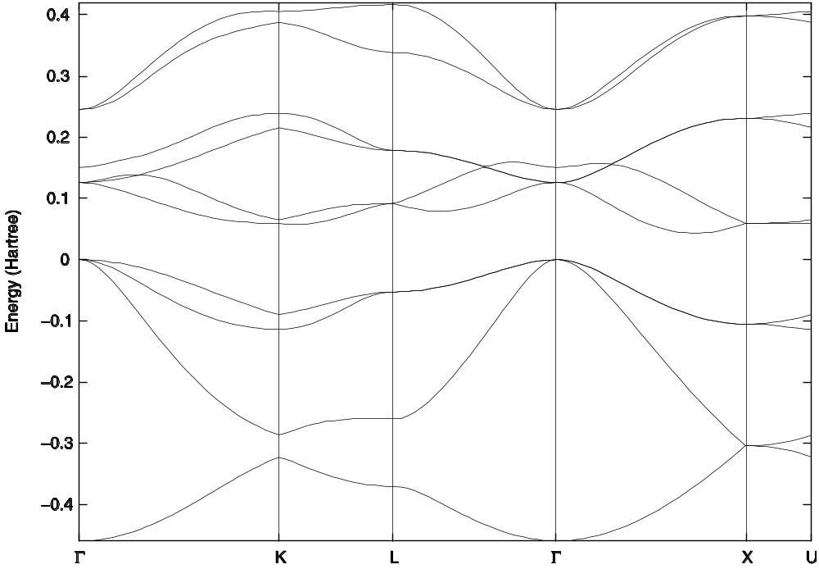
Examples of results - I
Silicon – fitted scheme with 5 functions per atom (s, 3p, s*)
(where s* denotes a second s state) i.e., a 10x10 matrix.)
If the smallest possible basis is used (s,p with 4 states per atom), the
conduction band will not have the correct shape with the minimum on the line
(called Δ) between Γ and X.
(Fig. 14.6 calculated by N. Romero

Slide 13
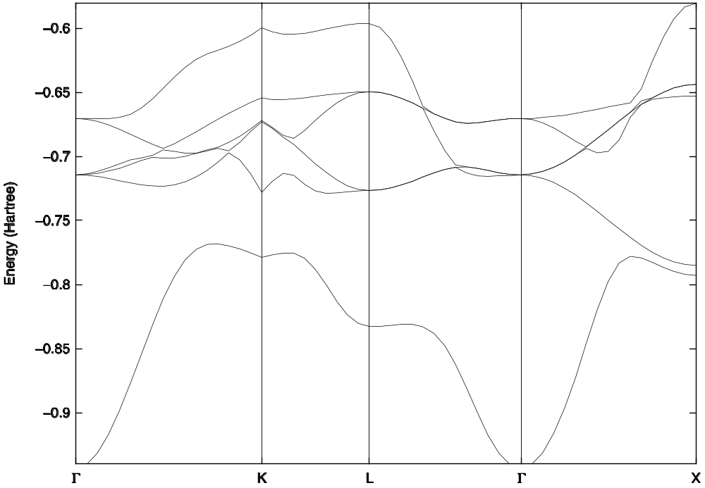
Examples of results - II
Nickel – simple Harrison scheme with 9 functions per atom (s, 3p, 5d)
Note the 5 narrow d bands and the one s band that crosses the d bands.
The Fermi energy is at E=0.
d bands
S band
(Fig. 14.7 calculated by N. Romero

Slide 14
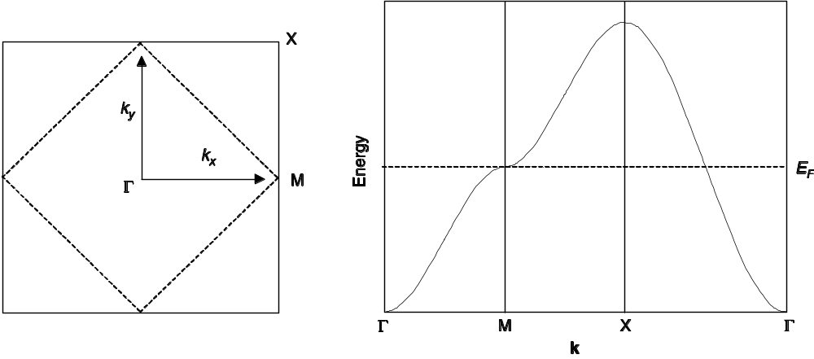
Simple examples – square lattice
Square lattice – s band – assume states are orthonormal and the
only non-zero matrix element of H is for nearest-neighbors
Fermi Surface for one electron per site - a half-filled band
The basic model the metallic bands near the Fermi energy
in Hi-Tc superconductors

Slide 15
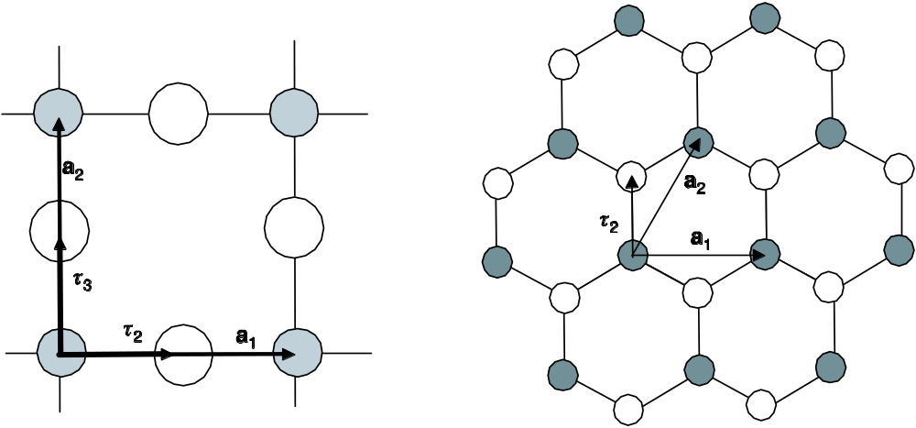
Simple examples - graphene
π bands of graphene (single sheet of graphite)
Two atoms per cell
- both carbon
states form strong s-p bonds in the plane
states are perpendicular to plane – interaction of two states in the same
plane is the same in all direction – i.e., s-like in the plane
See next slide

Slide 16
Simple examples - graphene
π bands of graphene -- tight-binding nearest neighbor matrix element t
t
Not in a line – Front - Back
Side view
+
+
+
+
+
+
-
-
-
-
-
-
states are perpendicular to plane – interaction of two states in the same
plane is the same in all direction – i.e., s-like in the plane
– assume states are orthonormal and the only non-zero matrix element of
H is for nearest-neighbors
With this assumption there are only matrix elements between connecting
states on white and black atoms

Slide 17
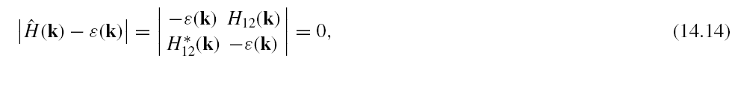
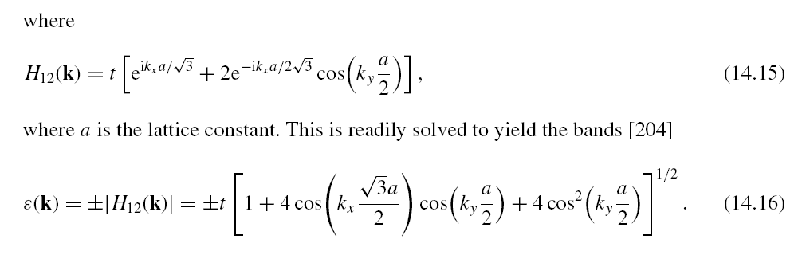
Simple examples – graphene continued
π bands of graphene (single sheet of graphite)
Two atoms per cell - both carbon
Only matrix elements between white and black atoms
Expressions for bands
Matrix element t
for each bond

Slide 18
Exercise in homework
Work out the matrix elements and
the bands yourself
The result should be given for k = (k_{x,}k_{y}) in the plane - but this depends upon the definition of the x and y directions. For the exercise take the
x and y directions as shown in the figure.
If you choose to use the formulas in the book,
You should know that there is a mistake in one edition of the book – you need to work it out yourself!
y
x

Slide 19
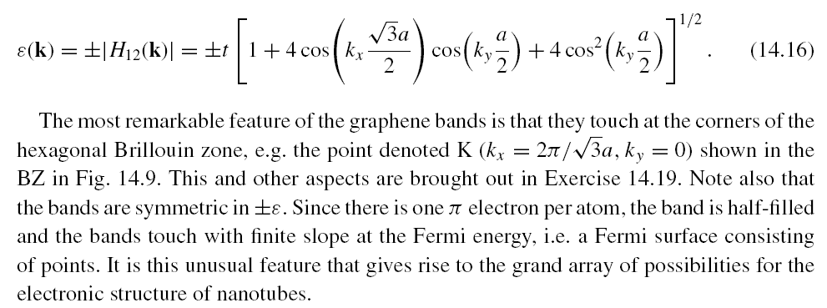
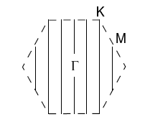
Simple examples – graphene continued II
π bands of graphene – repeating expression in tight binding approx.
Brillouin Zone
Two bands since there are
two sates per cell --- but
the bands touch at the six points
labeled K
Zero gap. Graphene has “Fermi points”
(instead of a normal metal Fermi surface)

Slide 20
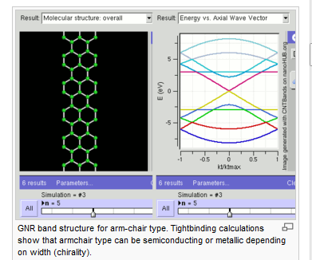
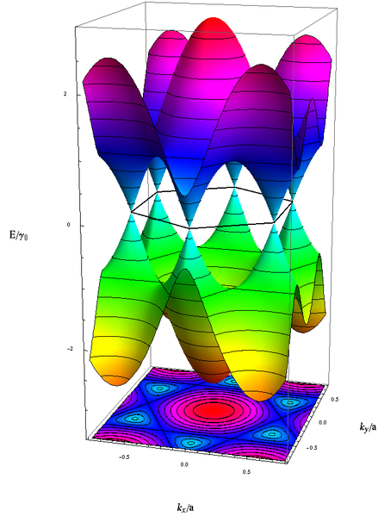
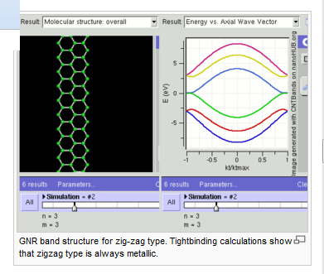
Graphene planes and “ribbons”
Two examples of “ribbons” cut from
graphene sheets – bands for e(k) in
one dimension
Infinite plane – Dirac points
where bands touch with linear
band slopes at points
Tight-binding calculations from
http://en.wikipedia.org/wiki/Graphene#Electronic_properties

Slide 21
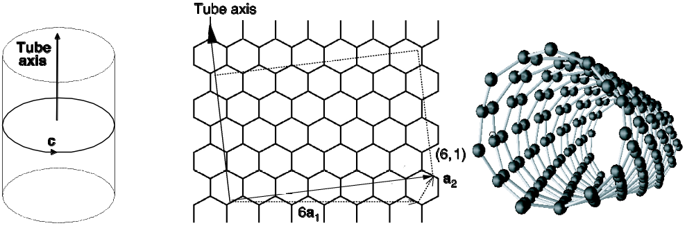
Carbon nanotubes
Rolled up sheets of graphene – π bands form states near Fermi energy
Model: π bands are the same as in graphene – the only difference
is that the only allowed states are those that satisfy the boundary
condition for the tube ψ(r+L) = ψ(r)
Vector L indicates points that are brought together in rolling
Bands depend on how sheet is rolled
Can be chiral, non-chiral, metals, insulators, …..

Slide 22
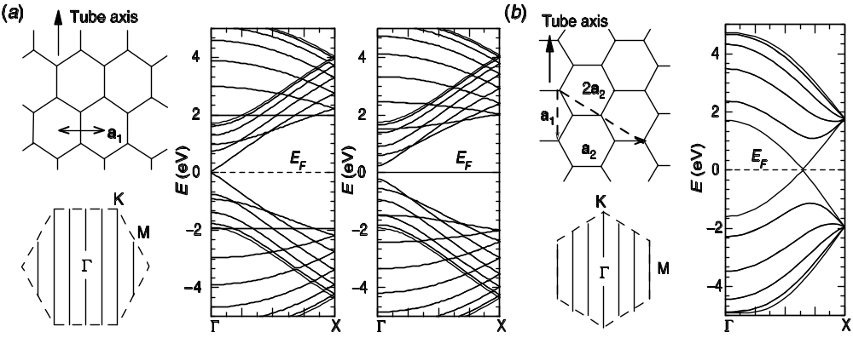
Carbon nanotubes – two examples
Rolled up sheets of graphene – π bands form states near Fermi energy
“Zig-zag” zero-gap metal or
narrow gap semiconductor
“Armchair” metallic because states
allowed by rolled tube always include
the zero-gap states
Works very well for large diameter tubes
– there are important corrections for very small diameter tubes

Slide 23
Accurate Kohn-Sham Calculations
  The LCAO method can be very accurate if a large basis with many atom-centered states are used
  The main computational difficulties are:
  - Calculation of the density and generation of the new potential in the iterations to the self-consistent solution
  - Calculation of the matrix elements
  Useful codes:
  SIESTA – very efficient – designed for solids
  - includes molecular dynamics, etc.
  Many Gaussian based codes designed for molecules – GAUSSIAN, . . .

Slide 24
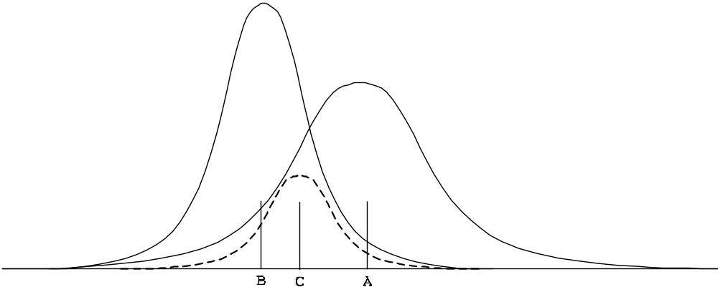
Why are Gaussians so useful?
The needed integrals always have the form
Im m’ m’’ = <χm |O m’’ | χm’> = ∫χm( r - Rm) O m’’ ( r – Rm’’) | χm’ ( r – Rm’)
These integrals can easily be evaluated for gaussians multiplied by any polynomial.
The reason is simple: The product of two gaussians is a gaussian
exp(–a (x – XA)² exp(–b (x – XB)²
= g exp(–c (x – XC)²
where it is straightforward to
derive the expressions for
g, c, and XC
(see Sec. 15.2)

Slide 25
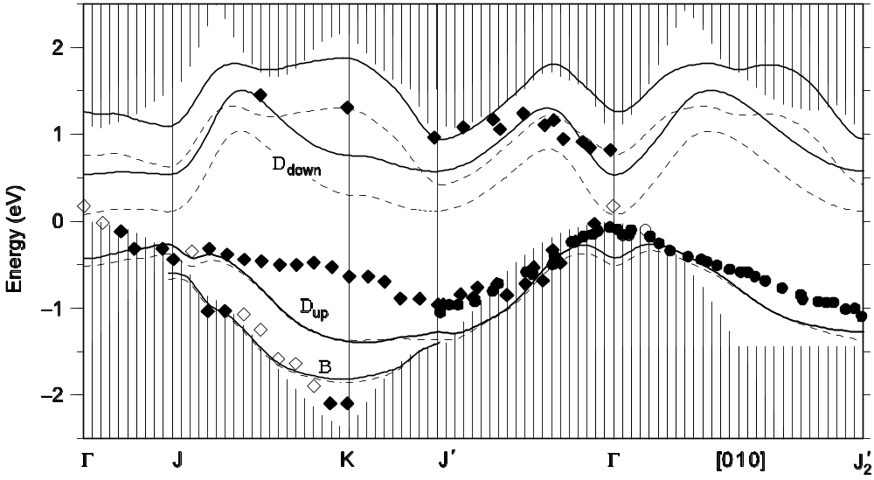
Example of Gaussian basis calculation
Surface states
Bulk states
Gaussian basis code by Rohlfing (Fig 15.2 in text) has been applied to the
bands of many materials – excellent agreement with plane waves
Here is an example of states at a surface of Ge. This shows both LDA results (the famous zero gap) and “GW” calculations (discussed later) done with the same basis.

Slide 26
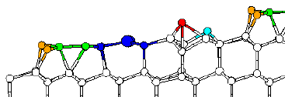
Au “wires” on Si (557) surface
SIESTA local orbital calculation (numerical modified atomic orbitals)
Most stable structure predicted from theory
in very good agreement with experiment done later
[I. K. Robinson, et al., PRL 88, 096104 (2002)]
Steps on the surface
Au atom
Si adatom
Side view of surface
After the finding structure, plane wave calculations were used to calculate
electronic bands (very close to bands from SIESTA ) – Novel large coupling to the electron spin effect predicted – PRL 93, 146803 (2004)

Slide 27
Conclusions
Atomic-like (LCAO) bases are very useful
  A very small number of states is sufficient to understand important aspects of bands
  Tight binding approximations leads to very simple algebra and description of bands
  Examples – Si, Ni, graphene, nanotubes, ….
  Useful codes available ( SIESTA (free) , GAUSSIAN,
  GAMESS free) ,
  Simple code - TBPW from my group, free

