Slide 1
Rotational modulation of Luhman 16: new analysis with TESS data sector 36 and 37
Nguyen Fuda, Daniel Apai, Domenico Nardiello
and others

Slide 2
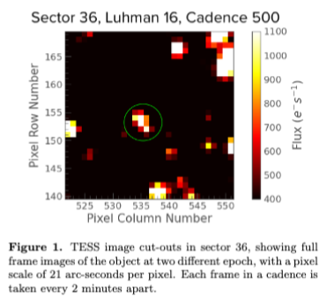
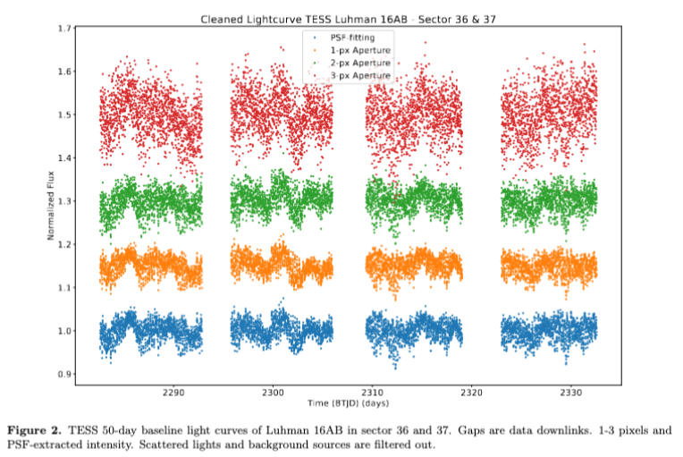
1. TESS Data
Data cleaning: remove points with sigma_SKY>140, DQUALITY # 0
Photometric error: 4.5%
Used PSF-extracted light-curve
Figure 1: image cutout (25 pixel) obtained with lightkurve
Figure 2: PSF & 1-3 pixel –extracted light-curve
Question: can we check light curve of possible contaminating-sources?
(Sector 36, 37 TESS extraction not found in PATHOS from astroquery.mast)

Slide 3
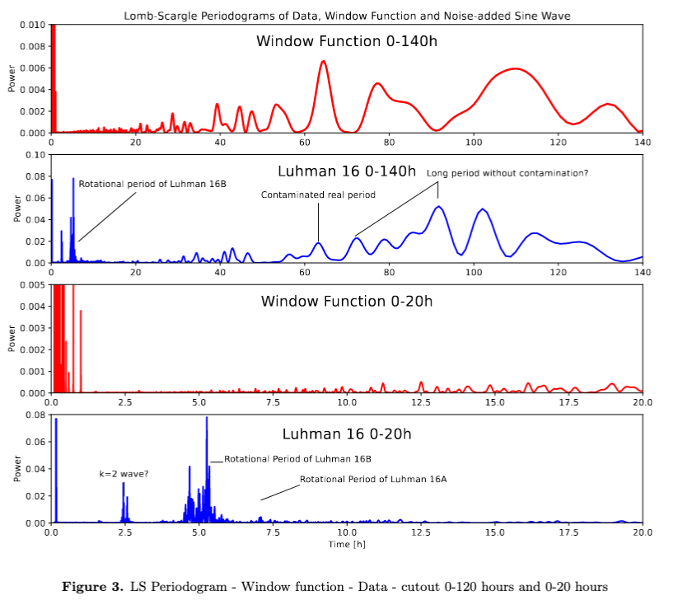
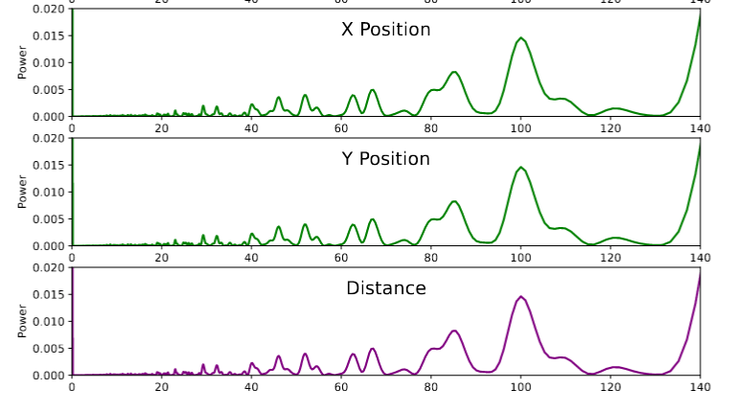
2. Periodograms
LS Periodograms: confirmed previous result, found multiple peaks. Figure 3, 4.
Short-period < 20 hours: no contamination from window function, found k=2 wave, signs of atmospheric rotational modulation
Long period < 140 hours: strong contamination from window function and spacecraft jitter.
Some specific period peaks (i.e 70, 90 hours) coincide with minima in window function/jitters periodograms -> recoverable?

Slide 4
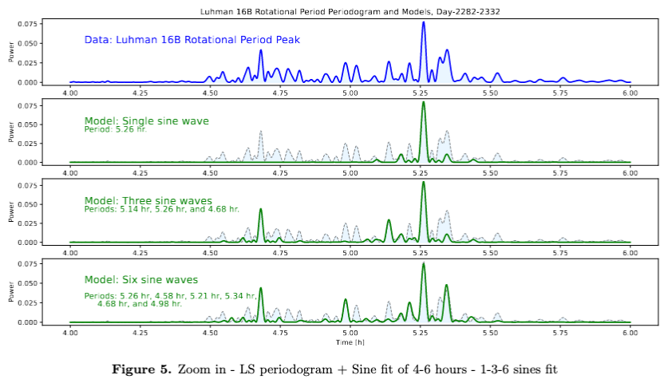
2. Periodograms fit
Periodogram sine fits: fit 1, 3 and 6 sine waves models
Multi-sine waves model *could explain* observation → planetary scale wave works well

Slide 5
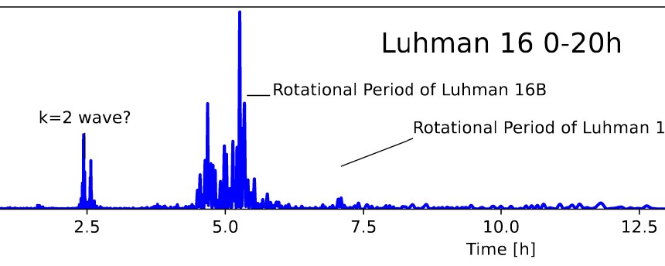
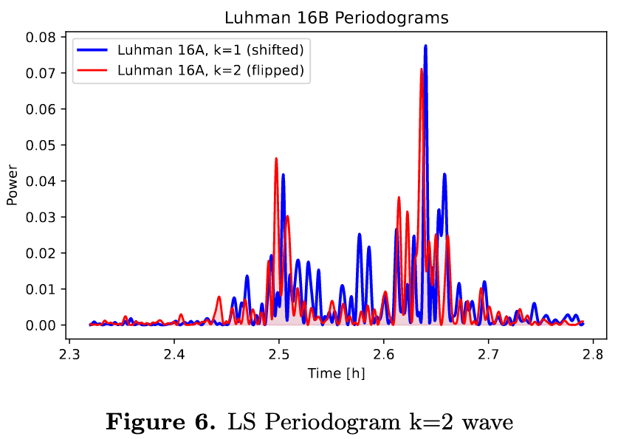
2. Periodograms: k=2 wavenumber
K=2 wave: waves in zonal circulation matching half rotation rates
Shift and flip
K=2 wavenumber: scale and match exceedingly well with k=1 main period peaks of Luhman 16B !
New data has 4 times better cadence -> confirm k=2 existence better than previous result

Slide 6
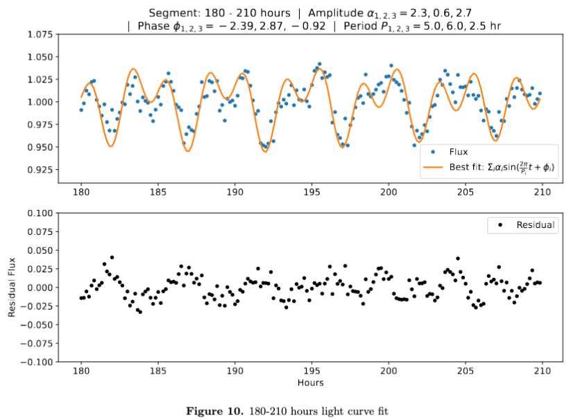

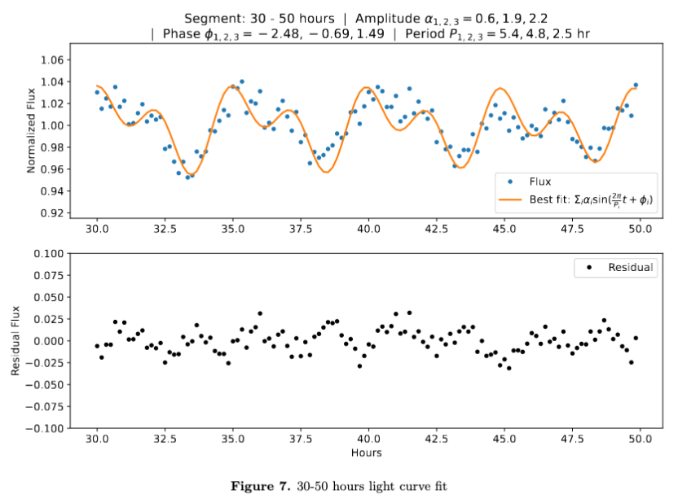
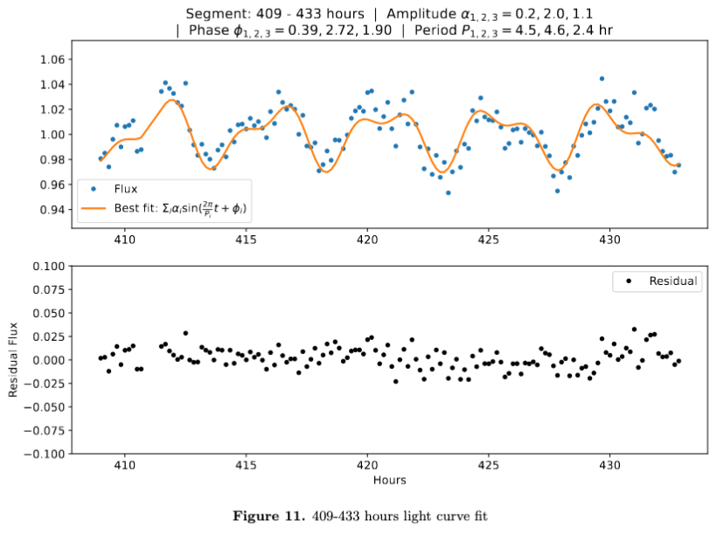
3. Light curve fit: short-period
Fit light curve with: *3-SINE WAVES* model, 9 params
MCMC routine: results matches well, contrains:
Two periods in k=1 regime around Period = 5 hours
One period in k=2 regime around Period = 2.5 hours

Slide 7
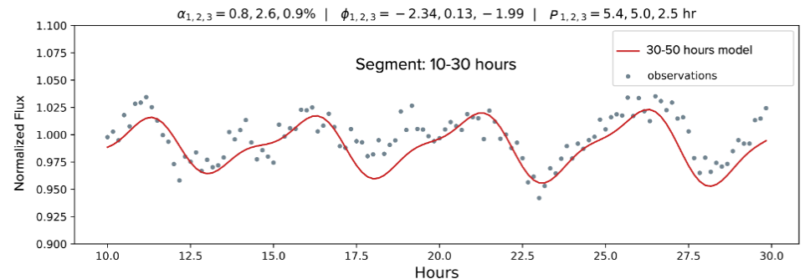
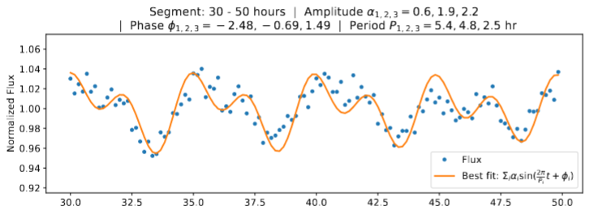
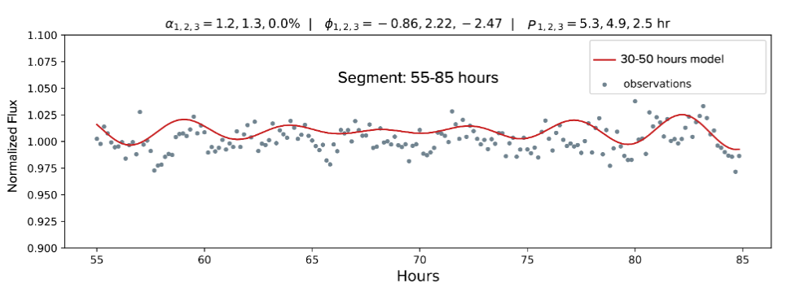
3. Light curve fit: evolution
Light curve shows variable evolution: Period peaks dissolve and evolve into other
Proof: 1. used previously fitted segment, 2. keep the periods relatively constant, allow fluctuation in amplitude & phase; 3. fit subsequent segment -> see changes in amplitude
10-30 hours
30-50 hours
Evolution of periods peaks with time
55-85 hours

Slide 8
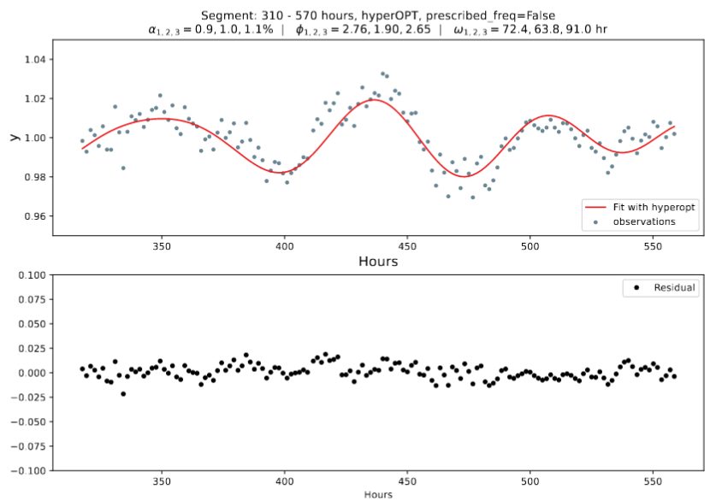
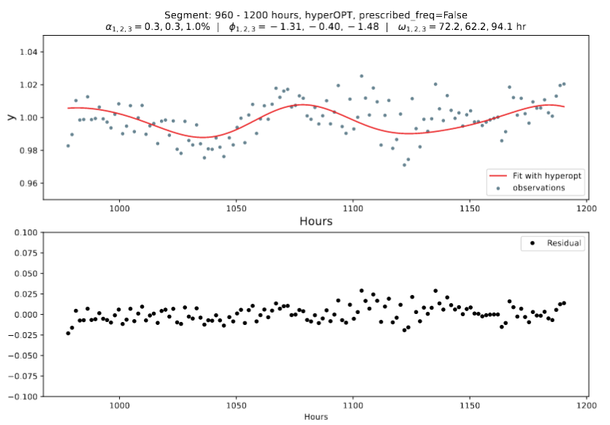
3. Light curve fit: long-period
Use similar 3-sine wave routine to fit long-period light-curve
Smoothing: box-car average periods larger than 20 hours to examine only the long-periods
Result: *COULD* fit long-periods with planetary scale wave model
Disclaimer: needs extra treatment, strong contamination in long-period, unknown credibility.

Slide 9
To be continued…
Overleaf draft: https://www.overleaf.com/project/63163d81cd30f854609620e4

