Slide 1
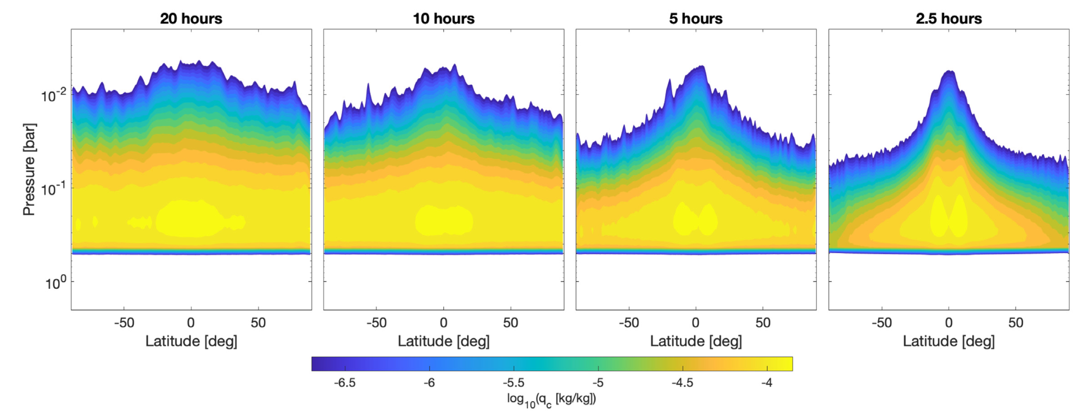
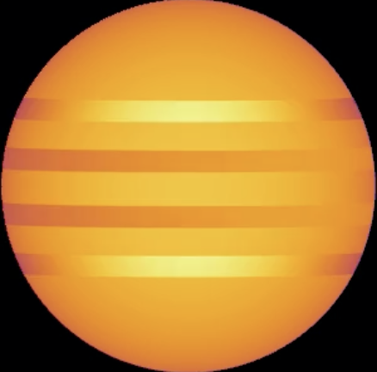
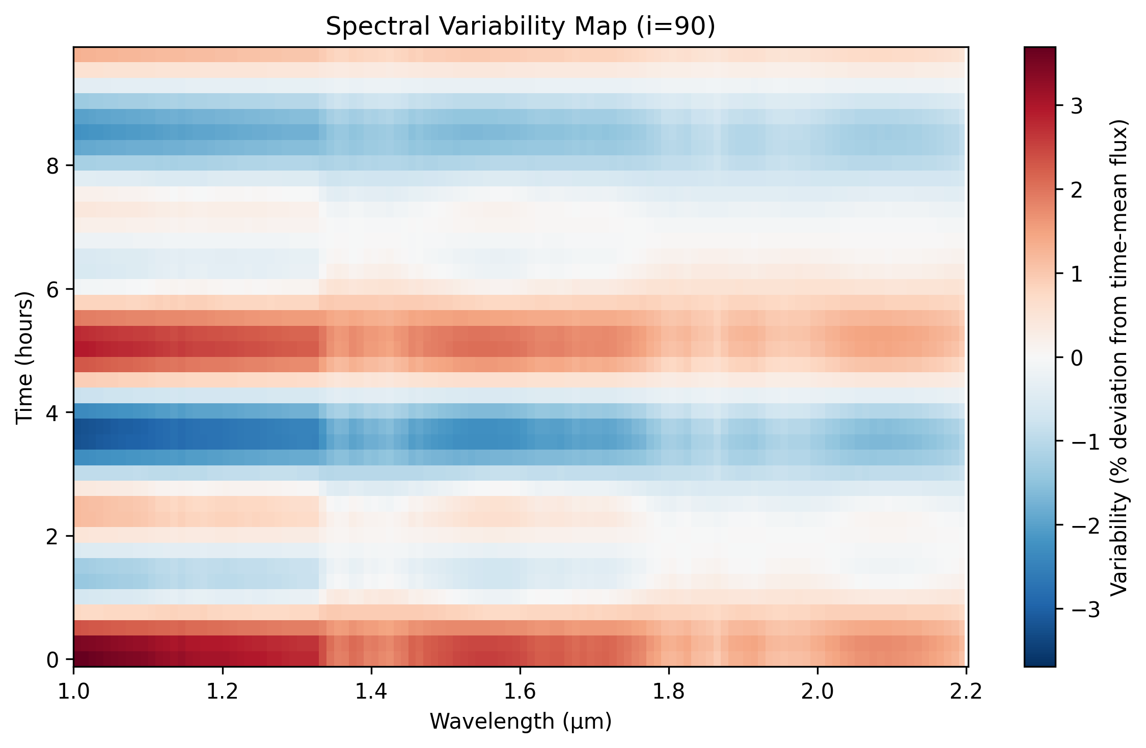
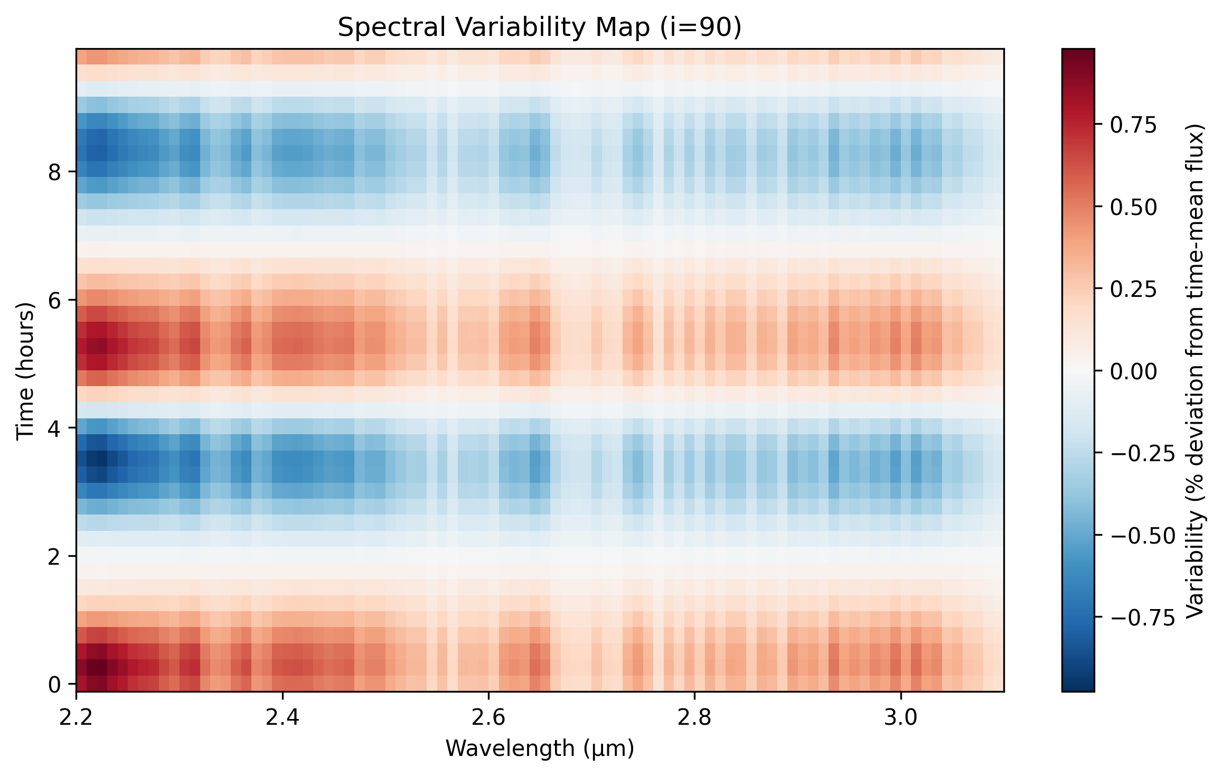
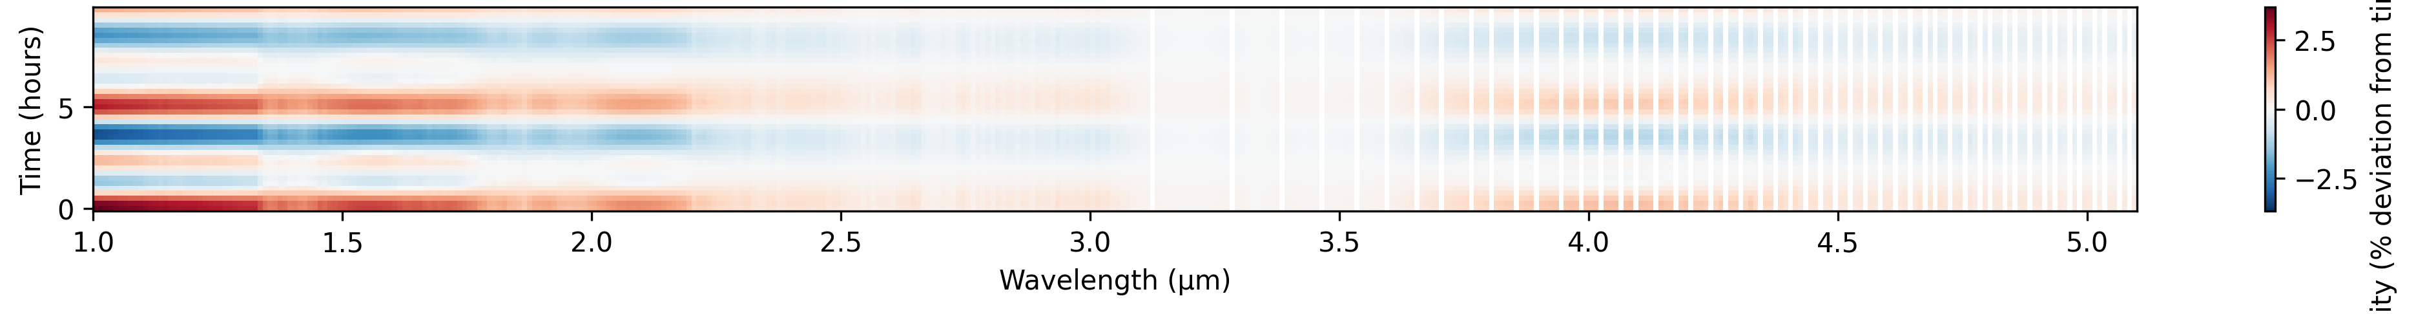
B) Latitudinal cloud-thickness difference
(Cloud mixing ratio, 2.5-hr rotator)
A) Latitude-dependent Waves
90°N
k1
45°N
k1 waves: thick equatorial clouds
k2
k2
k2
Fe, MgSiO₃, Mg₂SiO₄, Na₂S
fsed = 2.0 - 2.2
k1
k1
0°
k2 waves: thinner, mid-latitude clouds at depth?
k2
45°S
Fe, MgSiO₃: fsed = 3.0 - 3.6
(Tan & Showman 2021b)
90°S
Variability vs. Wavelength Map
C)
k2 waves
D)
k1 waves
E)

