Slide 1
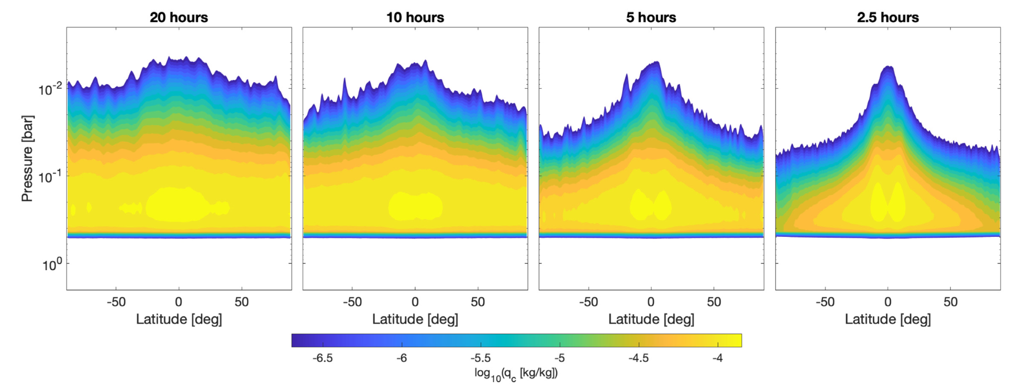
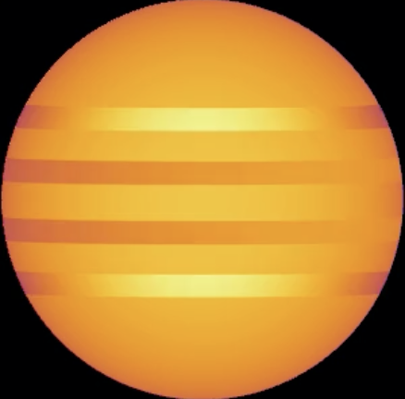
Latitude-dependent Waves
(Tan & Showman 2021b)
90°N
45°N
k=2 waves: thinner, mid-latitude clouds?
0°
k=1 waves: thicker equatorial clouds
k=2 waves: thinner, mid-latitude clouds?
45°S
90°S

