Slide 1
Polar vortices on directly-imaged letters
The polar vortex hypothesis predicts the polar regions of brown dwarfs and directly-imaged planets; like Jupiter; are vortex-dominated. Spectrophotometric simulation from maymo showing that the pole-on inclinations reproduce very low variability due to lacking of zonal bands rotating in and out of view at inclination i=20. Polar vortex changing slowly creates light curve variability as well over longer timescale.
Approach the framing from HR 8799. Campaigns in the past detected no variability, putting upper limits at 10% over 8 hours.
maymo forward-models the presumed consequences of a prescribed vortex structure on HR 8799.
Forward fit either the available spectra from HR8799 b/c/d using PICASO+virga, then using that spectra and vary clouds properties over the expected vertical pressure extent approriate to polar vortex clouds.
Explore 2 polar vortices scenarios: many small vortices changing individually (like Jupiter), or one large region changing (like Saturn). Expected variability over assumed timescale as a function of two morphologies types.

Slide 2
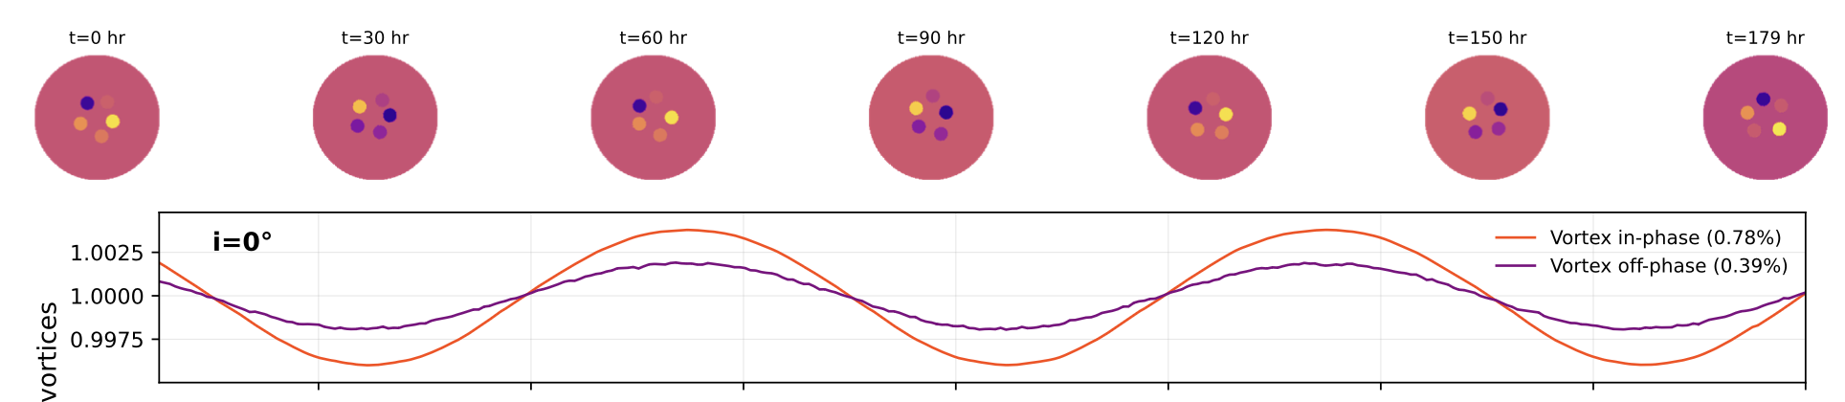
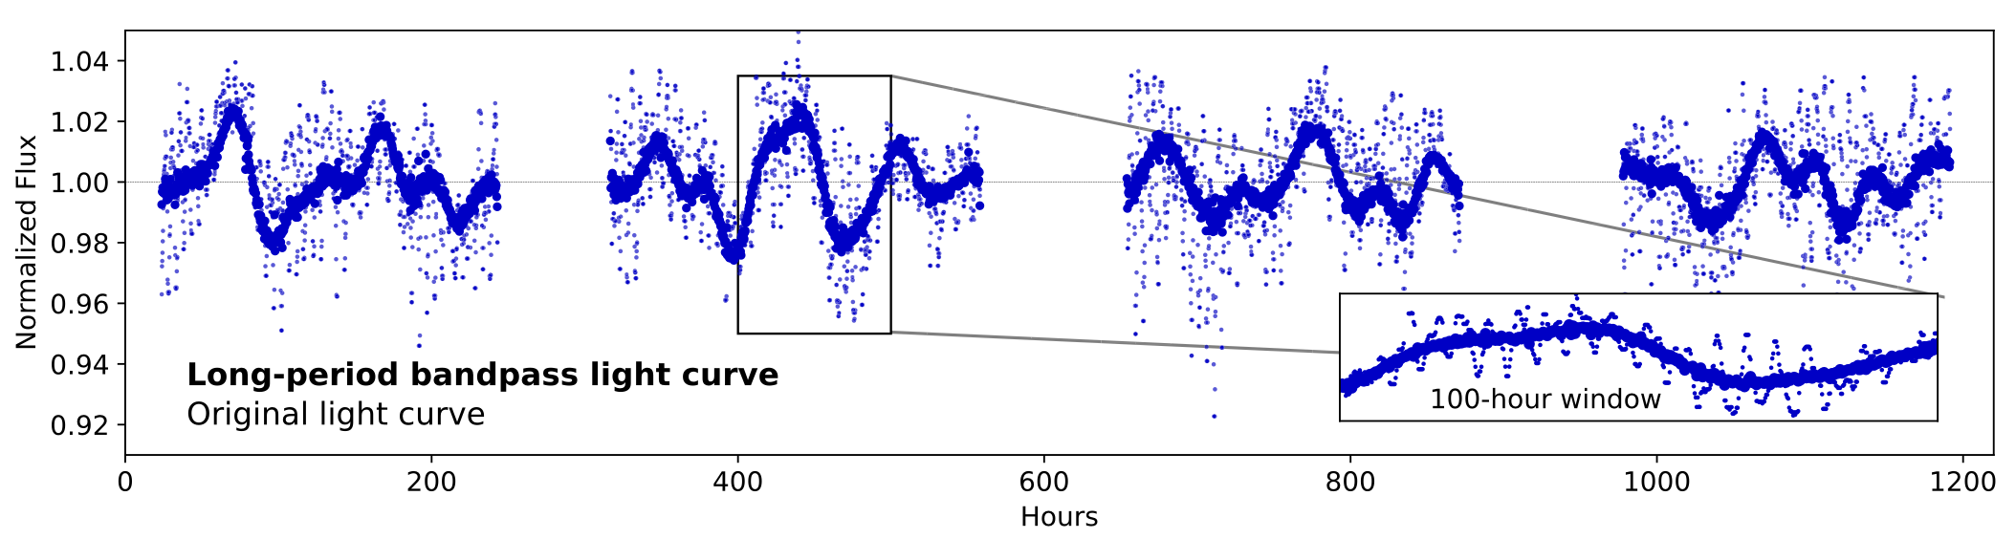
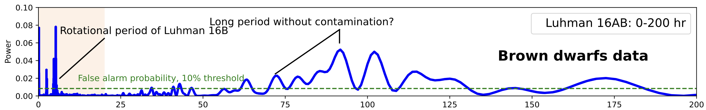
Long-timescale variability behaviors?
more predictable
Hours
more stochastic
more stochastic
Hours

Slide 3
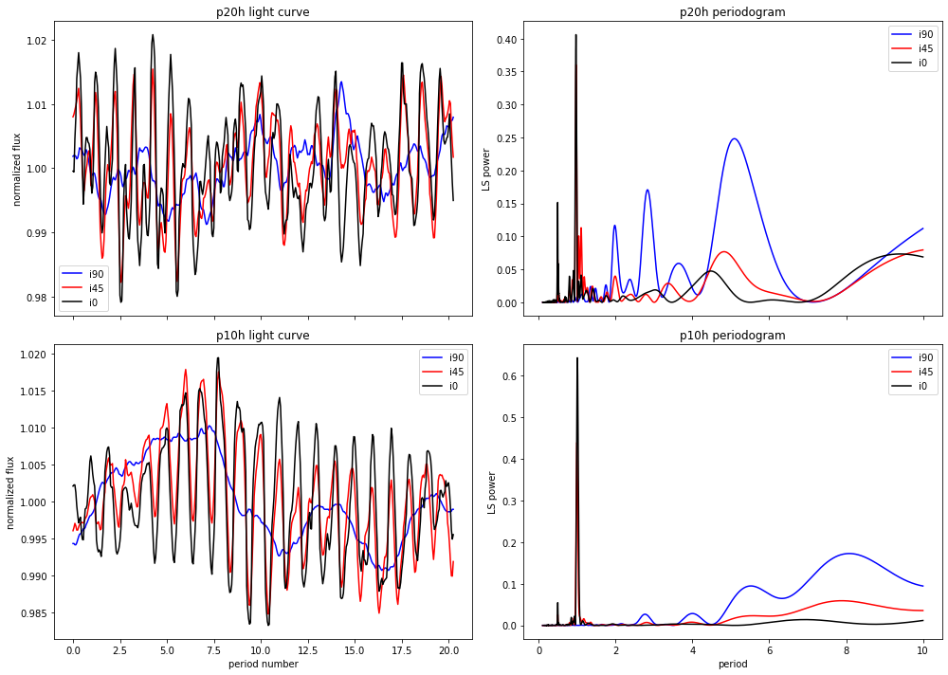
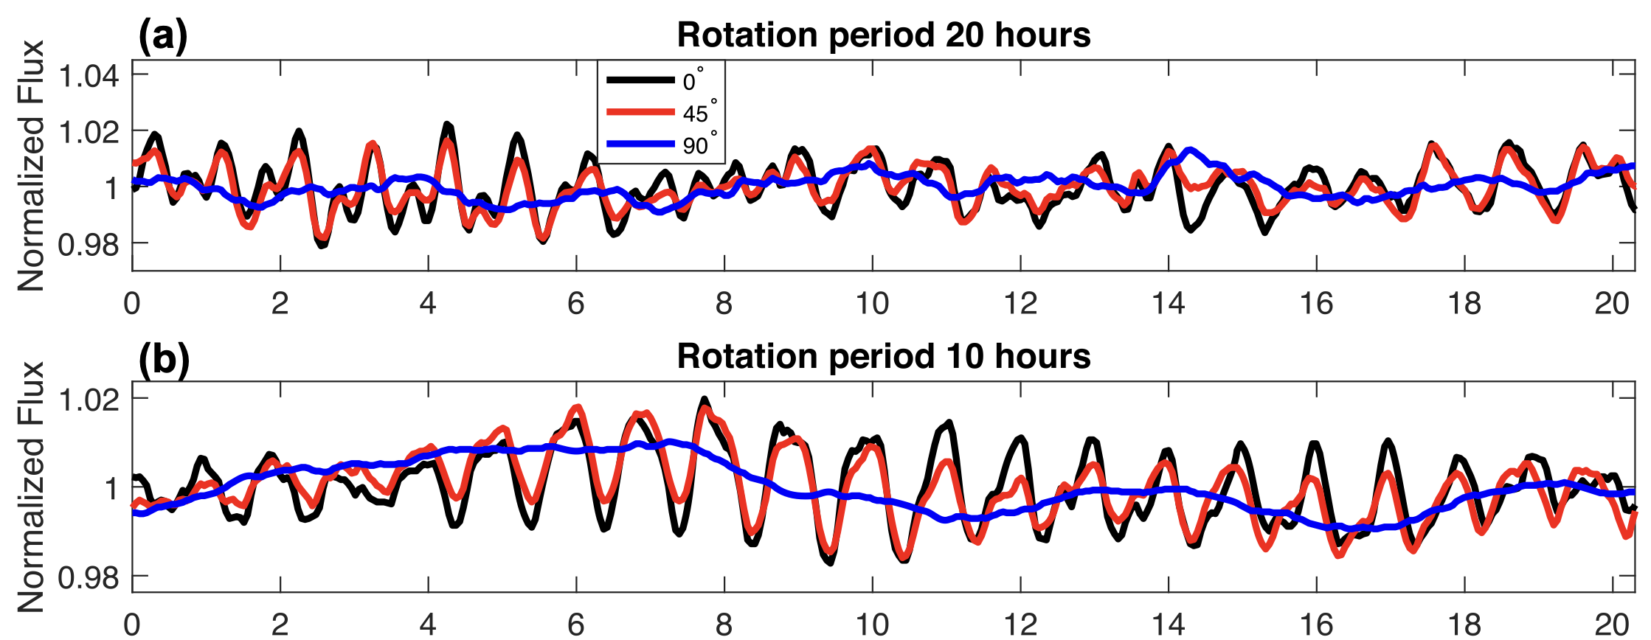
Long-timescale variability behaviors?
Tan, Showman 2021 GCMs
Periods

Slide 4
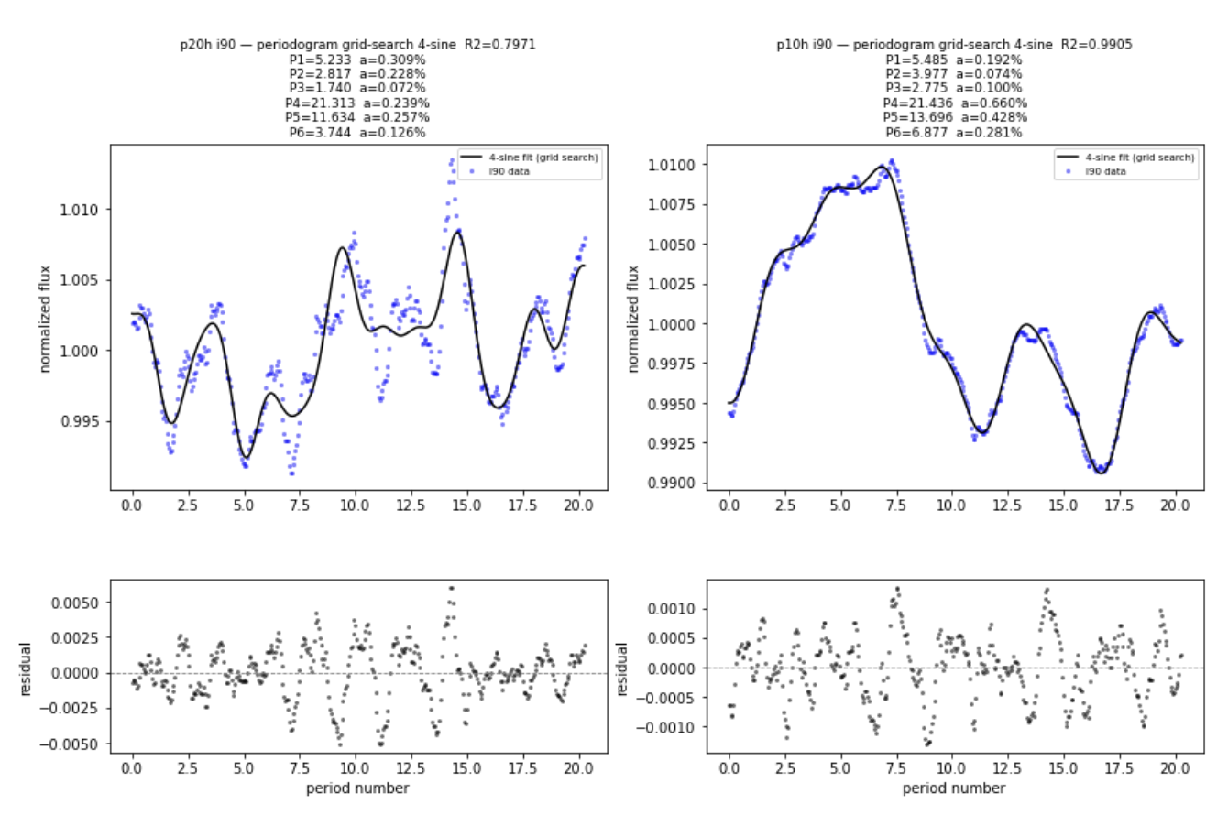
Long-timescale variability behaviors?

Slide 5
Polar vortices module improvement: stochastic vortex birth & dissipation
The polar atmosphere contains the following vortex features
Circular-spot vortices with radii limited by |R_vor_upper| that persist over a range of lifetime timescales |Tlife| in units of rotation periods.
The vortices have randomly spawned vortex start points as polar coordinates (with a given |seed|).
During their lifetime, the vortex radii |R_vor| as a function of time fluctuate sinusoidally at period |P_vor_shrinkgrow| with amplitude |A_vor_shrinkgrow| and phase |phase_vor_shrinkgrow|.
At the start of their lifetime, vortices grow over a transition timescale |Ttrans| from nothing into their final size, then dissipate into nothing as well at the end of their lifetime.
Each vortex have a randomized brightness value assigned at their birth, |flux_vor|, remaining constant throughout lifetime.

Slide 6
Polar vortices module improvement: stochastic vortex birth & dissipation
Claude dynamic vortex model requirements
I would like you to write this code and create a visualization in HTML to envision a dynamic polar vortex model. If a quantity is in |verb|, it is an important customizable parameter that can be controlled. You don't have to start from scratch, and you could review the sphere_shader.html module below for reference and understanding; however, remember that I want to create a new module independent of it with very different features. This will be a complex task, so feel free to split it into phases and into modular parts. Before you start, review the requirement carefully and ask for clarification if needed.
* [Polar vortex framework requirement] Create a spherical projection of the polar atmosphere. The sphere is at brightness level 1, and all the same except for the north polar region that extends from 60deg-90deg (with 90deg being the north pole). This atmosphere rotate over rotation period P — as a unit.
* The polar atmosphere contains the following vortex features: circular-spot vortices with radii limited by |R_vor_upper| that persist over a range of lifetime timescales |Tlife| in units of rotation periods. The vortices have randomly spawned vortex start points as polar coordinates (with a given |seed|). During their lifetime, the vortex radii |R_vor| as a function of time fluctuate sinusoidally at period |P_vor_shrinkgrow| with amplitude |A_vor_shrinkgrow| and phase |phase_vor_shrinkgrow|. At the start of their lifetime, vortices grow over a transition timescale |Ttrans| from nothing into their final size, then dissipate into nothing as well at the end of their lifetime. Each vortex have a randomized brightness value assigned at their birth, |flux_vor|
* === Suggested ranges and values (range means it can be randomly chosen): angular vortex upper limits R_vor_upper=2-6 degrees; Tlife=10-40 rotation periods; Ttrans=3-5 rotation periods. P_vor_shrinkgrow=30-80% of Tlife, A_vor_shrinkgrow = 4%-15% of R_vor_upper, phase_vor_shrinkgrow randomized between [-pi, pi]. flux_vor=1.0-1.1.
* For each vortex, it slowly migrates in a circular orbit at a randomized period |P_Migrate| and orbital radii |R_Migrate|. The speed and orbital radii are randomized. All circular orbits has to be contained within the latitude circles of |Lat1|60.5 degrees and |Lat2| 89.5 degrees, and do not overlap one another - this includes the footprint of the circular vortices themselves, and the circular orbit. The vortices cannot be closer than |R_stayaway| of 3degs. Allow an on/off option for the phase |phase_vor_orbit| of the circular orbits to be the same, or all different (randomized) in phase angle of orbit.
* ==== Suggested ranges and values: R_migrate=1-4 R_vor_upper, use above Lat1, Lat2. P_migrate = 10-40% of Tlife.
* Vortex spawning and tracking work as follows: the start point and minimum number of vortices N is 6, with no more than 10 vortices in the atmosphere. The tracking of vortices is as follows: Spawn new vortices following the above requirements, such that the minimum and maximum number of vortices is satisfied. Follow these rules: 1) If a vortice bigger than R_vor 5 radians exist, new spawn vortices is capped at less than 5 deg. 2) Favor spawning locations that are the intersection of these longitudes and latitudes: Longitudes (0, 30, 60, 90, 120, 180, 210, 240, 270, 300, 330, 360), and Latitudes (65, 70, 75, 80, 85).
* [Visualization requirement]: The visualization contains three panels: A1, A2 (two columns on the same row), and B (second row), and a third rows of sliders, and a box for parameters.
* A1 contains an animated image of the atmosphere and polar region viewed pole-on by default, with a user-customizable inclination viewing angle |i| in the slide. Sparse and thin spherical grid (longitude and latidude line) is shown on the projected atmosphere. The extent of the polar region (or really the 60 degree latitude line) is shown.
* A2 contains an animated lightcurve plot with flux and time. The flux is normalized to 1, and is calculated by summing all the pixel values in the map together. The time plot is in unit of periods, and has a default range of 1-10 periods — both the flux and time range have a box of custom axis bounds.
* B contains an animated plot of the periodograms/power spectrum in x-axis of period units with default range of 1-20 periods. The periodgrams get more detailed the more the simulation runs on.
* Sliders option: inclination i, Nmin and Nmax, speed of simulation (from 0.1x periods to 5x periods). Suggest parameters that works well as sliders.
* Parameters box option: include all the above parameters, along with other parameters you identify/create during the implementation process that matters.
==================================================================
[CLARIFICATIONS & DECISIONS — added Oct 7, 2026 after review]
==================================================================
Interpretation notes
* "R_vor 5 radians" in spawn rule 1 is interpreted as 5 degrees (angular radius).
* The longitude list in spawn rule 2 omits 150; the full grid 0,30,...,330 (0 and 360 identical) is used.
* The sphere rotates as a rigid unit with period P (= 1 time unit); vortices are fixed in the co-rotating frame apart from their own migration.
Decision
1. Orbit sizes: R_migrate default range is reduced to 0.3-1.5 x R_vor_upper (original 1-4 cannot fit 6-10 non-overlapping orbits inside 60.5-89.5 deg). The range remains editable in the parameter box. Orbits (plus R_stayaway) must not overlap and must lie within Lat1-Lat2.
2. Light curve: sum of pixel values over the visible projected disk (the A1 image), normalized to 1 (mean-normalized). Includes foreshortening for inclination i; no limb darkening unless added as an optional toggle.
3. Periodogram (panel B): FFT of the accumulated, uniformly sampled light curve (zero-padded; resolution improves as the run lengthens). X-axis in period units, default range 1-20 periods.
4. Technology: single self-contained HTML file, CPU Canvas 2D for the map (exact pixel sums) + Plotly for light curve and periodogram.

