Slide 1
PICASO / ATM. MODELING INDEP STUDY
Using fsed-range to simulate amplitude modulation
Multi fsed clouds in the same column to simulate phase differences/phase shifts
Status of spatial model
Fuda Nguyen PTYS 900 w/ Dr. Marley & Dr. Miles, 12/2025

Slide 2
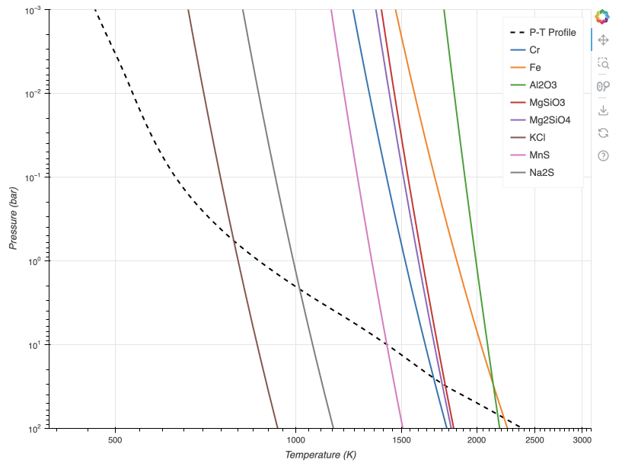
Using fsed-range to simulate amplitude modulation
Use simple cloud setup: Fe, MgSiO3, Na2S
Temp:
1200K, 950K log(g): 4, 3.5

Slide 3
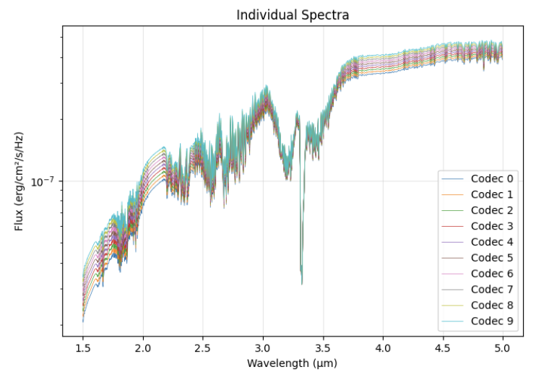
Fsed = 1.0-1.18

Slide 4
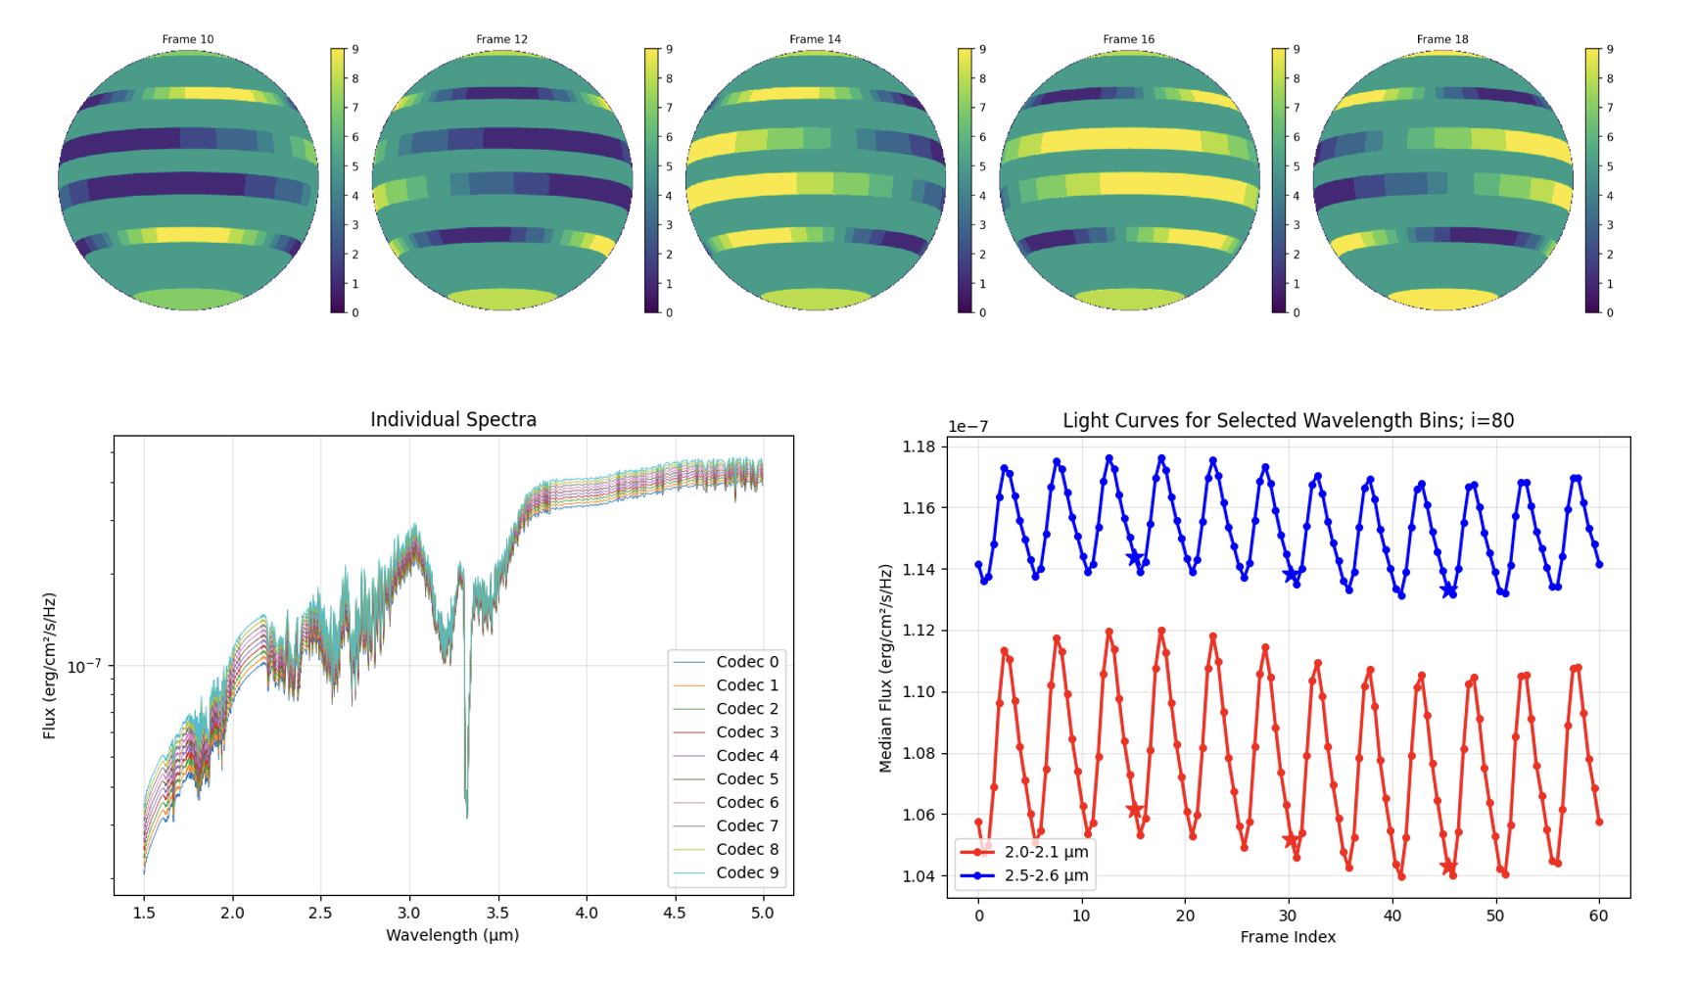
1200K

Slide 5
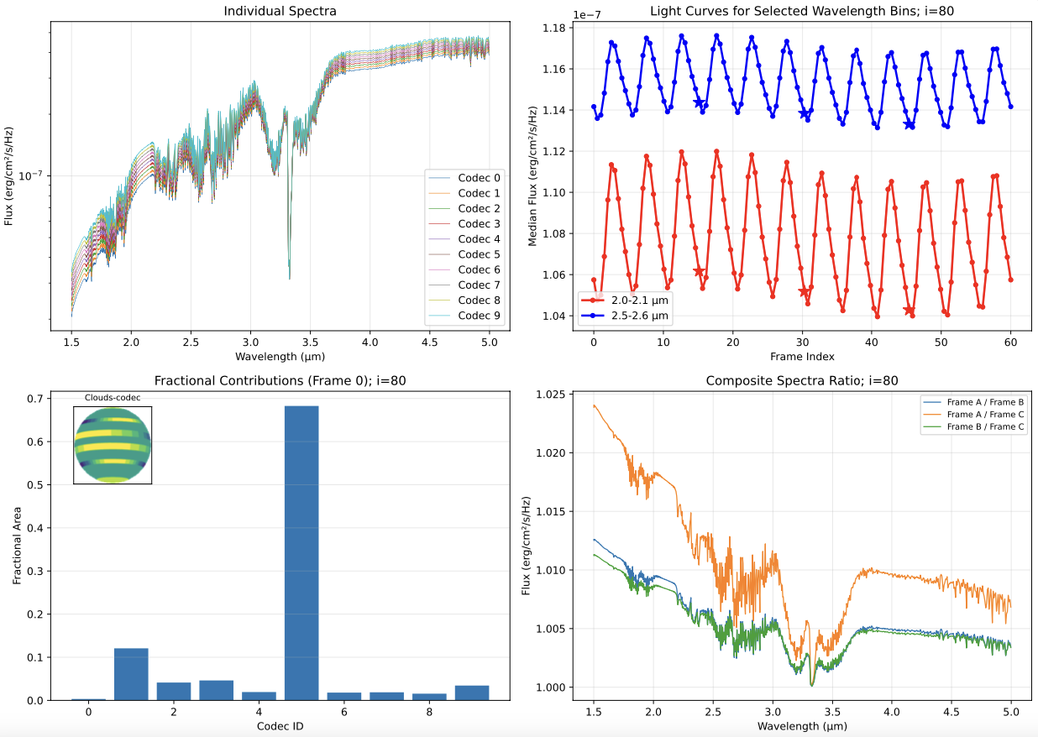
1200K

Slide 6
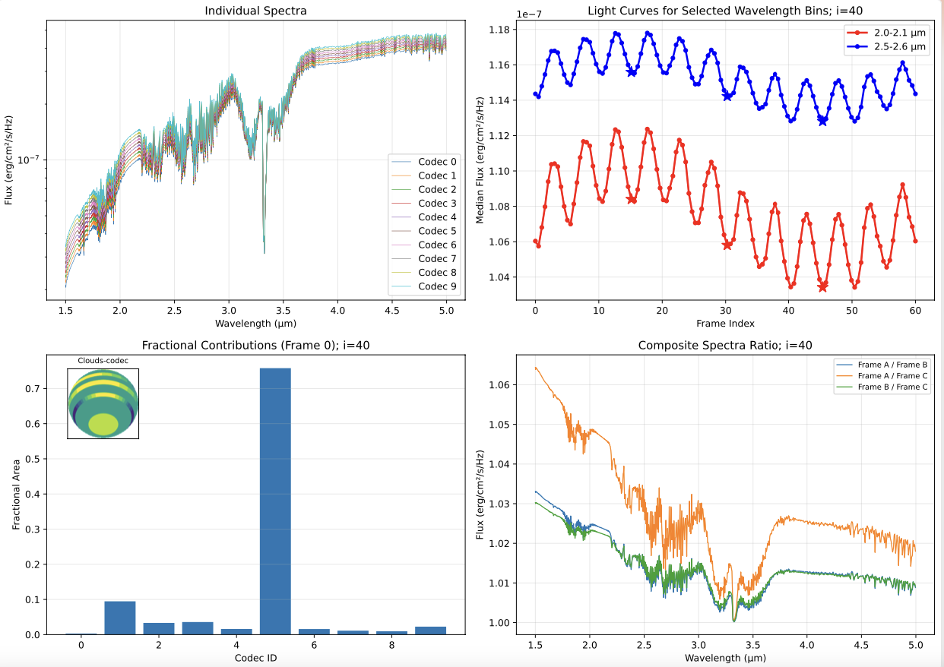
1200K

Slide 7
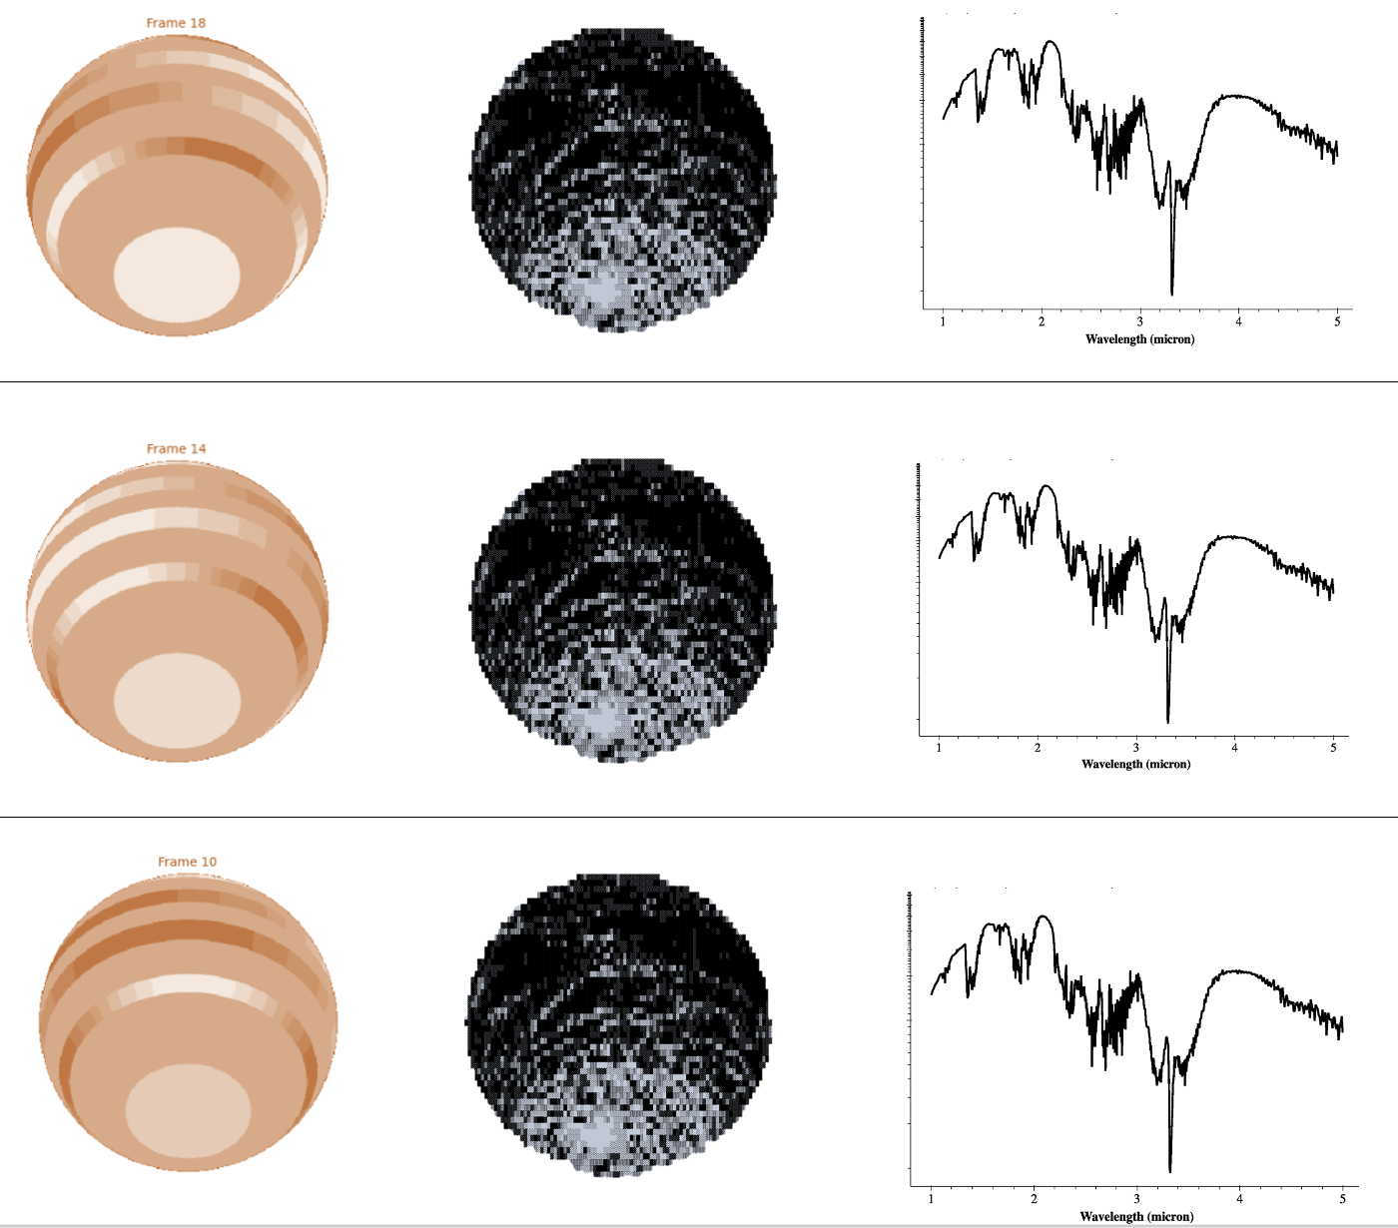
Clouds
kzz

Slide 8
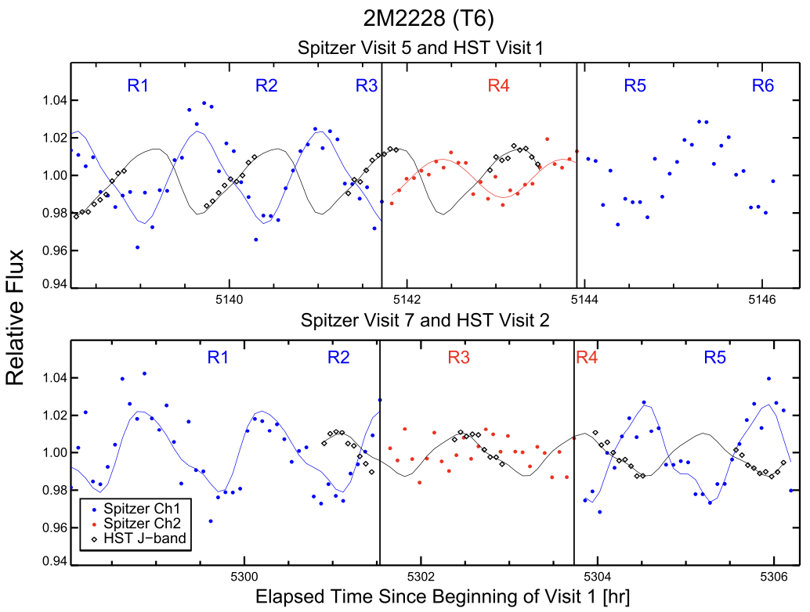
Multi fsed clouds in the same column to simulate phase differences/phase shifts
Yang+2016

Slide 9
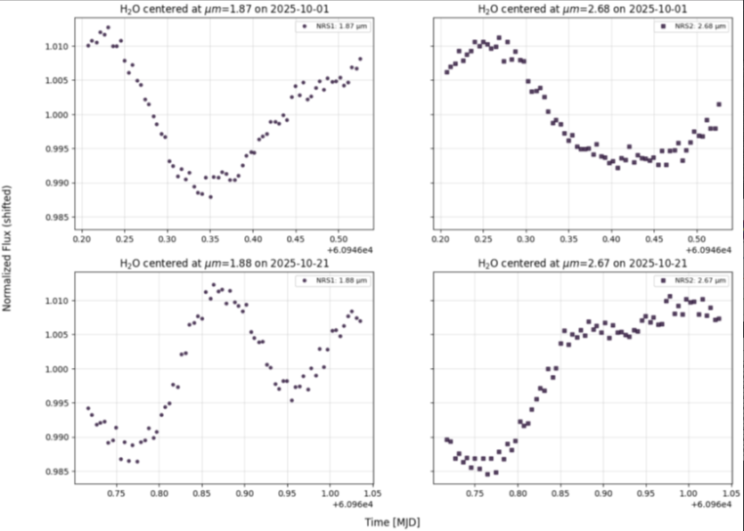
PSO-318 (unpublished JWST 8846)

Slide 10
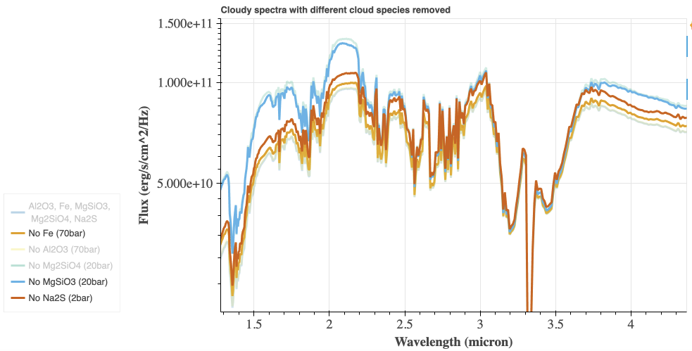
1200K

Slide 11
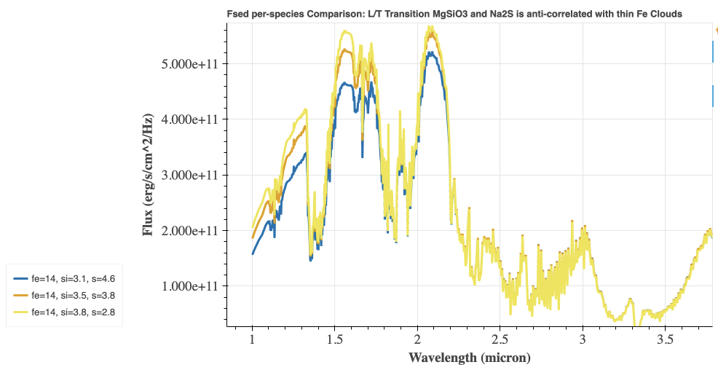
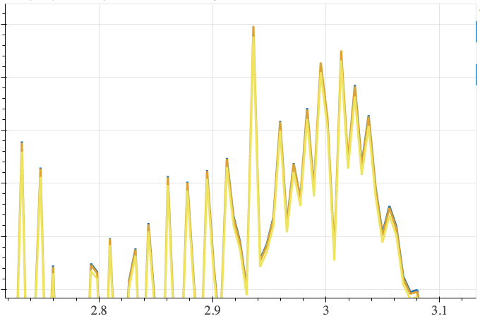
1200K
Per-species fsed
MgSiO3 and Na2S: Anti-correlated fsed
(when lower deck has thin cloud, upper deck has thick clouds)
(Small) Opposite trends?

Slide 12
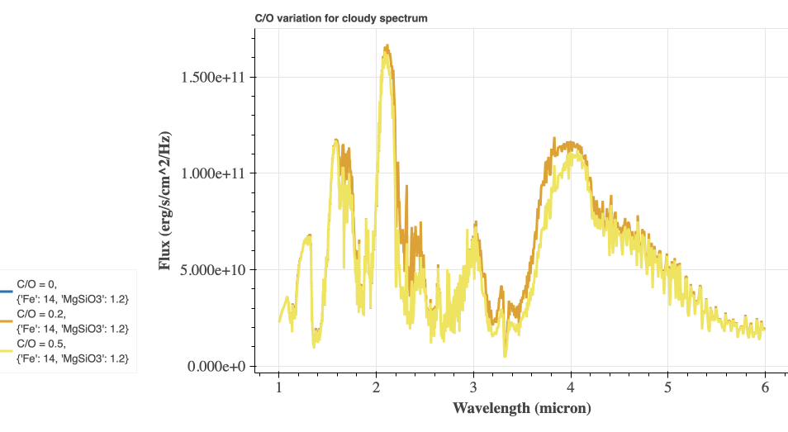
Changing C/O
1200K
Unrealistic because same latitudinal bands?

Slide 13
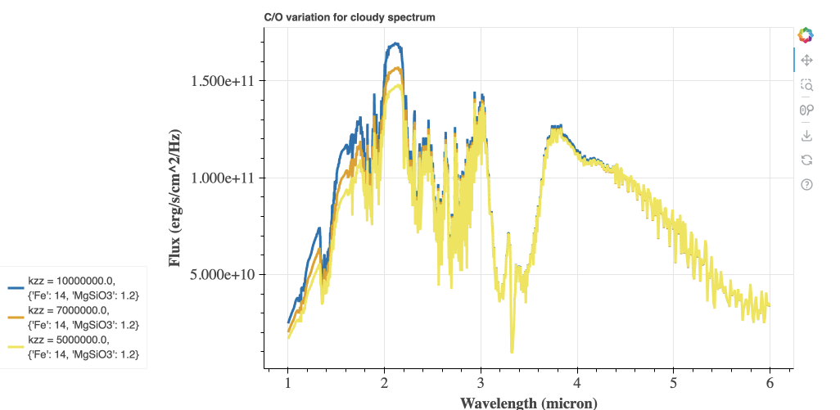
Changing Kzz
1200K
Unrealistic because same latitudinal bands?

Slide 14
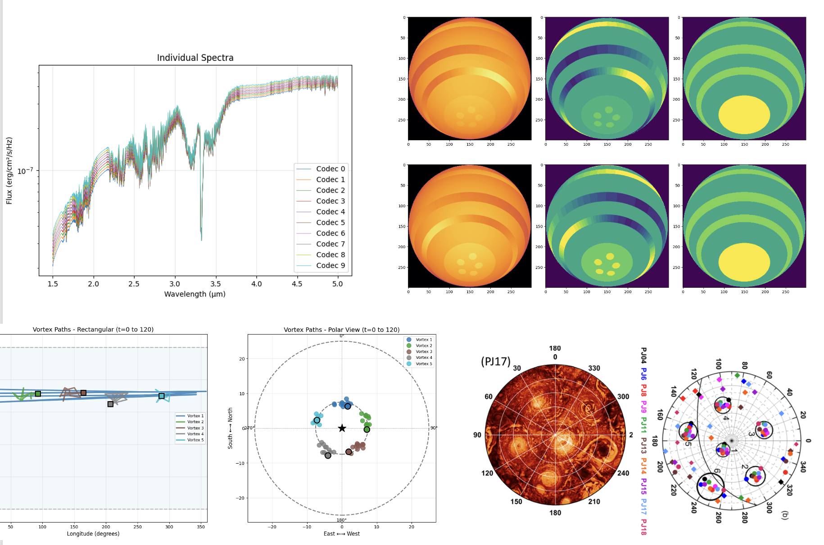
Status of spatial model

Slide 15
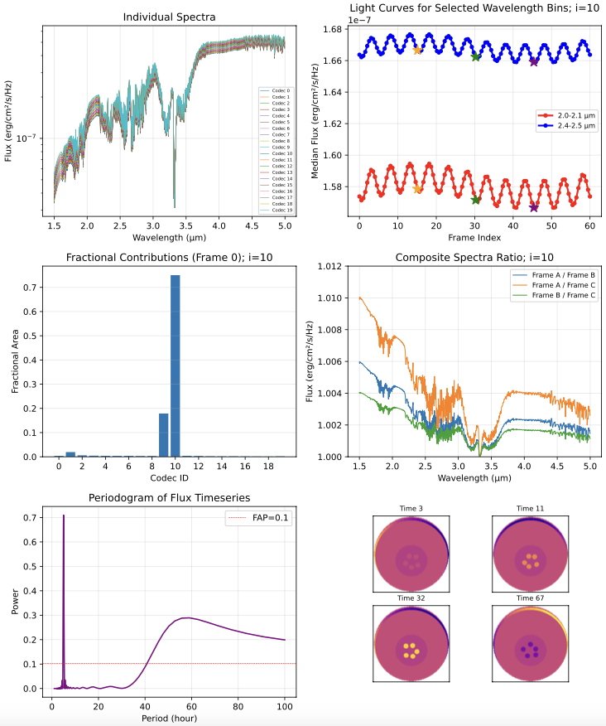
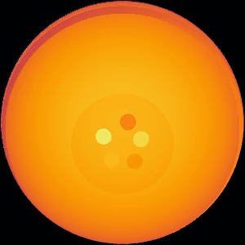

Slide 16
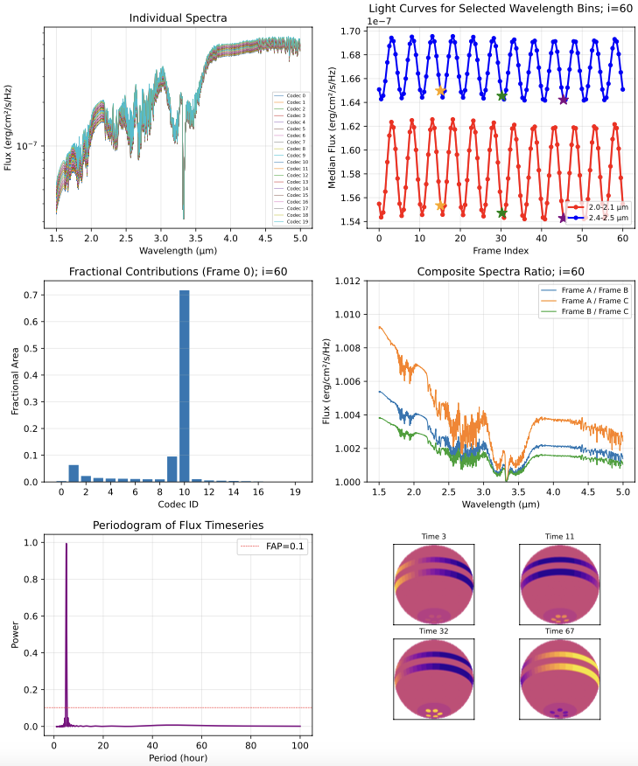
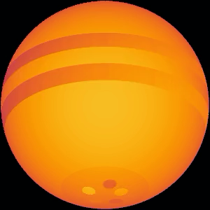

Slide 17
In report
Description of PICASO, model building, recreation on rotational modulation amplitude with cloud thickness difference
Experiment on multifsed clouds
Spatial model integration
Upcoming steps
More accurate Diamondback model profile
Test with lower Teff
Integrate pole-to-equator kzz difference.

Slide 18
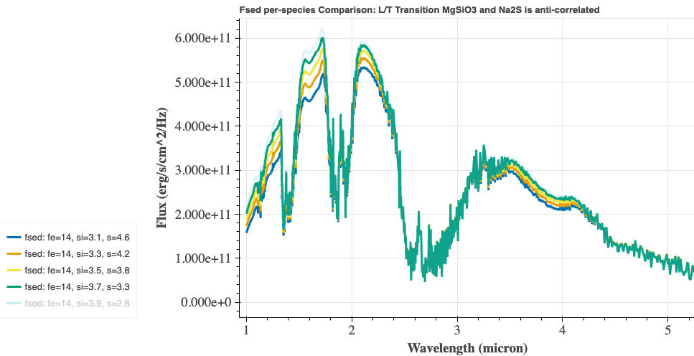
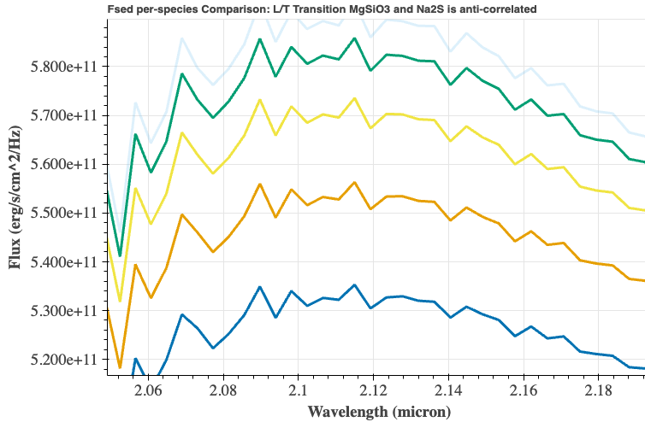
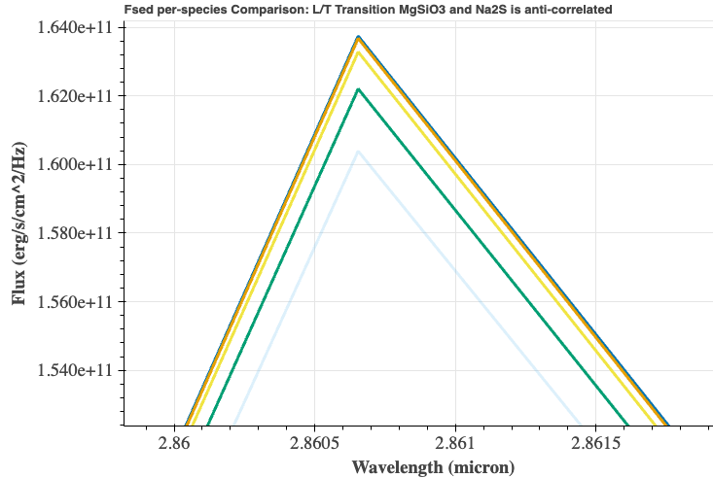
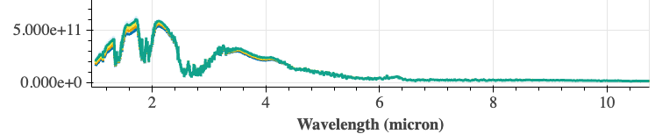
A
A
B
B
Full 1-10 micron spectra

Slide 19
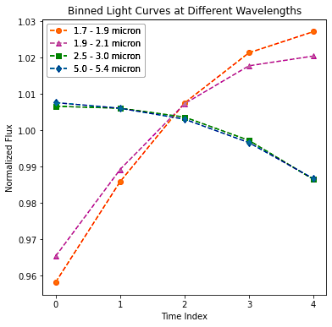
PICASO-simulated anti-correlation of Na2S and MgSiO3 clouds resulted in anti-correlation between short- and long-wavelength light curves similar to observation.
Picaso-simulated Light Curves
Spitzer & HST Light Curve of 2M2228 (Yang et al. 2016)

