Slide 1
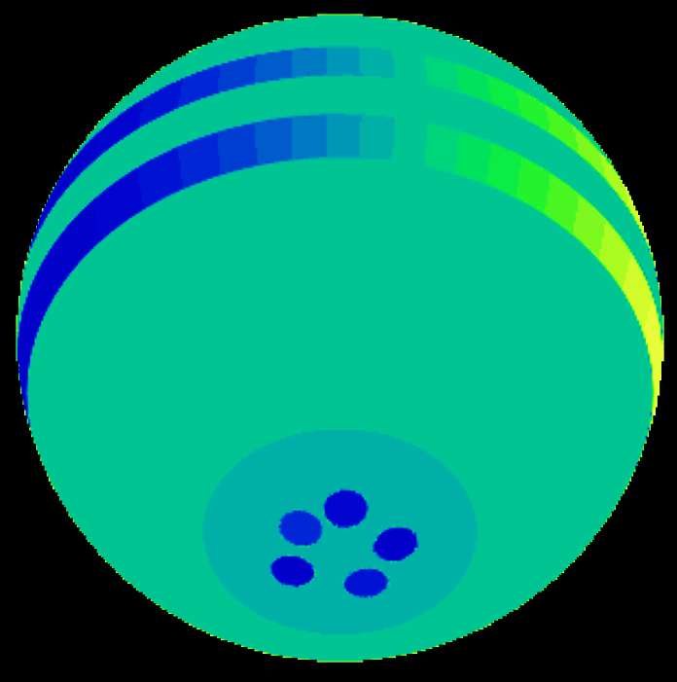
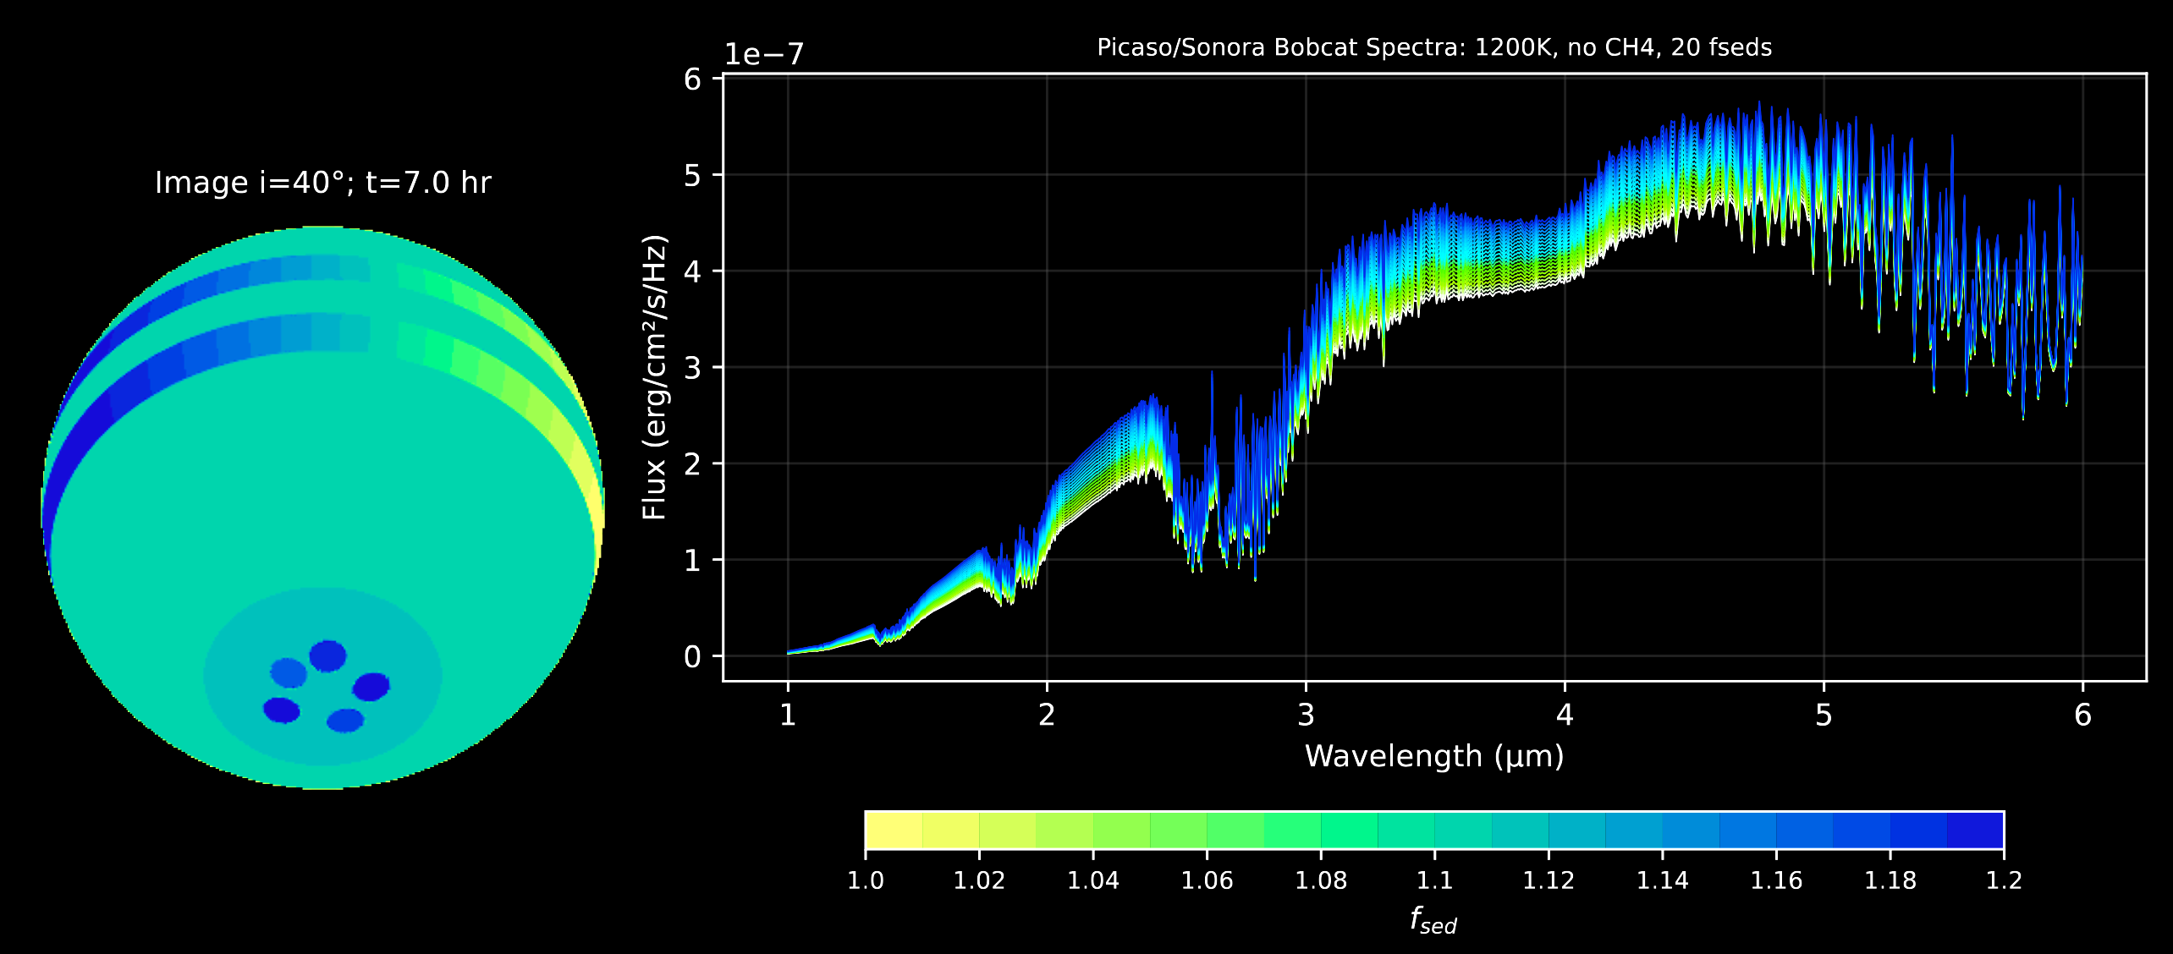
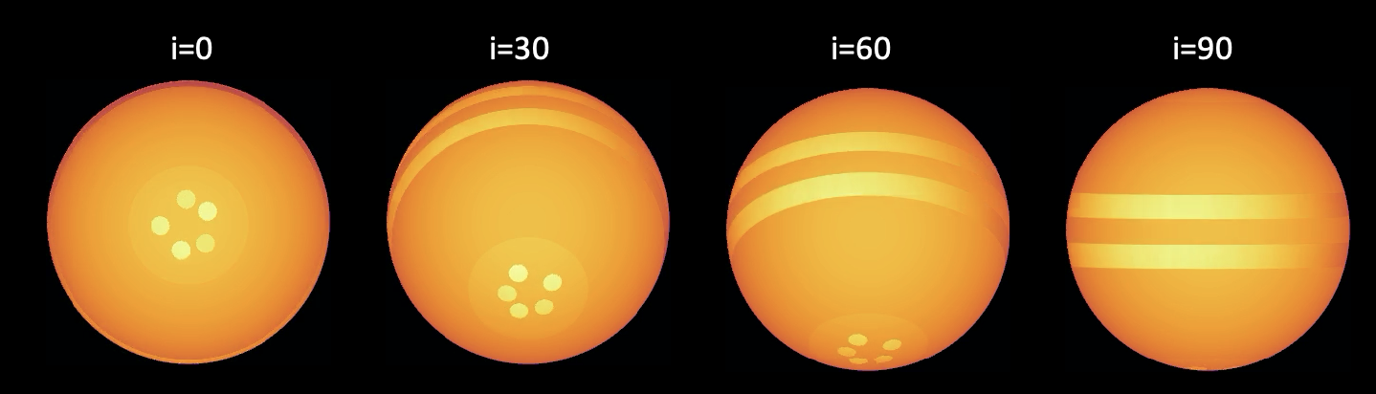
A Polar Vortex Forward-Modelling Framework: MAYMO 2D + 1D
Combining state-of-the-art models into a simpler multi-component framework
(Fuda in prep. 2026)
Each of these is a spectra!
Short-period Bands (planetary-scale waves)
f_{sed} = 1.0 – 1.2
2D Motivated Circulation
Long-Period Polar Vortices
20 Cloud spectra from PICASO/VIRGA
Notes:
1. spatial circulation framework based on earlier hypothesis: bands + vortex.

Slide 2
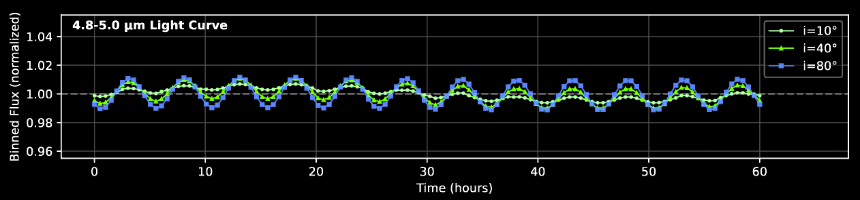
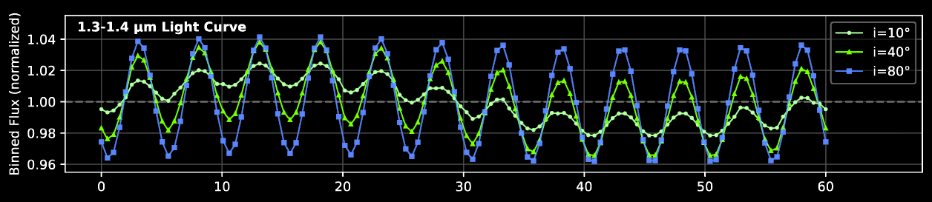

Slide 3
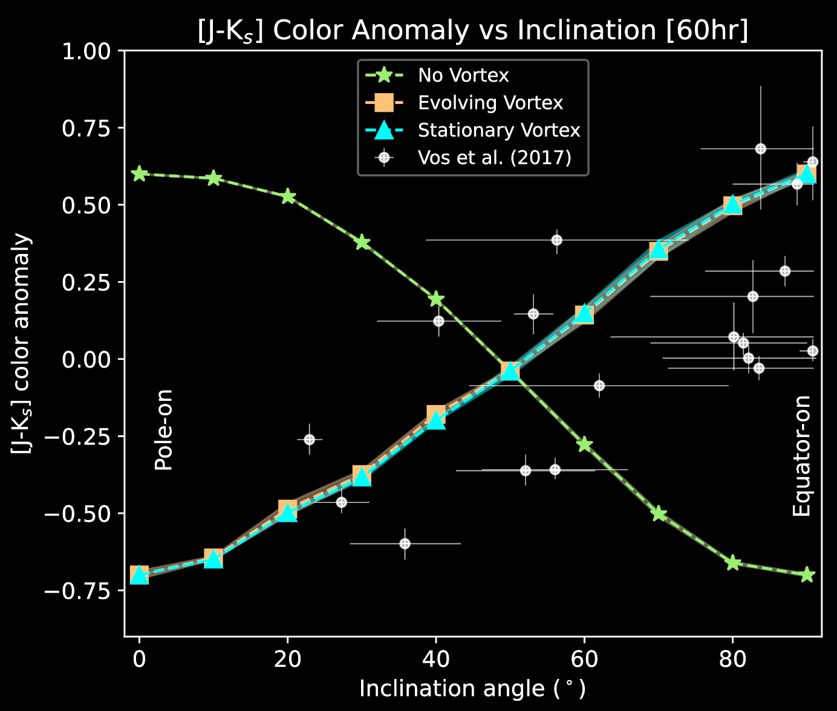
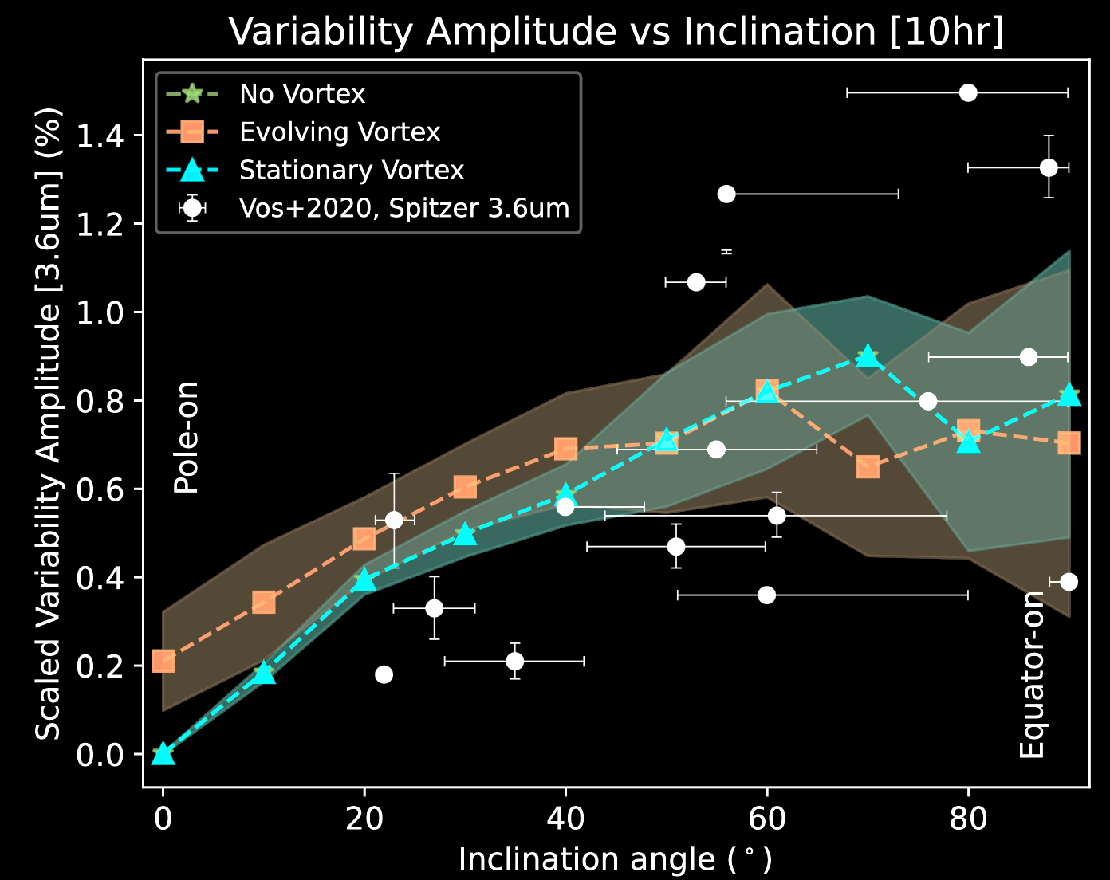
Simulated spectral timeseries consistent with observations
Variability & colors vs inclination trends: consistent with field BDs (Vos et al. 2020)
(Will have updated version in Fuda et al. 2026 in prep)
Variability v. inclination points to higher amplitude from the equatorial atmosphere
Color v. inclination can be explained with pole-to-equator cloud difference
(Fuda & Apai 2024)

Slide 4
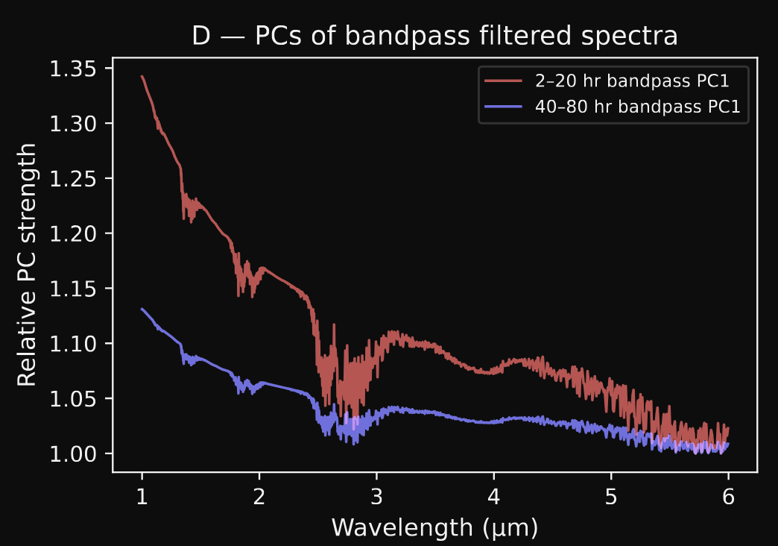
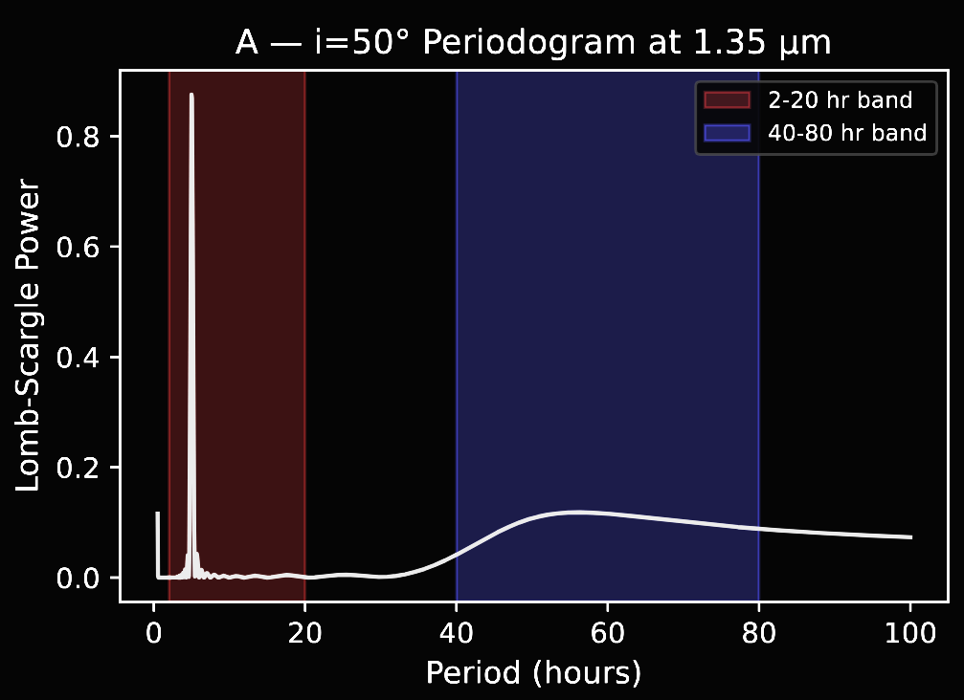
Simulated spectral timeseries w/ Maymo
(Fuda in prep. 2026)
at i=50
Band spectral ratio
Polar spectral ratio
Spectral ratio = spectra at max / min flux
Polar ratio less than bands because less of it is visible at i=50.
Simple methods (eg. PCA with a bandpass filter separating short vs long-period variation) can distinguish a long-period polar spectra vs. short-period band spectra in one BD.

Slide 5
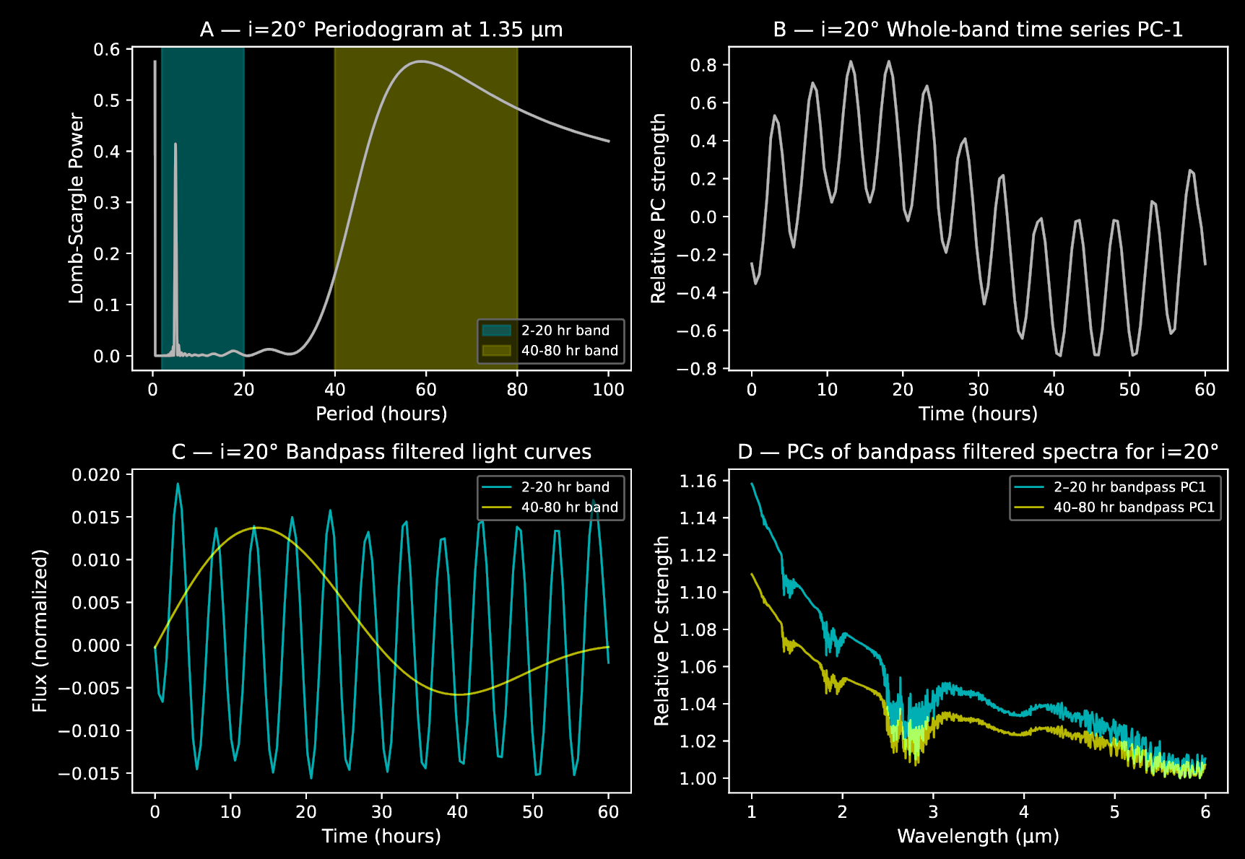
Simulated spectral timeseries w/ Maymo
(Fuda in prep. 2026)
Band spectral ratio
Polar spectral ratio
Spectral ratio = spectra at max / min flux
Polar ratio gets higher because more of it is visible compared to i=50.
Simple methods (eg. PCA with a bandpass filter separating short vs long-period variation) can distinguish a long-period polar spectra vs. short-period band spectra in one BD.

Slide 6
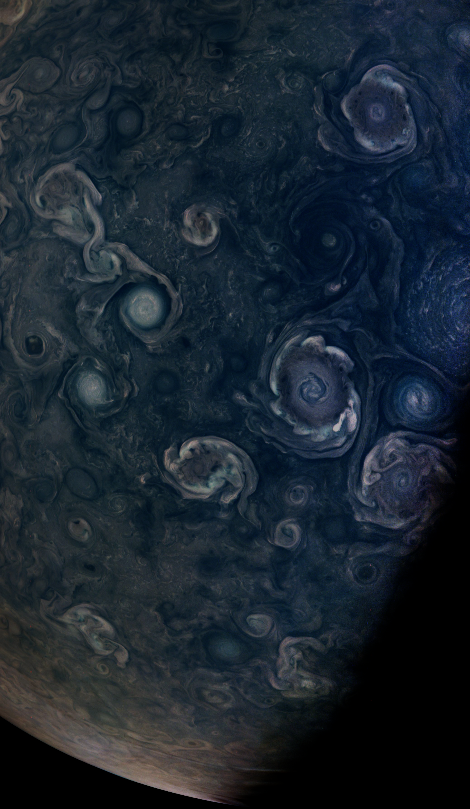

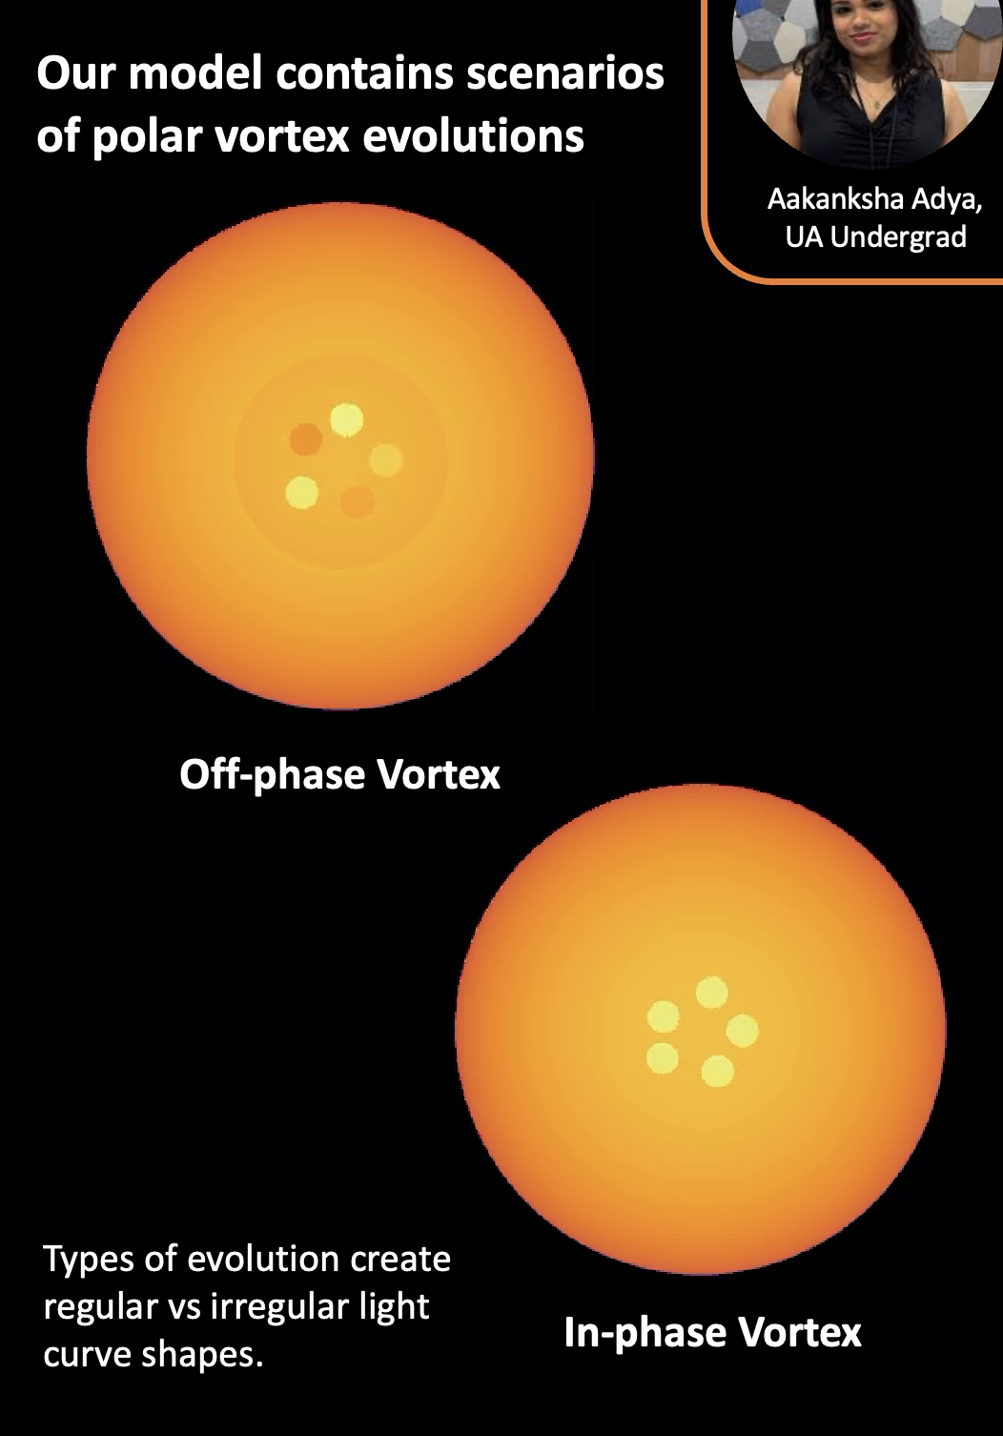
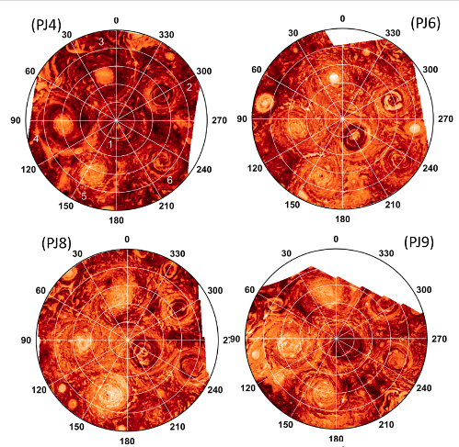
Simulating Polar Dynamics: Inspiration from Juno/Jupiter
Jupiter’s poles undergoes complex + dynamic evolution in cloud coverages!
Aakanksha Adya,
UA Undergrad
Juno Jupiter South Pole, JIRAM 3-5um Adriani et al. 2020

Slide 7
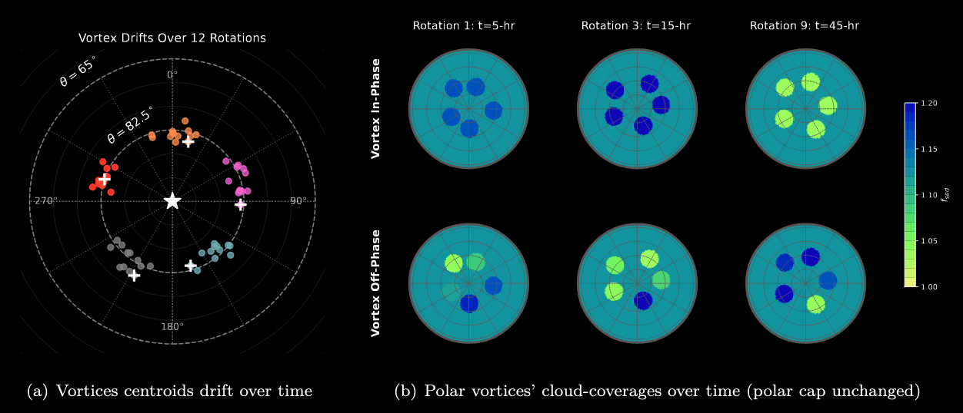
Simulating Polar Dynamics: Inspiration from Juno/Jupiter

Slide 8
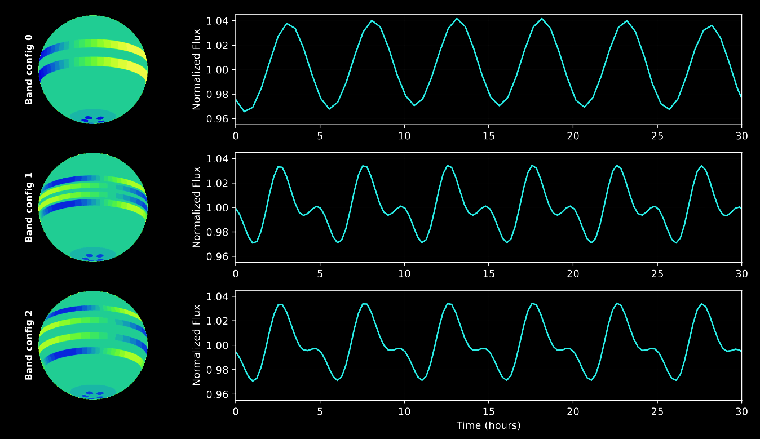

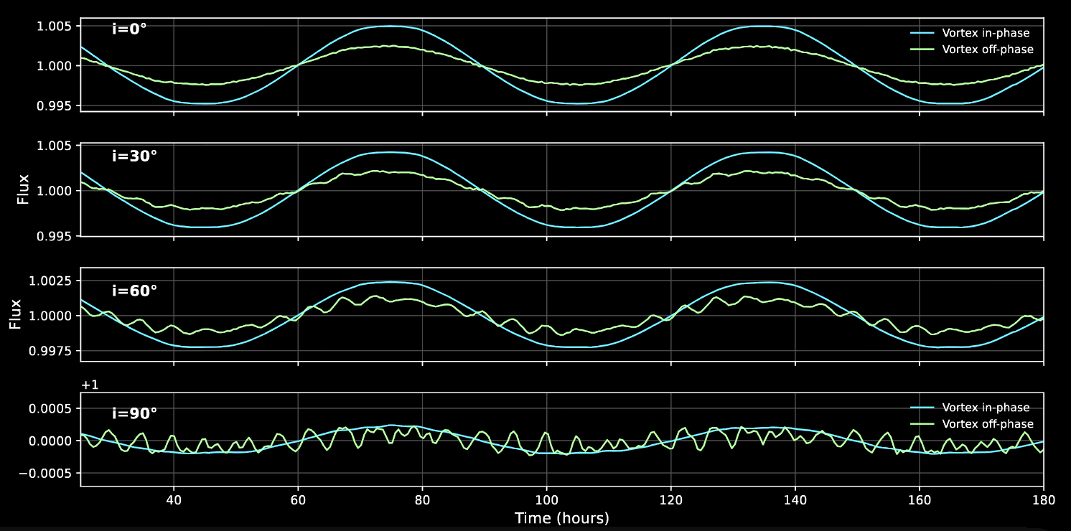

Lightcurve Galore!
(Fuda in prep. 2026)

