Slide 1
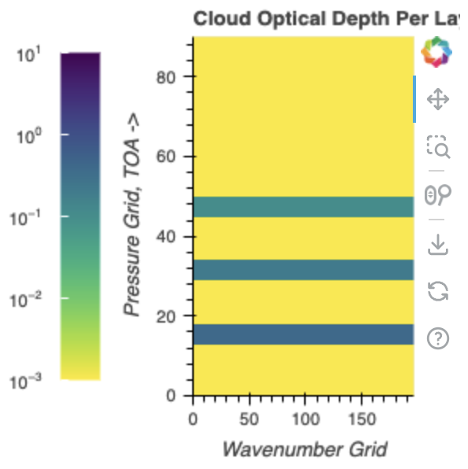
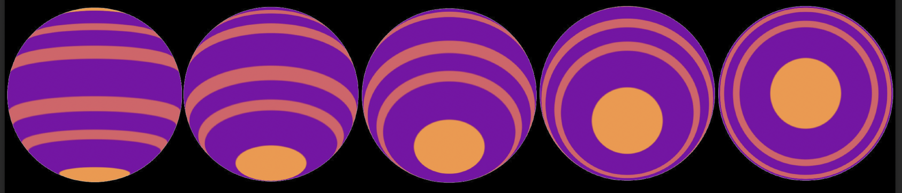

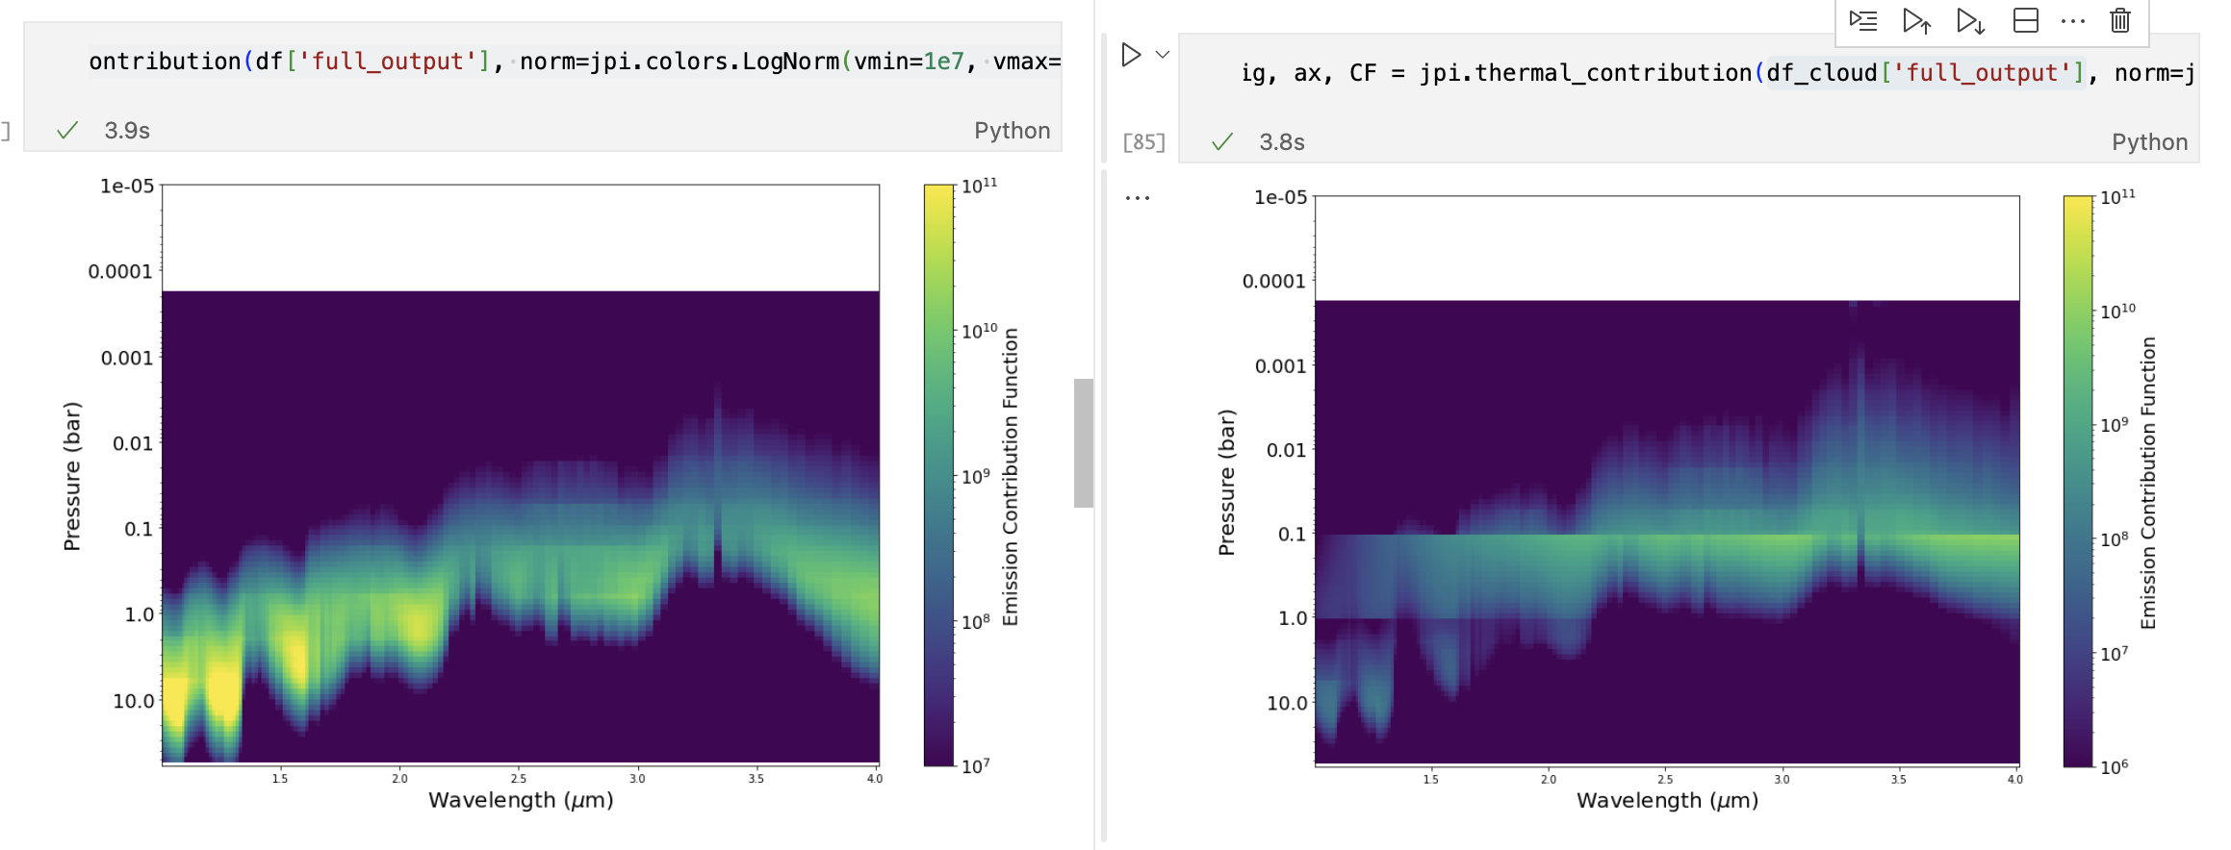
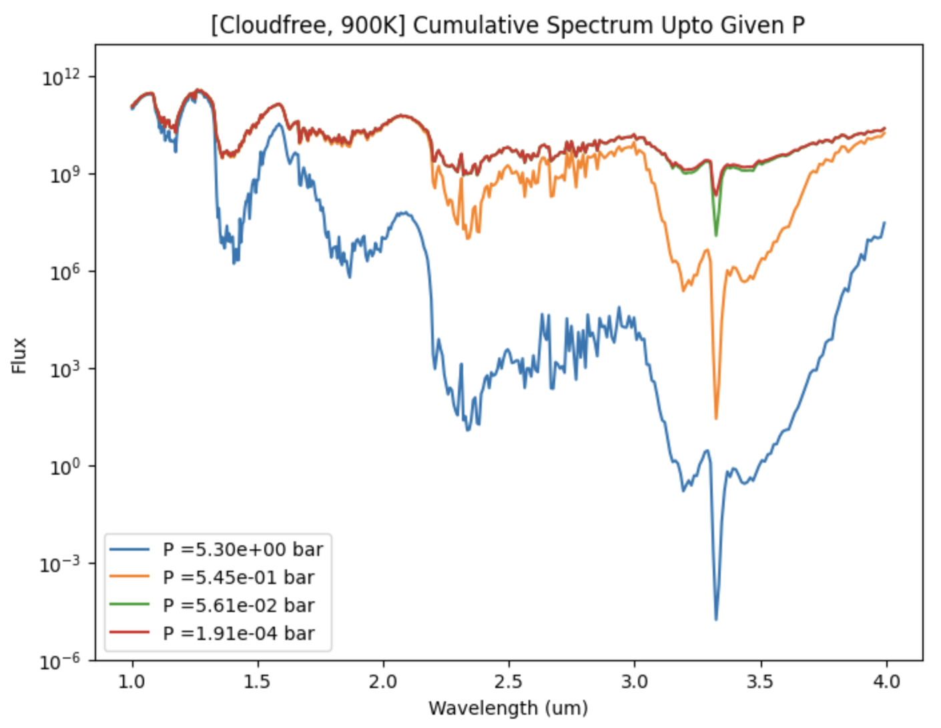
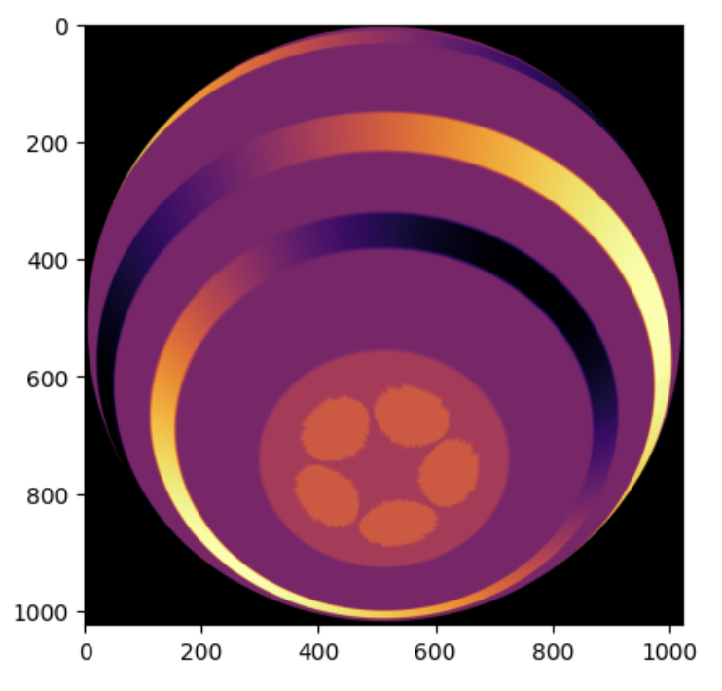
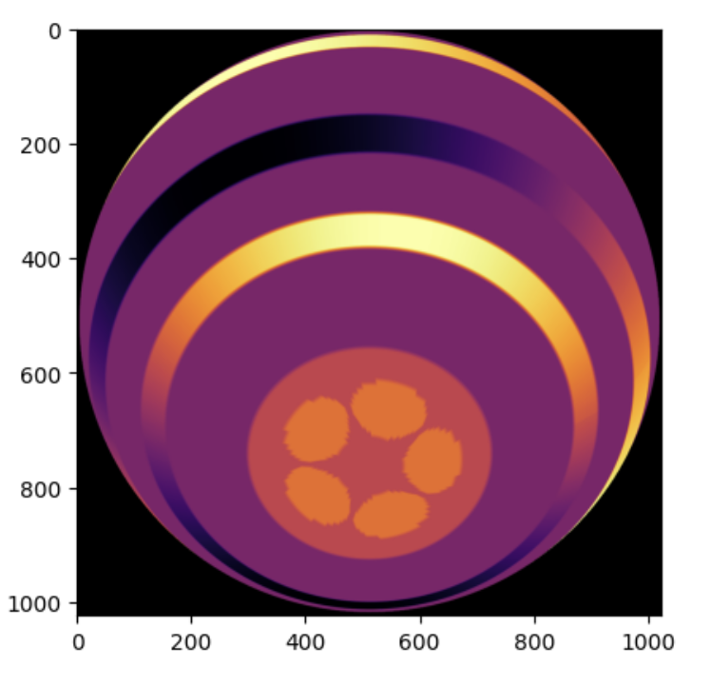
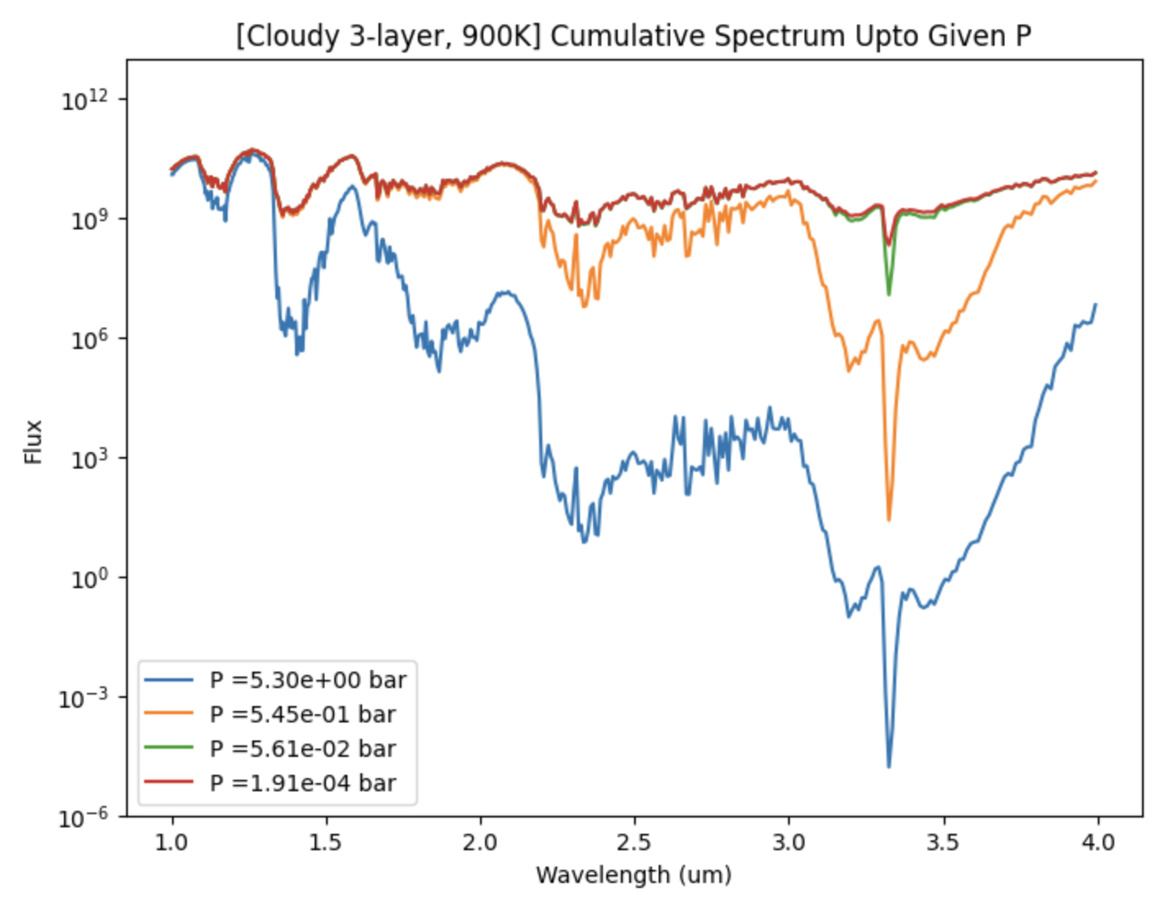
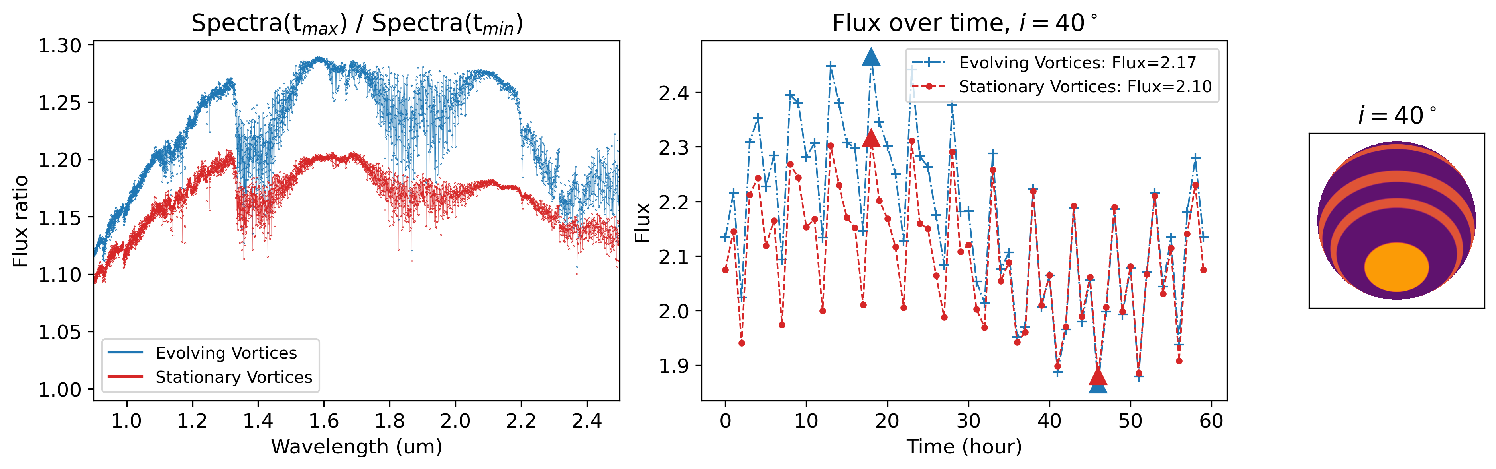
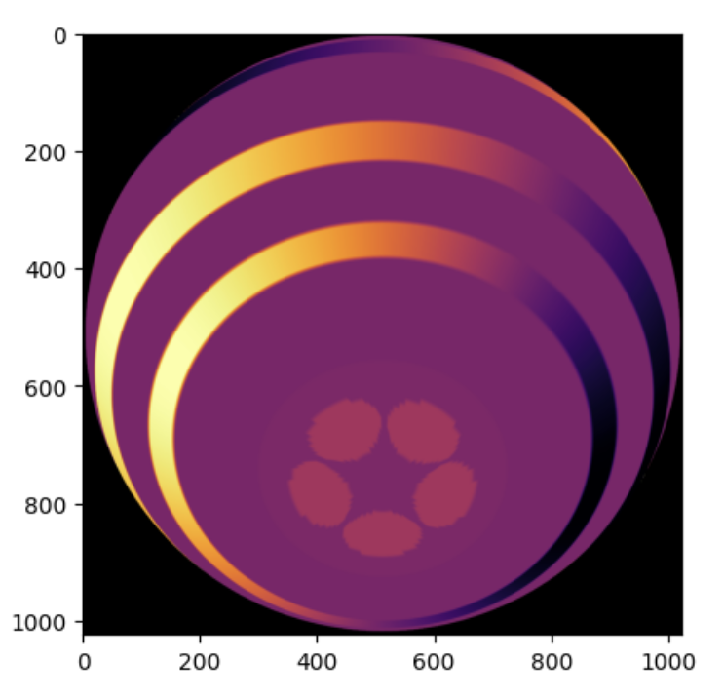
Spectral Input
Spatiotemporal Input
1D PT profile: Teff, log(g)
Spatial feature configs: latitudes, periods, modulation properties
Cloud config: {p_{i}, tau_{i}, s_{i}}_{Np}
for inclination i
Inclinations {i}
for layer Np
for time t
Varies the inclination and create simulated JWST spectral time series…
Cloud config
PICASO
CF-{type} at Np:
Contrast determination
Slant calculation at inclination
Cloudfree contribution function
Thermal contribution function: CF-{type}:
CF-P: less cloudy
CF-B: more cloudy
CF-A: ambient atmosphere
Latitudinal encodings
Spatio-latitudinal features
GCM parameterization
Spatiotemporal module
Spectral module
Time evolution
Short-period: bands
Long-period: poles
Multipressure spectra:
spectra(Np, type)
3 cloudiness degree → 3 spectral encoding (could be generalized to more)
Photometric time cube: data(i,Np,t)
Spectral lookup map:
specmap(i,Np,t)
Time-evolving photometry
Spatio-spectral module:
Matcher function;
Hemispherical integration;
Lightcurve creation
Timeseries, Multipressure, Inclination-dep. Spectra
{i,Np,t} {\lambda}
Cloudy contribution function
Time-dependent, pressure-dependent, inclination dependent spectra

