Slide 1
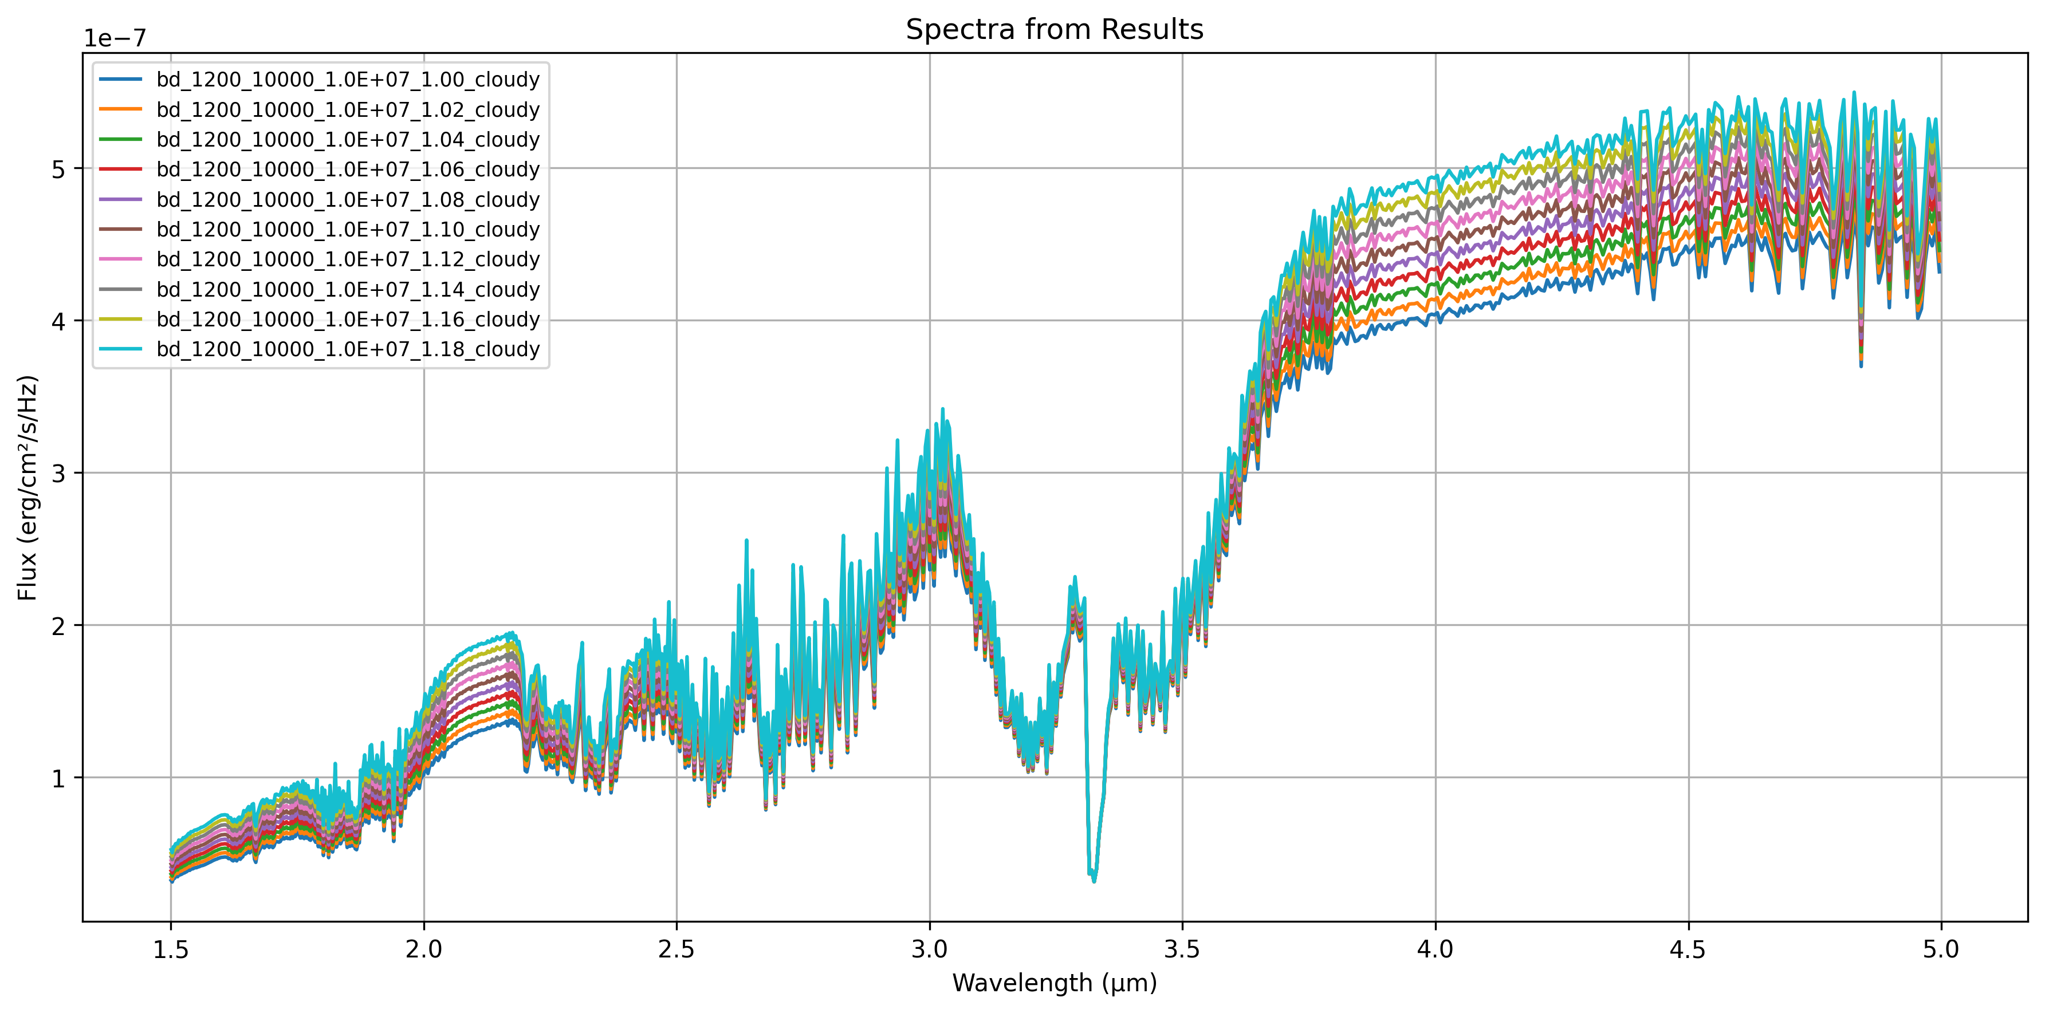
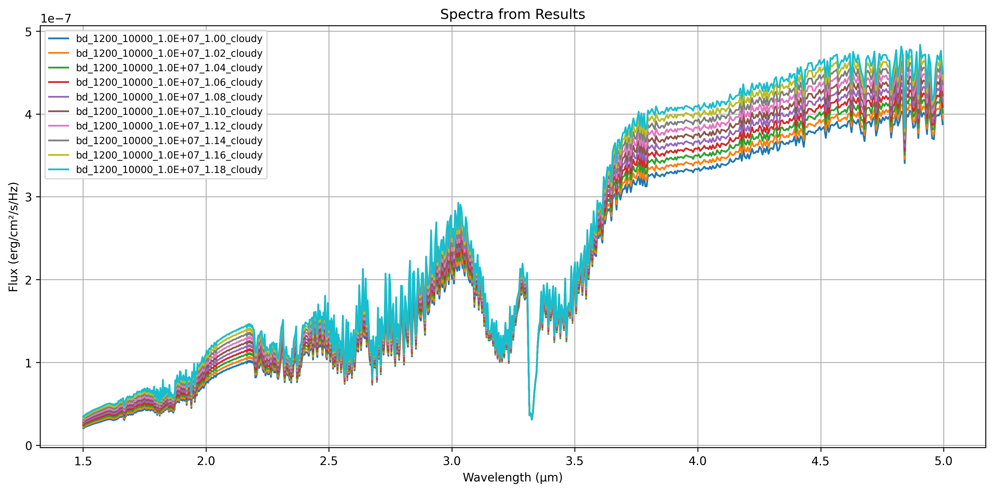
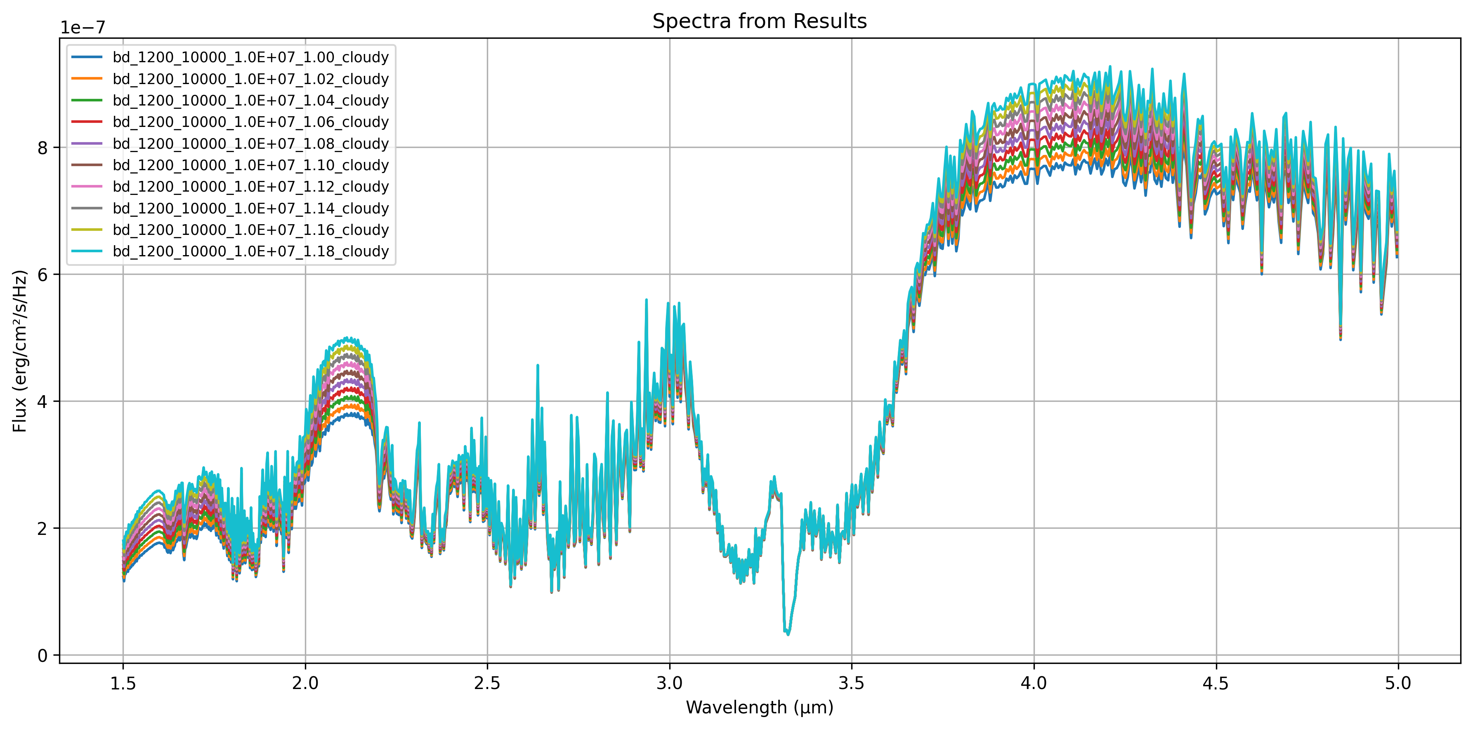
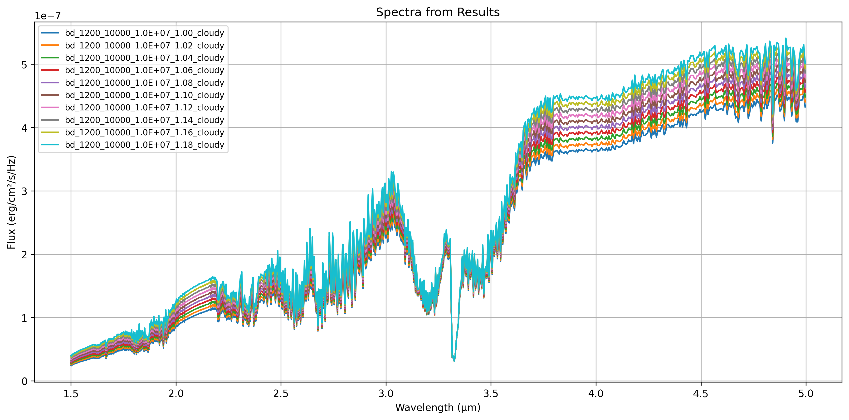
Fe, Al2O3, Mg2SiO4, MgSiO3, Na2S
No MgSiO3
(y-axis to-scale between panels)
No Na2S
Only Fe, Al2O3

Slide 2
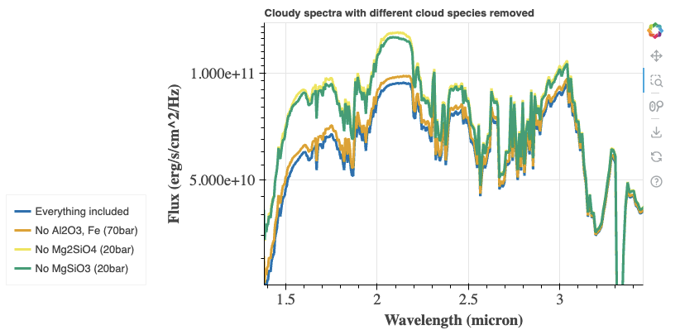

Slide 3
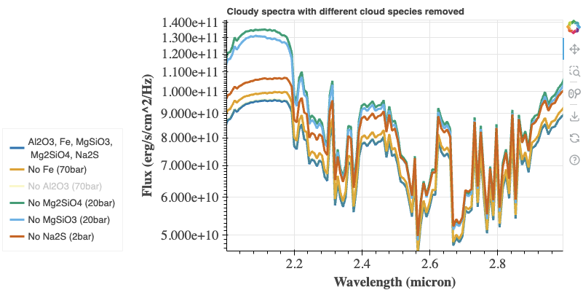

Slide 4
