Slide 1

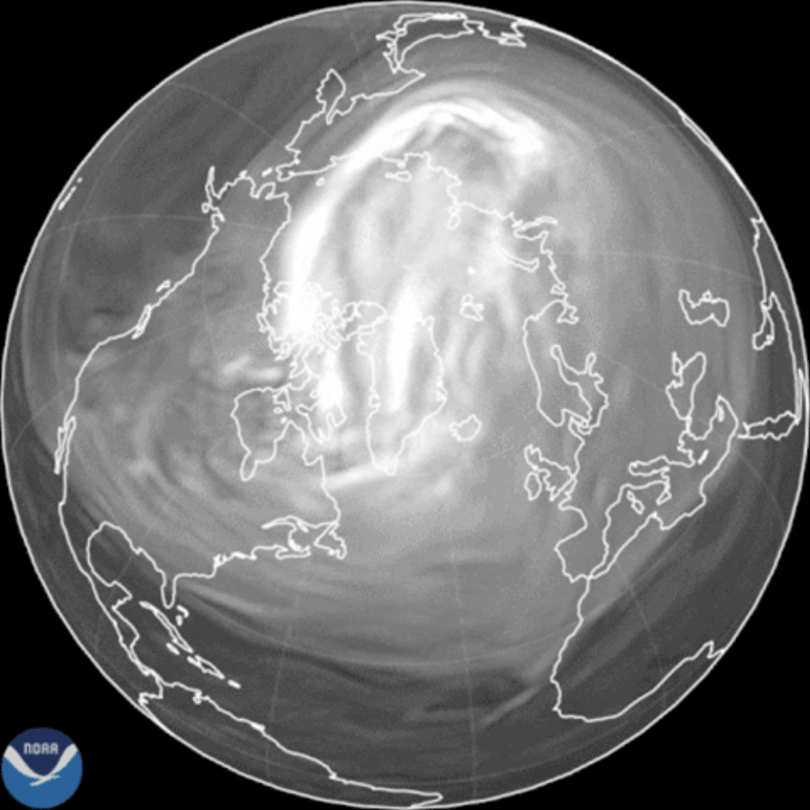
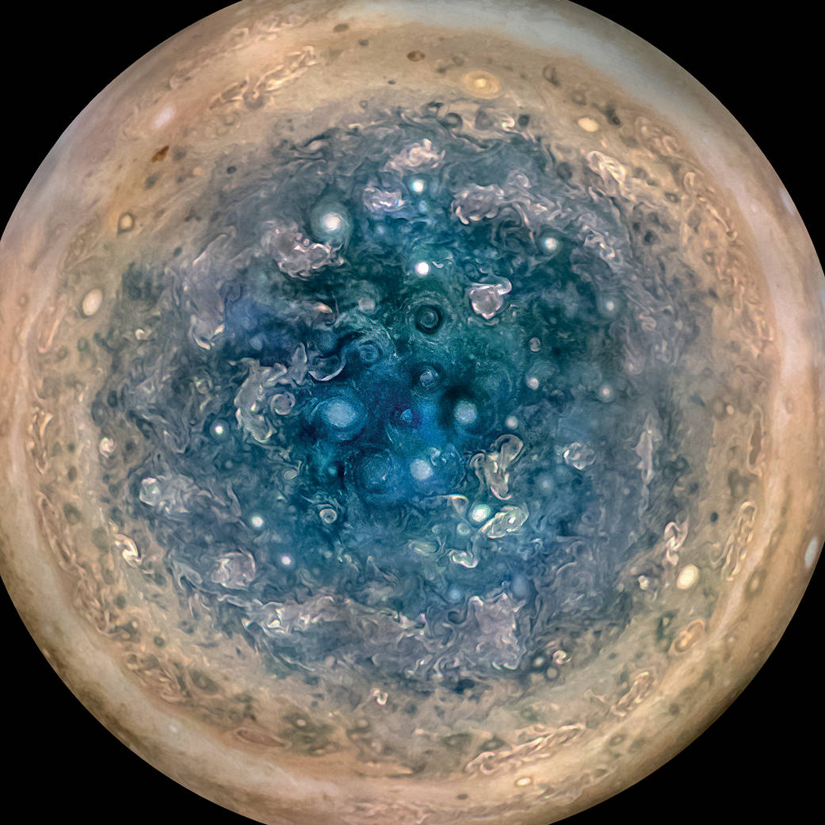
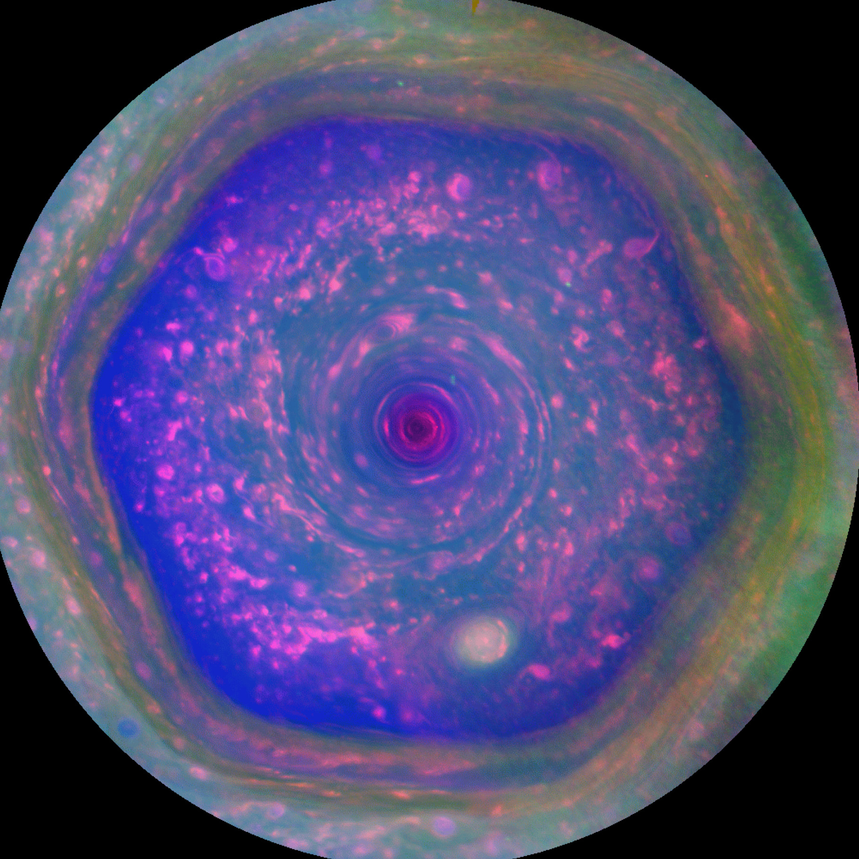
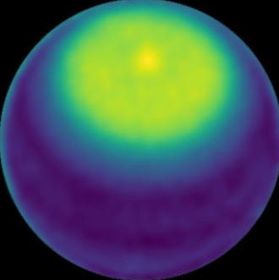
a) Our model
b) Earth
c) Jupiter
e) Saturn
d) Uranus
Notes:
https://www.nasa.gov/image-article/jupiters-south-pole/
https://www.nasa.gov/solar-system/planets/uranus/nasa-scientists-make-first-observation-of-a-polar-cyclone-on-uranus-2/
https://www.alamy.com/stock-photo-saturns-north-pole-135016257.html
https://www.nesdis.noaa.gov/news/satellites-help-visualize-the-polar-vortex

