Slide 1
Simple Store
Cs493
Capstone Product Presentation
Patrick Brossard

Slide 2
Introduction
What is SimpleStore?
A very simple online retail presence for eBay sellers
Provides a non-eBay branded web property where more complete product listings, details, or store information can hosted
Integrates with eBay for easier product and listing management
Project Goals
Research and define a best-practices web architecture for sites of this scope
Provide a complete implementation plan for the development of SimpleStore
Implement certain key components of the site as prototypes of the architecture
Notes:
Purpose of the Project

Slide 3
Design Guidelines
Constraints
Fluid requirements
Very small development team (1-3 persons)
Low budget
Goals
Best possible architecture for organized development
Reasonably low code complexity
Reasonable scalability, performance

Slide 4
Network Architecture
Network & Hosting Goals
Low level of hardware and network administration
Flexibility to run any software necessary
Low cost
Best possible performance and availability for the price point
Microsoft Azure
Platform-as-a-Service Model, major negative: lack of portability
Google App Engine
Platform-as-a-Service model, major negative: language selections undesirable
Amazon EC2
Infrastructure-as-a-Service model, major negative: more network administration necessary

Slide 5
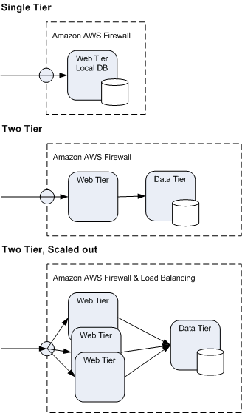
Final Network Architecture
Amazon EC2
Flexibility of running a “bare” server
Scaling up and out is simple
Low cost
No vendor lock-in in development
Other valuable offerings for future needs: monitoring, content delivery network, cloud-based RDBMS, etc.

Slide 6
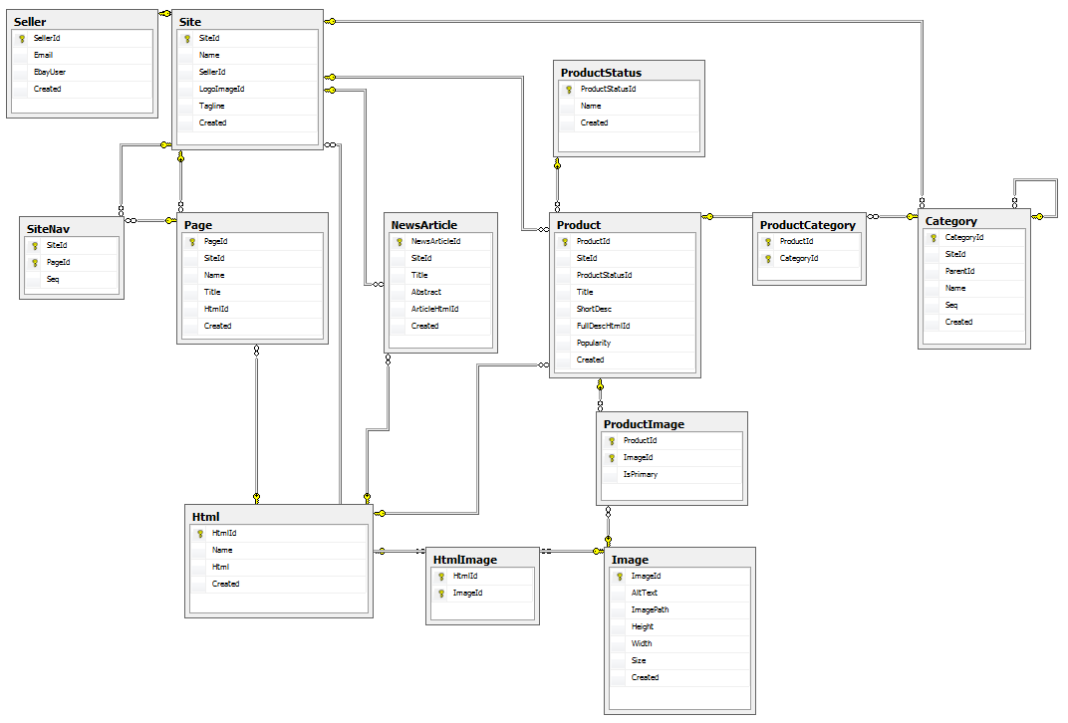
Database Design
Database Design Goals
Avoid platform-specific implementations
Normalize tables no less than third normal form

Slide 7
Architecture Goals
Single Responsibility Principle
Each component should have a single responsibility, and that responsibility should be entirely encapsulated
Separation of concerns increases cohesion, enables looser coupling
Complete Test Coverage
Unit tests should be run quickly and provide cover application scope
Techniques to allow this include:
Dependency Injection
Mocking
Convention over Configuration
Reduces plumbing code
More streamlined, intuitive coding
Fewer environment and deployment complications

Slide 8
Reference Architectures
Major Architectural Pattern: MVC
Selection of Microsoft web technologies and emphasis on Single Responsibility Principle nominates ASP.NET MVC.
Nerd Dinner
Simple MVC implementation, updated for ASP.NET MVC 2
Uses ORM, but simplistic data model, rudimentary mocking
MVC Music Store
Simple MVC implementation, more for educational purposes
Slightly more complicated data model, no testing at all
Sharp Architecture
Very complete, highly refined architecture
Extremely complicated, many third party dependencies

Slide 9
Final Architecture
Final Architecture: Stripped down “Sharp Architecture Lite”
Included:
Dependency Injection with Castle Windsor
Mocking with Rhino Mocks
NHibernate ORM
Discarded:
Multiple view engines
NUnit in favor of built-in Visual Studio test framework
Multiple NHibernate mapping strategies (only using Fluent mappings)
Huge multiple-project solution structure reduced to: Web, Core, Services, Data & Tests

Slide 10
Architecture goals Realized
Single Responsibility Principle
MVC provides good separation already
Sharp Architecture Lite further separates data access from core objects
Complete Test Coverage
Test-Driven Development tools in Sharp Architecture Lite
Castle Winsor dependency inversion allows MVC Controllers to be tested in isolation
Rhino Mocks allows tests to be abstracted from data sources
Convention over Configuration
MVC already based on strong conventions
NHibernate ORM primarily uses auto-mapped conventions from database

Slide 11
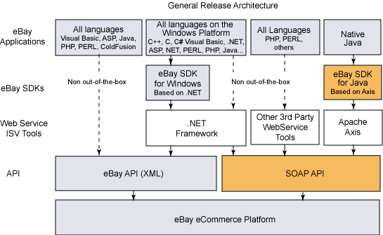
Application Services
eBay Integration
eBay provides a full API exposing virtually everything possible through the standard UI
A full eBay SDK for .NET exists to abstract development in common Windows metaphors

Slide 12
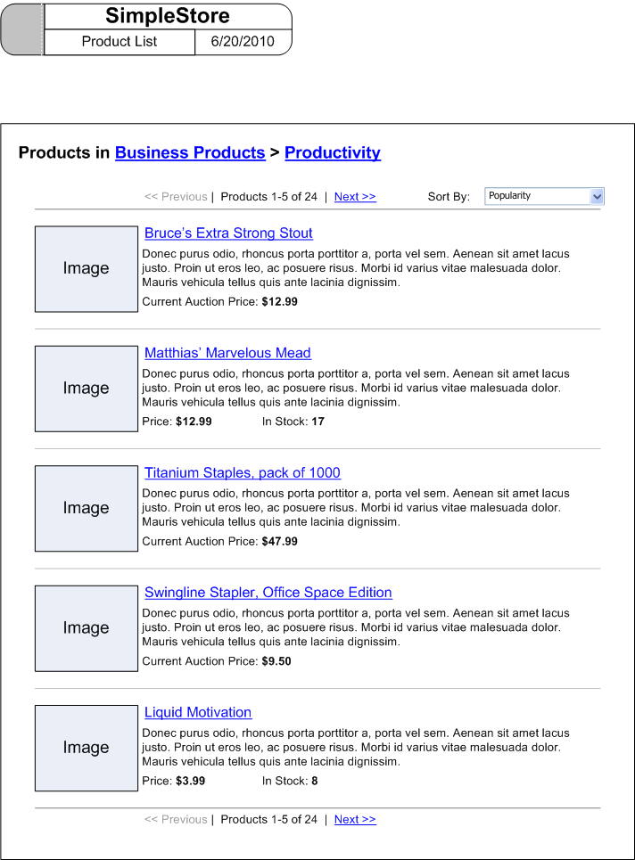
UI Design
UI Design Guidelines
Simple, clean interface initially, such as http://www.etsy.com
Eventually customizable through user-configurable settings and styles
Separate client UI and admin UI interfaces and wireframes
Wireframes to show desired page functionality

Slide 13
Conclusion & Next Steps
Conclusions
Research outcome: An ideal architecture for implementing a small website given our goals and constraints
Project outcome: A set of documents describing the implementation of the site
Next Steps
Check out the architecture in code through the prototypes
Check out the database schema
Check out the UI wireframes

