Slide 1
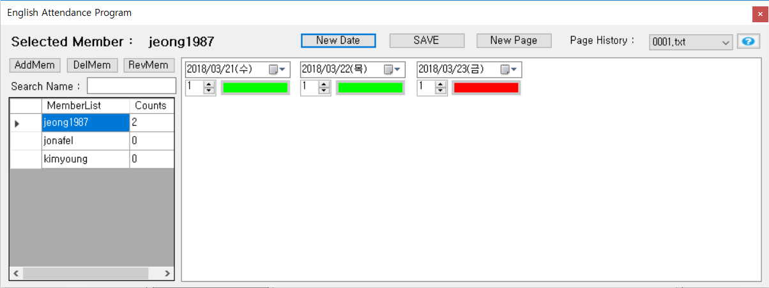


Attendance Book Help
If you select member in “A”, this label will be changed to the name which you choose
Attendance Count is limited to 25 per a page, so If this page is full, please click this button
You can choose previous attendance history if you want to know that
This Button is to show you this help.pptx
c
If you complete to select date and count, click this button, and then “c” is change to green color
Originally, this show you latest history file
If you want to get filtered list, input text and then “A” will be filtered.
If you click this button, it will add new date and numeric count to “B”
A
B
If you want to add new member to “A”, click this button.
If you want to delete and revise name, firstly select member in “A” and click this button

Slide 2
Attendance Book Help
Attention Please!
This Program should make the folder which path is “c:\SEIAttendanceBook” , if you delete this folder, you will lose the attendance history, don’t delete it
For the first time, when starting the program, It is ok to open smart screen, don’t be embarrassed.
Don’t hesitate to contact me if you have some questions.
My Email is “macrozm@naver.com”

