Slide 1
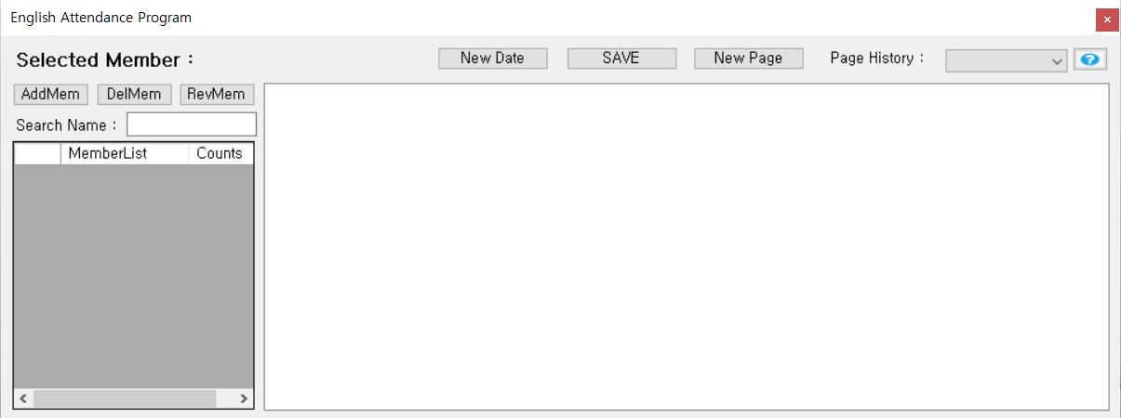
Attendance Book Help

