Slide 1
The history and principles of the IPA
Michael Ashby

Slide 2
The International Phonetic Alphabet
universal standard notation for phonetic representation
used in any context
developed by, and remains in the care of, the International Phonetic Association

Slide 3
The International Phonetic Alphabet
many earlier competing alphabets
only the IPA survived
incorporated in Unicode

Slide 4
Linguistic relevance
not every human vocal sound (no symbols for laughter, coughing etc)
a sound must be a phoneme in at least one language
does not cover disordered speech

Slide 5
Where the symbols come from
Basic Latin Alphabet [a] [b] [c] … [z]
Extended Latin Alphabet [æ] [ð]
notice square brackets [ ] for phonetic symbols

Slide 6
Where the symbols come from
new invented shapes such as [ɳ], [ɰ]

Slide 7
Where the symbols come from
Greek Alphabet [ɸ] [ɣ]
Small Latin capitals:
[r] and [ʀ] stand for different sounds
[n] and [ɴ]

Slide 8
no capital (upper-case) letters
no text effects such as bold and italic
superscripts such as [ʰ ʷ ⁿ] are allowed but only a small number are defined

Slide 9
Unicode
every phonetic symbol has an approved shape
every phonetic symbol has a Unicode code point: four digit hexadecimal number

Slide 10
Unicode
example æ usually called ‘ash’
code point = U+00E6
Unicode name “latin small letter ae”

Slide 11
The IPA Chart
one-page summary
basic division Consonants / Vowels
Consonants: Pulmonic / Non-Pulmonic

Slide 12
Pulmonic Consonants
array (or matrix)
columns = places of articulation
rows = manners of articulation
voiceless/voiced = left, right
empty cell = not yet found
shaded cell = impossible

Slide 13
Vowels
displayed in a different way
arranged around a quadrilateral = the vowel space

Slide 14
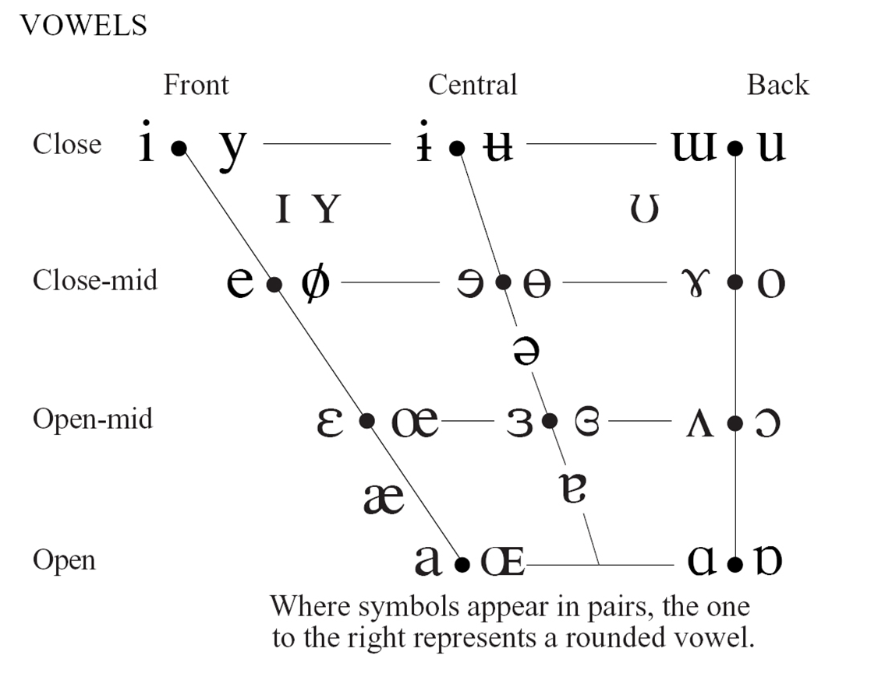

Slide 15
Assumed phonetic framework
binary voicing choice
various airstream mechanisms
various places and manners of articulation
the vowel quadrilateral

Slide 16
Places of articulation
most of those on the IPA Chart name the passive articulator
exceptions: bilabial, labiodental, glottal

Slide 17
Manners of articulation
arranged along a scale of degrees of openness

Slide 18
Consonant vs Vowel
vowels are syllabic
consonants are non-syllabic

Slide 19
Consonant vs Vowel
syllabic mark can only be added to consonants
[n̩]

Slide 20
Consonant vs Vowel
non-syllabic mark can only be added to vowels
[e̯]

Slide 21
Implicit theoretical assumptions
vowel/consonant distinction
syllable
segment

Slide 22
Air-stream mechanisms
ejectives – symbolized with a following apostrophe
[ p’ t’ kʼ ] etc
implosives – symbols with a ‘hook top’ [ɓ, ɗ, ɠ, ...]
clicks – special symbols [ ʘ ǀ ǃ ǂ ǁ ]

Slide 23
The rest of the Chart
‘Other symbols’
Diacritics
Suprasegmentals
Tones and word accents

