Slide 1
IPA Consonants
Michael Ashby

Slide 2
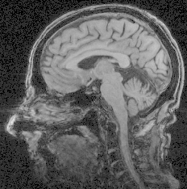
MRI mid-sagittal view

Slide 3
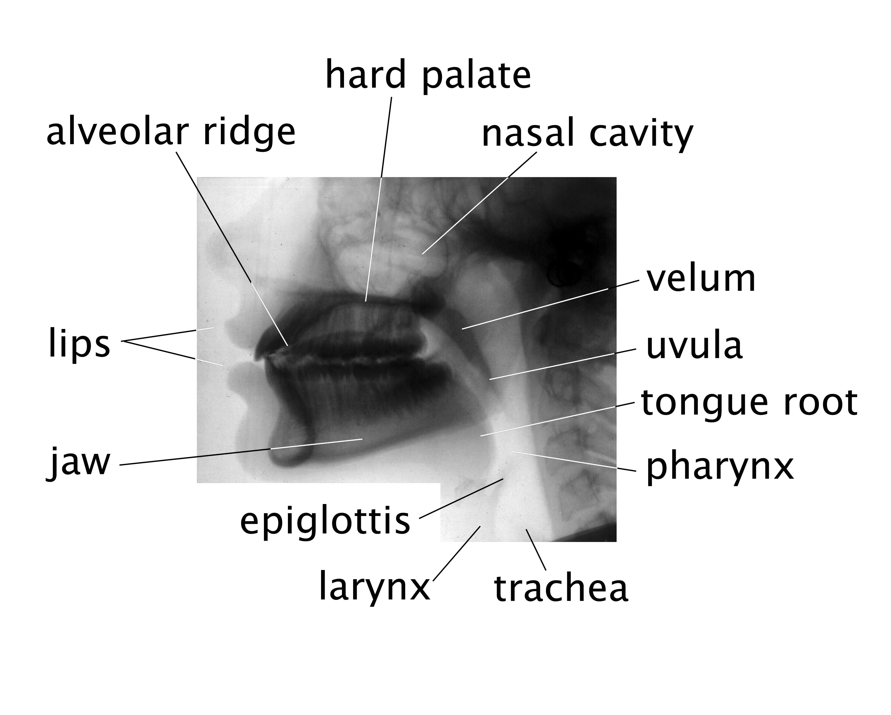
Lateral X-ray of the vocal tract

Slide 4
Mid-sagittal section of the vocal tract

Slide 5
Areas of the tongue

