Slide 1
Vowel description

Slide 2
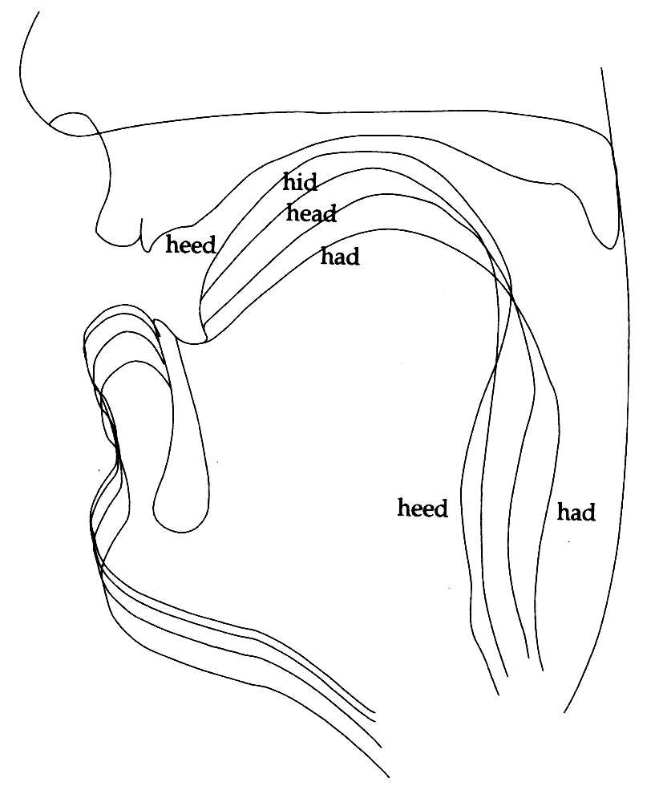
Tongue shapes in front vowels

Slide 3
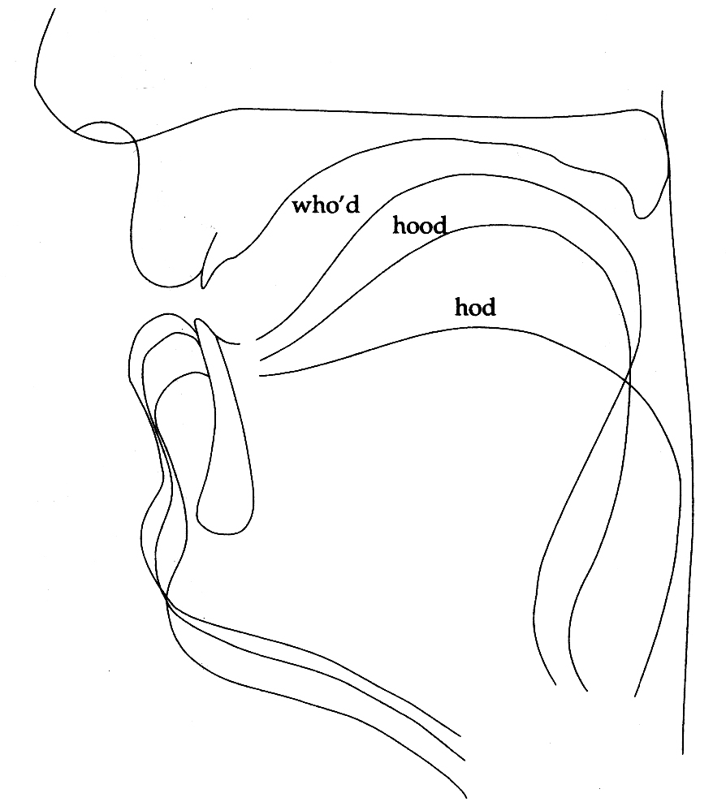
Tongue shapes in back vowels

Slide 4
Classification of English vowels

Slide 5
Classification of English diphthongs

Slide 6
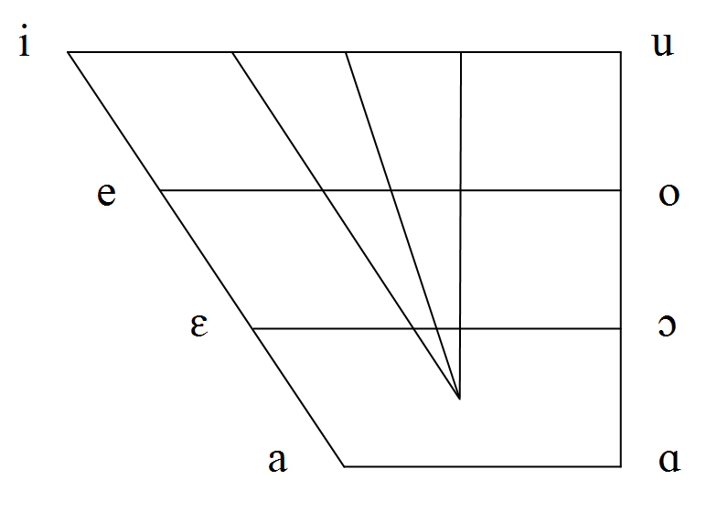
Primary Cardinal Vowels

Slide 7
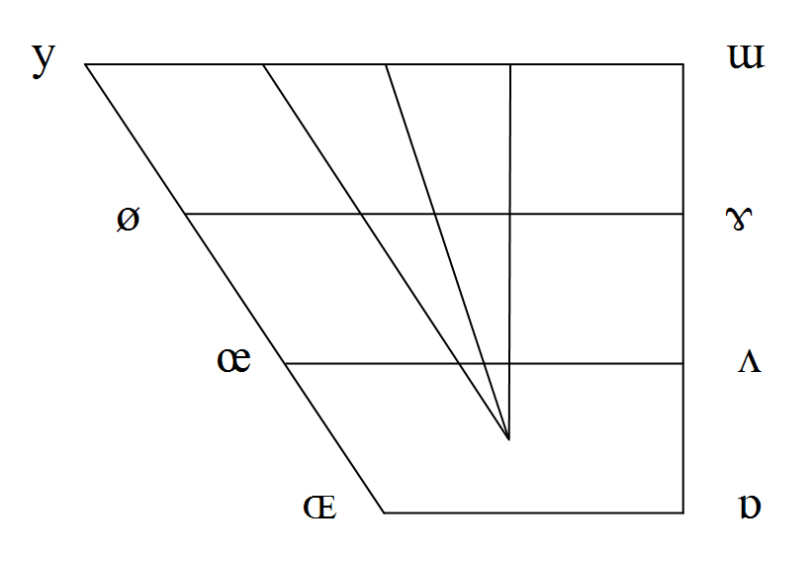
Secondary Cardinal Vowels

Slide 8
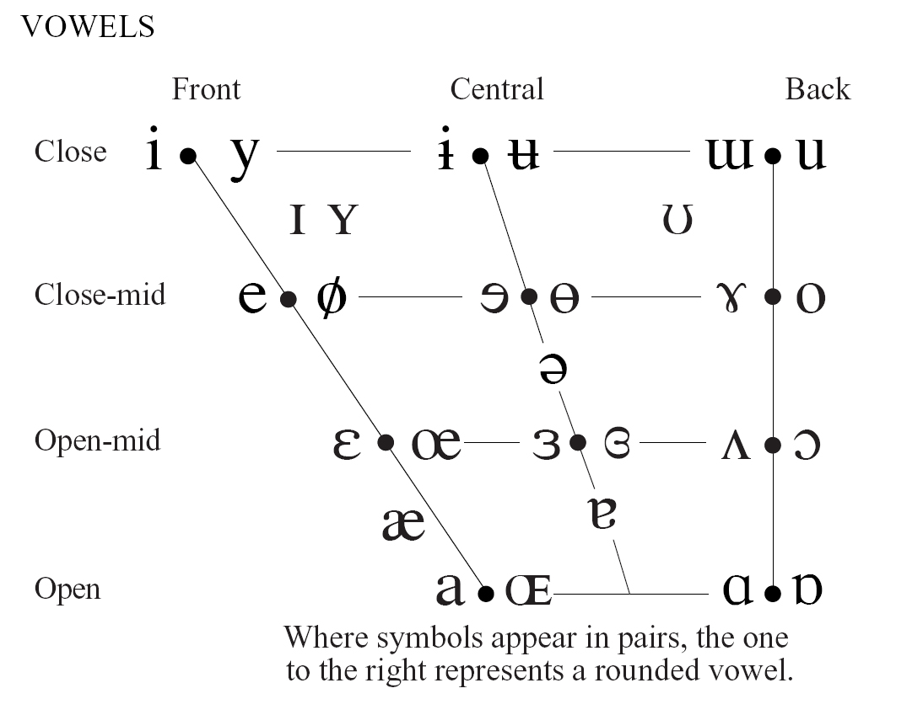
Vowels of the IPA

Slide 9
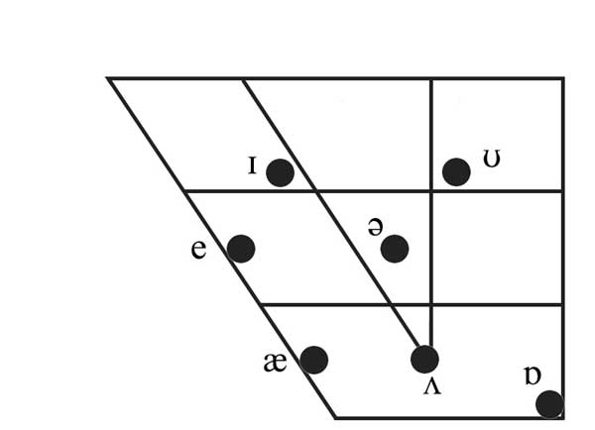
English short monophthongs

Slide 10
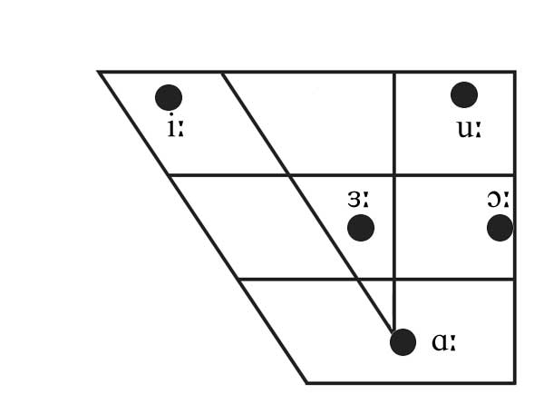
English long monophthongs

Slide 11
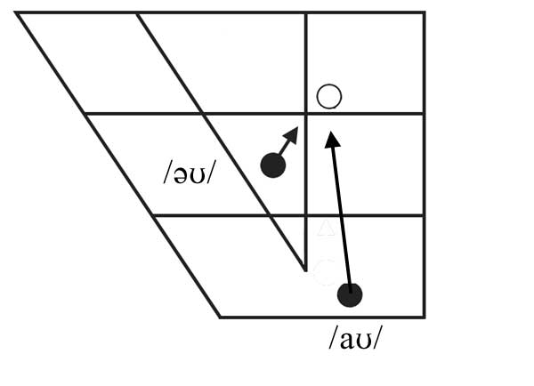
English diphthongs closing to /ʊ/

Slide 12
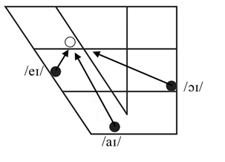
English diphthongs closing to /ɪ/

