Slide 1
Syntacticization of Discourse Speaker-Addressee Phrase and Commitment Phrase
Based on Syntax in the Treetops (2020 draft)
Shigeru Miyagawa
MIT
Seoul National University Colloquium
November 2020

Slide 2
Something special happens at the top of the tree structure.
“main clause phenomena,” “root phenomena”
These treetop phenomena link the utterance to the discourse context.
Tag question
You are coming to the party, aren’t you?
*I asked if you are coming to the party, aren’t you.
The MCPs involve illocutionary force – performing an act (Austin)
Illocutionary force typically requires a speaker and an addressee.

Slide 3
Proposal:
The speaker and addressee representations necessary for performing illocutionary acts are present in syntax.
Syntacticization of discourse (Speas and Tenny 2003; Miyagawa 2012a, 2017; Wiltschko 2014, 2017; Krifka 2019b, 2020).
Starting point: Emonds (1969), Ross (1970)
Two very different studies, but when we identify the problems and the solutions: Emonds = Ross
Existence of speaker and addressee representations at the top of the tree associated with illocutionary force.

Slide 4
There’s more…
How are the participant representations related to the utterance’s proposition?
Two major approaches:
Mentalist (intentions) (Grice)
By uttering “the door is closed,” the speaker M-intends for the addressee to believe that the speaker believes that the door is closed (Grice 1968).
Social (commitments) (Pierce; Searle; Krifka; also Austin)
“…commitment is a three-place relation between two individuals, [the speaker] and [the addressee], and a propositional content, p: [the speaker] is committed to [the addressee] to act on p…” Guerts (2019: 3).
Krifka’s (2019b, 2020) Commitment Phrase will play an important role in our proposal.

Slide 5
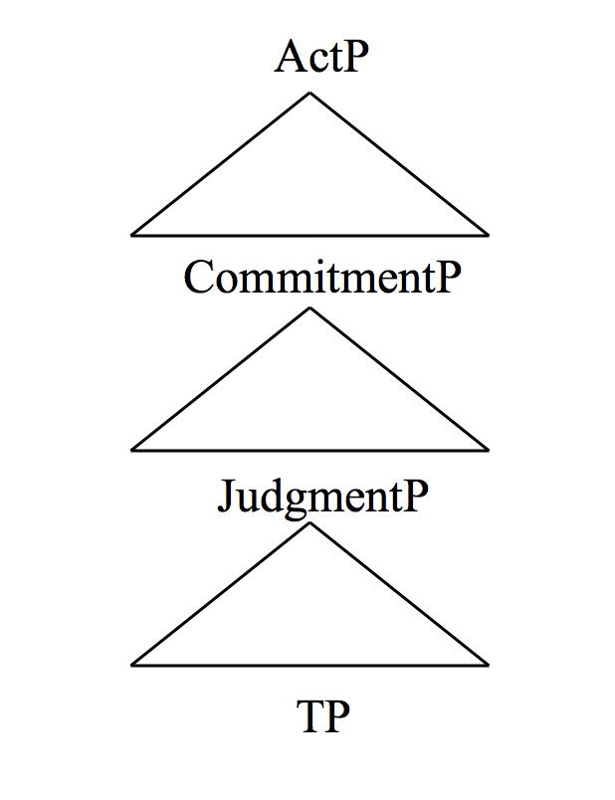
(3) Krifka (2019b, 2020)
Top layer (ActP): Locus of illocutionary force
Commitment Phrase – Spk’s commitment to the Addr to act on p
JudgmentP — Spk’s judgment about the proposition (“probably”)

Slide 6
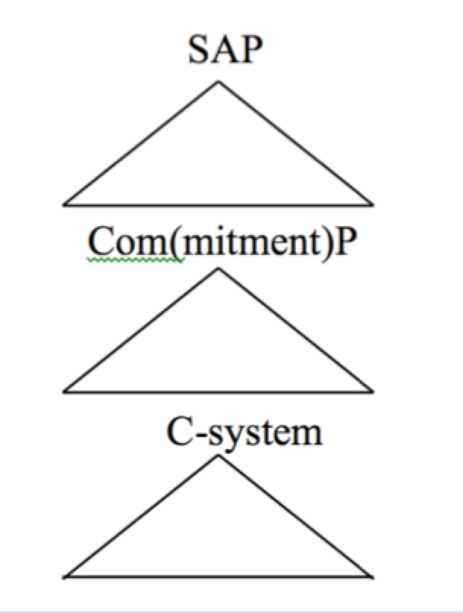
SAP
(4) Krifka (2019, 2020) (5) SIT (Miyagawa 2020)

Slide 7
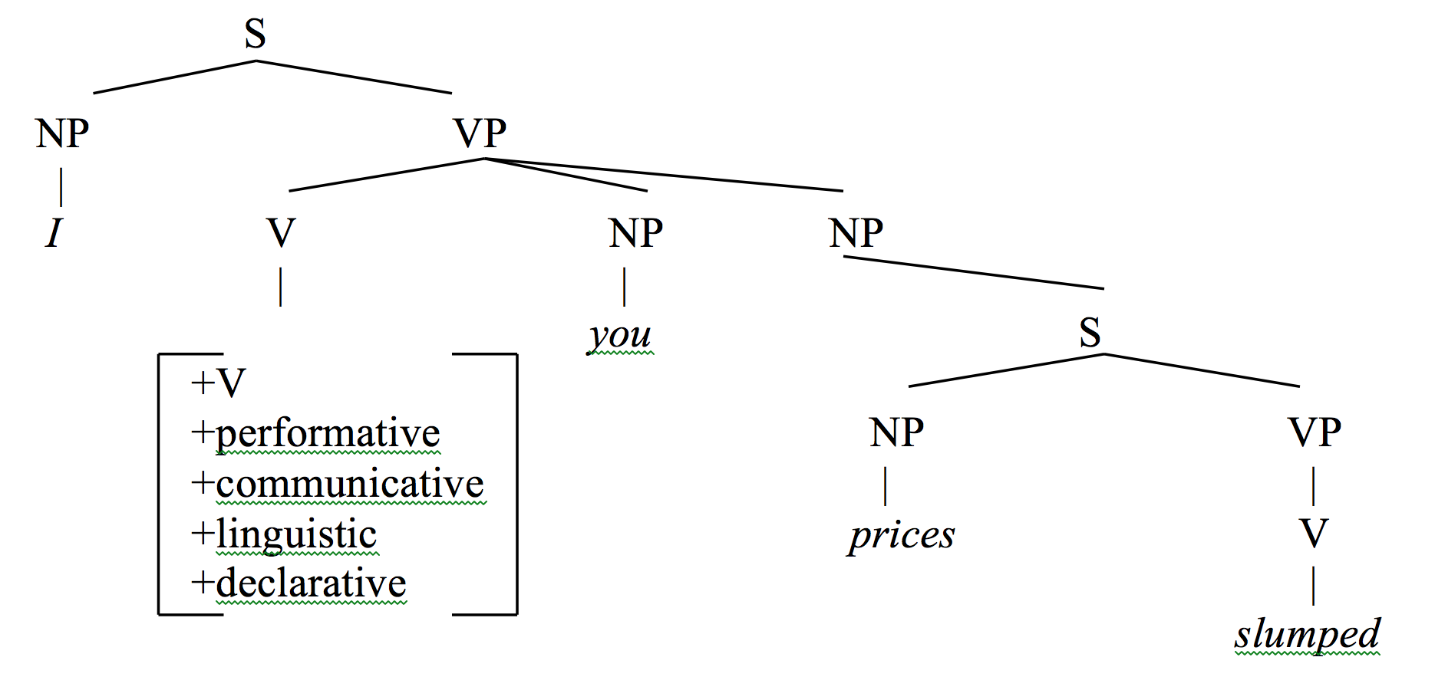
Speaker and addressee: the performative analysis
“On declarative sentences” (Ross 1970) maps Austin’s (1962) speech act theory onto a superordinate structure.
(6) Prices slumped.
(7)

Slide 8
Problems with the performative analysis
Incongruent truth-values
(8) a. Prices slumped.
b. I declare to you, prices slumped
Problem: (3a) and (3b) have different truth-values.
Questionable evidence for speaker/addressee
(9) Tom believed that the paper had been written by Ann and himself/*herself/*myself/*yourself.
(10) The paper was written by myself/*himself/*herself/*yourself.
However, the usage of myself in (10) is likely logophoric (see Charnavel 2019 for references)

Slide 9
Modern evidence for the speaker-addressee representation
Allocutive agreement and addressee representation
Souletin, a Basque dialect (de Rijk 2008: 811).
(11) joan ‘to go’
k: 2P, M n: 2P, F
I am going noa noak noan
he is going doa zoak zoan
we are going goaz goazak goazan
they are going doaz zoazak zoazan

Slide 10
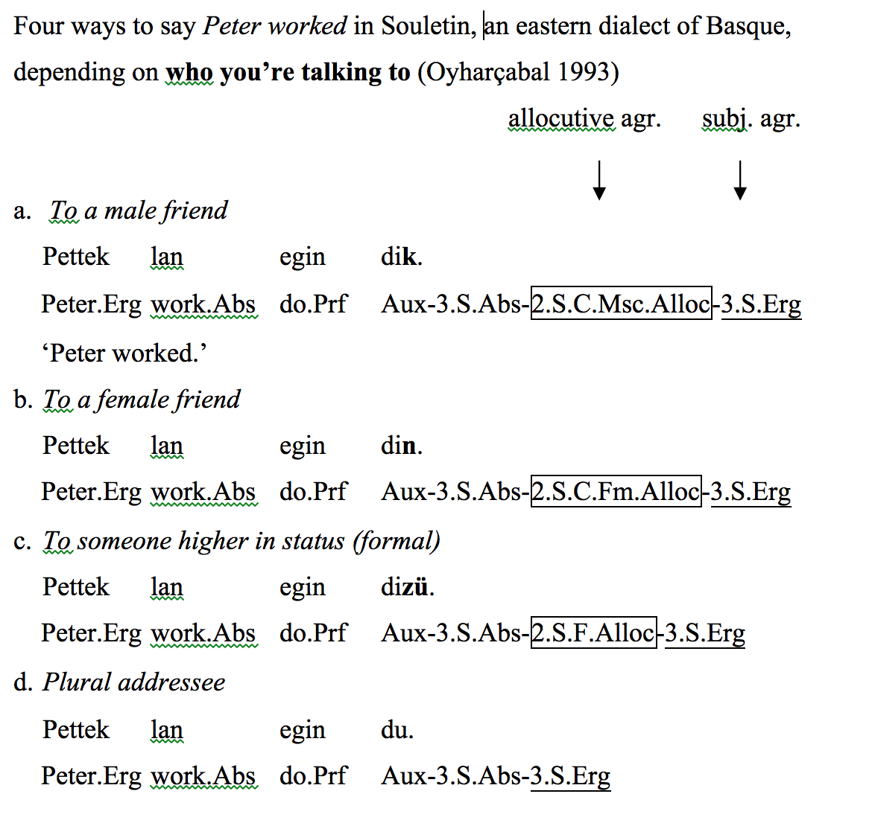
(12)

Slide 11
Evidence for speaker representation: Romanian
Romanian has sentential particles that occur either sentence-initially or finally. These particles, which have as its basic form, hai, occur only in the main clause, and appear very high in the structure, above the CP (Hill 2007, 2013; Haegeman and Hill 2014).
(13) Hai cã iar am greş/s-a greşit! (Hill 2007, 26a)
hai that again have-I erred/ARB-se has.erred.
‘Damn, I messed it up again. /Right, it has been messed up again.’

Slide 12
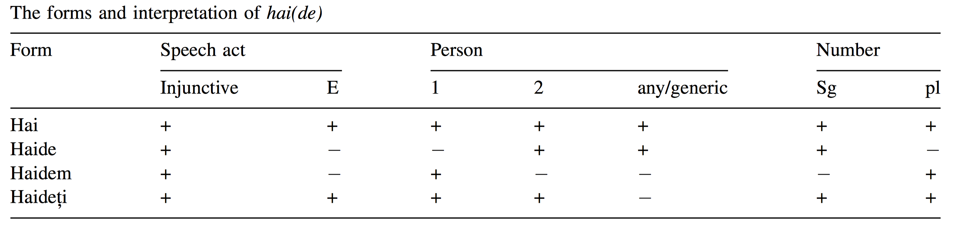
Table 1 (Hill 2007)
(14) Haidem sã începem lucrul! (Hill 2007, 25d)
hai-1PL SUBJ start work
‘Let’s start the work!’
Evidence from Basque and Romanian suggests that there are speaker and addressee representations present in syntax. As we will see later, these representations occur very high, at the treetop, reflecting Ross’s superordinate structure.

Slide 13
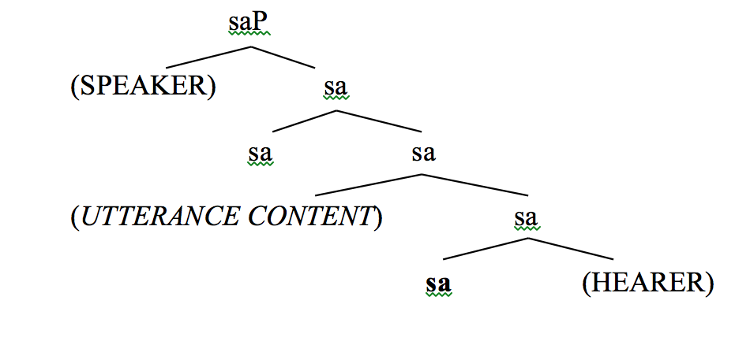
Speech Act Phrase (saP) / Speaker-Addressee Phrase (SAP)
Speas and Tenny (2003): saP
(15)

Slide 14
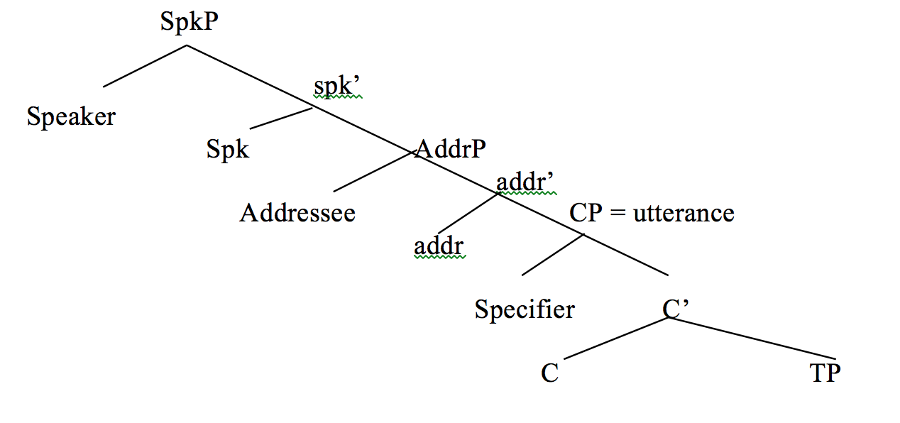
Haegeman and Hill (2011), plus my own labeling of SpkP and AddrP: SAP
(16)

Slide 15
Emonds (1969): Root
In Root and structure-preserving transformations (1969), Emonds identified transformations that only apply in root environments. He called these non-structure preserving transformations.
(17) Root
A root will mean either the highest S in a tree, an S immediately dominated by the highest S or the reported S in direct discourse. (Emonds 1969: 6)
Negative Constituent Preposing
(18) a. Never had I had to borrow money.
b. Because never had I had to borrow money, I have a lot saved.
c. John said that never had he had to borrow money.
d. *The fact that never had he had to borrow money is well-known.

Slide 16
Problem with the root definition
Too many counterexamples to the root definition (Hooper and Thompson 1973)
(19) Negative Constituent Preposing
I found out that never before had he had to borrow money. (H&T (119))
(20) Preposition Phrase Substitution
It seems that on the opposite corner stood a large Victorian mansion.
(H&T (89))
(21) Topicalization
It appears that this book he read thoroughly. (H&T (92))

Slide 17
Politeness marking: allocutive agreement
The politeness marking in Japanese fits exactly Emonds’s definition of the root (Miyagawa 2012a, 2017).
(22) Colloquial
Hanako-wa kur-u.
Hanako-TOP come-PRES
‘Hanako will come.’
(23) Formal (-mas-)
Hanako-wa ki-mas-u.
Hanako-TOP come-MAS-PRES
‘Hanako will come.’

Slide 18
(24) a. Highest S
Hanako-wa ki-mas-u.
Hanako-TOP come-MAS-PRES
‘Hanako will come.’
b. S dominated by highest S
Hanako-ga ki-mas-u kara, ie-ni ite-kudasai.
Hanako-NOM come-MAS-PRES because home-at be-please
‘Because Hanako will come, please be at home.’
c. Reported S in direct discourse
Taroo-wa Hanako-ga ki-mas-u to itta.
Taro-TOP Hanako-NOM come-MAS-PRES C said
‘Taro said that Hanako will come.’

Slide 19
While examples in (24) above are fine, the politeness form does not occur, for example, in the complement of the verb ‘believe’.
(25) Taroo-wa [Hanako-ga kuru/*ki-mas-u to] sinzitei-ru.
Taro- TOP [Hanako- NOM come/come-MAS-PRES C believe-PRES
‘Taro believes that Hanako will come.’
The politeness marker in Japanese, like the allocutive agreement in Souletin Basque, targets the addressee — as, for example, socially superior to the speaker. In this way, it is an agreement of sort with the addressee. It goes with the addressee representation in the SAP (Miyagawa 2012a, 2017).

Slide 20
Ross = Emonds
Emonds’s root definition is about the distribution of the Speaker-Addressee Phrase.
Since the speaker-addressee representation originally comes from Ross (1970), we are able to unify Emonds (1969) and Ross (1970) as being about the SAP.
The question is, why?
The SAP is at the top of the utterance – in the treetops. This top projection is the locus of the illocutionary force of the utterance (Krifka 2015, 2020; Frey and Meinunger 2019, etc.).

Slide 21
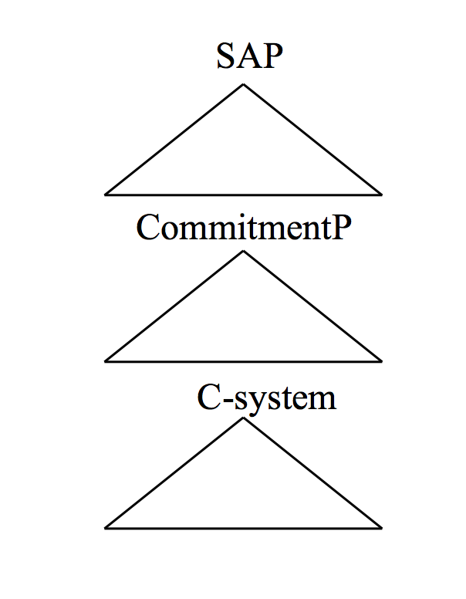
Combining Speas & Tenny and Krifka: Expression and propositional components of an utterance
(26)
SAP: Locus of illocutionary force; contains Spk and Addr representations;
CommitmentP: Spk’s commitment to Addr to act on p
C-system: CP + extended C system, including Judgment, Topicalization, etc.

Slide 22
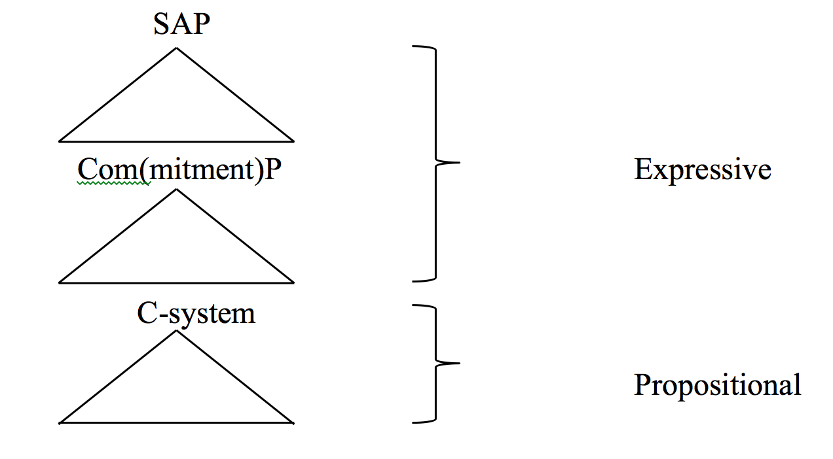
(27)

Slide 23
Politeness marking: Root phenomena
Distribution of the politeness marker is highly limited (Harada 1976). Parallels Basque, which doesn’t allow the allocutive agreement in embedded contexts.
In Japanese, the politeness marking is limited to Emonds’s (1969) Root environments (Miyagawa 2012a, 2017).
(28) Root
A root will mean either the highest S in a tree, an S immediately dominated by the highest S or the reported S in direct discourse.
(Emonds 1969: 6)

Slide 24
(29) a. Highest S
Hanako-wa ki-mas-u.
Hanako-TOP come-MAS-PRES
‘Hanako will come_{-mas}.’
b. S dominated by highest S
Hanako-ga ki-mas-u kara, ie-ni ite-kudasai.
Hanako-NOM come-MAS-PRES because home-at be-please
‘Because Hanako will come_{-mas}, please be at home.’
c. Reported S in direct discourse
Taroo-wa Hanako-ga ki-mas-u to itta.
Taro-TOP Hanako-NOM come-MAS-PRES C said
‘Taro said that Hanako will come_{-mas}.’

Slide 25
In contrast, other kinds of complements do not allow the allocutive.
(30) Taroo-wa [Hanako-ga kuru/*ki-mas-u to] sinzitei-ru.
Taro- TOP [Hanako- NOM come/come-PRES C believe-PRES
‘Taro believes that Hanako will come.’
(31) Taroo-wa [Hanako-ga kita/*ki-mas-u koto]-o hitei-sita.
Taro- TOP [Hanako- NOM came/come-MAS-PRS C -ACC deny-PAST
‘Taro denied that Hanako will come.’
(32) Taroo-wa [Hanako-ga kita/*ki-mas-i-ta koto]-ni odoroi-ta.
Taro-TOP [Hanako-NOM came/come-MAS-PAST C_{FACT}-DAT surprise-PAST
‘Taro was surprised that Hanako came.’
(33) Taroo-wa [sono hikooki-ga tuirakusita/*tuirakusi-mas-i-ta koto]-o
Taro-TOP that plane-NOM fall/fall-MAS-PAST C-ACC
sit-te-i-ta.
know-PROG- PAST
‘Taro knew that the airplane fell down.’ (adapted from Harada’s (104b))

Slide 26
Discrepancy between form and function
-mas- is allocutive agreement (Miyagawa 2012a, 2017; Oyharçabal 1993). But it is in the wrong place.
Below tense
(34) Hanako-wa piza-o tabe-mas-u.
Hanako-TOP pizza-ACC eat-MAS-PRS
‘Hanako will eat_{FORMAL} pizza.’
Below negation
(35) Hanako-wa piza-o tabe-mas-en.
Hanako-TOP pizza-ACC eat-MAS-NEG
‘Hanako will eat_{FORMAL} pizza.’

Slide 27
Korean, Tamil, Thai: Allocutive φ-feature originates at C
(36) Korean (Portner, et al. 2019)
Ecey pi-ka o-ass-supnita.
yesterday rain-NOM come-PST-DECL_{POLITE}
‘It rained yesterday’
(37) Thai (Iwasaki and Ingkaphirom 2005: 207)
lian yɛ̂ɛ ləy lə̆ khráp.
study problematic PP Q POLITE_{MASC}
‘She studies so badly?’
(38) Tamil (McFadden 2017, 2018)
Naan jaangiri vaang-in-een- ŋæ.
I Jangri buy-PST-1.SG.SUBJ-ALLOC
‘I bought Jangri.’

Slide 28
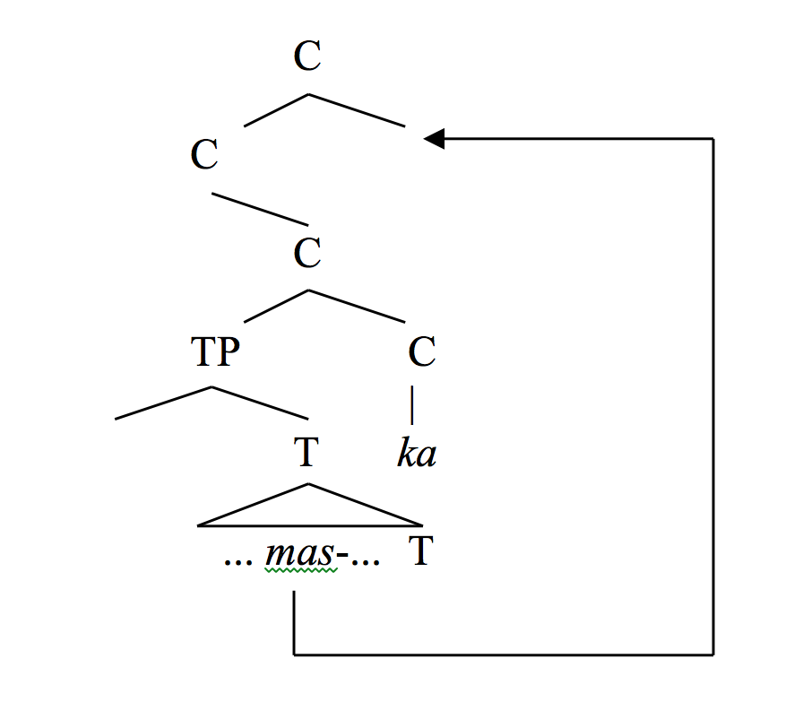
The allocutive φ-feature closes the gap between form and function
(39) -mas- LF-excorporation (Miyagawa 1987)

Slide 29
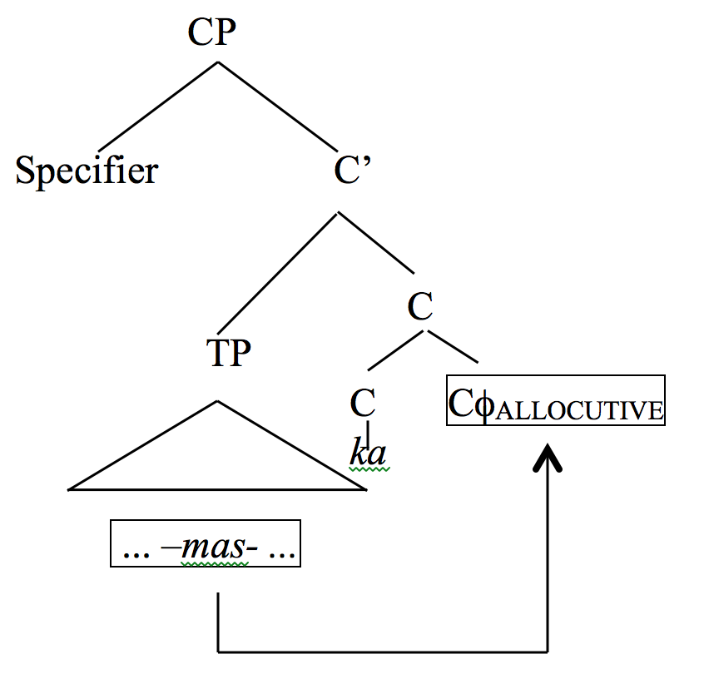
Modern version based on allocutive φ-feature
(40)
Head Movement Constraint (Travis 1984): head-to-head
(41) Hanako-wa iki-mas-en desita.
Hanako-TOP go-MAS-NEG COP.PST
‘Hanako didn’t go.’
(42) Hanako-wa ika-na-katta.
Taro-TOP go-NEG-PST
‘Hanako didn’t go.’

Slide 30
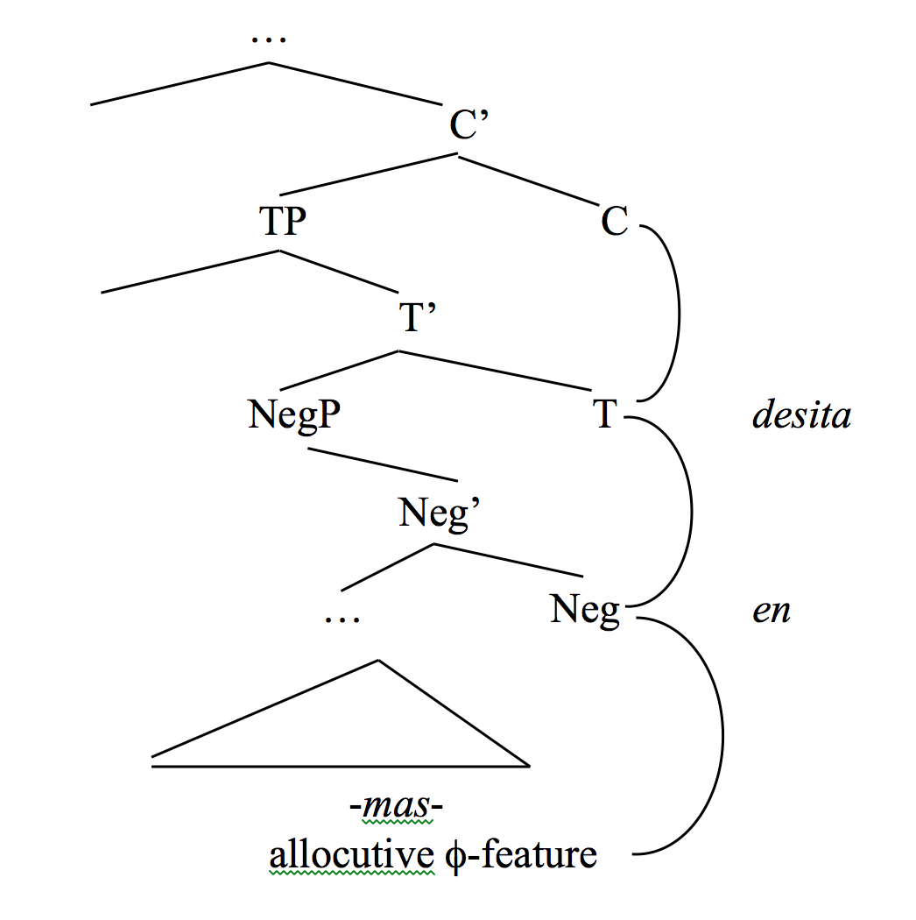
(43)
(44) NEG - allocutive φ-feature --> en
T_{PAST} - allocutive φ-feature —> desita

Slide 31
The allocutive φ-feature moves above TP.
(45) Nimotu-wa moo todoki-mas-i-ta desyoo ka?
package-TOP already arrive-MAS-PST INTERJECTION Q
‘Has the package arrived already?’ (Nitta 1991: 6.5 (11))
(46) Nimotu-wa moo todoi-ta daroo ka?
package-TOP already arrive-PST INTERJECTION Q
‘Has the package arrived already?’
If we combine with negation, we get the full head-to-head movement
(47) Nimotu-wa todoki-mas-en-desita desyoo ka?
package-TOP arrive-MAS-NEG-COP.PST INTERJECTION Q
‘Didn’t the package arrive?’

Slide 32
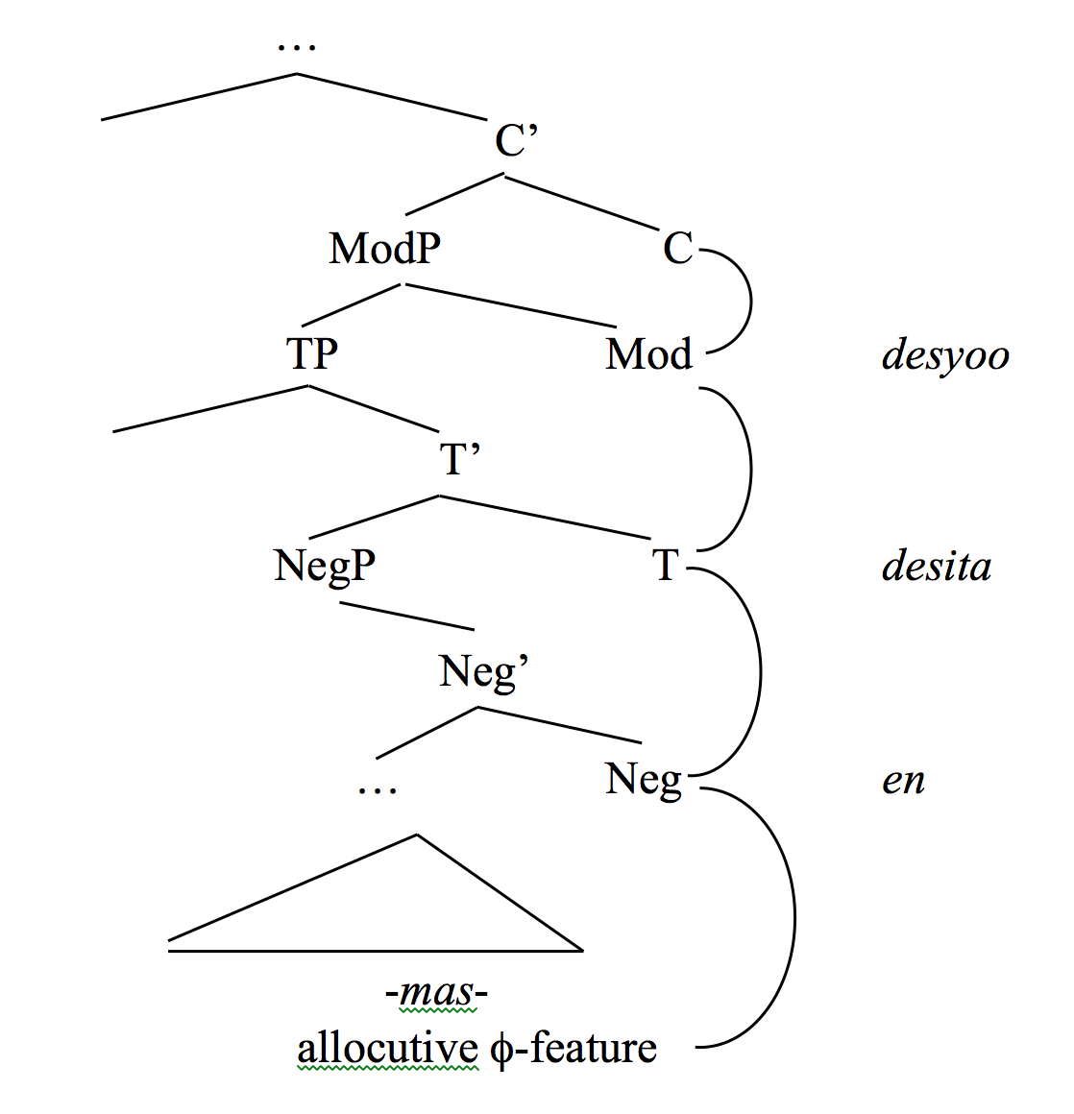
Koizumi (1991, 1993): Modal phrase above TP for items such as daroo
(48)

Slide 33
Sentence-final particles and expressivity
Sentence-final particles (SFP) are highly expressive.
(49) Kare-wa piza-o tabe-ru yo.
he-TOP pizza-ACC eat-PRES YO
‘He will eat pizza!’
(50) (i) small set of SFPs
(ii) don’t contribute to the truth value of the proposition
(iii) high frequency
(iv) has a special grammatical structure
(51) yo ‘certainty’, kana ‘uncertainty’, ne ‘confirmation’

Slide 34
SAP
(52) Krifka (2019, 2020) (53) SIT (Miyagawa 2020)

Slide 35
Structure of SFPs: A preview
(54) SAP
CommitmentP SFP_{SAP}
C-system SFP_{COMMIT}
SFP_{C}
(55) SAP + CommitP: Expressive component – speech act / illocutionary
C-system: Propositional component – truth-value / locutionary
(56) SAP + CommitP: Root

Slide 36
SFPs are main clause phenomena
(57) Root (Emonds 1969: 6)
A root will mean either the highest S in a tree, an S immediately dominated by the highest S, or the reported S in direct discourse.
(58)a. Highest S
Hanako-wa ku-ru yo.
Hanako-TOP come-PRES YO
‘Hanako will come!, Hanako will come!’
b. S dominated by highest S
Hanako-ga ku-ru kara yo, ie-ni ite-kudasai.
Hanako-NOM come-PRES because YO home-at be-please
‘Because Hanako will come!, please be at home.’
c. Reported S in direct discourse
Taroo-wa Hanako-ga ku-ru yo to itta.
Taro-TOP Hanako-NOM come-PRES YO C said
‘Taro said that Hanako will come!’

Slide 37
(59) Hanako-wa [kare-ga piza-o tabe-ru (*yo) to (*yo)] omottei-ru.
Hanako-TOP he-NOM pizza-ACC eat-PRES YO C YO think-PRS
‘Hanako thinks that he will eat pizza.’
(60) SFPs occur in the Expressive component: SAP – CommitmentP

Slide 38
The structure of SFPs
(61) Expressivity of SFPs
(i) small set
(ii) high frequency
(iii) grammatical structure
NE / YO
(62) Hanako-wa piza-o tyuumonsuru ne.
Hanako-TOP pizza-ACC order NE
‘Hanako will order pizza, won’t she?.’

Slide 39
(63) Hanako-wa piza-o tyuumonsuru yo.
Hanako-TOP pizza-ACC order YO
‘Hanako will order pizza!.’
(64) Uyeno (1971: 96): ne is used if the speaker expects the addressee to be familiar with the information in the proposition; yo is used if the speaker assumes that the addressee is not aware of the information.
(65) A number of linguists: ne is addressee-oriented; yo is speaker-oriented.

Slide 40
Ne
Necessarily directs the entire expression to the addressee because, like a question, the speaker assumes that the addressee knows the truthfulness of the proposition, and is confirming that.
Yo
Amplifies the commitment by the speaker relative to the speech act embodied in the utterance.
(66) Assertion: amplifies the speaker’s commitment to the truth of p.
Hanako-wa ik-u yo!
Hanako-TOP go-PRS YO
‘Hanako will go!’
(67) Imperative: amplifies the speaker’s commitment to have the addressee bring about p.
Ik-e yo!
go-IMP YO
‘Go, for goodness’ sake!’

Slide 41
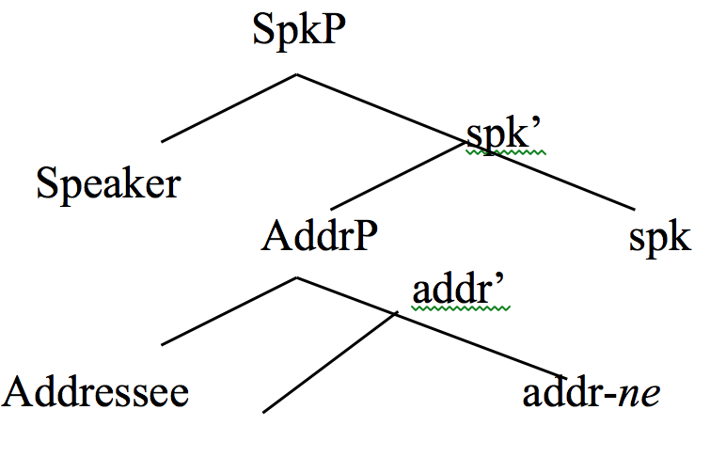
Structure of ne
(68) Ne
The idea that sentential particles occurs on the head of participants: works on Germanic such as Bayer (2012, 2018, 2020) and Haegeman and Hill (2014).

Slide 42
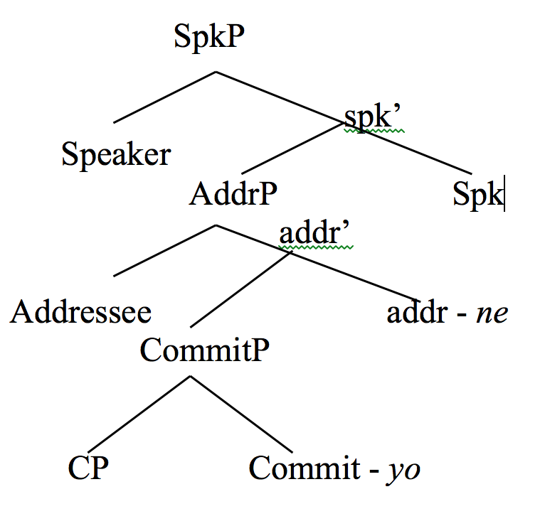
Structure of yo
(69) Yo
(70) yo-ne, *ne-yo
If yo were speaker oriented, the ordering *ne-yo should be the only option.
(71) Hanako-wa piza-o tyuumonsuru yo-ne.
Hanako-TOP pizza-ACC order YO-NE
‘Hanako will surely order pizza, right?’

Slide 43
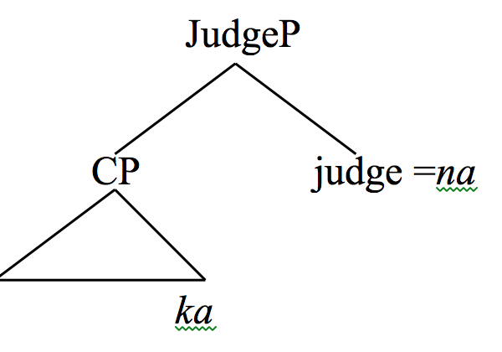
Uncertainty kana
(72) Ka of kana is Q
Dare-ga kur-u ka-na?
who-NOM come-PRS Q-NA
‘I wonder who will come.’
-na is a kind of speaker judgment about p; it selects Q.
(73)

Slide 44
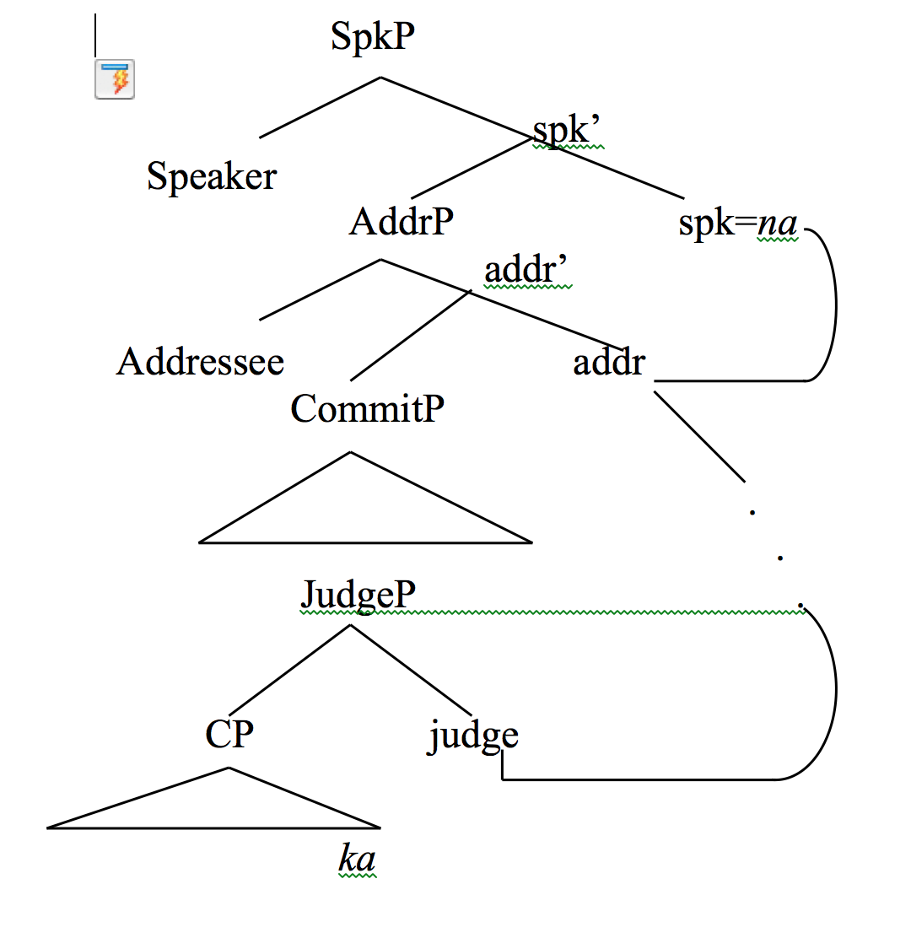
At the same time, -na is speaker oriented: it can only be used by the speaker.
(74)
This shows the Expressive-Propositional split. Na originates in the C-system because it has to select ka. But being an SFP, it makes no contribution to the truth value of p, thus it raises into the Expressive component.

Slide 45
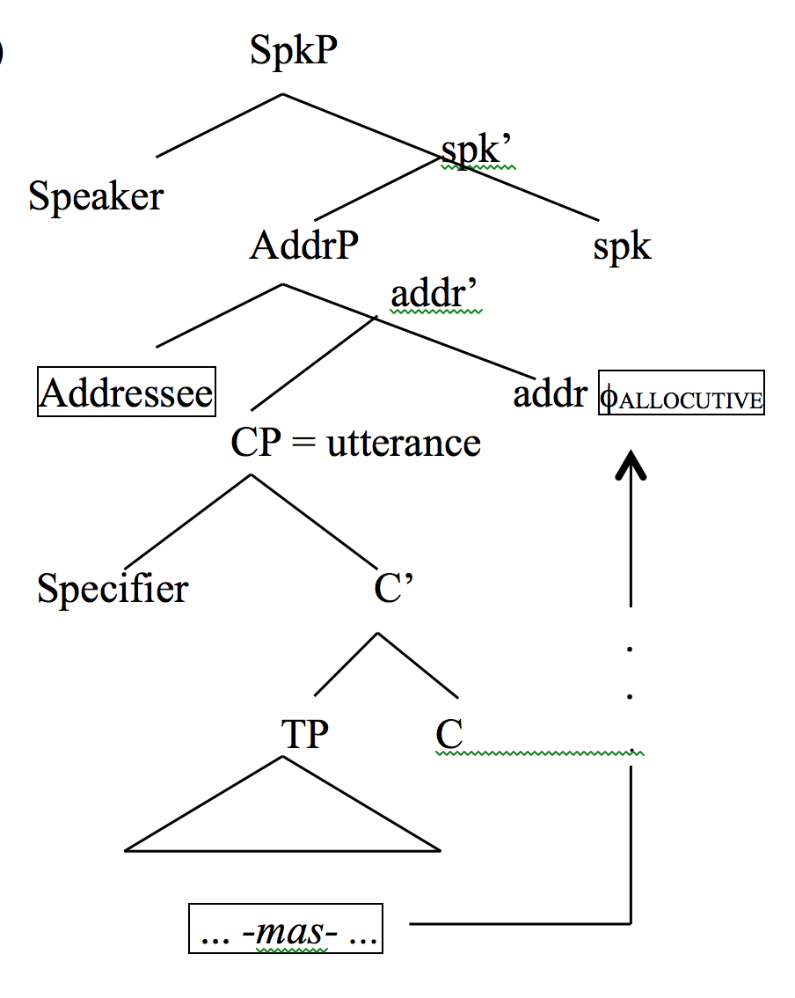
Interaction of kana and –mas-
The analysis predicts that kana cannot occur with –mas-.
(75) Raising of the allocutive φ-feature

Slide 46
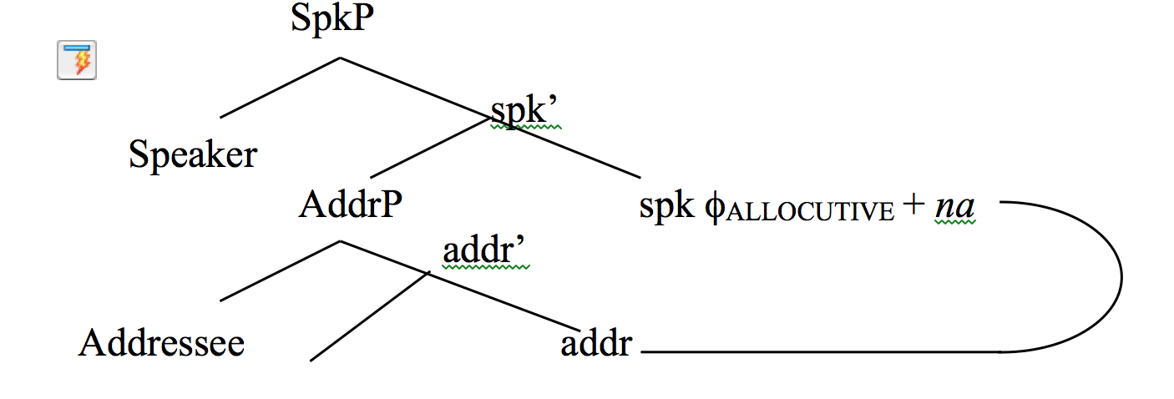
(76)
(77) Hanako-wa kur-u/*ki-mas-u kana.
Hanako-TOP come-PRS/come-MAS-PRS KANA
‘I wonder if Hanako will come.’

Slide 47
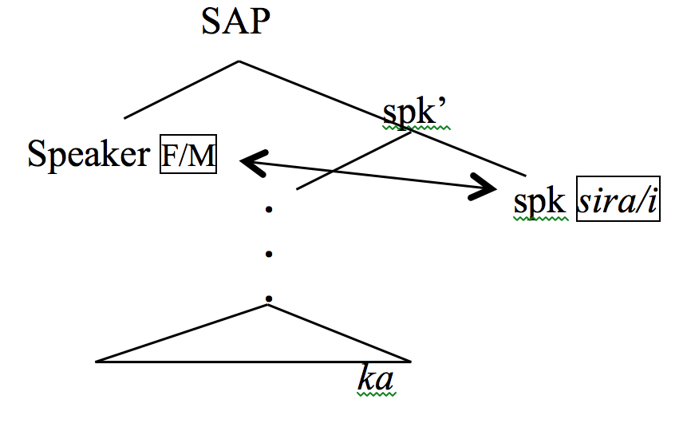
Kasira / i
Two additional uncertainty SFPs that behave similarly to kana: sira / i. Both must occur with the Q-particle, ka.
(78) Hanako-wa kur-u ka-sira/-i.
Hanako-TOP come-PRS Q-SIRA/I
‘I wonder if Hanako will come.
Neither allows –mas-.
(79) Hanako-wa kur-u/*ki-mas-u ka-sira/-i.
Hanako-TOP come-PRS/come-MAS-PRS Q-SIRA/-I
‘I wonder if Hanako will come.’
An additional factor: gender agreement
(80) -(ka)sira: Feminine speaker
-(ka)i: Male speaker

Slide 48
The language of children with ASD and SAP-CommitP
(81) Children with ASD
Linguistically high-functioning young people with autistic spectrum disorders (ASD) tend not to use SFPs
Linguistically high functioning mentally retarded children use SFPs frequently
When trained, children with ASD could use both ne and yo (Matsuoka et al. 1997)
Those with ASD show problems with pragmatics, for example, involving the addressee; confuse Sie and Du (Baltaxe 1977).

Slide 49
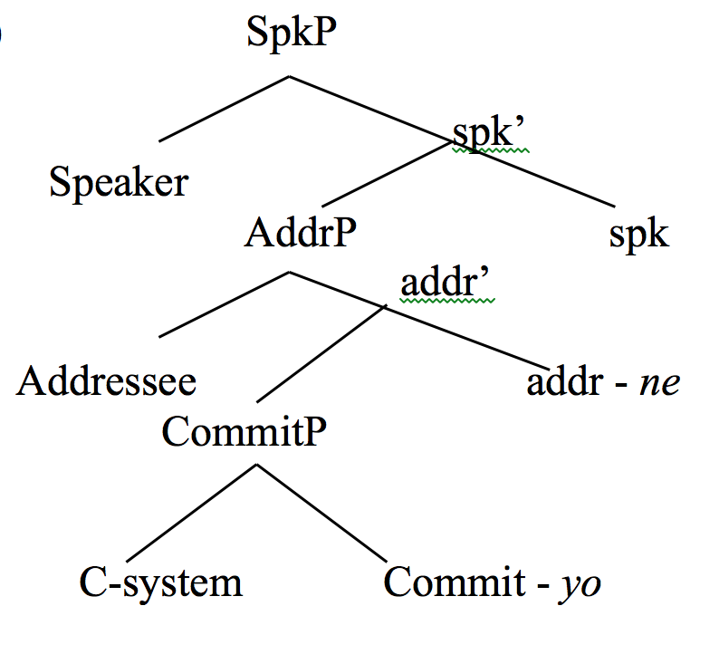
SAP, CommitP, and ne (affirm with addressee); yo (amplify commitment)
(82)

Slide 50
Asymmetry between ne and yo
Matsuoka et al. (1997)
Subject: 7;2, enrolled in first grade; did not use SFPs before the experiments.
Experiment 1: 1 hour a week, 6 month
Experiment 2: once a week, for 8 months.
With training, became adept at ne and yo.
Observation in natural setting: at home, once a week for 5 weeks.

Slide 51





Experiment 1 (Matsuoka et al. 1997)
First Scenario: the subject goes to Room 2 and tells Experimenter B what he played in Room 1. YO
Room 2 B
Room 1
A
Second Scenario: the subject goes to Room 2 and tells Experimenter A what he played in Room 1. NE
1 hour/week, 6 months

Slide 52
Experiment 2
Base line: was able to use yo correctly, but not ne
Once a week, 8 months
Room 1
A
NE
YO

Slide 53
In natural setting
After Experiment 2, the child was observed in the home setting, 75 minute session, once a week, 5 weeks.
271 occurrences of yo
4 occurrences of ne

