Slide 1
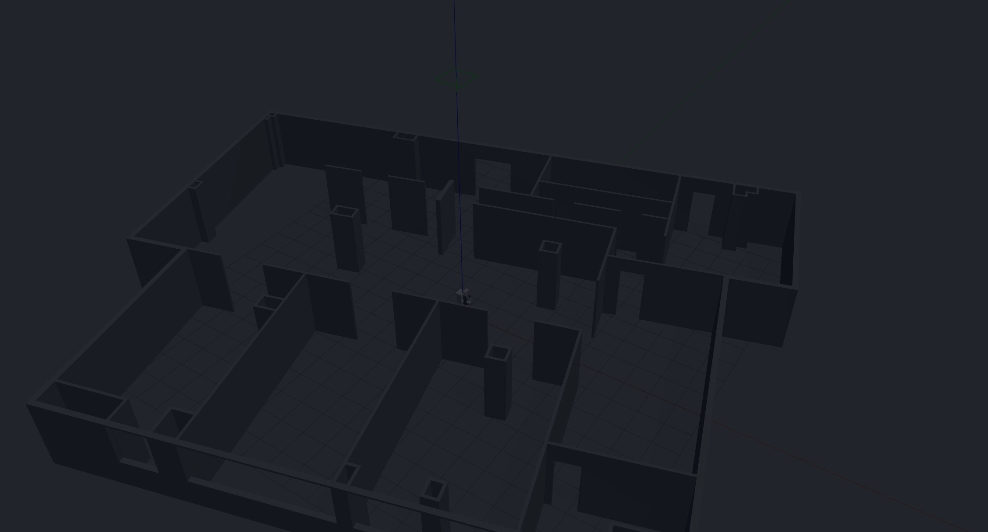
TIAGO ROBOT
TIAGo Robot Simulation
in ROS 2
Environment Setup, Gazebo Worlds,
Autonomous Navigation, and MoveIt 2
SIMULATION DEMONSTRATION
ROS 2 Humble | October 2026
PAL Robotics public TIAGo simulation stack

Slide 2
01 · ENVIRONMENT
Validated Simulation Environment
A reproducible ROS 2 stack running on a Windows workstation through WSL2.
HOST PLATFORM
LINUX DISTRIBUTION
Nav2 / MoveIt 2
Windows + WSL2
Ubuntu 22.04.5 LTS · x86_64
TIAGo ROS 2 Packages
ROBOTICS MIDDLEWARE
SIMULATOR
ROS 2 Humble · Cyclone DDS
Gazebo Classic · WSLg / D3D12
ROS 2 Humble + Cyclone DDS
Ubuntu 22.04 on WSL2
ROBOT STACK
TOOLS
PAL TIAGo public simulation
humble-devel
RViz2 · Nav2 · MoveIt 2
ros2_control
Windows Workstation
Public simulation — no physical robot required
TIAGo Robot Simulation
02

Slide 3
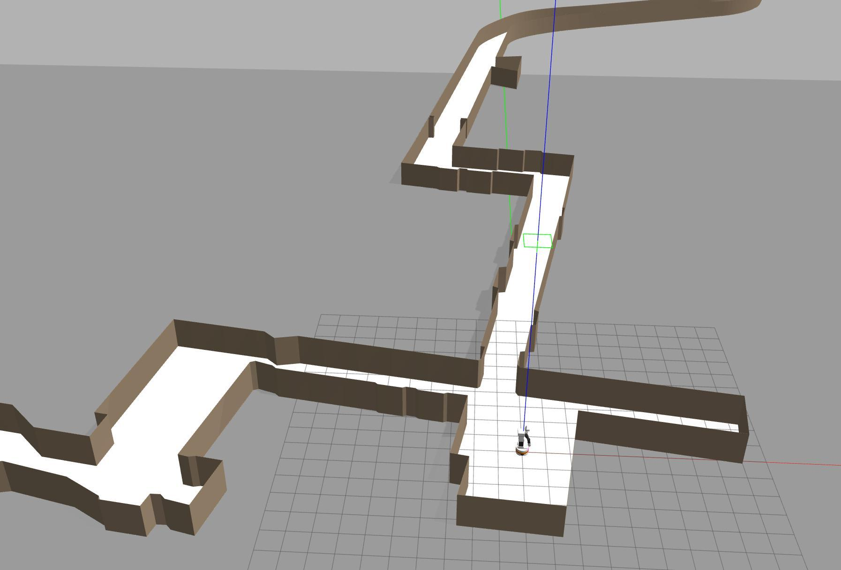
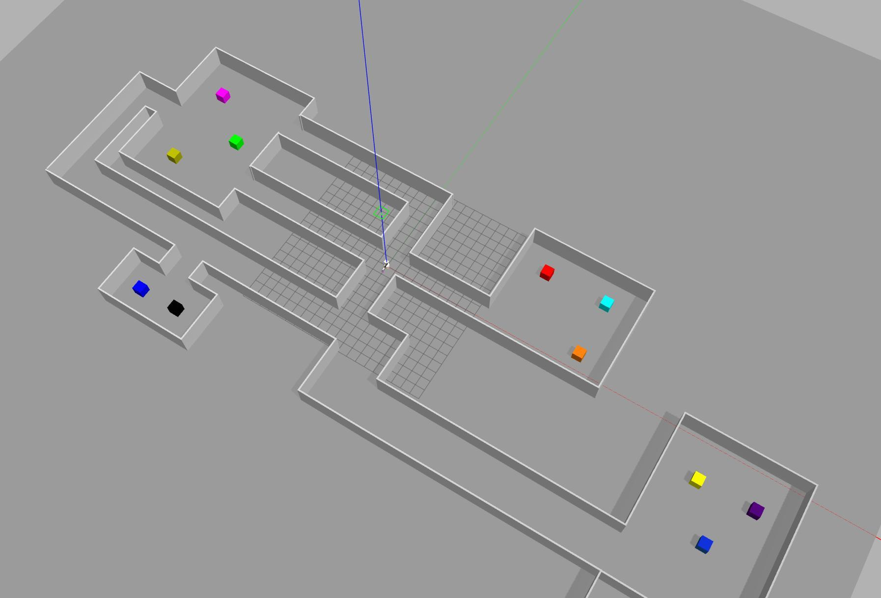
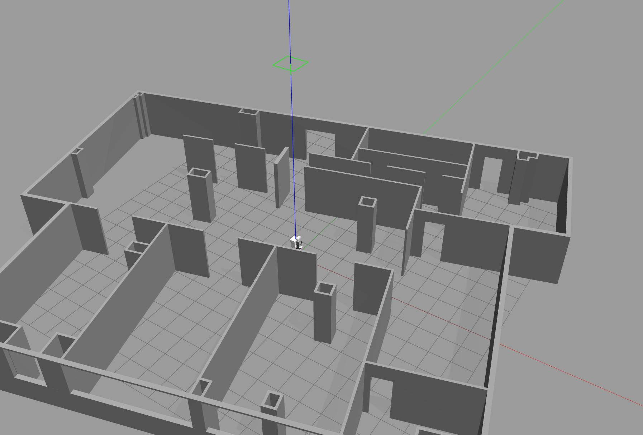
02 · GAZEBO WORLDS
Multiple Simulation Environments
The same TIAGo software stack was launched in three structurally different worlds.
Hospital
Factory
PAL Office
Long corridors and an irregular floor plan
Large connected areas with multiple regions
Dense rooms, doors, and narrow passages
WORLD 1
WORLD 2
WORLD 3
World selection changes geometry while preserving the robot, controllers, and ROS 2 interfaces.
TIAGo Robot Simulation
03

Slide 4
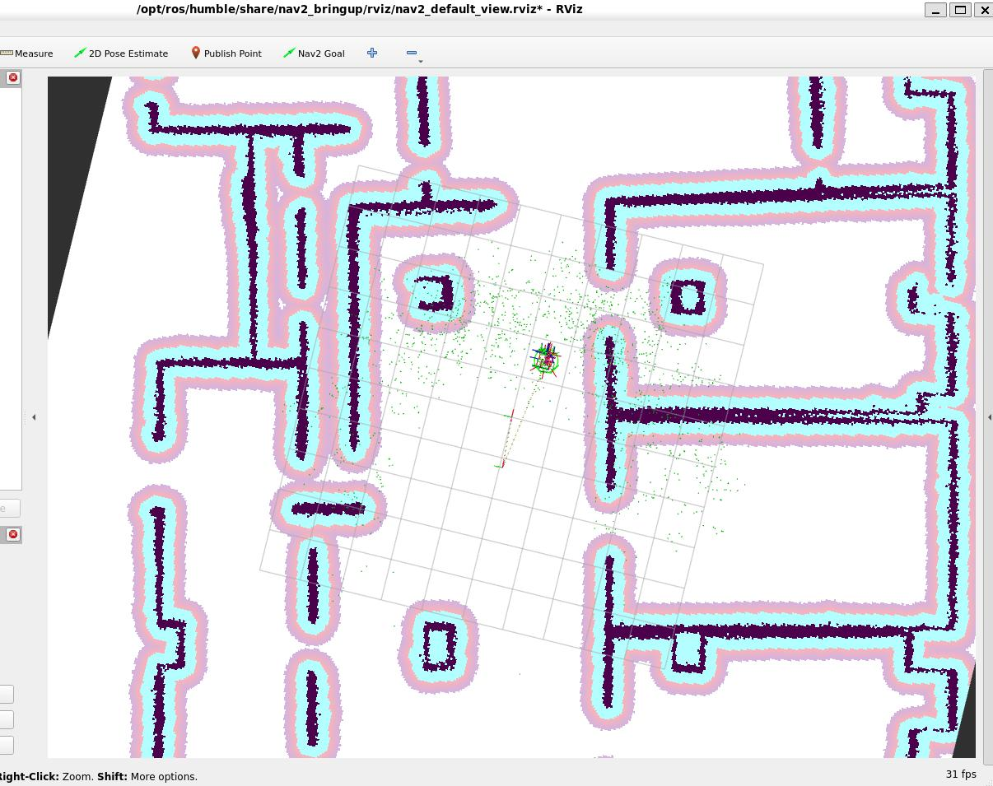
03 · NAVIGATION
Nav2 Goal Selection in RViz2
The target pose is selected in RViz2; Nav2 converts it into motion commands for the simulated base.
RVIZ2 INTERFACE
NAV2 GOAL
Visible information
• 2D occupancy map of the office environment
• Inflated cost regions around walls and obstacles
• Live laser measurements around the robot
• Nav2 Goal tool for defining position and orientation
Nav2 Goal
TIAGo Robot Simulation
04

Slide 5
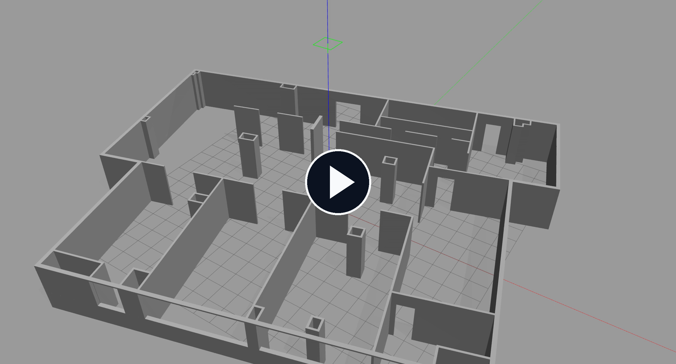
03 · NAVIGATION
Navigation Execution in Gazebo
The video shows the physical execution result after a navigation target was issued.
12 s VIDEO
Observed result
• Starts from rest
• Moves smoothly through the office corridor
• Turns toward the right-side passage
• Stops near the requested destination
Click the video to play
Scope: point-to-point navigation execution; the planning interface is shown on the previous slide.
TIAGo Robot Simulation
05

Slide 6
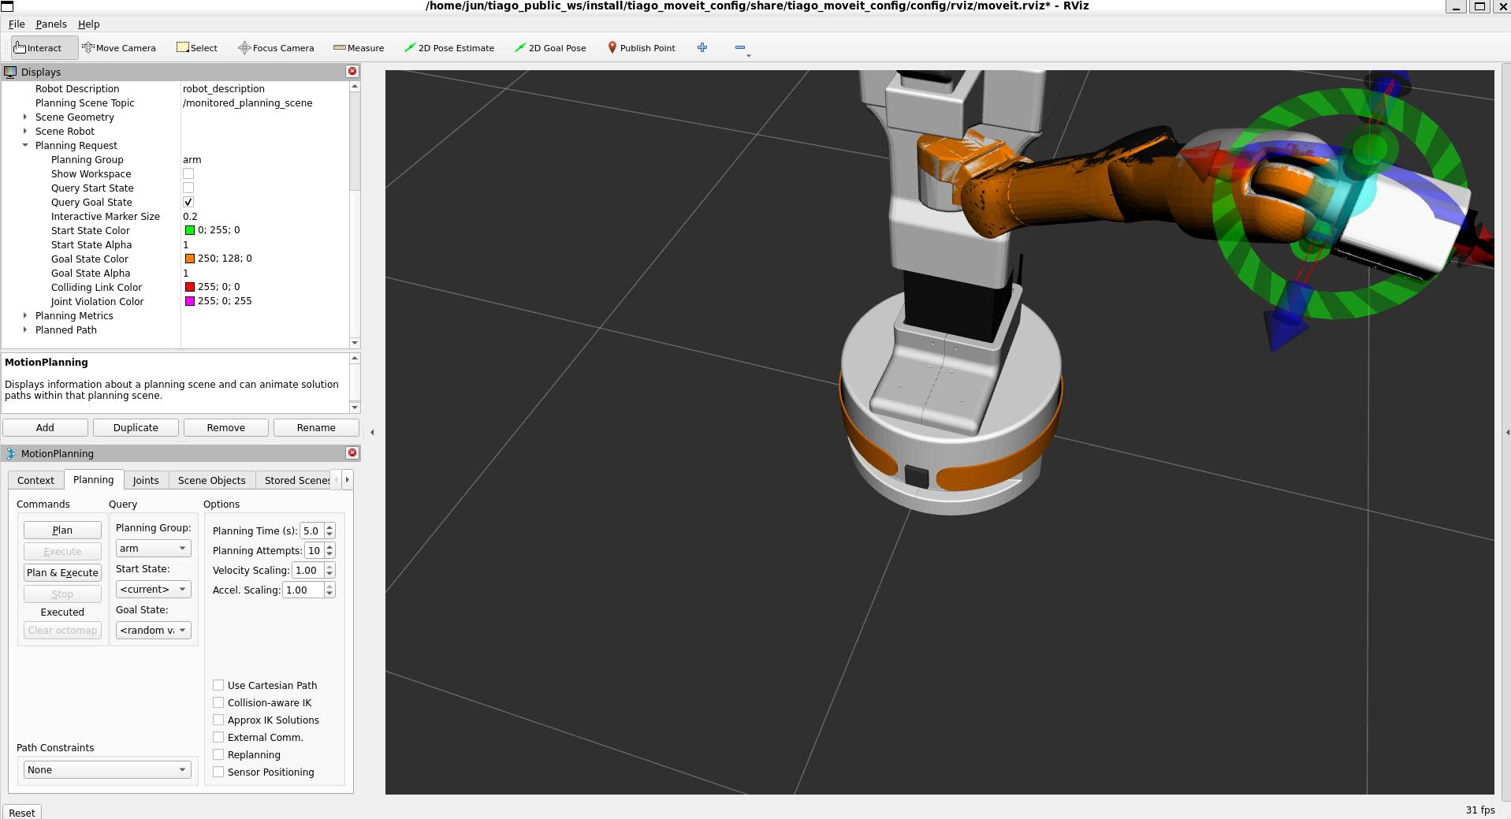
04 · MOVEIT 2
Interactive Arm Planning in RViz2
MoveIt 2 uses the current robot state and an interactive end-effector target to generate a joint trajectory.
MOTION PLANNING
Workflow
1
Select the arm planning group
2
Set the goal pose with the 6-DoF marker
3
Generate a collision-aware trajectory
4
Execute through ros2_control
Demo scope: free-space arm motion
TIAGo Robot Simulation
06

Slide 7
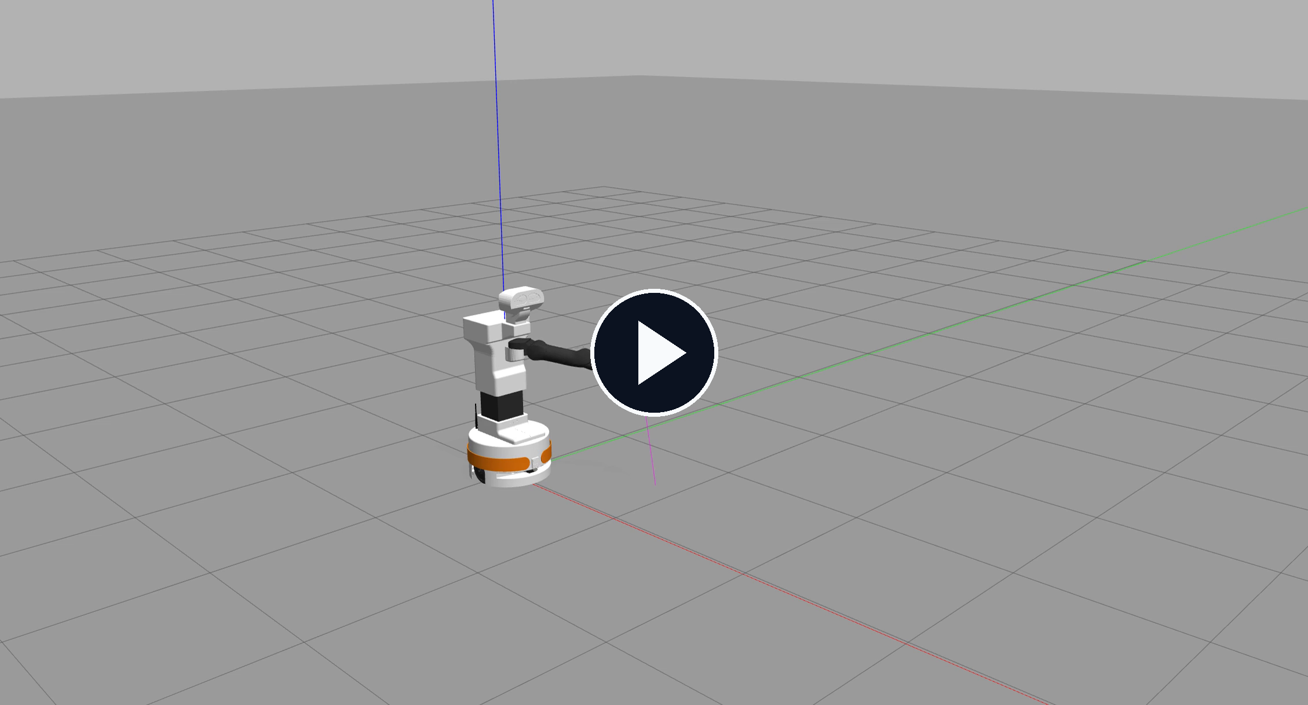
04 · MOVEIT 2
Planned Arm Trajectory Execution
The generated trajectory is executed by the simulated TIAGo arm in Gazebo.
6 s VIDEO
Observed result
• Right arm moves from a folded pose to a forward extension
• Shoulder, elbow, and wrist move smoothly
• Base and torso remain stationary
• Trajectory completes without visible discontinuity
Click the video to play
Scope: free-space trajectory execution; no grasping or object interaction is shown.
TIAGo Robot Simulation
07

Slide 8
SUMMARY
Demonstrated Capabilities
The public simulation stack is ready for repeatable TIAGo experiments without access to the physical robot.
01
Environment
02
Worlds
ROS 2 Humble and the TIAGo public stack were installed and validated in WSL2.
The robot was launched successfully in Hospital, Factory, and PAL Office environments.
03
Navigation
04
Manipulation
A target pose was selected in RViz2 and executed as point-to-point motion in Gazebo.
MoveIt 2 planned and executed a smooth right-arm trajectory in simulation.
Next steps
SLAM mapping · custom environments · object-aware manipulation · validation on the physical TIAGo
TIAGo Robot Simulation
08

