Slide 1
Self-adaptive Differential Evolution
with Neighborhood Search
(SaNSDE)
Joel Chacon Castillo
Juan Gerardo Fuentes Almeida

Slide 2
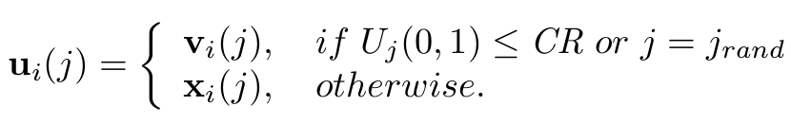
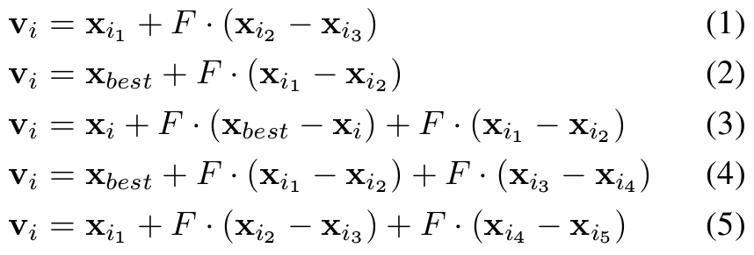
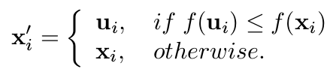
I. Classical DE
Individuals = d-dimensional vectors
1. Mutation
2. Crossover
Strategies :
u_{i} = crossed individuals
U_{j}(0,1) = uniformly distributed random
number in (0,1)
CR = crossover rate
j_{rand} ensures population u is different
than population x
v_{i} = Mutated individuals
i_{i} = random integers
F = scale factor
3. Selection
x'_{i} = selected individuals
f( ) = fitness evaluation

Slide 3

II. DE with Neighborhood Search (NSDE)
Individuals = d-dimensional vectors
1. Mutation
Strategies :
v_{i} = Mutated individuals
i_{i} = random integers
F = scale factor
N_{i} (μ, σ) = normally distributed
random variable
U_{j} (0,1) = uniformly distributed
random variable in (0,1)
f_{p} = 0.5 in NSDE
δ_{i} = Cauchy random variable
with scale parameter t=1
2. Crossover
3. Selection
Same as classical DE.
Same as classical DE.

Slide 4
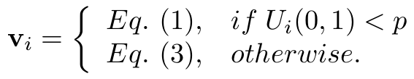

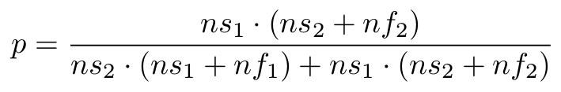
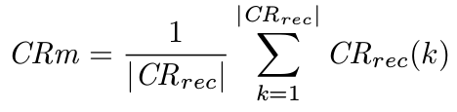
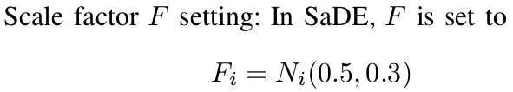
III. Self-adaptive DE (SaDE)
Individuals = d-dimensional vectors
1. Mutation
2. Crossover
for each individual :
p is updated every 50 generations according to :
CRm = 0.5 initially
Every generation, an array CR_{rec} is updated with CR values associated with offspring succesfully entering the next generation. After 25 generations, CRm is updated :
ns₁, ns₂ = number of offspring successfully
entering the next generation while generated
by Eq. (1) and Eq. (3) resp.
nf₁, nf₂ = number of offspring discarded while
generated by Eq. (1) and Eq. (3) resp.
3. Selection
Same as classical DE.

Slide 5
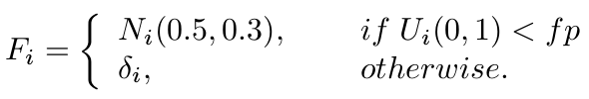
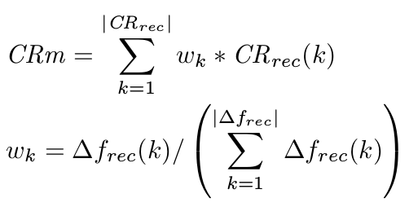
IV. Self-adaptive DE with Neighborhood Searh (SaNSDE)
Individuals = d-dimensional vectors
1. Mutation
2. Crossover
Same mutation strategy as SaDE.
Scale factor F is set to :
Self-adaptation using weithed crossover rates.
Improvement on fitness value
Δf_{rec}(k) = f (k) - f_{new}(k) is stored in array Δf_{rec} along with the corresponding CR value, then CRm is updated using this expresion :
f_{p} is updated using the same strategy used
with CR_{i} in SaDE
3. Selection
Same as classical DE.

