Slide 1

Imaging transducer
speed of
sound map

Slide 2
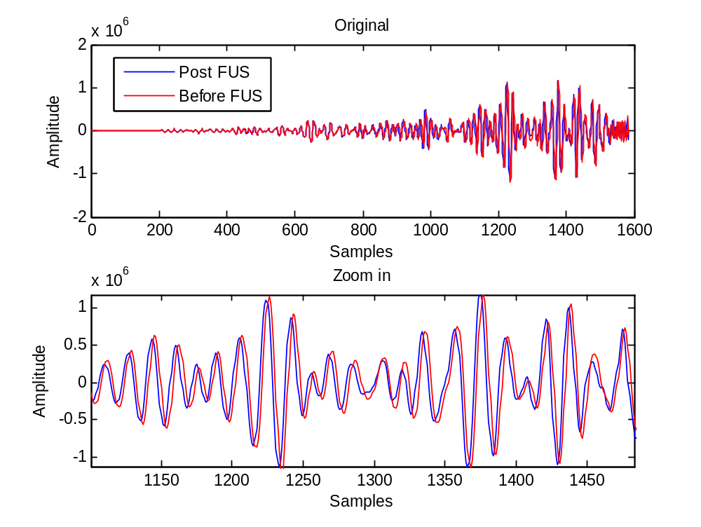

Slide 3
window size
overlapping ratio
Time

Slide 4
Ideal
Traditional CC
Echo time shift
Depth

