Slide 1
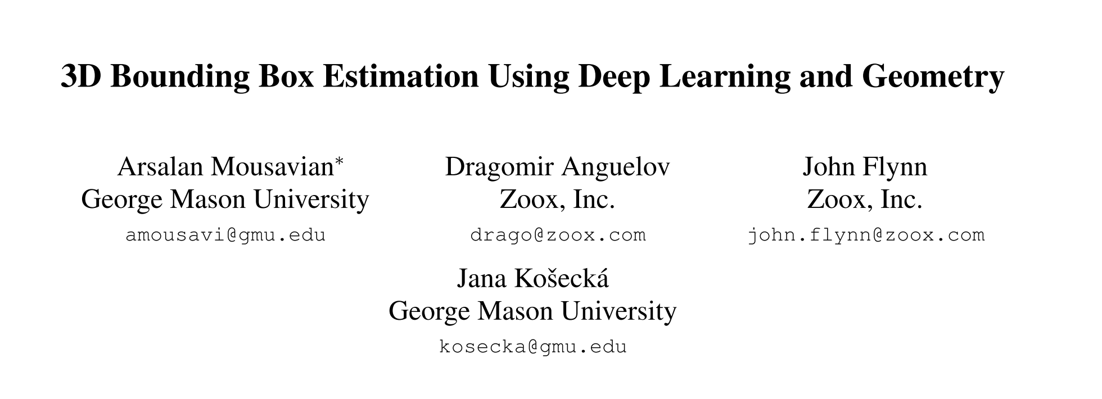

Slide 2

3D Box Definition
R = $\left[θ, ∅, α\right]$, Rotation
T = [$t_{x}{, t}_{y}, t_{z}$], Translation
D = [$d_{x}{, d}_{y}, d_{z}$], Dimension

Slide 3
Orientation Problem

Slide 4
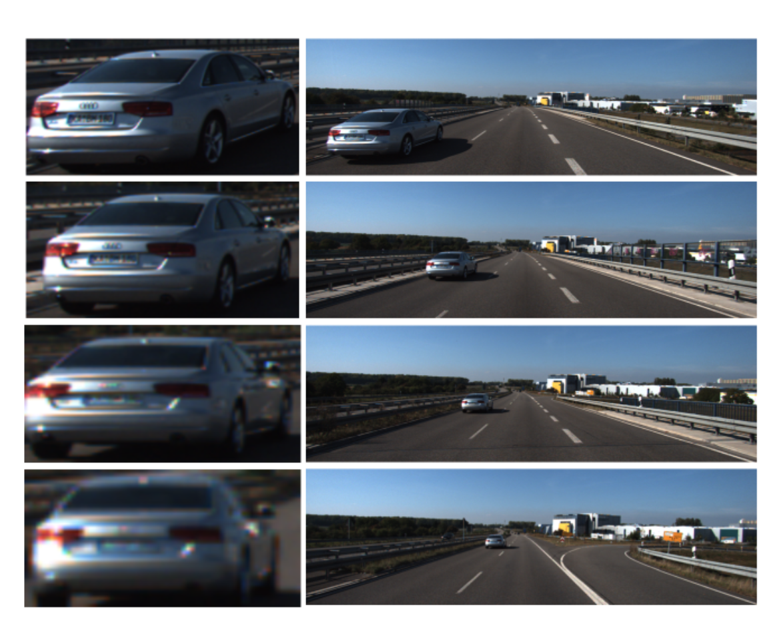
Orientation

Slide 5
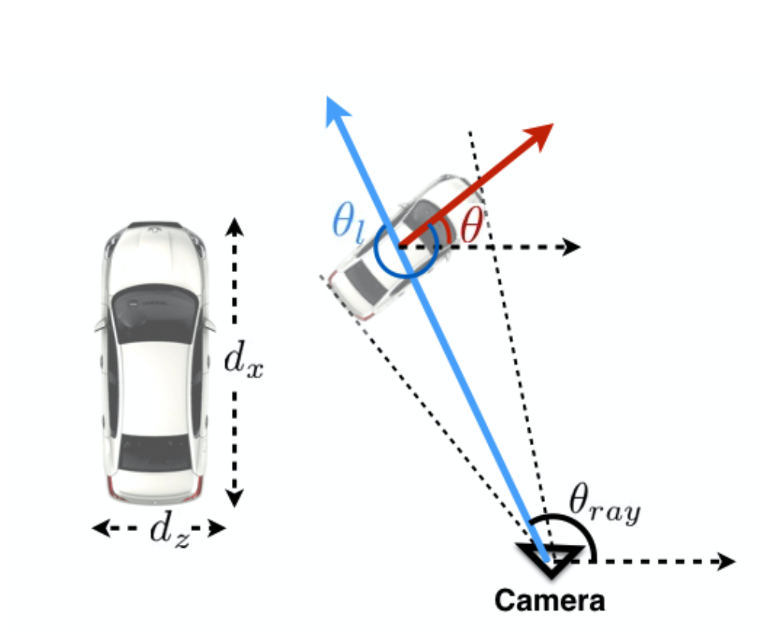

Orientation
$$θ= θ_{ray+ }θ_{l}$$

Slide 6
Procedure
Predict Orientation
Predict Dimension
Solve Translation
Low variance between each category
Solve linear system
Fatal to 3D Box

Slide 7
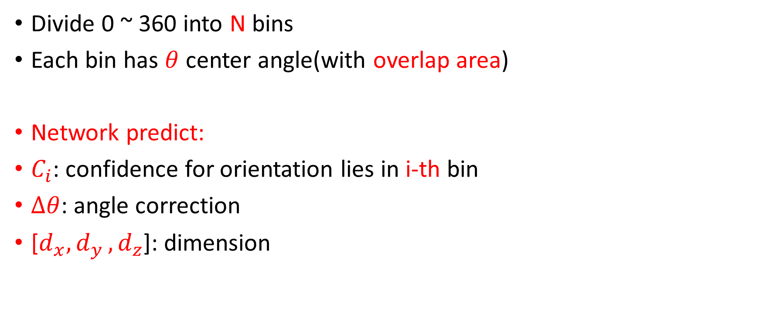
MultiBin Architecture
Divide 0 ~ 360 into N bins
Each bin has $θ$ center angle(with overlap area)
Network predict:
$C_{i}$: confidence for orientation lies in i-th bin
$∆θ$: angle correction
[$d_{x}{, d}_{y}, d_{z}$]: dimension

Slide 8
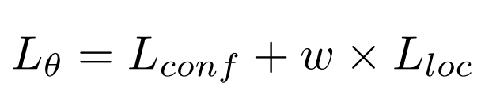
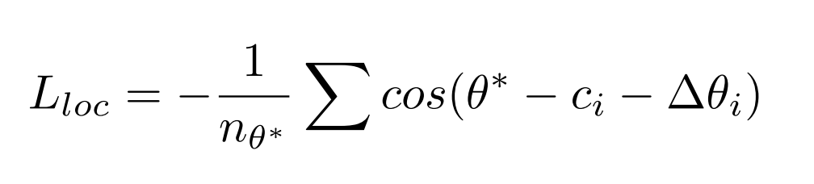
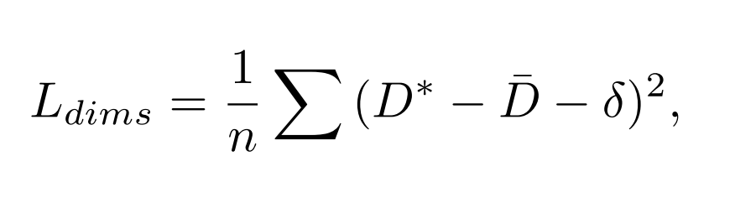

Slide 9
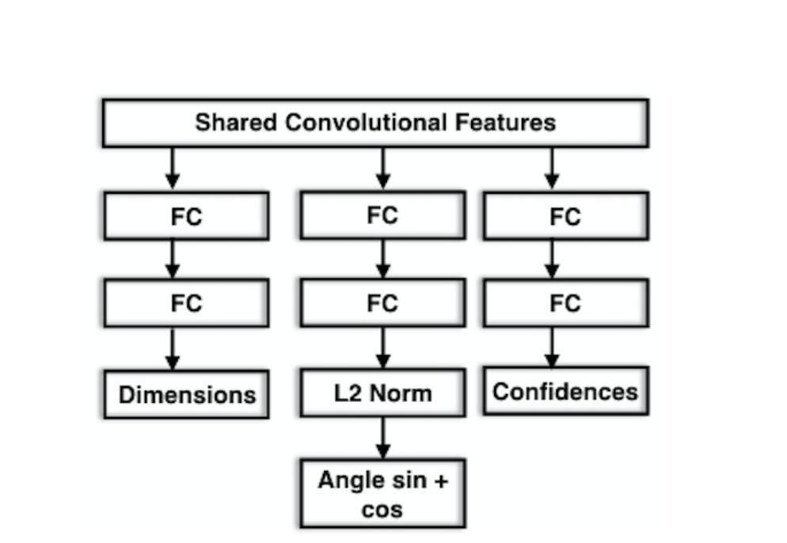
Network
VGG without FC

Slide 10
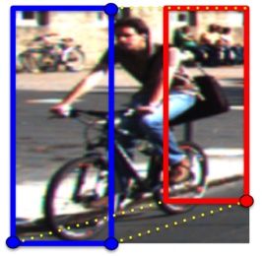
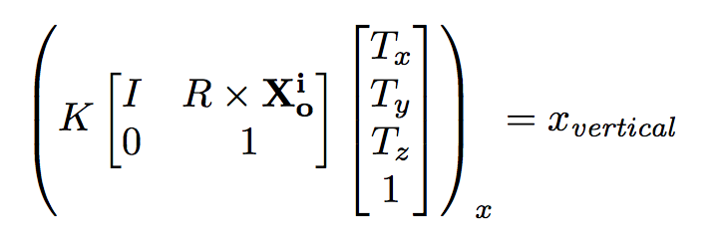
Translation
For vertical side of the 2D detection box
[±dx/2, .,±dz/2]
For horizontal side of the 2D detection box
[.,±dy/2,±dz/2]

Slide 11
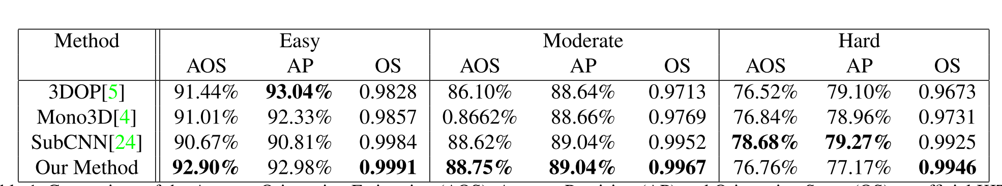
Orientation

Slide 12
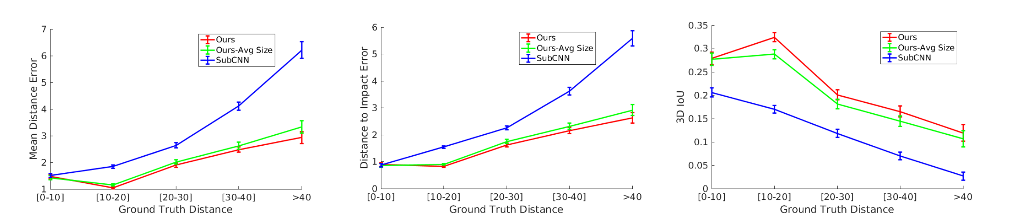
3D Bounding Box

