Slide 1
&yQaea B. B.
11 COHæø6pu 2025 r.

Slide 2


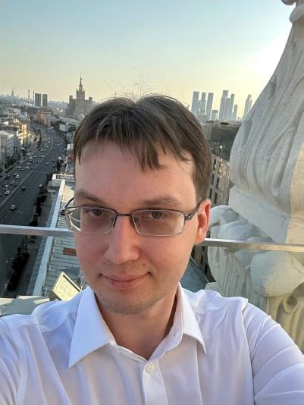
& y aea B iaqHMHp BnaQ,HMH OBiiu
MexMam MfiY, KaH,o,ii,o,am nayx (2006-2018)
https://istina.msu.ru/profi1e/FufaevVV
IJoc+qox &KH BIIID (2019-2021) BTB, YIJAMO (c 2021)
27 14

Slide 3



Y,QHao+eno an He»QQex+i+aHOCTo LLM a pemem+ix anropi++Mouecxnx aaqau^{l}
Model | Percent of puzzles solved fully | Percent of cells answered correcUy
GPT-4o | 0& | 9.SP
Gemini-1.5 Pro | 0& | 10.2
Causal Language Modeling Can Elicit Search and Reasoning Capabilities on Logic Puzzles, 2024

Slide 4
Y,QHao+eno an He»QQex+i+aHOCTo LLM a pemem+ix anropi++Mouecxnx aaqau^{l}
Model | Percent of puzzles solved fully | Percent of cells answered correcUy
GPT-4o | 0& | 9.SP
Gemini-1.5 Pro | 0& | 10.2
Causal Language Modeling Can Elicit Search and Reasoning Capabilities on Logic Puzzles, 2024
Chain-of-Thought?
O6yoe we ma nan ax?

Slide 5



Hierarchical Reasoning Model, 2025
Guan Wana, Jin Li, Yuhao Sun, Xing Chen, Changling Liu, Yue Wu, Meng Lu, Sen Sona, Yasin Abbasi Yadkori
Sapient Intelligence, Singapore

Slide 6



Hierarchical Reasoning Model, 2025
Guan Wang, Jin Li, Yuhao Sun, Xing Chen, Changling Liu, Yue Wu, Meng Lu, Sen Song, Yasin Abbasi Yadkori
Sapient Intelligence, Singapore
Sen Song
Tsinghua University, China

Slide 7




Hierarchical Reasoning Model, 2025
Guan Wana, Jin Li, Yuhao Sun, Xing Chen, Changling Liu, Yue Wu, Meng Lu, Sen Sona, Yasin Abbasi Yadkori
sapient
Sapient Intelligence, Singapore
Sen Song
Tsinghua University, China
https://discord.gg/sapient
https://github.corn/sapientinc/HRM

Slide 8


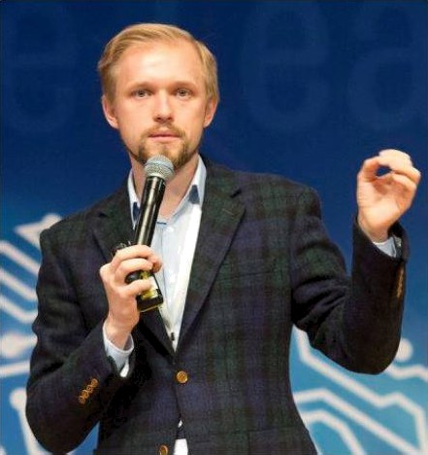
HiixoneHxo Cepreñ Hropeaiiu
https://www.wikipedia.org/)
KaH,O,1I,O,HT FiHlIKO-MaTehiaTxuOCxEfx Hayx (2009)
NOMH PAH CIJ6AY WKH BIIID

Slide 9
HzKoae KoCepreñWropeaza
UeMnHOH M R PfiK (2015, 2017,
https:// w.wikipedia.org/)
K£tHQFfQ,fiT HaHKO-Ma+eMa+Hoecxrix oayx (2009)
GOMH PAH CIJ6AY WKH BIIID
Data Fusion 2023: CoapeMenHoe nonome He gem a Myra-
HCO noHcxe
https://t.me/sinecor/
O•@S,O•
@5TNECOR
5 / 14

Slide 10


&opmynnpoøxa npo6nevoI:
Ecsc aaqauo xnacca P (pemaevole aa nonoHOMiianoooe ripens) , a ecsc pagan“,
pemaevole cxevavii nOcæOoHHOñ rny6nHL•I ( U⁰) .
LLM “,qymaio'r” ma ecæecæøeoHov ooolxe.

Slide 11
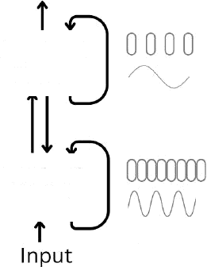
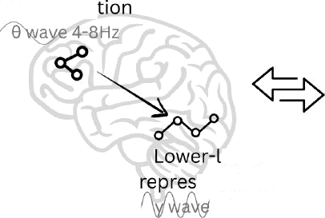

& opmyniipOaxa npo6nexinI:
Ecsc oaqauii xnacca P (peiuaexioIG HH nOH1IHOM1iaML•HOe apevo) , a ecsc oaqauii,
eITI aehl L•IG CXOhJHhJll EIOC TOHH HOñ ruy6iiH L•I A G ) .
LLM “,qysiaio'r’ Ha ecxeCTBOHHOhJ HHL•IKO.
Bio-inspired peiueHiie
Cross Frequency
Coupling
Meta- representa
H RM
Output
High-level Slo a'or
even
entation
Low-level
// = Update

Slide 12
& opmyniipOaxa npo6nexinI:
Ecsc oaqauii xnacca P (peiuaexioIG HH nOH1IHOM1iaML•HOe apevo) , a ecsc oaqauii,
eITI aehl L•IG CXOhJHhJll EIOC TOHH HOñ ruy6iiH L•I A G ) .
LLM “,qysiaio'r’ Ha ecxeCTBOHHOhJ HHL•IKO.
Bio-inspired peiueHiie
Cross Frequency
Coupling
Meta- representa
H RM
Output
High-level Slo a'or
even
entation
Low-level
// = Update
The HRM model consists of four learnable components: an input network f ( ; 8J) , a low-level recurrent module /p(-; 8p) , a high-level recurrent module IH ‹-: *H) , and an output network Jp (-; 8p ).

Slide 13



98 class Attention(nn.Module):
109
110
111
112
113
114
115
116
117
118
119
120
self.qkv_proj = CastedLinear(self.hidden_size, (self.num_heads + 2 " self.nun_key_value_head self.o_proj - CastedLinear(self.output_size, self.hidden_size, bias-False)
def forward(self, cos_sin: CosSin, hidden_states: torch.Tensor) -> torch.Tensor:
batch_s1ze, seq_1en, _ = h1dden_states.shape
# hidden_states: [bs, seq_len, num_heads, head_dim] qkv self.qkv_proj(hidden_states)
# Split head
qkv = qkv.view(batch_size, semen, self.num_heads + 2 " self.nun_key_va1ue_heads, self.head query = qkv[:, :, :self.num_heads]
129
130
131
132
133
134
135
136
# flash attn
attn_output
flash_attn_func(q-query, k=key, v=value, causal=self.causal)
lf isinstance(attn_output, tuple): # fa2 and fa3 compatibility attn_output = attn_output[e]
S attn_output: [batch_size, num_heads, semen, head_dim]
attn_output = attn_output.view(batch_size, seq_len, self.output_size) # type: ignore
returw self.o_proj(attn_output)
7 14

Slide 14


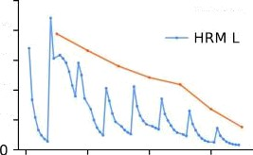
Bio-inspired
Tpmx №1: Hierarchical convergence
МедиеНнао Moqeuo o6yuae+co N maroa, бе•Ісхрао - TN (Pemae+ N раапых sa,цao)
250
zoo
150
iO0
50
HRM Н
Forna rd resid1ua
0
20 40
Depndex#
60
87 14

Slide 15
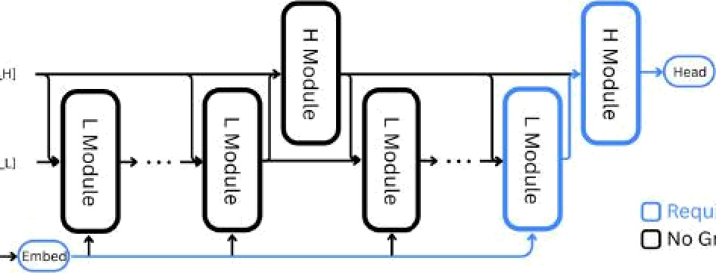
Biœinspired
Tpmx №1: Hierarchical convergence
MeдneH an Moqeuo o6yuaeæco N maroa, 6e•Icæpao - TN (Pemae+ N paanыx sa,цao)
250
zoo
150
iO0
50
HRM H
Forna rd resid1ua
0
20 Æ0
Depndex#
60
Tpmx №2: Approximate gradient
TeopeMa o neoBnOñ ynxrti+i+ a oxpecæ œ CTR TOUKi+ oKcæpemyva, nepøoie npo6ni+- ,
Unrolling over time
read —e[Outpu0
“
“
O(1) sMeczo O(W) no Ila u ’l'lż.
•
No d
” *"
87 14

Slide 16
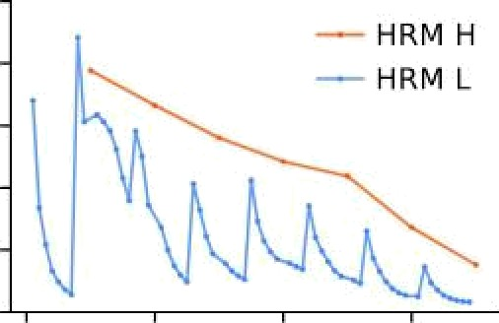
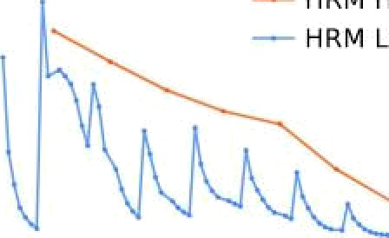
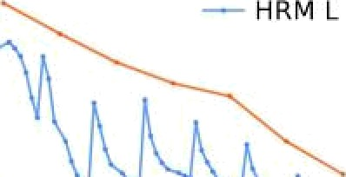
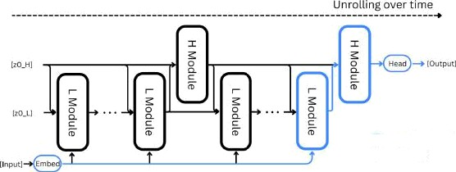
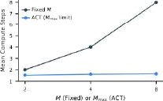
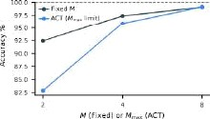
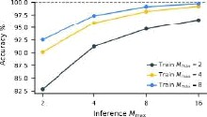
Biœinspired
Tpmx N-°1: Hierarchical convergence
MeдneHHaø Moдenь o6yuaeæcø N maroø, 6øicæpaø - TN (Pemaez N pmHoix Japan) %
250
HRN H
NRM L
z ZOO
E
œ 150
100
50
0
0
20 40
Step Ind6ex
60
Tpmx №2: Approximate gradient
TeopeMa o Heoønoñ Qynxqnri a oxpecænœ czn zouxo oxczpeMyMa, nepaьie npx6nx- were.
O(1) øMeczo O(F) no IIaMHTn.
@ Requires Grad
@ No Grad
Tpmx N-°3: Adaptive computational time
IJoд6H &ØT UHCuo nporoHoø Moдenn M. Q-learning algorithm no RL (MapKOB- CKHñ npoqecc: aa6øpaeM øarpaдy ønH дaømeMcø quume).
8/14

Slide 17



Допопненпе к тріоку 3:
Deep supervision: Допоиниzепьпые боссы на ка
ом mare (регуиярпаац ).

Slide 18
QononHeHiie x +pioxy 3:
Deep supervision: QonOnHEfTenL•HoIe nocCnI Ha Kamqoxi iiiare (peryuopHoaiiiio).
For all Transformer blocks in this work—including those in the baseline models—we incorporate the enhancements found in modern LLMs (based on Llama53 architectures). These improvements include Rotary Positional Encoding54, Gated Linear Units55, RMSNorm56, and the removal of bias terms from linear layers.
Furthermore, both HRM and recurrent Transformer models implement a
Post-Norm architecture. with weights initialized via truncated LeCun Norrrial initialization, while the scale and bias parameters are excluded from RMSNorm.

Slide 19


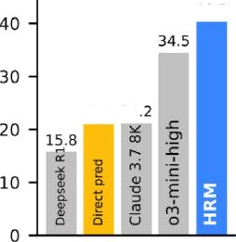
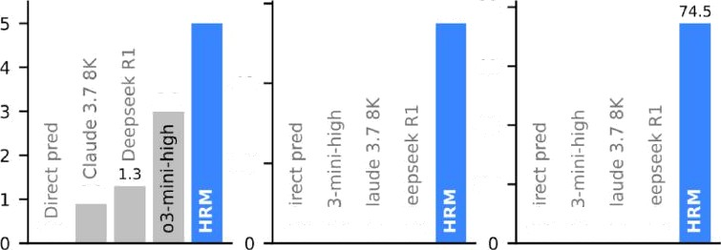
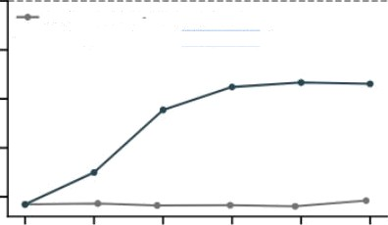
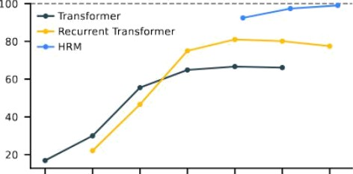


IJporpecc a pemeHim oaqaU (27M napave+poa)
ARC-AGI-1
960 training examples
40.3
ARC-AGI-2 Sudoku-Extreme (9x9) Maze-Hard (30x30)
1120 training examples 1000 training examples 1000 training examples
60
5.0 5s.o 80
40
60
Accuracy%
3.0
21.0 21
40
20
20
0.9
0.0
0.0 0.0 0.0 00
0.0 0.0 0.0 0.0
Chain-of-thought, pretrained
mm Direct prediction, small-sample learning
TOO
Scaling Width 8 Iayers I xed
—=- 5t aIing Depth S 2 hIdden size fixed
80
30
27M S4i•l
1 09M 218M
Parameters
436N
872Id
8
16 32 64 I2 B 256 512
Depth / Transformer layers computed
4 M rt ai n i n g exe rxip le s
1(’) 11

Slide 20
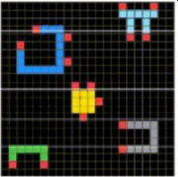
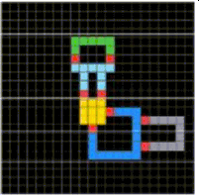
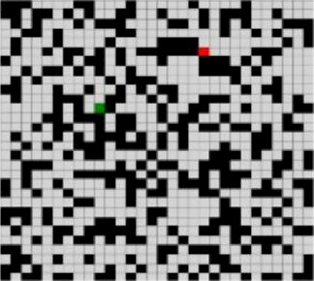
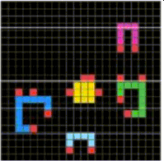
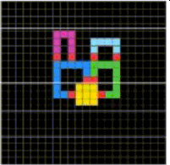
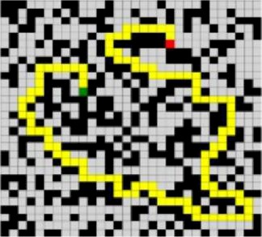
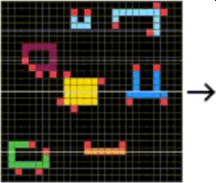


Нп+ерпре+пруеМос+ь
£ 5 | 2 | 1
2 | 5 | 9 | 5 | 4 | ? | 812
5 | 3 | В | 4 | 5 | 6 | 12 °
¢ |  | В | 2 | ? | 3 | 5 9 В
g | 7 | 2 | 8 | 5 |  | Z 6
5 | 9 | 3 | 5 |  | 8 | 2 7 4
Z | ¥ | 7 | 9 | 6 | 2 | 3 51
1 | Z | Б | ? | 3 | 4 | 6 В 9
--
(а) ARC-AGI
Q) Sudoku-Hnd
(с) Maze navigaèon
117 14

Slide 21
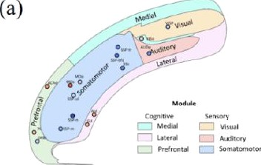
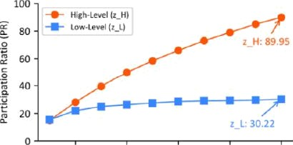
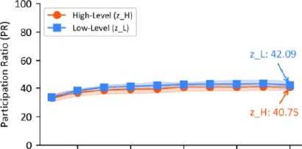
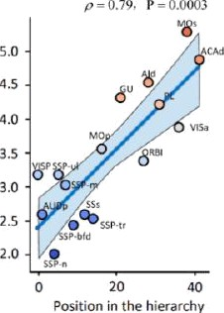

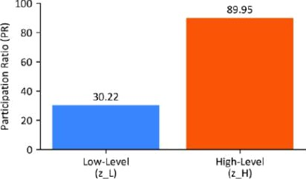
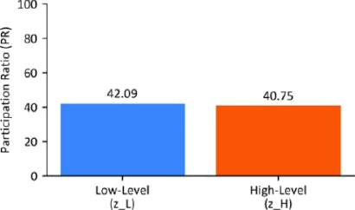


A HHHOPHH c 6xODOOHCJI (
IJOHTAHHEH HC H
XH H HHMG
HOCTOJI)
20
40 60
Number of Trajectories
80
100
20
40 6O
NumberofTraectones
80
100
(b)
(d)
Bid: Participation Ratio (P1'•) , a measure of effective neural dimensionality
en
eigenvalues of the covariance matrix of ncural trajectorios.
HRM: trajectories tasks, the covariance matrix derived from neural states gathered across rriultiple Sudoku-solving trajectories.

Slide 22


C . H. HiixoneHxo:
1) two ecnii vacm+a6ii OaH+o o+o go paovepoa coapeveHHoIX LLM?
2) D TO HOBL•Iñ anropiixviiuecxiiñ AI? (KOMIJHKTHL•Iñ, He xpe6ym qaxacexoa H cnertiianiioll OBHHHL•III HP KOHxpexHaIX oa,qauax) Ero iiCnOnoooaa+o xax qononHeHHe x LLM.
Hii 6OHL•ITIHX
xiOMHO
1. l 1

Slide 23

H. Hrixoneoxo:
two ecnH vacmTa6opoaa+o o+o go pmvepoa coapeveoHoIX LLM?
WTO HOBfiIil anropo+vi+uecxoñ AI? (xovnax+HfiIñ, we +pe6yio nñ 6onamnx qa+ace+oa ii cnertoanooopoaaHHL•Iil Ha KoHxpe+ooIX aa,qauax) Ero vomoo ocnonoooaa+o xax qononneHi+e x LLM.
Pao6op pw6opa:
C+a+oo 10/ 10, PM6op 9/ 10 (-1 oa-aa bio-inspiration -0 oa can. noqpo6ooCTii) .
He eqoHc+aeoooIH aoavOMHL•Iñ cooCO6 moqenopoaa+a +axyio pa6o+y moara.
(Energy-based Transformers)

Slide 24


Bnaroqapm H£t BHiIMa
rie!
14 / 14

Slide 25


Bnaroqapm H£t BHiIMa
rie!
t.me/t1g vld f
ArtAI: Theory and Practice
t.me/Art AI_T P
https://github.com/fufaevvlvl
14 / 14

Slide 26
Bnaroqapm H£t BHiIMa
rie!
t.me/t1g vld f
ArtAI: Theory and Practice
t.me/Art AI_T P
https://github.com/fufaevvlvl
2025 08 Transformers Week
Flash Attention
Energy-based Transformers
14 / 14

