Slide 1
Thread Cluster Memory Scheduling:
Exploiting Differences in Memory Access Behavior
L N PANDEY PRINCE KUMAR
PRIYA DIXIT

Slide 2
SINCERE THANKS TO:
DR. PROF. V. KAMAKOTI - IIT MADRAS
DR. PROF. ONUR MUTLU - CARNEGIE MELLON UNIVERSITY

Slide 3
PROJECT STATUS
PROJECT SPONSOR
IIT MADRAS and Govt. of INDIA
1. WORKING WITH 8 CORES 2. Main goal is to upgrade it to 24 CORES 3. We are working remotely from AIT on IITM servers under MS and PhD scholars. 4. In next 2-3 months we will get Bluespec licensed version in our college.

Slide 4


Motivation
Memory is a shared resource
Core Core
Memory
Core Core
Threads’ requests contend for memory
Degradation in single thread performance
Can even lead to starvation
How to schedule memory requests to increase
both system throughput and fairness?

Slide 5
Previous Scheduling Algorithms are Biased
17
15
13
11
9
7
5
3
1
Better fairness
Maximum Slowdown
System throughput
bias
FRFCFS STFM PAR-BS ATLAS
Fairness bias
8
8.2 8.4 8.6 8.8
Weighted Speedup
Better system throughput
9
No previous memory scheduling algorithm provides
both the best fairness and system throughput

Slide 6














Why did Previous Algorithms Fail?
Throughput biased approach Fairness biased approach
Prioritize less memory-intensive threads Take turns accessing memory
Good for throughput
thread A
Does not starve
less memory intensive
thread B
higher priority
thread C
thread A
thread B
thread C
not prioritized ➔
reduced throughput
starvation ➔ unfairness
Single policy for all threads is insufficient

Slide 7






















Insight: Achieving Best of Both Worlds
higher
priority
thread thread thread thread
For Throughput
Prioritize memory-non-intensive threads
For Fairness
Unfairness caused by memory-intensive
being prioritized over each other
Shuffle threads
Memory-intensive threads have
different vulnerability to interference
Shuffle asymmetrically
thread
thread
thread
thread

Slide 8
Outline
Motivation & Insights
Overview
Algorithm
Bringing it All Together
Evaluation
Conclusion

Slide 9
Overview: Thread Cluster Memory Scheduling
Group threads into two clusters
Prioritize non-intensive cluster
Different policies for each cluster
higher priority
Non-intensive
cluster
Memory-non-intensive
thread
thread
Throughput
thread
Prioritized
thread
higher priority
thread
thread
thread
Threads in the system
Memory-intensive
Intensive cluster
Fairness

Slide 10
Outline
Motivation & Insights
Overview
Algorithm
Bringing it All Together
Evaluation
Conclusion

Slide 11
TCM Outline
1. Clustering

Slide 12





















Clustering Threads
Step1 Sort threads by MPKI (misses per kiloinstruction)
^{th} thread thread _{thread}
^{re} read
ad
th
higher
MPKI
Intensive
cluster
Non-intensive
cluster
αT
T
T = Total memory bandwidth usage
α < 10%
ClusterThreshold
Step2 Memory bandwidth usage αT divides clusters
10

Slide 13
TCM Outline
Clustering
Between
Clusters

Slide 14
Prioritization Between Clusters
Prioritize non-intensive cluster
>
priority
Increases system throughput
Non-intensive threads have greater potential for
making progress
Does not degrade fairness
Non-intensive threads are light
Rarely interfere with intensive threads

Slide 15
TCM Outline
3. Non-Intensive
Cluster
1. Clustering
Throughput
2. Between
Clusters

Slide 16
Non-Intensive Cluster
Prioritize threads according to MPKI
higher
priority
lowest MPKI
thread
thread
thread
thread
highest MPKI
Increases system throughput
– Least intensive thread has the greatest potential
for making progress in the processor

Slide 17
TCM Outline
3. Non-Intensive
Cluster
1. Clustering
Throughput
4. Intensive
Cluster
2. Between
Clusters
Fairness

Slide 18

Intensive Cluster
Periodically shuffle the priority of threads
higher
Most prioritized
priority
thread
thread
Increases fairness
thread
Is treating all threads equally good enough?
BUT: Equal turns ≠ Same slowdown

Slide 19
Case Study: A Tale of Two Threads
Case Study: Two intensive threads contending
random-access
streaming
Which is slowed down more easily?
Prioritize random-access
Prioritize streaming
14
12
10
8
6
4
2
0
14
12
10
8
6
4
2
0
11x
Slowdown
Slowdown
7x
prioritized
prioritized
1x
1x
random-access streaming random-access streaming
random-access thread is more easily slowed down

Slide 20
Why are Threads Different?
rows
Memory
Bank 1
Bank 2
Bank 3
Bank 4

Slide 21
Why are Threads Different?
random-access
activated row
req
rows
Memory
req
req
req
Bank 1 Bank 2 Bank 3
Bank 4
All requests parallel
High bank-level parallelism

Slide 22
Why are Threads Different?
random-access streaming
req
activated row
req
req
rows
Memory
req
Bank 1 Bank 2 Bank 3
Bank 4
All requests parallel
High bank-level parallelism
All requests ➔ Same row
High row-buffer locality
20

Slide 23
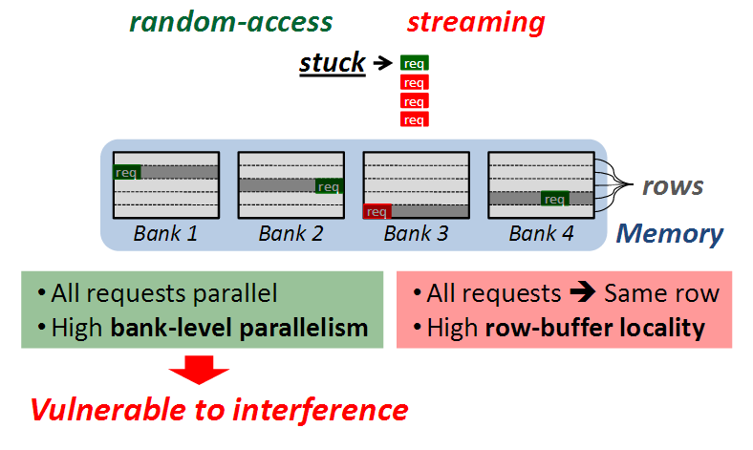
Why are Threads Different?

Slide 24
TCM Outline
3. Non-Intensive
Cluster
1. Clustering
Throughput
4. Intensive
Cluster
2. Between Clusters
Fairness

Slide 25
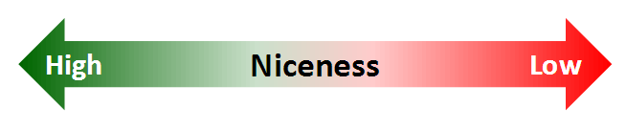
Niceness
How to quantify difference between threads?
Bank-level parallelism
Row-buffer locality
Vulnerability to interference
Causes interference
+
-
Niceness

Slide 26
Shuffling: Round-Robin vs. Niceness-Aware
1. Round-Robin shuffling
⬅ What can go wrong?
2. Niceness-Aware shuffling

Slide 27
Shuffling: Round-Robin vs. Niceness-Aware
1. Round-Robin shuffling
⬅ What can go wrong?
2. Niceness-Aware shuffling
Most prioritized
D A B C
GOOD: Each thread prioritized once
D
Priority
D
A
B
C
D
Nice thread
C
D
A
B
C
B
C
D
A
B
Least nice thread
Time
A
B
C
D
A
ShuffleInterval

Slide 28
Shuffling: Round-Robin vs. Niceness-Aware
1. Round-Robin shuffling
⬅ What can go wrong?
2. Niceness-Aware shuffling
Most prioritized
D A B C
GOOD: Each thread prioritized once
D
Priority
D
A
B
C
D
D C B
Nice thread
C
A
B
C
B
D
C
A
B
Least nice thread
Time
A
D
A
BAD: Nice threads receive lots of interference
ShuffleInterval

Slide 29
Shuffling: Round-Robin vs. Niceness-Aware
1. Round-Robin shuffling
2. Niceness-Aware shuffling

Slide 30
Shuffling: Round-Robin vs. Niceness-Aware
1. Round-Robin shuffling
2. Niceness-Aware shuffling
GOOD: Each thread prioritized once
Most prioritized
D C
B
A
D
Priority
D
D
B
A
D
Nice thread
C
C
C
B
C
B
B
D
C
B
Least nice thread
Time
A |  | A |  | A
D
A
ShuffleInterval

Slide 31
Shuffling: Round-Robin vs. Niceness-Aware
1. Round-Robin shuffling
2. Niceness-Aware shuffling
GOOD: Each thread prioritized once
Most prioritized
D C
B
A
D
Priority
D
D
B
A
D
Nice thread
C
C
C
B
C
B
B
D
C
B
Least nice thread
Time
A |  | A |  | A
D
A
GOOD: Least nice thread stays mostly deprioritized
ShuffleInterval

Slide 32
TCM Outline
3. Non-Intensive
Cluster
1. Clustering
Throughput
4. Intensive
Cluster
2. Between Clusters
Fairness
30

Slide 33
Outline
Motivation & Insights
Overview
Algorithm
Bringing it All Together
Evaluation
Conclusion

Slide 34
Quantum-Based Operation
Previous quantum
(~1M cycles)
Current quantum
(~1M cycles)
Time
Shuffle interval
(~1K cycles)
Beginning of quantum:
Perform clustering
Compute niceness of
intensive threads
During quantum:
Monitor thread behavior
Memory intensity
Bank-level parallelism
Row-buffer locality

Slide 35
TCM Scheduling Algorithm
Highest-rank: Requests from higher ranked threads prioritized
Non-Intensive cluster > Intensive cluster
Non-Intensive cluster: lower intensity ➔ higher rank
Intensive cluster: rank shuffling
Row-hit: Row-buffer hit requests are prioritized
Oldest: Older requests are prioritized

Slide 36
Implementation Costs
Required storage at memory controller (24 cores)
Thread memory behavior | Storage
MPKI | ~0.2kb
Bank-level parallelism | ~0.6kb
Row-buffer locality | ~2.9kb
Total | < 4kbits
No computation is on the critical path

Slide 37
Outline
Motivation & Insights
Overview
Algorithm
Throughput
Bringing it All Together
Evaluation
Conclusion
Fairness

Slide 38
Previous Work
FRFCFS [Rixner et al., ISCA00]: Prioritizes row-buffer hits
Thread-oblivious ➔ Low throughput & Low fairness
STFM [Mutlu et al., MICRO07]: Equalizes thread slowdowns
Non-intensive threads not prioritized ➔ Low throughput
PAR-BS [Mutlu et al., ISCA08]: Prioritizes oldest batch of requests while preserving bank-level parallelism
Non-intensive threads not always prioritized ➔ Low
throughput
ATLAS [Kim et al., HPCA10]: Prioritizes threads with less memory service
Most intensive thread starves ➔ Low fairness

Slide 39

Results: Fairness vs. Throughput
Averaged over 96 workloads
16
FRFCFS
Better fairness
Maximum Slowdown
14
ATLAS
5%
12
STFM
10
39%
PAR-BS
5%
8
TCM
6
8%
7.5 8 8.5 9 9.5 10
4
Weighted Speedup
Better system throughput
TCM provides best fairness and system throughput

Slide 40


Results: Fairness-Throughput Tradeoff
When configuration parameter is varied…
12
FRFCFS
10
Better fairness
Maximum Slowdown
STFM
ATLAS
8
PAR-BS
6
TCM
4
2
Adjusting
12
13
14
Cluste¹r⁵Threshold¹⁶
Weighted Speedup
Better system throughput
TCM allows robust fairness-throughput tradeoff

Slide 41
Outline
Motivation & Insights
Overview
Algorithm
Throughput
Bringing it All Together
Evaluation
Conclusion
Fairness

Slide 42
Conclusion
No previous memory scheduling algorithm provides
both high system throughput and fairness
– Problem: They use a single policy for all threads
TCM groups threads into two clusters
Prioritize non-intensive cluster ➔ throughput
Shuffle priorities in intensive cluster ➔ fairness
Shuffling should favor nice threads ➔ fairness
TCM provides the best system throughput and fairness

Slide 43
How TO IMPLEMENT THIS??
BLUESPEC TECHNOLOGY

Slide 44
WHAT is OUR ROLE?
We are contributors in SHAKTI PROCESSORS It is India’s First open source HARDWARE INITIATIVE.

Slide 45

THANK YOU….. Any Questions?

