Slide 1
Image中操作的应用
1.above、beside、overlay的基本应用
(beside/align "bottom"
(triangle 40 "solid" "red")
(triangle 30 "solid" "red"))
(define victorian
(above (beside/align "bottom"
(triangle 40 "solid" "red")
(triangle 30 "solid" "red"))
(rectangle 70 40 "solid" "black")))
(define door (rectangle 15 25 "solid" "brown"))

Slide 2

(overlay/align "center" "bottom" door victorian)
(define door-with-knob
(overlay/align "right" "center" (circle 3 "solid" "yellow")
door))
(define house(overlay/align "center" "bottom" door-with-knob victorian))

Slide 3
2.above、beside迭代产生的效果
(define (koch-curve n)
(cond
[(zero? n) (square 1 "solid" "black")]
[else
(local [(define smaller (koch-curve (- n 1)))]
(beside/align "bottom"
smaller
(rotate 60 smaller)
(rotate -60 smaller)
smaller))]))

Slide 4
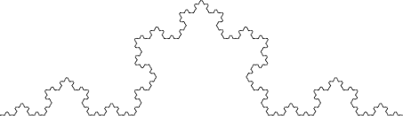
(koch-curve 5)

Slide 5
3.旋转、迭代、颜色透明度的结合
定义函数spin-alot
(define (spin-alot t)
(local [(define (spin-more i θ)
(cond
[(= θ 360) i]
[else
(spin-more (overlay i (rotate θ t))
(+ θ 1))]))]
(spin-more t 0)))

Slide 6


(spin-alot (isosceles-triangle 120 30 "solid" (color 0 0 255 1)))
(rectangle 120 30 "solid" (color 0 0 255 1)))

Slide 7


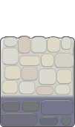
一个有趣的库(require 2htdp/planetcute)
http://www.lostgarden.com/2007/05/dancs-miraculously-flexible-game.html （planetcute的网站）

Slide 8
应用image的基本操作构建planetcute场景
定义新操作：
(define (stack imgs)
(cond [(empty? (rest imgs))(first imgs)]
[else (overlay/xy (first imgs)
0 40
(stack (rest imgs)))]))

Slide 9
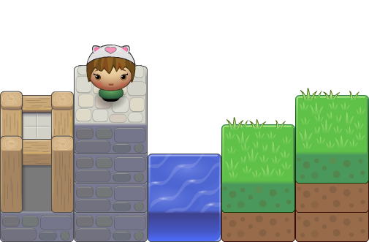
应用stack和image的基本above、beside等基本操作构建的场景
(beside/align
"bottom"
(stack (list wall-block-tall stone-block))
(stack (list character-cat-girl
stone-block stone-block
stone-block stone-block))
water-block
(stack (list grass-block dirt-block))
(stack (list grass-block dirt-block dirt-block)))

Slide 10
应用基本操作自定义新操作：
(define (vertical-align imgs)
(cond [(empty? (rest imgs))(first imgs)]
[else (underlay/xy (first imgs)
0 80
(vertical-align (rest imgs)))]))
(define (horizon-align imgs)
(cond [(empty? (rest imgs))(first imgs)]
[else (overlay/xy (first imgs)
100 0
(horizon-align (rest imgs)))]))
(define (put/xy x y img1 img2)
(overlay/xy img1
(- 0 (* 100 x)) (+ 40(* 80 (- 0 y)))
img2))
(define (stack/xy x y new old)
(overlay/xy new
(- 0 (* 100 x))(* 80 (- 1 y))
old))

Slide 11
