Slide 1
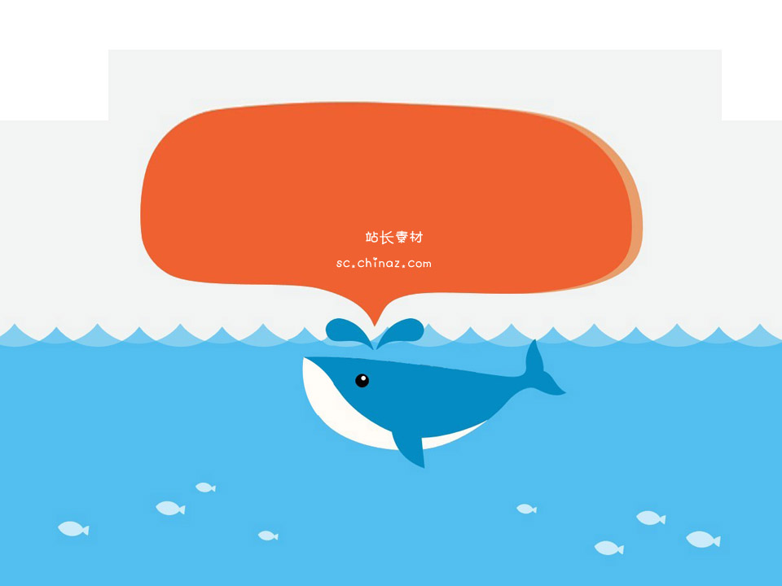
GIT
一个版本控制神器

Slide 2
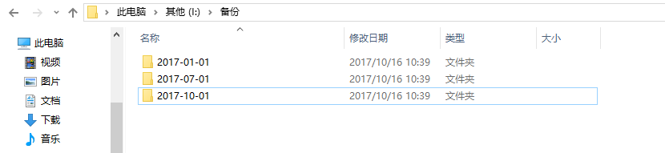
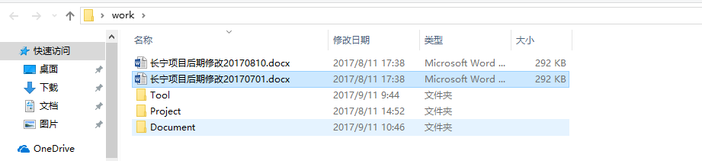
什么是版本控制？
看看下面的版本备份例子

Slide 3
什么是版本控制？

Slide 4

目录
点击添加标题
点击添加标题

Slide 5

添加文本
点击添加文本
点击添加文本
点击添加文本

Slide 6

添加文本
点击添加文本
点击添加文本

Slide 7
What is Social Journal?
Social Journal is a new platform that will help the journalists to improve the way they create content for online newspapers:
Get all the multimedia tools to upload photos, audios or videos.
Create content from the web or mobile device.
Present their social activity from elsewhere on the Newspaper.
Social Journal will help newspapers to engage readers in a new way and monetize their activity:
Allow them to get access to their favorite journalist’s articles.
Comment and share all the content.

Slide 8





Multimedia Web and Mobile upload tools for the journalists
Write posts
Upload Video
Upload Photos
Record Live Video
Journalist

Slide 9



Full integration allows journalists and readers to use their Facebook and Twitter credentials.
journalists can present their Facebook and Twitter content in the newspaper.
Newspaper’s
Social Journal

Slide 10
Journalist’s content can get posted instantly on Facebook and Twitter:
Photos
Journalist
Posts
Videos

Slide 11




Allows readers to comment on articles and expand article visibility via “share” or “recommend” tools:
Users
Comments
FULLY MODERATED
Favorite
Share

Slide 12
Readers can follow and receive updates from their favorite journalists
FOLLOW
Journalist 1
Journalist 3
Users
UPDATES
Journalist 2

Slide 13


Readers can “friend” other readers and send messages to one another
FRIENDS

Slide 14

Users backend management tools and newsletters platform:
User 1
User 3
User 2
Newsletter
Journalist 1
Journalist 2

Slide 15
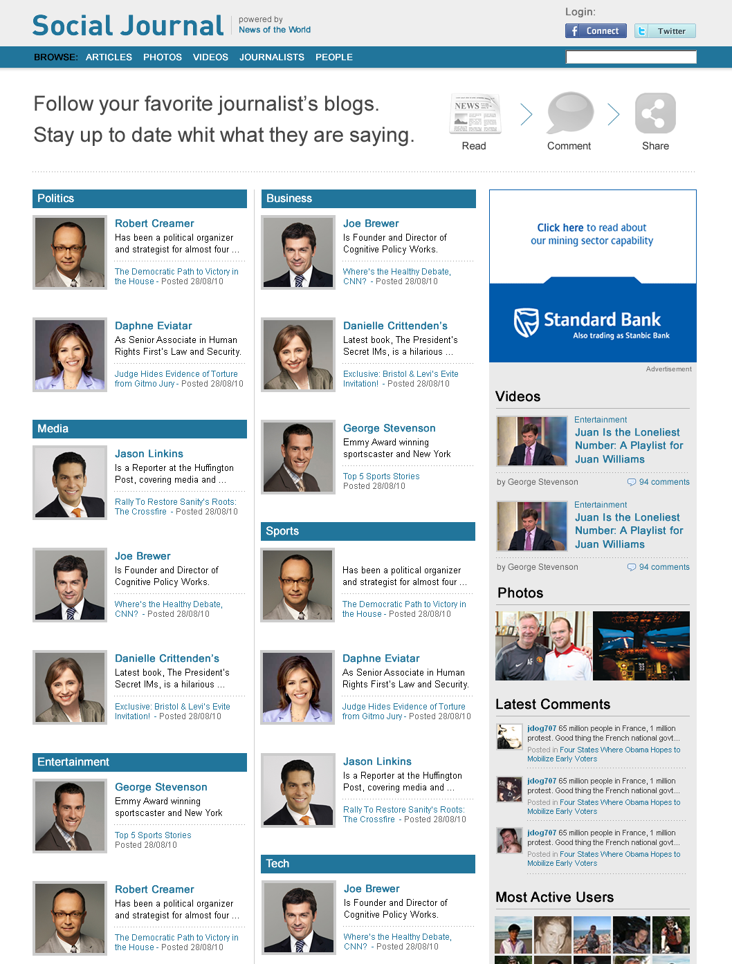
Users can login via Facebook and Twitter
At the home page, all the journalists are listed with their latest headline.
Ad Banner 300x250
Latest videos uploaded by journalists
Latest photos by journalists
Latest comments from users
More active users in the community
Home Page with all the journalists

Slide 16
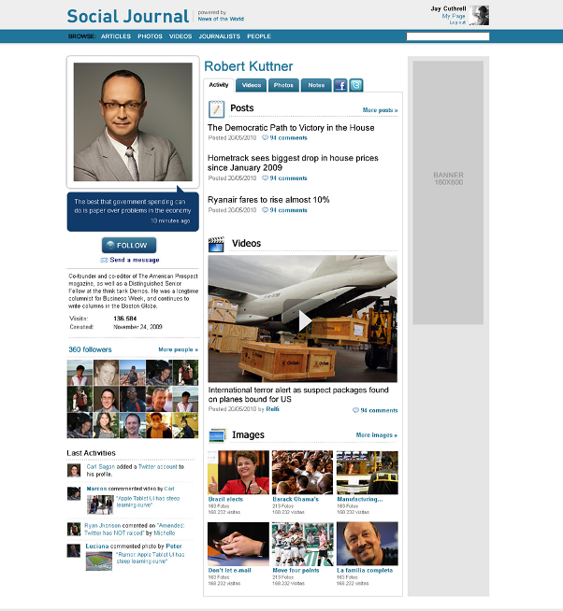
Journalist contents. photos, videos, posts and feeds from Facebook and Twitter.
User logged in.
Ad Space Banner 160x600.
Latest news written by the journalist. The link takes the user to the article in the main newspaper.
Users can follow journalists, and receive updates in their own space.
Latest videos uploaded by the journalist.
Users who are following the journalists.
Latest activities of the journalist’s followers.
Latest photos uploaded by the journalist.
Journalist’s Space

Slide 17
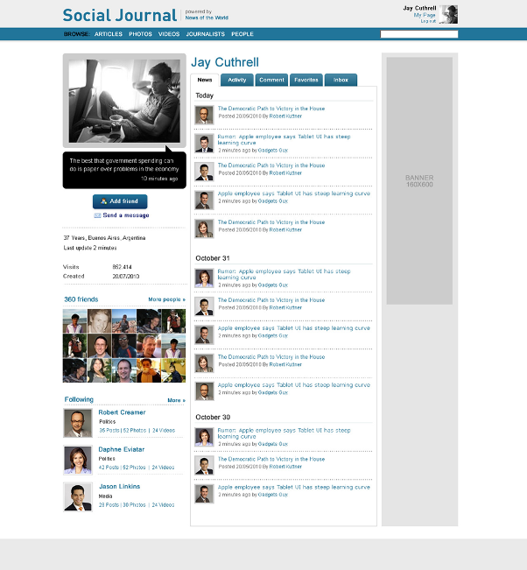
Users can see the latest news, the activity of their friends, their comments on the website, their favorite articles from the newspaper and messages sent from users and the newspaper.
Users can make friends with other users.
In their own space, users can see the feed of latest articles published by the journalists who they are following.
The links from these articles take the user to the newspaper’s website.
Journalists that the user is following.
User’s Space

Slide 18
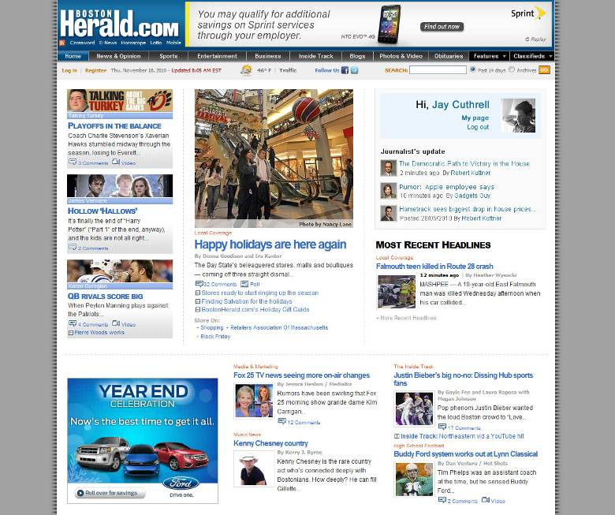
When a user logs into the newspaper’s
website the articles of the journalists being followed can be seen.
Newspaper’s Home with users news feed

Slide 19
Thank You!

