Slide 1
Performance Analysis of Cache for SPEC CPU2000 Benchmarks
Group member: Yuwei Huang, Shuo Fan, Peiyao Yang
December 8th,2015

Slide 2
SimpleScalar and SPEC 2000
SimpleScalar is a set of tools that model a virtual computer system with CPU, Cache and Memory Hierarchy.
SimpleScalar can simulate Alpha and PISA,ARM, and x86 instruction sets
SimpleScalar tools can be built on either UNIX or Windows NTbased Operating Systems
sim-cache: This simulator can emulate a system with multiple levels of instruction and data caches, each of which can be configured for different sizes and organizations.
SPEC 2000 is one of the benchmark suites developed by the Standard Performance Evaluation Corporation (SPEC)
References:
1.www.simplescalar.com
2.http://www.ecs.umass.edu/ece/koren/architecture/Simplescalar/SimpleScalar_introduction.htm

Slide 3
Methodology
All functional data are collected from the Simplescalar toolset. We modified the simulator to simulate multiple caches, and report statistics every 100 million instructions. L1 instruction and L1 data cache ranging from 1KB to 256KB with 64B block size and set associativity of 1, 2, 4, 8 and full.
We modified the Simplescalar to distinguish between prefetch and load/store instructions and statistic the number of load/store instructions and prefetch instructions.
We run benchmarks with and without prefectch operation and see the performance of L1 data cache.
We test four spec2000 benchmarks: the gzip, the swim, the ammp, and the applu, the gzip is a integer benchmark and the swim, ammp and the applu is the float benchmark.

Slide 4
Prefetch
Prefetch is a cache optimization way to reduce the miss ratio and improve the performance of the cache.
Two kinds of prefetch:
1 Hardware prefetch
Fetch two blocks on miss, when a cache miss occurs, fetch the required block and another block(prefetch)
2 Compiler prefetch:
Insert prefetch instructions when compile program
In this project, we used the hardware prefetch.

Slide 5
Algorithms of hardware prefetch
1 Next line prefetching
When processor need a block, the block next to the required block may also be needed in shortly future. So this algorithm fetch the required block and the block next to the required block when a cache miss occurs.
2 stride prefetching
Using a Reference Predictor Table (RPT) to record the previous address of memory instructions and determine which block to prefetch based on the historical data.
3 Other prefetch algorithms

Slide 6
Potential side-effect of prefetching that may decrease the cache performance
Cache pollution:
The prefetched data may replace the more useful data in the cache and actually decrease the cache performance. When the cache size is small, it is more possible for the occur of cache pollution and the decrease of the performance. We can see this in the data analysis of cache simulation.
Prefetch will use the memory bandwidth
When the prefetch operation works not well, it may have very negative impact on performance.
In this project, we choose the next line prefetch algorithm to research the impact of prefetch on the cache performance.

Slide 7
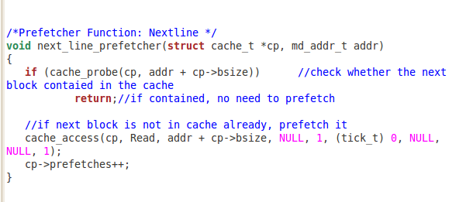
Implementation of next line prefetch
In order to implement the next line prefetch, we modified the Simplescalar code. Our main work is to add the prefetch function and the function to control whether the prefetch operation is executed.
The prefetch function

Slide 8
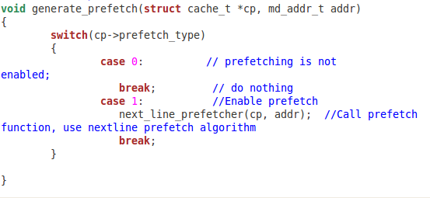

Function to choose whether to execute the prefetch operation
Code to print out the number of prefetches

Slide 9
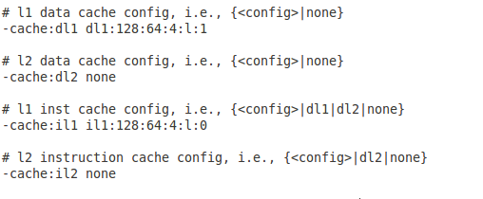
Configuration file to set the parameter of cache
There are five parameter to simulate the cache, the first one means number of sets, the second means block size, the third is set associative, the forth is the replacement strategy and the last one is used to set whether to use a prefetch operation. 1 means with prefetch and 0 means without prefetch.
In this sample, both the level 1 instruction cache and the level 1 data cache are set to be 32KB cache size with 64B block size and 4-way set associativity. The data cache with the prefetch and the instruction cache without the prefetch.

Slide 10
Simulation result
Benchmark | Instructions | Loads/Stores | Load/Store Rate | Prefetches | Prefetch Rate
swim | 100000000 | 24350876 | 0.243509 | 139814 | 0.001398
gzip | 100000000 | 32664925 | 0.326649 | 1071905 | 0.010719
ammp | 100000000 | 30715803 | 0.307158 | 3479400 | 0.034794
applu | 100000000 | 32701906 | 0.327019 | 660152 | 0.006601
Loads and prefetch instructions statistics every 100 million instructions using four spec2000 benchmarks
Simulation parameter: 32KB cache, 64Bytes block size, 2-way set associative

Slide 11
Miss ratio result using benchmark Gzip (Integer)
Level 1 Instruction cache:
We can find the miss ratio generally decrease as the increase of the cache size and the set associative.

Slide 12
Miss ratio result using benchmark Gzip(Integer)
Level 1 data cache without prefetch operation
Level 1 data cache with prefetch operation
For the miss ratio with and without the prefetch, we can find prefetch decrease the miss ratio in bigger size cache. When the cache is bigger, the efficiency is better. But the miss ratio in smaller size cache increase, this may be resulted from cache pollution.

Slide 13
Miss ratio result using benchmark swim (Float)
Level 1 Instruction cache:

Slide 14
Miss ratio result using benchmark swim (Float)
Level 1 data cache without prefetch operation
Level 1 data cache with prefetch operation
There is a similar result as the benchmark gzip

Slide 15
Miss ratio result using benchmark applu (Float)
Level 1 Instruction cache:

Slide 16
Miss ratio result using benchmark applu (Float)
Level 1 data cache without prefetch operation
Level 1 data cache with prefetch operation
In the benchmark applu, almost all the miss ratio decreased after using prefetch operation

Slide 17
Conclusion
1 When the set associative increases, the miss ratio of cache generally decreases. This is because when the set associative increase, it will reduce the conflict misses and improve the cache performance.
2 When the cache size increases, the miss ratio generally decreases. This is because when the cache size becomes larger, it will reduce the capacity misses.
3 The efficiency of prefetch operation depends on the prefetch algorithm, if the prefetch algorithm designed well and can avoid prefetching too much useless data, it will improve the miss ratio significantly, or it may decrease the performance.
4 When using the next line prefetching algorithm, it has quite good efficiency in larger size cache and may decrease the performance of small size cache.

