Slide 1
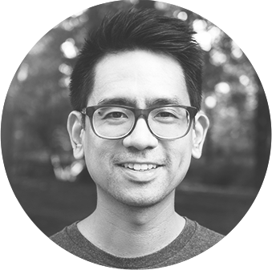
Fred Duong
I research compassion, empathy, and gratitude.
I study their effects on moral judgement, and prosocial decision-making and behaviors. I am a PhD student at Northeastern University, working with David DeSteno and Judith A. Hall.
Google Scholar

Slide 2




Fred Duong
I research compassion, empathy, and gratitude.
I study their lay conceptions and their effects on moral judgement and decision-making, with a focus on prosocial behaviors. I am a PhD student at Northeastern University, working with David DeSteno and Judith A. Hall.
VISUAL PORTFOLIO | OSF | RESEARCHGATE | GITHUB

