Slide 1
Be Free, Little Guardbunny!
Presented at Shmoocon 2016
Kristin Paget
Director of Security Data Cloud
kristin@tombom.co.uk
kpaget@salesforce.com
@kristinpaget

Slide 2

Much love and many thanks
JP Martin
Henry and the Recursion crew
Salesforce
All the engineers that I've talked at about this :)
My wife and her m4d 5MD 5k1llz <3

Slide 3
Theory

Slide 4
What is GuardBunny?
An active RFID shield.
Conventional shields attempt to block the signal
Stronger signals saturate and eventually penetrate
GuardBunny absorbs the signal and uses it
Stronger signals? No problem!
It's a lot like an RFID tag
In a lot of ways it is an RFID tag
In other ways...not so much :)
NB: “RFID” = “Contactless” = “NFC” = “WTFEver”.
As long as it's at 13.56MHz

Slide 5

GuardBunny vs RFID
 |  | MIFARE Classic | iClass
Passively powered, active device | ✔ | ✔ | ✔
Communicates via load modulation | ✔ | ✔ | ✔
Memory | 4 bits | Up to 4K | Up to 4K
Non-volatile storage | ✘ | ✔ | ✔
Has CPU | ✘ | ✔ | ✔

Slide 6
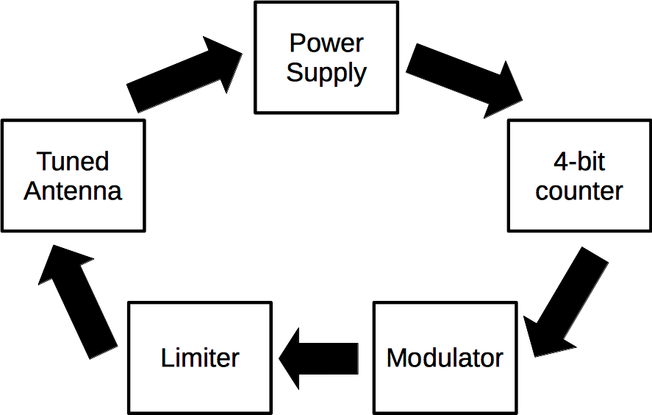
Flow of Operation

Slide 7
Why a 4-bit counter?
ISO 14443 specifies an ~847KHz subcarrier
A.K.A. fc/16 = carrier frequency / 16
1 bit duration = 8 periods of the subcarrier
In these systems fc/16 is critical
4 bit counter = 16 possible states
16 states into a modulator gives you fc/16
GuardBunny speaks ISO14443! :)

Slide 8
So what’s with the fc/16?
The tag communicates via fc/16
GuardBunny outputs fc/16
GuardBunny doesn't have to be loudest
If it can flip a single bit, it wins
If it can de-sync the reader's timing, it wins
If it can confuse the reader at all, it wins
Loud enough to be heard is good enough.

Slide 9
Electrical

Slide 10
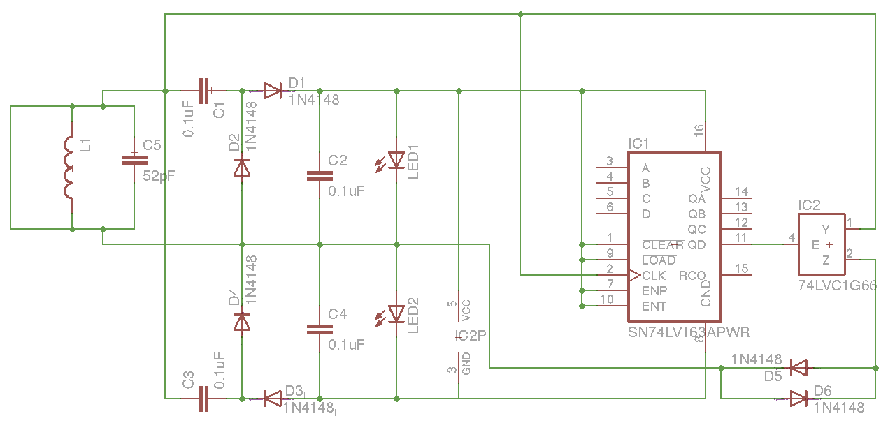
Schematic

Slide 11
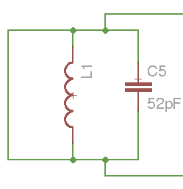
Stage 1: Antenna
Nothing too special
Shorted for the PCB layout
Electrically, it kinda is
Tuning is tricksy.
But critical!
Use another PCB to tune.

Slide 12
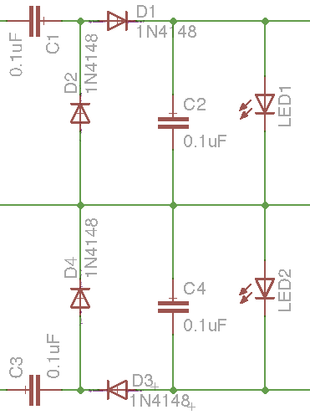
Stage 2: Power Supply
Two halves of a full-wave rectifier
The middle line is “ground”
C1 & C3 decouple the supply
D2&4 compensate for D1&3
While doubling voltage
2 phases doubles voltage again
C2 & C4 are tanks
LED1 & 2 act as voltage limiters
Very low drop-out

Slide 13
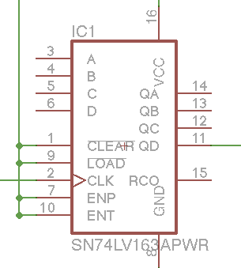
Stage 3: 4-bit counter
74LV163, but any binary counter is fine
Key specification rating: Turn-on voltage
(74LV is 2V)
Check datasheets for weird pins
Make sure it'll take a 13.56MHz clock...

Slide 14
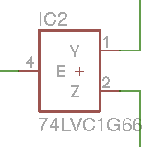
Stage 4: Modulator
“Analog switch”
Switching speed and voltage rating are crucial
When E is high, short Y and Z together.
Y and Z go to coil, E now load-modulates

Slide 15
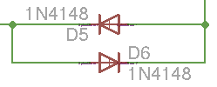
Stage 5: Limiter
The counter gets its clock from the coil
If the coil is shorted there is no clock!
Solution: don't short the coil completely.
D5 & D6 guarantee at least 0.7V on the coil

Slide 16
Schematic Redux

Slide 17
Demo

Slide 18
Improvements

Slide 19
That’s v1. What would v2 look like?
Antenna geometry matching
PSU trickery
Counter chip input impedance
Constant-current regulators to the rescue!
Modulator logic
Different approaches
Power supply
Switchmode for lower dropout?
Additional alerts

Slide 20
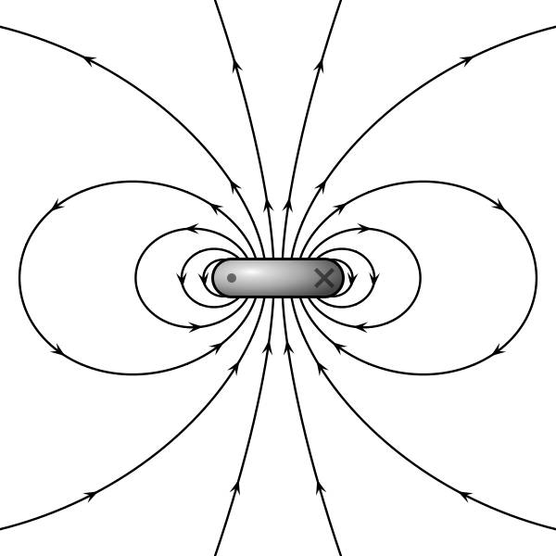
Capturing the Flux
Magnetic field lines flow through the coil
If coils don't match, not all flux is matched
If flux is mismatched, power is mismatched
Power the tag but not GuardBunny :(

Slide 21
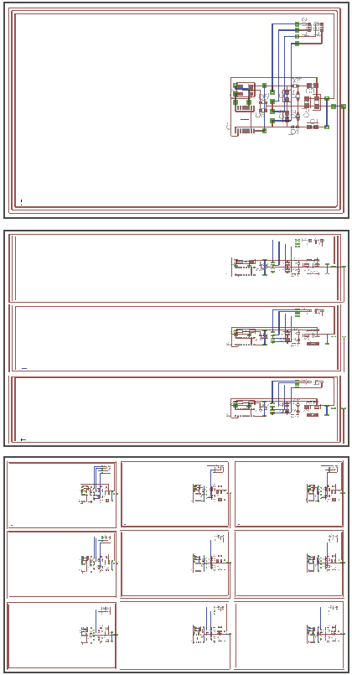
Solution: Antenna arrays
Use lots of antennas!
Crude: Multiple GuardBunny circuits per instance
Better: give each antenna a PSU, combine in series
Ultimate: Manipulate phase and combine at the antenna.
Once powered, modulate all the antennas as one

Slide 22
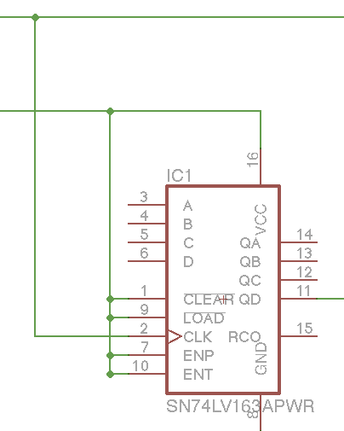
Counter input
Counter chip gets its clock directly from the coil
Not a problem unless power is high
The LEDs ultimately limit coil voltage
Protection diodes shunt away the excess
Killing our modulation depth in the process
Loss of good power for no signal benefit

Slide 23
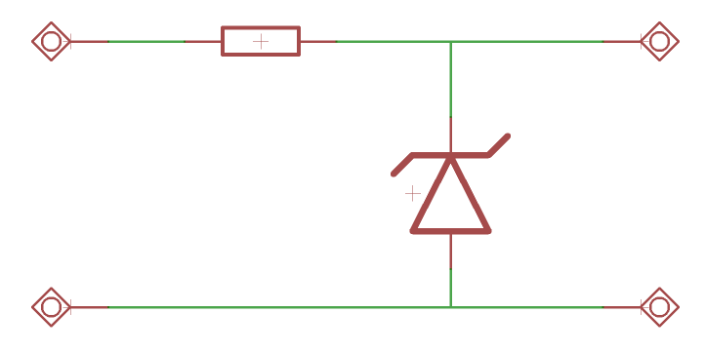
Solution: Impedance trickery
We want low impedance at low voltage
We want the chip to turn on quickly
We want high impedance at high voltage
We don't want excess voltage reaching the chip
We also don't want power from the coil to be shunted
Simple PSU approaches don’t work!

Slide 24
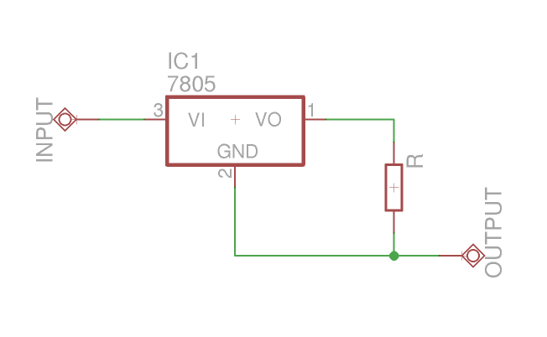
Constant current regulator
Converts constant V to constant I
Set I very low (input impedance is known)
Use something better than a 7805
Some kind of LDO regulator, probably
Output voltage is odd
Efficiency vs logic thresholds

Slide 25
Modulator logic
The current logic:
If PSU is overcharged, discharge through LEDs
If the modulator is on, short-circuit the coil (+/- lim)
At high energy, too much power goes to LEDs
An alternate approach:
Allow PSU to charge endlessly
Modulator dumps power from PSU into LEDs
PSU recharge current back-propagates to coil
Phase shifts might cause problems (or fun!)

Slide 26
Power supply
The present combination works well
No uncompensated voltage drops, high efficiency, 4x multiplier
Could avoid dumping power to LEDs
Same constant current trickery as for counter
Could go for a higher multiplier
Tradeoff: more caps and diodes. Not too bad. Useful?
Switchmode might help low-end performance
Very tricksy to design
Still might get killed by lack of power

Slide 27
Alerting options
Extend the counter - bit 10 is audio
Several good tones at Q10-14, choose or combine
(Q16 && Q10) || (!Q16 && Q11) == 2-tone siren!
Drive a piezo with them!
Should be enough power to drive a BLE chip
Increase PSU caps to stay alive longer if needed
Lots of UI possibilities in a card form factor
Screen showing event count?
Button to disable device?

Slide 28
Failure Modes
Antennas don't match
Can't ever be perfect. Does “good enough” exist?
Way, WAY too much power
LEDs will likely die first, releasing PSU voltage
Chips die pretty soon after == no more fc/16
Finally, PSU caps are rated at 25V (magic smoke?)
Use a high-voltage zener to protect against this
Dies eventually – but so will the tag.
DSP to separate GB modulation from tag
Static electricity (the counter chip is sensitive)

Slide 29
Build

Slide 30
Build a Batch of Bunnies
It's designed to fit into a clamshell case
Counter IC is TSSOP – 1.2mm thick
Flex PCBs will fit, FR4 probably not
Production costs (approx):
$100 / board in qty 10 (not including assembly)
$10 / board in qty 1,000 (including assembly)
$5 / board in qty 10,000 (including assembly)
None of the parts are particularly tricksy
0603 caps, SOD523 diodes, SOT23-5 modulator

Slide 31
Component Selection
Tuning caps are sensitive! Use 1%, C0G, 100V
PSU caps not so sensitive. 10V+, 0.1uF+
Diodes: Fast recovery is key, ideally a few ns
1N4148 works fine at 4ns, but could be improved
Make sure your limiter diode Vf will allow clock to tick!
Counter: Low-voltage turnon is crucial. TSSOP.
Any old 4-bit binary counter will work though!
Modulator: Check voltage / current ratings.

Slide 32
Component selection: LEDs
Start by checking voltage ratings on chips
Each LED shunts half the supply voltage
This sets the maximum forward voltage allowed
Tradeoff: forward voltage
Higher Vf means GuardBunny is more effective
Lower Vf means that the LEDs turn on sooner
Tradeoff: forward current
Higher If means brighter lights
Lower If means more effective but vulnerable to high power

Slide 33
Conclusions
It's a v1, proof-of-concept device.
It works, but has (fixable) weaknesses
My opinion:
Not yet worthy of selling as a product
Definitely worthy of talking about :)
Lots of work to do – help appreciated!

Slide 34
Questions?
Schematic, layout, BOM, gerbers, logos etc:
https://github.com/kristinpaget/GuardBunny

