Slide 1
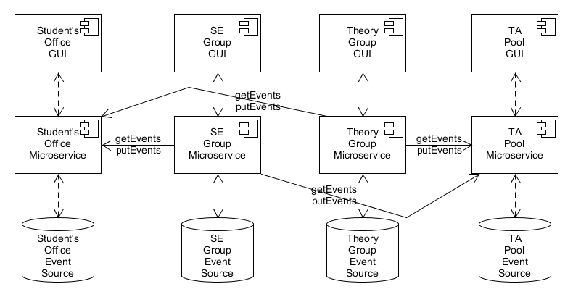
Student Affairs Case Study
Software Engineering Group MX Ttrafos Dagstuhl © 07.11.26 Sebastian Copei, Albert Zündorf, Kassel University

Slide 2
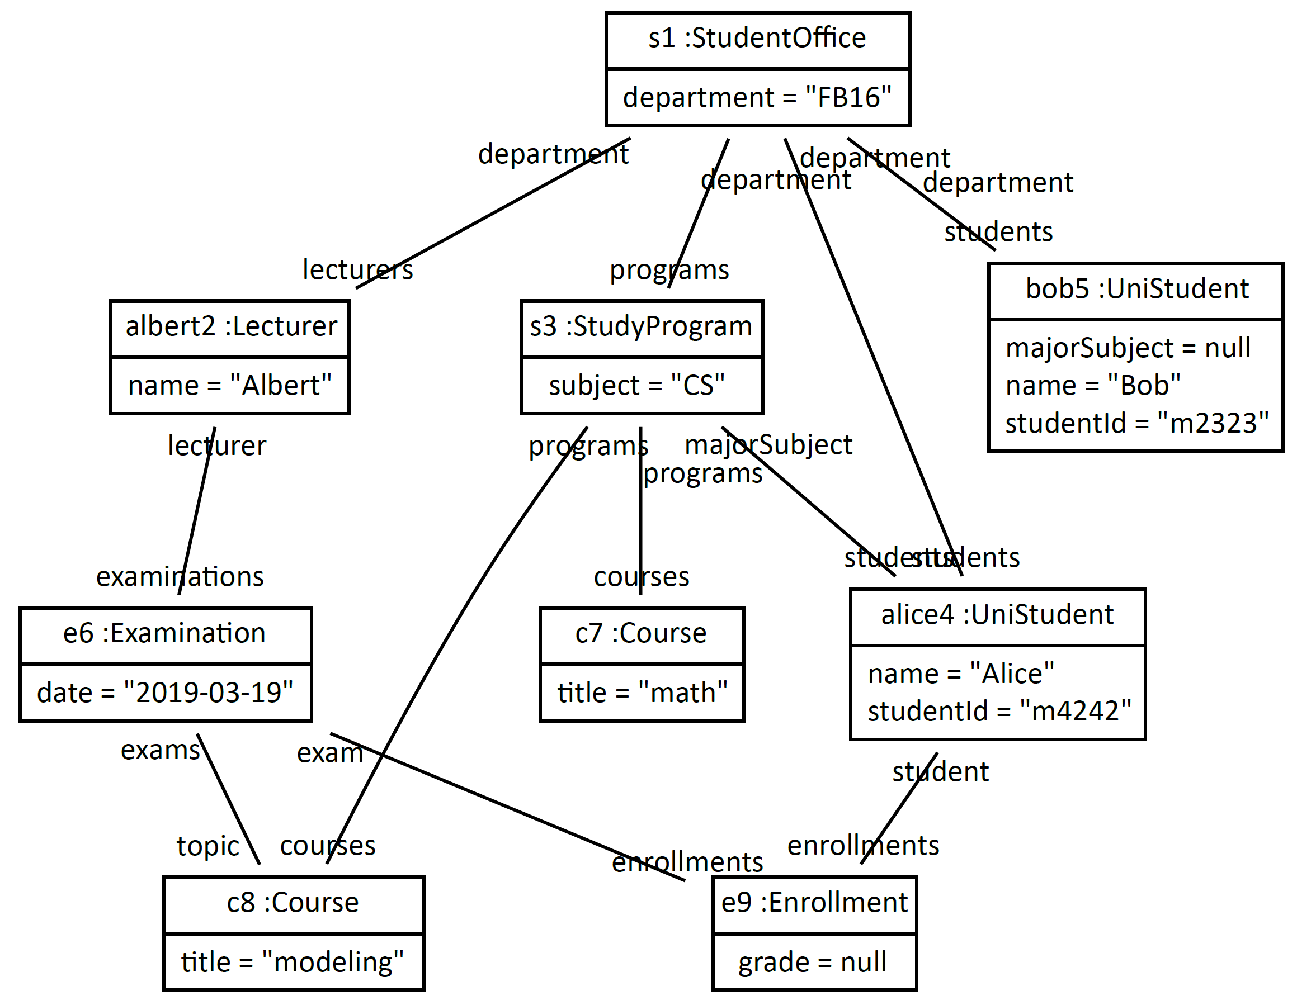
Student Affairs Case Study
Software Engineering Group MX Ttrafos Dagstuhl © 07.11.26 Sebastian Copei, Albert Zündorf, Kassel University

Slide 3
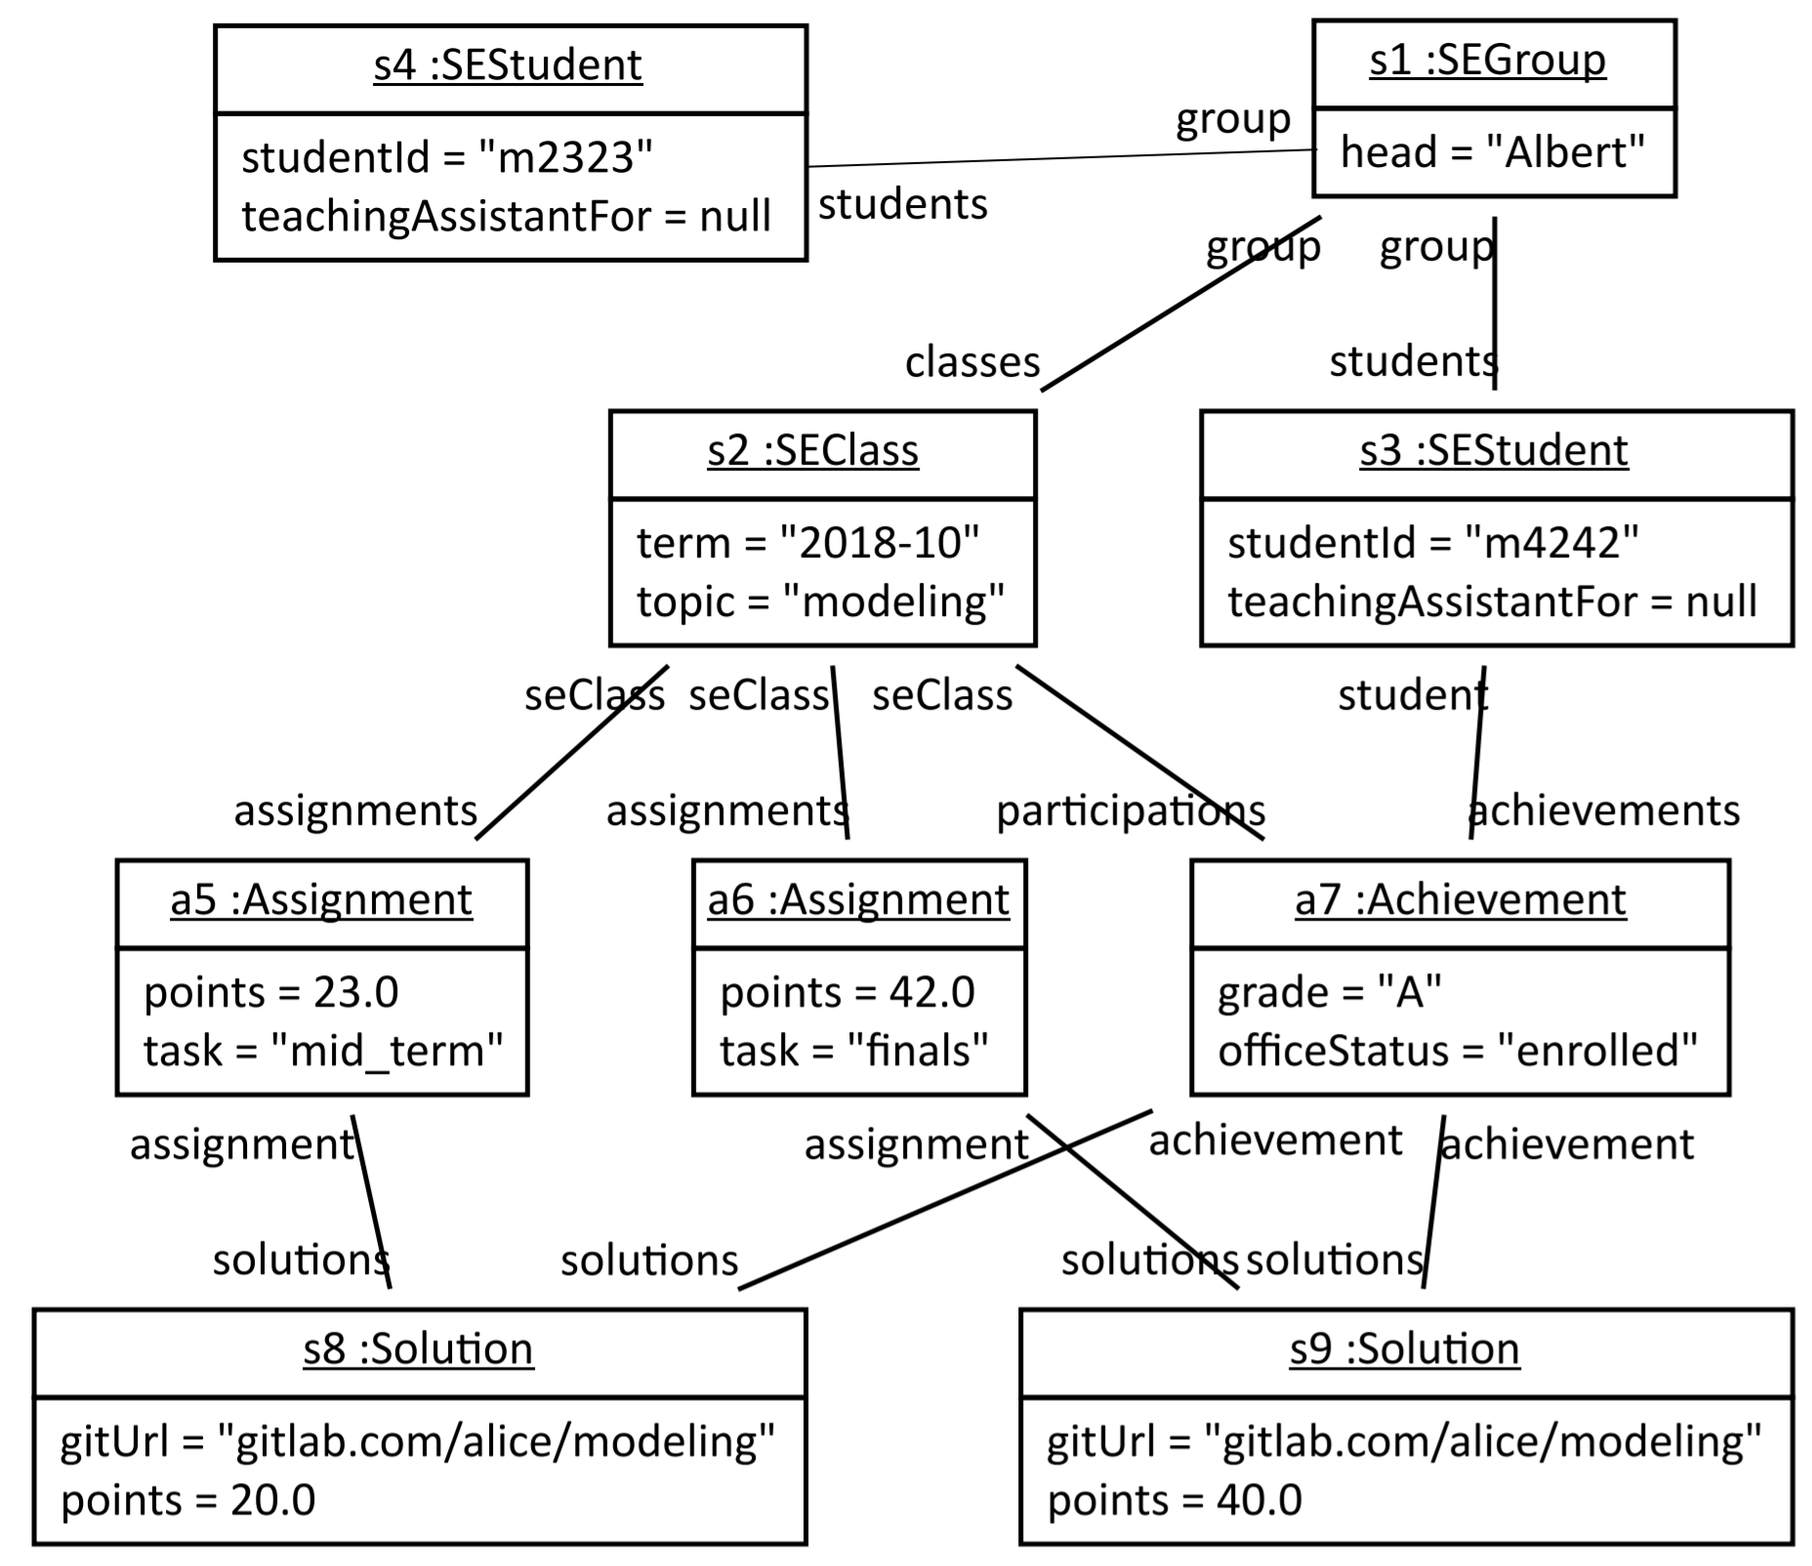
Student Affairs Case Study
Software Engineering Group MX Ttrafos Dagstuhl © 07.11.26 Sebastian Copei, Albert Zündorf, Kassel University

Slide 4
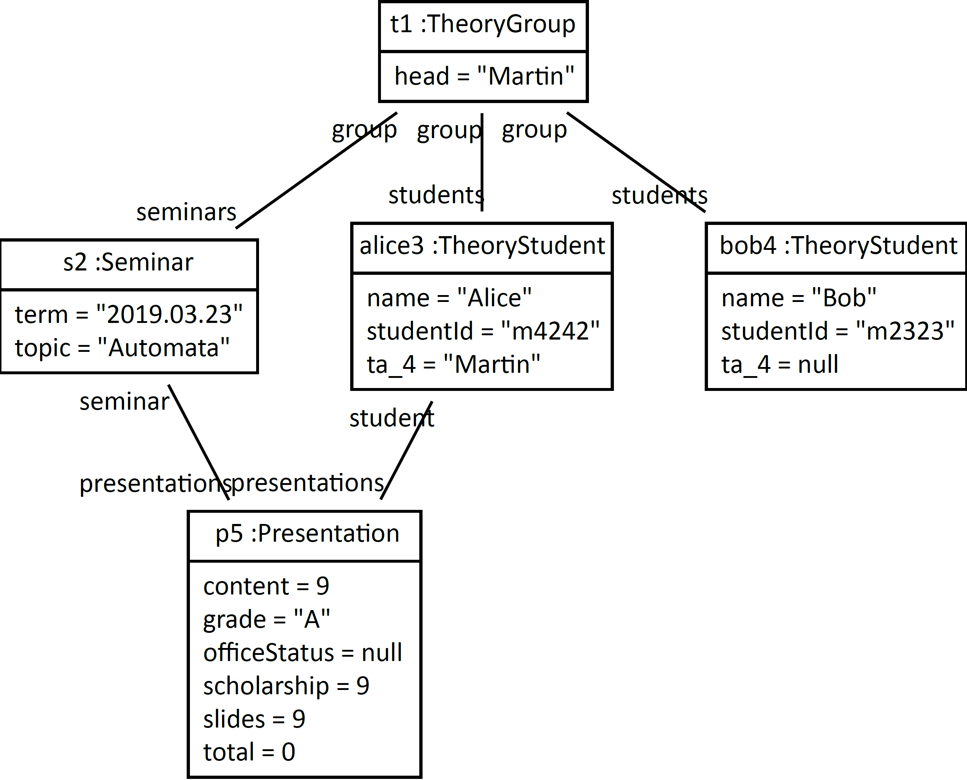
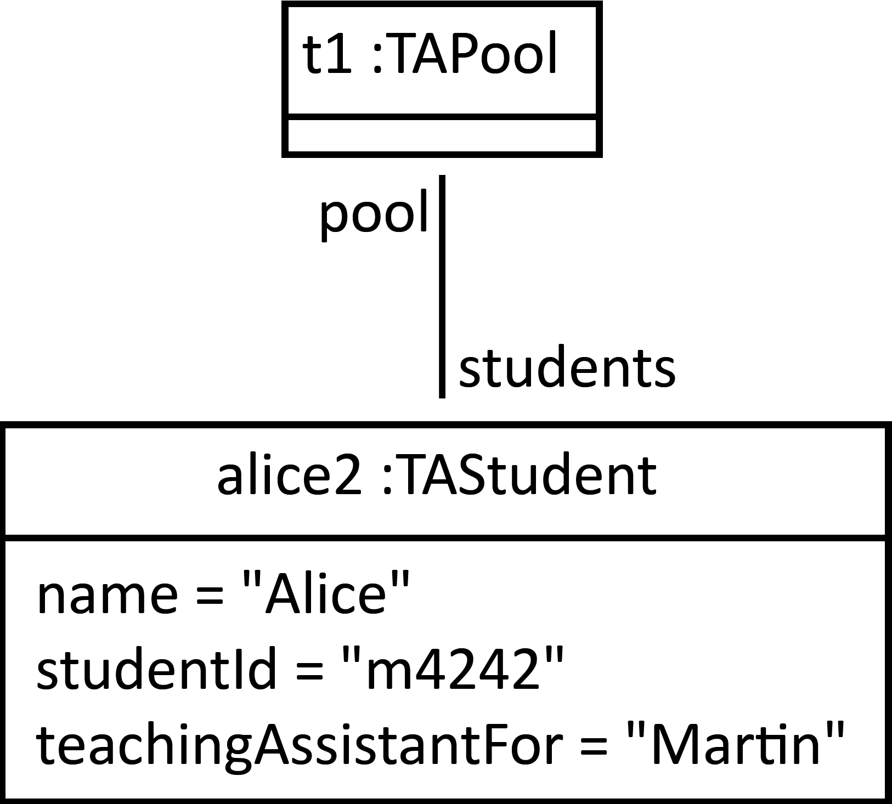
Student Affairs Case Study
Software Engineering Group MX Ttrafos Dagstuhl © 07.11.26 Sebastian Copei, Albert Zündorf, Kassel University

Slide 5
Student Affairs Case Study
eventType: studentCreated
studentId: m2323
name: Bob
.eventNumber: 7
eventType: studentCreated
studentId: m4242
name: Alice
.eventNumber: 8
eventType: studentEnrolled
studentId: m4242
courseName: modeling
lecturerName: Albert
date: "2019-03-19"
.eventNumber: 10
Students‘ Office API:
getOrCreateStudent(studId, name)
getOrCreateCourse(title, …)
getOrCreateExam(course, date)
enroll(student, exam)
…
SE Group API:
getOrCreateStudent(studId)
getOrCreateClass(title, term)
enroll(student, exam)
...
Software Engineering Group MX Ttrafos Dagstuhl © 07.11.26 Sebastian Copei, Albert Zündorf, Kassel University

Slide 6
MX problem
s1: SEGroup
- studId: m4242
name: Alice
s3:SEStudent
s1: StudentsOffice
name = „Alice“
studentId = „m4242“
alice4:UniStudent
name = „Alice“
studentId = „m4242“
t1: TheoryGroup
alice3:TheoryStudent
- studId: m4242
name: Alexa
name = „Alexa“
studentId = „m4242“
Software Engineering Group MX Ttrafos Dagstuhl © 07.11.26 Sebastian Copei, Albert Zündorf, Kassel University

Slide 7
MX problem
s1: SEGroup
- studId: m4242
name: Alice
s3:SEStudent
s1: StudentsOffice
name = „Alice“
studentId = „m4242“
alice4:UniStudent
name = „Alexa“
studentId = „m4242“
t1: TheoryGroup
alice3:TheoryStudent
- studId: m4242
name: Alexa
name = „Alexa“
studentId = „m4242“
Software Engineering Group MX Ttrafos Dagstuhl © 07.11.26 Sebastian Copei, Albert Zündorf, Kassel University

Slide 8
Open Questions
Formalization
Relation to TGGs
Relation to Lenses
Implementation guide lines, verification, validation, guarantees
Software Engineering Group MX Ttrafos Dagstuhl © 07.11.26 Sebastian Copei, Albert Zündorf, Kassel University

Slide 9
Student Affairs Case Study
Software Engineering Group MX Ttrafos Dagstuhl © 07.11.26 Sebastian Copei, Albert Zündorf, Kassel University

