Slide 1
Replacing legacy systems with FreeSWITCH
David Knell
3C Limited

Slide 2
About me
MA in Computer Science
25 years software development
15 years in telephony
Hardware

Slide 3
The problem
Client has call center in Brazil
TDM (Dialogic) IVR
  Reliability
  Cost
  Perception
Integrated with management tools

Slide 4
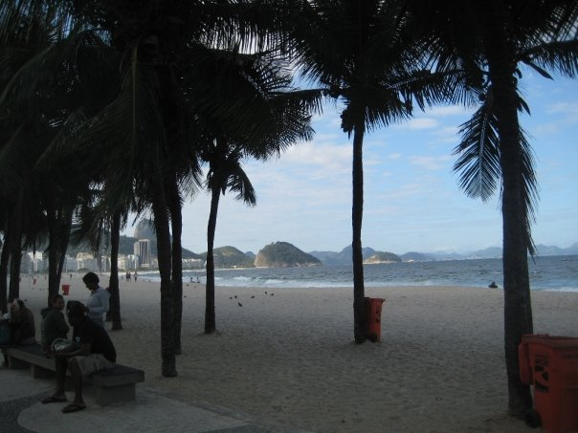
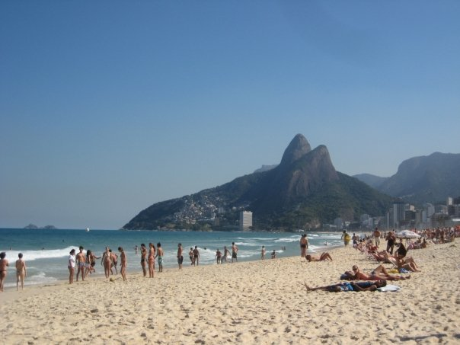
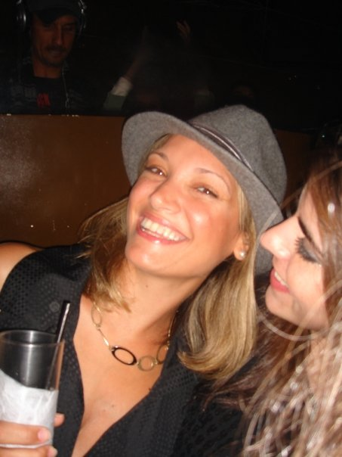
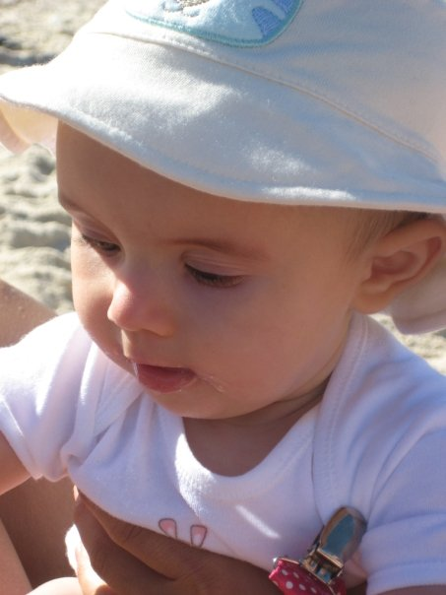
The attraction

Slide 5
The solution

Slide 6
Things of note
V8Call exports V8Call object for IVR control
Beanshell enables IVR scripting in interpreted Java
Full power of Java libraries available
My first Java anything

Slide 7
Metrics
V8Call – 645 lines
Emulator – 400 lines
25 calls/sec
250 concurrent calls
Start to first successful call: ~ 1 week

Slide 8
Media processing
1997: 486 @ 66MHz + 40MHz DSP
  60 calls
  ~ 1 MIPS/call
2009: Quad-core Xeon @ 2.4GHz
  250 calls
  ~ 200 MIPS/call
Wirth's Law in action

Slide 9
How it's done now
RTP
  100 packets/sec/call
  100 context switches/sec/call
Monolithic slabs – mod_conference:
  6,000 lines of code
  DSP (noise gate, gain, mix)
  Events (talk start, stop..)
  Control
Everything in the core, everything in C

Slide 10
MRCP – an aside
Needed ASR; mod_openmrcp bust
Event socket + unicast + Perl:
  Simple MRCP client in less than a day
  ~200 lines of code
mod_unimrcp:
  3600 lines of C just to interface with the library
  ~10K lines of C in the library itself

Slide 11
RISC vs CISC
Old enough to remember the debate..!
KISS, and be orthogonal
CPU | Transistors | Speed
80286 | 134,000 | 1.5 MIPS @ 8MHz
68020 | 190,000 | 4 MIPS @ 20MHz
ARM2 | 30,000 | 4 MIPS @ 8MHz

Slide 12
NewMedia
Small, specific DSP and I/O blocks
  Gain, AGC, noise gate
  RTP in, out
  File in, out
  Resampler
  Mixer
  FFT
Create them, and wire them up
Separate DSP and control

Slide 13
NewMedia conferencing

Slide 14
FastRTP
Direct control of network hardware
  Can be done from user space
  Device specific
Linux kernel module
  Hooks network stack
  Intercepts and buffers RTP in
  Polled once every frame time
  Transmits buffered RTP out

Slide 15
Benchmarks
Benchmarks are simplistic and flawed
100 calls, file replay, Dell D820 laptop
Media stack | % CPU usage
FreeSWITCH native | 39%
FreeSWITCH + NewMedia | 32%
FreeSWITCH + NewMedia/FastRTP | 8%
FreeSWITCH – calls parked (no RTP) | 8%

Slide 16
Metrics
NewMedia – 2,200 LOC
FastRTP – 600 LOC
Still a lot of work to be done

Slide 17
SoftIVR
Hosted IVR platform
ASR, TTS, transcription...
JavaScript scripting
Examples: find me, follow me, SpinVox-alike, voice dial from Google address book...
~10K calls/day

Slide 18
That's all, folks..
http://www.softivr.com
http://www.ukddi.com
dave@3c.co.uk
+44 20 3298 2000

