Slide 1
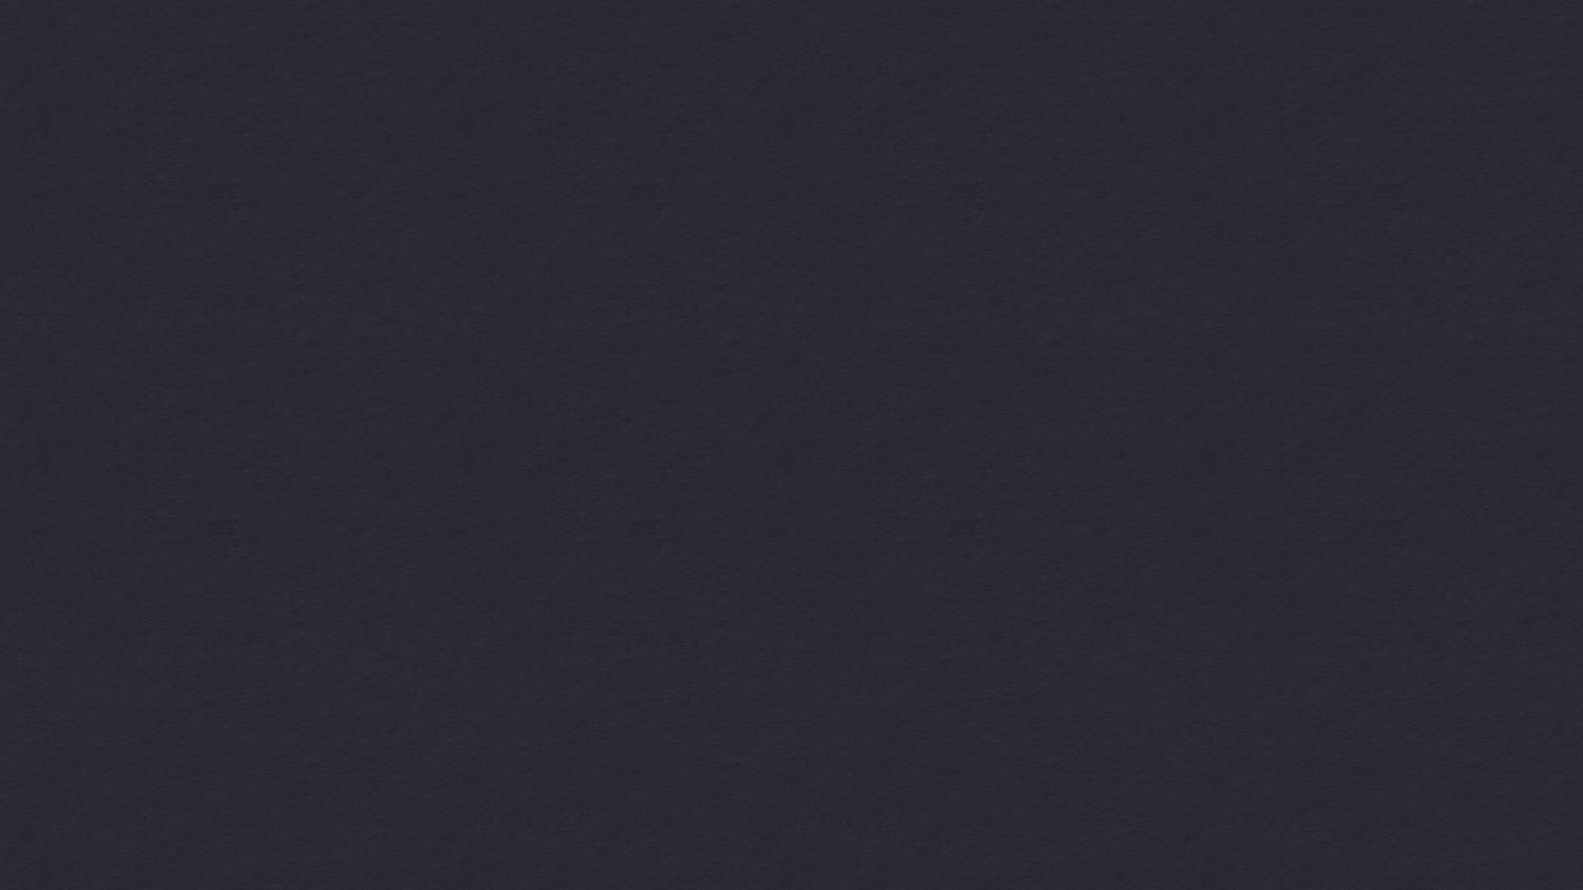
FreeSWITCH: Learning to Think Fourth Dimensionally

Slide 2
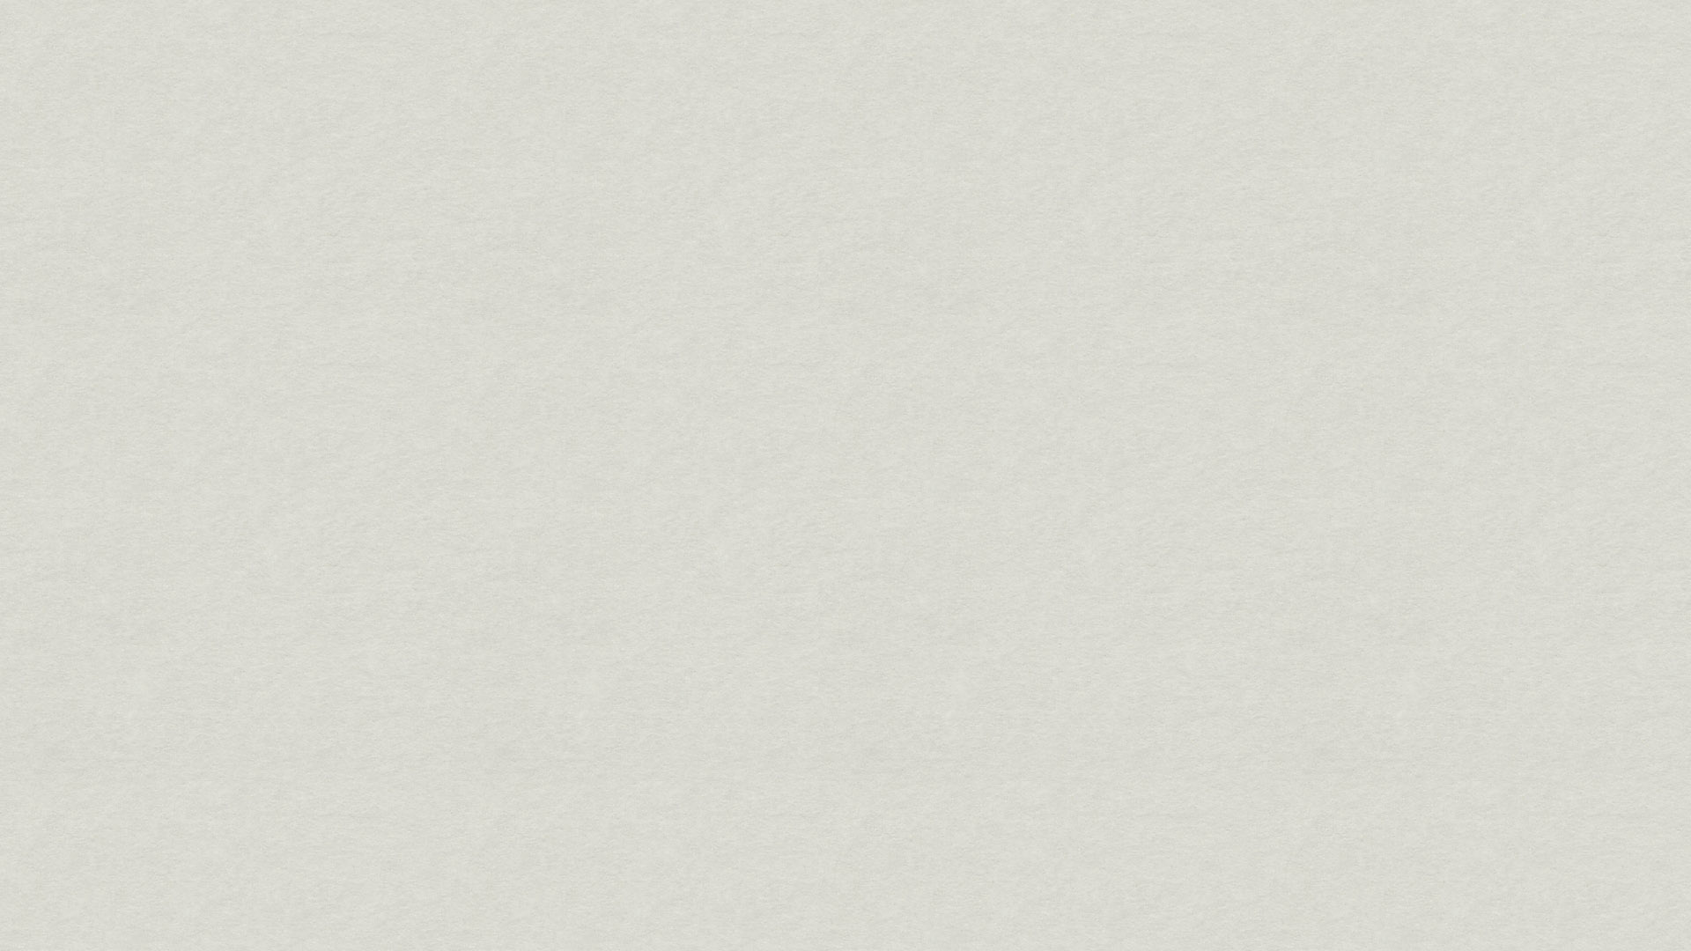

FreeSWITCH Status
1.0.3 Released early January
1.0.4 Released July 31st (yep just 4 days ago!)

Slide 3
FreeSWITCH 1.0.4
Skype (mod_skypiax)
H.323 (mod_opal)
MRCP (mod_unimrcp)
ZRTP (core)
NAT Traversal (core)

Slide 4
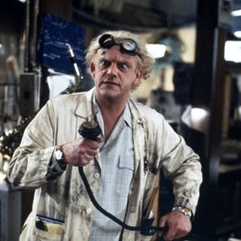
What we mean by 4D
  Great SCOTT!

Slide 5
Example Scenario
Make a call and talk to the other party.
Decide you both would like to join a conference.
Dial a digit sequence.
Transfer both calls to the conference.

Slide 6
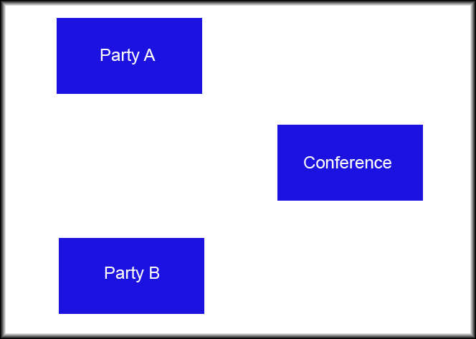
Call Scenario

Slide 7
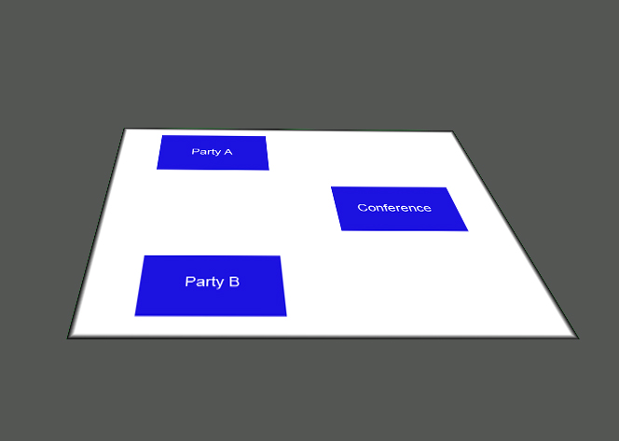
Call Scenario

Slide 8
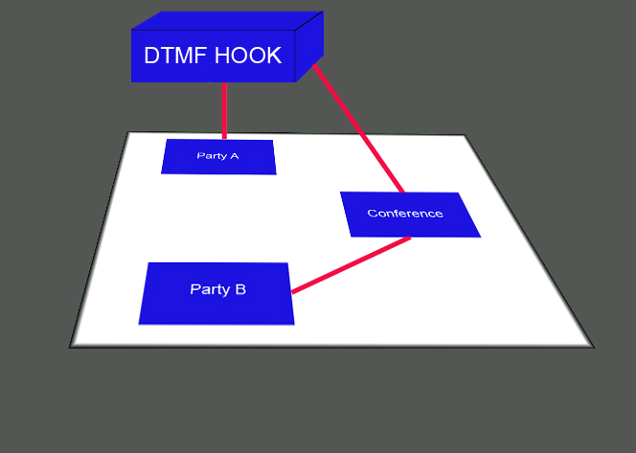
Call Scenario

Slide 9
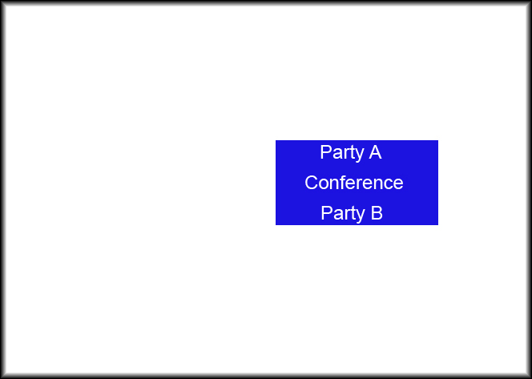
Call Scenario

Slide 10
bind_meta_app
USAGE: <key> [a|b|ab] [a|b|o|s|1] <app>

Slide 11
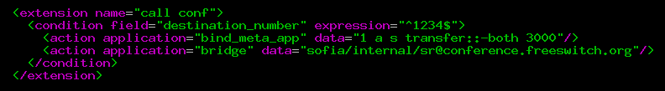
Dialplan Example

Slide 12
Other 4D Perspectives
Media Bugs
I/O Hooks
XML Hooks
Event Socket

Slide 13
Media Bugs
Attaches to the channel.
Forces a decode path.
Taps your code into the audio stream.
ASR / Call Recording / Inband DTMF

Slide 14
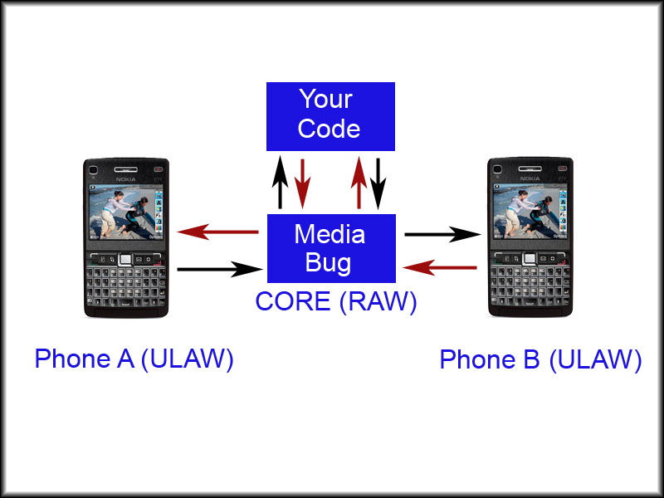
Bug Example

Slide 15
I/O Hooks
Attaches to channel.
Binds to interesting I/O Events.
Inband DTMF Generation.

Slide 16
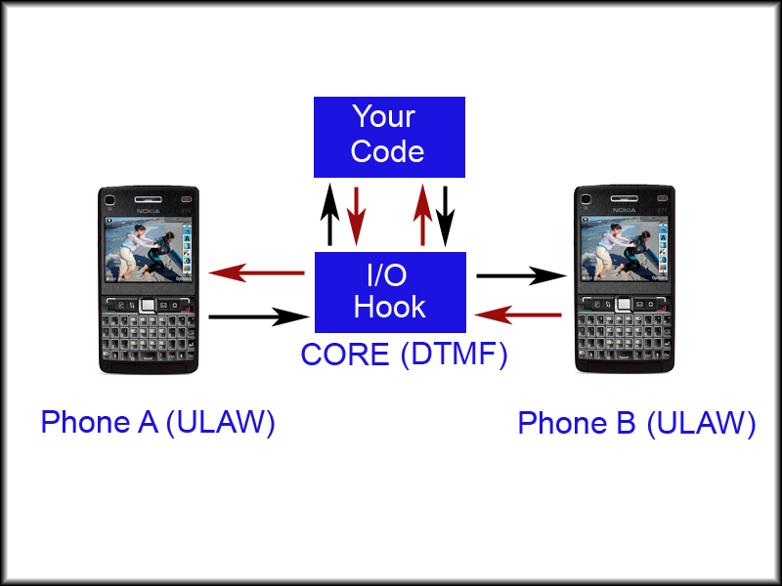
I/O Hook Example

Slide 17
XML Hooks
Binds to XML interface.
Allows you to return dynamic content.
mod_xml_curl

Slide 18
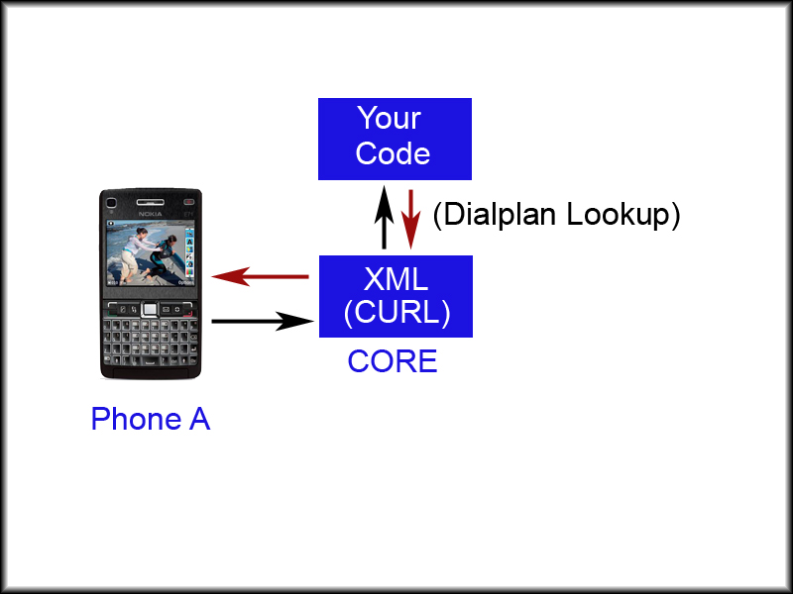
XML_CURL Example

Slide 19
Event Socket
Connects a socket to a channel or the core.
Allows asynchronous control.
Binding to system and channel events.

Slide 20
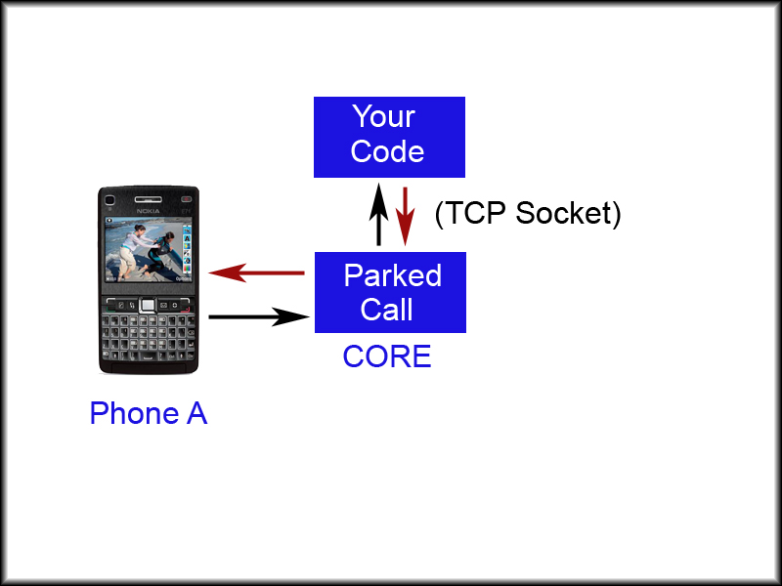
Event-Socket Example

Slide 21
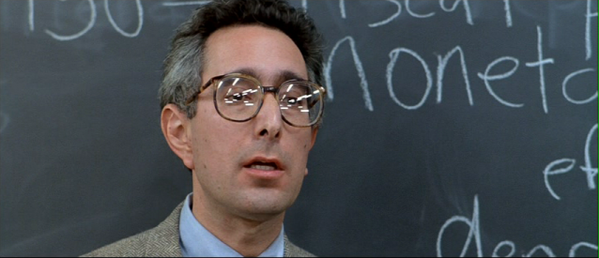
Questions
Anyone....???
Bueller....???

Slide 22
Thank You!

