Slide 1
Media Handling in FreeSWITCH
Moisés Silva
Software Engineer / Manager
moy@sangoma.com

Slide 2
Agenda
Audio Codecs
Transcoding
Codec Negotiation
Bypass Media
Proxy Media
Sangoma Transcoding
© 2011 Sangoma Technologies
8/10/2011

Slide 3
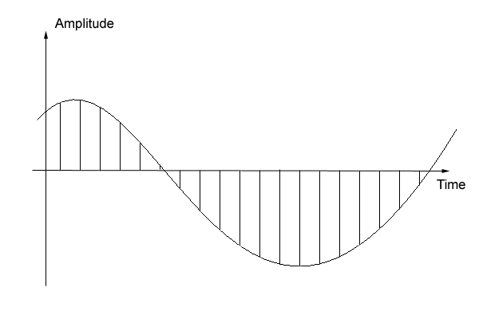
Audio Codecs
© 2011 Sangoma Confidential
8/10/2011

Slide 4
Audio Codecs
Codecs encode and decode voice for network transmission
  Algorithm (compression technology)
  Bit rate
  Sampling rate
  Packetization
Algorithm is the core of the codec
Bit rate defines bandwidth required. (how many bits per second)
Sampling rate defines the quality. (all other things being equal)
Packetization affects latency and bandwidth overhead
© 2011 Sangoma Technologies
8/10/2011

Slide 5
Audio Codecs
G.711 (PCMU/PCMA, Ulaw/Alaw) – Narrowband.
  64kbps per second (Bit rate)
  8kHz (Sampling rate)
  10ms, 20ms, 30ms, 40ms … + (Packetization)
G.722 – Wideband
  48kbps, 56kbps and 64kbps
  16kHz (IANA clocks it at 8kHz due to historical error in RFC1890)
  10ms, 20ms, 30ms, 40ms … +
G.722.1 Annex C - Ultra-wideband
  48kbps
  32kHz
  20ms, 40ms, 60ms
© 2011 Sangoma Technologies
8/10/2011

Slide 6
FreeSWITCH Audio Codecs
FreeSWITCH supports a wide range of codecs
  Narrowband (G.711, G.726, G.723.1, G.729AB, Speex …)
  Wideband (G.722, G.722.1, G.722.2, Speex …)
  Ultra-wideband (G.722.1C, Speex)
  CD-quality (CELT)
FreeSWITCH core requires the media to be in L16 (signed linear, raw digital audio) format for manipulation (mixing, tone detection etc)
Codec modules encode and decode from/to L16 format
Pass-thru codec modules are dummies (mod_g729, mod_g723_1)
© 2011 Sangoma Technologies
8/10/2011

Slide 7
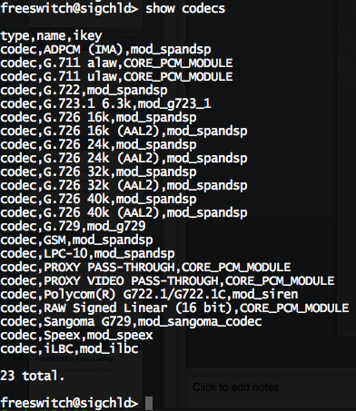
FreeSWITCH Audio Codecs
© 2011 Sangoma Technologies
8/10/2011

Slide 8
Transcoding
© 2011 Sangoma Confidential
8/10/2011

Slide 9
Transcoding
Required when endpoints have no codec in common
FreeSWITCH must stay in the media path
Increases CPU usage (particularly if done in software)
Is a must if you need:
  Call recording
  Tone detection
  Play announcements or tones
© 2011 Sangoma Technologies
8/10/2011

Slide 10
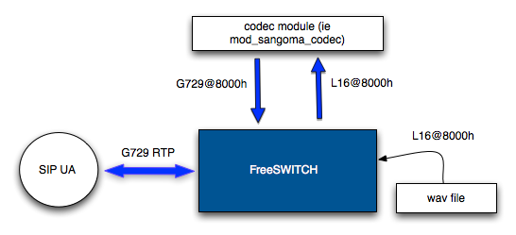
FreeSWITCH Transcoding
Transcoding in one-legged call
© 2011 Sangoma Technologies
8/10/2011

Slide 11
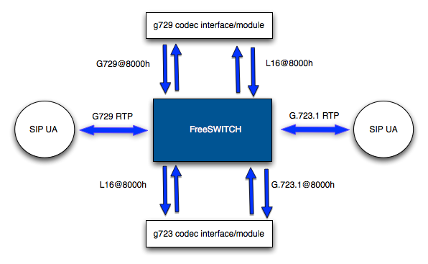
FreeSWITCH Transcoding
Transcoding 2 SIP legs
© 2011 Sangoma Technologies
8/10/2011

Slide 12
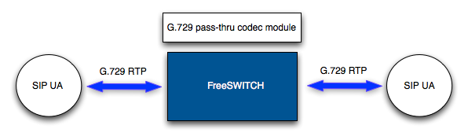
FreeSWITCH codec pass-thru
Pass-thru codecs do not do transcoding
© 2011 Sangoma Technologies
8/10/2011

Slide 13
Codec Negotiation
© 2011 Sangoma Confidential
8/10/2011

Slide 14
Codec Negotiation
Decisions to be made to choose a codec for a call
From a list of codecs, pick one!
You can choose when this happens (early vs late)
Early happens before call hits the dial plan
Late will happen when the leg is answered (or in pre-answer)
© 2011 Sangoma Technologies
8/10/2011

Slide 15

Codec Negotiation
3 inbound negotiation algorithms
  generous
  greedy
  Scrooge (Bah HUMBUG!)
Use inbound-codec-negotiation in SIP profile
Use sip_codec_negotiation variable in the dial plan
© 2011 Sangoma Technologies
8/10/2011

Slide 16
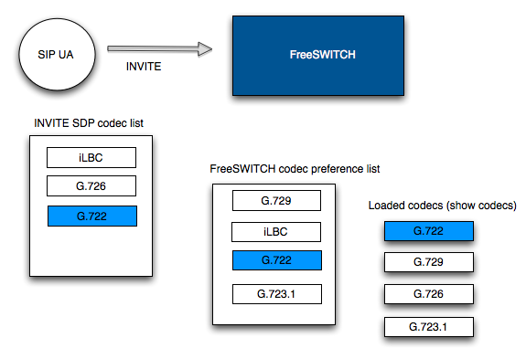
Codec Negotiation
© 2011 Sangoma Technologies
8/10/2011

Slide 17
Early Negotiation
Default negotiation mode in FreeSWITCH
The codec is chosen matching SDP vs inbound-codec-prefs in the SIP profile
“disable-transcoding” offers the same codec chosen for the inbound leg to the outbound leg
absolute_codec_str is a good brute-force approach
© 2011 Sangoma Technologies
8/10/2011

Slide 18
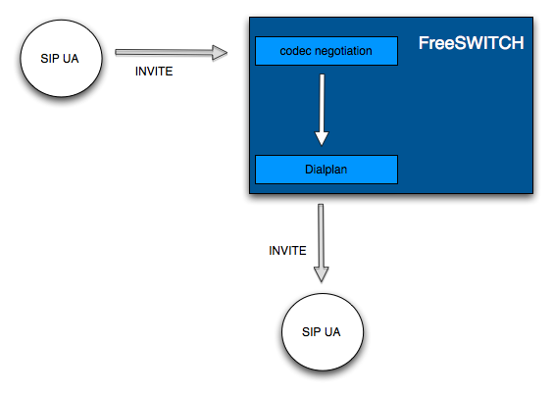
Early Negotiation
© 2011 Sangoma Technologies
8/10/2011

Slide 19
Late Negotiation
“Smarter” approach to codec negotiation
“inbound-late-negotiation” set to “true” in the SIP profile
Call will hit the dial plan without looking at codecs
Negotiation will occur when incoming leg is answered (or requires early media)
© 2011 Sangoma Technologies
8/10/2011

Slide 20
Late Negotiation
You can examine the incoming SDP and re-write SDP to fit your own needs
“inherit_codec” variable is available to try to use the codec from the B leg for the A leg
“ep_codec_string” contains the codecs offered by the endpoint
© 2011 Sangoma Technologies
8/10/2011

Slide 21
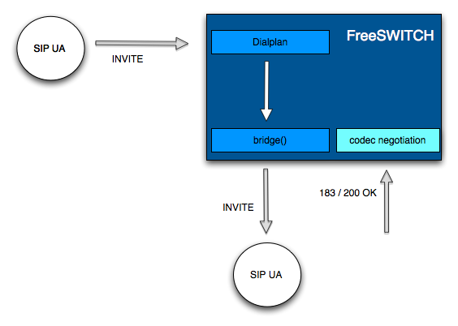
Late Negotiation
© 2011 Sangoma Technologies
8/10/2011

Slide 22
Media Modes
© 2011 Sangoma Confidential
8/10/2011

Slide 23
Bypass Media
Media goes around FreeSWITCH (not through) directly between the endpoints
SIP signaling stays in FreeSWITCH
Enable by setting variable “bypass_media=true” before bridging
Set inbound-no-media or inbound-bypass-media in the SIP profile for a permanent solution
© 2011 Sangoma Technologies
8/10/2011

Slide 24
Bypass Media
You can still play files! (uuid_broadcast)
uuid_media [off] can re-invite FreeSWITCH on/off the media path
Recording will fail unless you manually put back FreeSWITCH on the media path
© 2011 Sangoma Technologies
8/10/2011

Slide 25
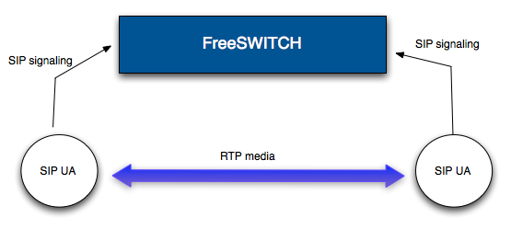
Bypass Media
© 2011 Sangoma Technologies
8/10/2011

Slide 26
Proxy Media
Also called “transparent proxy mode” for the RTP
No media capabilities enabled
Only the “c=” part in the SDP is modified
Allows FreeSWITCH to pass-thru codec media that does not support
© 2011 Sangoma Technologies
8/10/2011

Slide 27
Proxy Media
Set “proxy_media=true” variable before the bridge to enable it
Set “inbound-proxy-media” in the SIP profile for a permanent solution
You most likely want to have “late negotiation” enabled
© 2011 Sangoma Technologies
8/10/2011

Slide 28
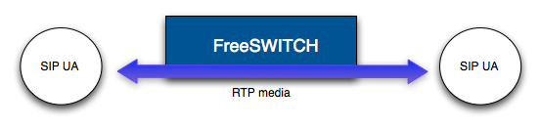
Proxy Media
© 2011 Sangoma Technologies
8/10/2011

Slide 29
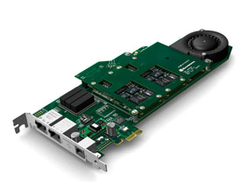
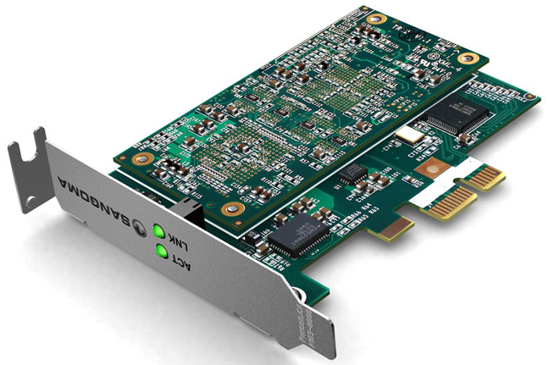
Sangoma Transcoding
© 2011 Sangoma Confidential
8/10/2011

Slide 30
Sangoma Transcoding
Wider codec support in the industry
Seen as an ethernet interface by the operating system
SOAP interface for transcoding control
Multiple servers can use a single card
Firmware upgradable on the field
License upgradable (from 30 licenses to 400)
© 2011 Sangoma Technologies
8/10/2011

Slide 31
Capacity
Codec/P Time | 10 ms | 20 ms | 30 ms | 40 ms | 50 ms
G.729 AB | 300 | 440 | 459 | 462 | 466
G.722 | 290 | 388 | 410 | 388
GSM |  | 480
AMR 12.20 |  | 200 |  | 226
AMR 4.75 |  | 258 |  | 281
ILBC 15.2 |  | 310 |  | 298
ILBC 13.3 |  |  | 273
G.723 5.3 |  |  | 200
G.723 6.3 |  |  | 200
G.726 32 | 310 | 450 | 480 | 480 | 480
PCM/U | 310 | 390 | 420 | 440 | 460
PCM/A | 310 | 390 | 420 | 440 | 460
© 2011 Sangoma Technologies
8/10/2011

Slide 32
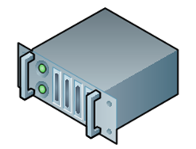
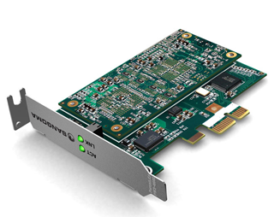
Single Server Setup
  FreeSWITCH
I/O core
codec module
SOAP client
(libsngtc-node)
Control
(SOAP TCP
connection)
SOAP server
RTP
(Voice)
API
(libsng-tc)
Board discovery
at Install time
Ethernet Driver
© 2011 Sangoma Technologies
8/10/2011

Slide 33
Distributed Setup
Transcoding
Server
App
Server
  FreeSWITCH
I/O core
codec module
SOAP client
(libsngtc-node)
RTP
(Voice)
Control
(SOAP TCP connection)
SOAP server
App
Server
  FreeSWITCH
API (libsng-tc)
I/O core
Ethernet Driver
codec module
SOAP client
(libsngtc-node)
RTP
(Voice)
© 2011 Sangoma Technologies
8/10/2011

Slide 34
Supported Codecs
G.729
G.726-32
G.722
G.722.1
G.723.1
iLBC
AMR
  *more codecs supported by the D-series cards but not
  yet implemented by FreeSWITCH codec module
© 2011 Sangoma Technologies
8/10/2011

Slide 35


THANK YOU
© 2011 Sangoma Confidential
8/10/2011

