Slide 1
CELLIAX,
Interfacing GSM Networks with
FreeSWITCH and Asterisk
CHICAGO, USA, September 2009

Slide 2
AGENDA
Features overview
Audiocables
Datacables
How it Works
Implementation Details
CLI commands
SMS Application
Q&A Session

Slide 3
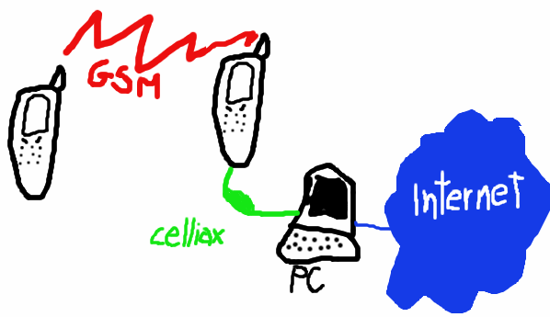
One picture... a thousand words

Slide 4
CELLIAX Features Overview
A Datacable to the (USB) serial port and an Audiocable to the soundcard, to interface the physical cellphone
Incoming and Outgoing call using most popular (cheap) cellphones and other communication devices
Incoming and Outgoing SMSs

Slide 5
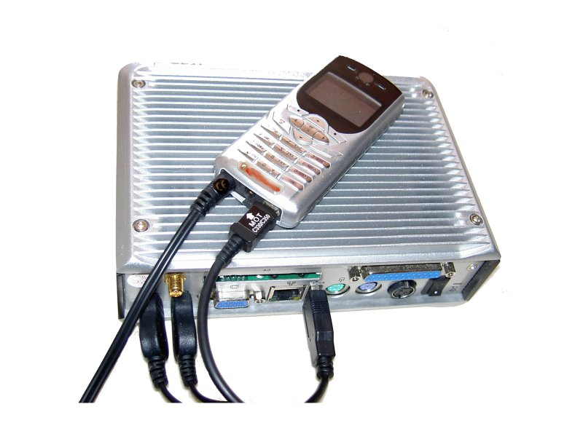
Celliax in Action!

Slide 6
CELLIAX AudioCables
You need an audiocable between the cellphone used as celliax physical interface and the soundcard of the PC running the core
You can buy it or build it (little soldering needed)‏
  For cellphones using standard 3pole 2.5mm handsfree jack you can start from a cheap headset cut it before the microphone and solder two 3pole 3.5mm jacks
  For Nokias using 4pole 2.5mm handsfree jack more work is needed
  electrical schemas are availables at www.celliax.org
Professionally manufactured audiocables will be available at www.celliax.org

Slide 7
CELLIAX DataCables
You need a datacable between the cellphone used as physical interface and the serial port (or USB) of the PC running core
  Celliax can work without datacable, but it cannot originate calls, will have no information at all on the incoming calls (autoanswered by the cellphone) , will rely on a period of silence to notice a remote hangup
Most cellphones has datacables available, at least aftermarket (notably Nokia models)‏
Datacables for the cellphones most used with Celliax will be available at www.celliax.org

Slide 8
TOO MANY CABLES?

Slide 9
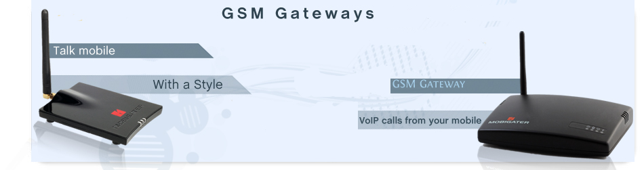
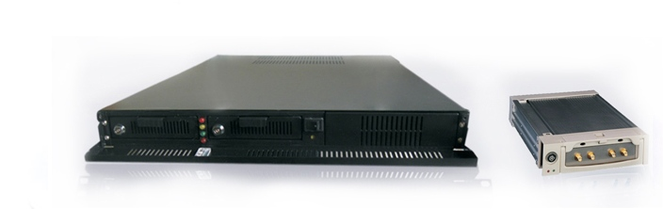
CELLIAX Official Devices
...coming soon

Slide 10
Endpoints, Channel Drivers
Each endpoint channel driver implements the functions to be used by core (call, answer, dial, etc)‏
Into the driver, a loop thread monitors all its physical interfaces, accepting interface events (RING, DOWN, etc)‏
When a call incomes or is originated, the driver creates an instance that mediates between the core and the interested interface. That particular interface is no more in the monitored pool
When the call is finished, that interface go back into the monitored pool

Slide 11
CELLIAX development challenges
Real Time: delays, buffer lenght, latency, etc
Audio: echo, compression, analysis
Locks: threads, mutexes
Resources: RAM, CPU, IRQs, etc

Slide 12
CELLIAX Implementation 1
When not in a call, we need to monitor various sources of events:
  Serial Port (for datacable incoming signaling/indications)‏
  Cellphone Audio (for sensing a RING if we do not have serial indications, eg: Nokia 3310, or no datacable)‏
We've got a loop monitor thread for each kind of events' sources

Slide 13
CELLIAX Implementation 2: audio
Soundcard interfacing APIs tend to be platform specific, CygWin has only a very rough OSS-like layer, MacOS is specific, etc
Celliax can use Portaudio, the opensource multiplatform audio library (runs on whatever :-)‏
Additional Acoustic Echo Cancelling is performed by the speexdsp opensource library
Celliax can use native audio API for efficiency and simplicity, with devices that does not require AEC
Incoming audio is analyzed to recognize silence and DTMFs by the spandsp opensource library

Slide 14
CELLIAX Implementation 3: serial
Serial interfacing is implemented in very different ways on Windows and *nix (on CygWin is like *nix)
Celliax uses various kind of serial signaling:
  AT standard commands, for the most part of cellphones
  FBUS2 proprietary commands, for various old Nokia models
  Other serial commands/signaling protocols, eg. for DECT modules (would be very nice to have IDEN)‏
Each kind of signaling has its own functions, over a common serial layer for physical I/O

Slide 15
CELLIAX CLI commands
From the CLI console, you can give various commands to interact with chan_celliax:
  celliax_usage: give a list of chan_celliax CLI commands and dialplan applications
  celliax_console: shows or sets the chan_celliax interface on which further commands are acting upon
  celliax_dial, celliax_hangup: during a call, sends DTMF to the interface (not to remote party) or hangup the call. Useful for no_serial tests without cellphone (only headset/mic)‏
  celliax_playback_boost, celliax_capture_boost: shows or sets the audio scaling
  celliax_echo: shows or sets the Acoustic Echo Cancellation parameters
  celliax_sendsms: sends an SMS
  celliax_at: sends an AT command to the cellphone

Slide 16
CELLIAX Application: celliax_sendsms
Celliax_SendSMS(interface/remote_number,text)‏
  Sends an SMS to the cellphone at remote_number with content text, using the given interface
    interface is the name of the chan_celliax interface we want to use for sending the SMS, eg. nicephone
    remote_number is the number of the cellphone to which we want to send the SMS to
    text is the content of the SMS, all standard dialplan escaping rules apply, eg: ${DATETIME} "This a SMS test\, we\'re testing\, yes\, we\'re testing..."

Slide 17
Thank you for your attention!
Any questions?
for more info, very soon: www.celliax.org
Giovanni Maruzzelli
gmaruzz@celliax.org

