Slide 1

FreeSWITCH modules for
Asterisk developers.
Moises Silva <moy@sangoma.com>
Software Developer
Sangoma Technologies
05-Aug-09/ <number>

Slide 2
Agenda
Why Modules?
Module Architecture.
Core Basics.
Module Interfaces.
Application skeleton.
Module Configuration.
Argument parsing.
Interacting with the CLI.
Events and actions.
05-Aug-09 / <number>

Slide 3

Why modules?
Building blocks.
Extend core capabilities.
Distribution and bug fixing is easier.

Slide 4
Examples of modular architectures
Linux kernel (character devices, block devices, filesystems etc).
PHP, Python and PERL interpreters (extensions).
Apache (loggers, generators, filters, mappers).
FreeSWITCH and Asterisk.
05-Aug-09 / <number>

Slide 5
Common Approach to Modules
Register interfaces with the core.
The core provides APIs to module writers.
The core uses the module interfaces function pointers.
Core APIs
Module
Application
Module interfaces

Slide 6
Core basics
How a call leg is abstracted?
Asterisk
Incoming call
FreeSWITCH
05-Aug-09 / <number>

Slide 7
Core basics
How a call leg is abstracted?
Asterisk
struct ast_channel
FreeSWITCH
switch_core_session_t
05-Aug-09 / <number>

Slide 8
Core basics
How a call leg is represented?
switch_core_session_t
Memory pool
Owner thread
I/O event hooks
Endpoint interface
Event and message queues
Codec preferences
Channel
  Direction
  Event hooks
  DTMF queue
  Private hash
  State and state handlers
  Caller profile
FreeSWITCH
05-Aug-09 / <number>

Slide 9
Core basics
How a call leg is represented?
Asterisk
struct ast_channel
No memory pool
No owner thread
Just audio hooks
Tech interface
No event or message queues
Codec preferences
Direction as flag AST_FLAG_OUTGOING
No DTMF queue (generic frame queue)
Data stores instead of private hash
No generic state handlers
Extension, context and ast_callerid instead of caller profile.
05-Aug-09 / <number>

Slide 10
Core basics
What about Asterisk struct ast_frame?
Represents signaling.
Audio.
DTMF.
And more …
Asterisk
Incoming leg frames
Outgoing leg frames
Asterisk frames (signaling, audio, dtmf, video, fax)
05-Aug-09 / <number>

Slide 11
Core basics
FreeSWITCH has switch_frame_t.
switch_frame_t just represent media.
Signaling is handled through switch_core_session_message_t.
DTMF is handled through the DTMF queue.
Incoming leg audio
Outgoing leg audio
FreeSWITCH
Incoming leg dtmf
Outgoing leg dtmf
Incoming leg signaling
Outgoing leg signaling
Different data structures for signaling, audio, dtmf etc.
05-Aug-09 / <number>

Slide 12
Core basics
How a two-leg call is handled?
Routing
Incoming leg
Outgoing leg
05-Aug-09 / <number>

Slide 13
Core basics
Asterisk making a call bridge between SIP and PRI.
(monitor thread)
SIP: Invite
chan_sip
- Allocate ast_channel
Set caller data
call ast_pbx_start()
(new thread)
PBX core
ISDN: SETUP
ast_request -> ast_call()
chan_zap
loop
extensions.conf calls
Dial() application
ast_waitfor()
ISDN: CONNECT
Media
Exchange
ast_bridge_call()
ast_channel_bridge()
PBX core
05-Aug-09 / <number>

Slide 14
Core basics
FreeSWITCH making a call bridge between SIP and PRI.
(monitor thread)
SIP: Invite
mod_sofia
- call switch_core_session_request
Set caller profile
call switch_core_session_thread_launch()
(new thread)
ISDN: SETUP
mod_openzap
State machine
routing state
execute state
Bridge Application
switch_ivr_originate()
ISDN: CONNECT
(new thread)
loop
Handling
state changes
State machine
Media
Exchange
loop
Handling
state changes
05-Aug-09 / <number>

Slide 15
Core basics
FreeSWITCH
  switch_core_session_t is the call structure.
  Each session has its own state machine thread.
  You allocate memory using the session memory pool.
Asterisk
  struct ast_chan is the call structure.
  The initial leg thread is re-used for the outgoing leg.
  You allocate memory from the process heap directly.
05-Aug-09 / <number>

Slide 16
FreeSWITCH Modules and interfaces.
Modules are shared objects or DLL’s.
The core loads the shared object on startup or on demand.
You must register your interfaces on module load.
Interface types:
  Endpoints (switch_endpoint_interface_t -> ast_channel_tech)
  Codec (switch_codec_interface_t -> ast_translator)
  Files (switch_file_interface_t -> ast_format)
  Application (switch_application_interface_t -> ast_app)
  API (switch_api_interface_t -> no exact match)
More interfaces defined in src/include/switch_module_interfaces.h.
05-Aug-09 / <number>

Slide 17
Asterisk application skeleton.
Fundamental steps.
  static int app_exec(struct ast_channel *c, const char *data);
  Define static int load_module() and static int unload_module();
  AST_MODULE_INFO_STANDARD(ASTERISK_GPL_KEY, “Desc”);
  Call ast_register_application_xml() on in load_module() to register app_exec
Your app_exec function will be called if the app is called from the dial plan.
Call ast_unregister_application in unload_module().
Module loading and registering relies on gcc constructor-destructor attributes.
05-Aug-09 / <number>

Slide 18
FreeSWITCH application skeleton.
Fundamental steps.
  SWITCH_MODULE_SHUTDOWN_FUNCTION(mod_dummy_shutdown)
  SWITCH_MODULE_RUNTIME_FUNCTION(mod_dummy_run)
  SWITCH_MODULE_LOAD_FUNCTION(mod_dummy_load)
  SWITCH_MODULE_DEFINITION(mod_dummy, mod_dummy_shutdown, mod_dummy_run, mod_dummy_load)
This is true for all modules, regardless of the exported interfaces.
The runtime routine is called once all modules have been loaded.
05-Aug-09 / <number>

Slide 19
FreeSWITCH application skeleton.
Define your main application function.
  SWITCH_STANDARD_APP(dummy_function){
  // arguments received are:
  // switch_core_session_t *session, const char *data
  }
Register your application interface.
  SWITCH_MODULE_LOAD_FUNCTION(dummy_load) { ….
  switch_application_interface_t *app_interface;
  *module_interface = switch_loadable_module_create_interface(pool, modname);
  SWITCH_ADD_APP(app_interface, “dummy”, “dummy app”, “”);
  … }
05-Aug-09 / <number>

Slide 20
FreeSWITCH application skeleton.
Load function prototype:
  switch_status_t dummy_load(switch_loadable_module_interface_t **module_interface, switch_memory_pool_t *pool);
The module_interface argument is the place holder for all the possible interfaces your module may implement (endpoint, codec, application, api etc).
Your module may implement as many interfaces as you want.
Runtime and shutdown routines have no arguments.
SWITCH_MODULE_DEFINITION will declare static const char modname[] and the module function table.
Each module has a memory pool, use it for your allocations.
05-Aug-09 / <number>

Slide 21
Asterisk module configuration.
Asterisk has a configuration API abstract from the backend engine.
struct ast_config is your handle to the configuration.
To get your handle you call ast_config_load().
You then use some functions to retrieve the configuration values:
  const char *ast_variable_retrieve(struct ast_config *c, char *category, char *variable);
  char *ast_category_browse(struct ast_config *c, const char *prev)
  ast_variable_browse(struct ast_config *c, const char *category)
05-Aug-09 / <number>

Slide 22
Asterisk module configuration.
Assuming we have an application configuration like this:
[section]
parameter-x1=123
parameter-x2=456
05-Aug-09 / <number>

Slide 23
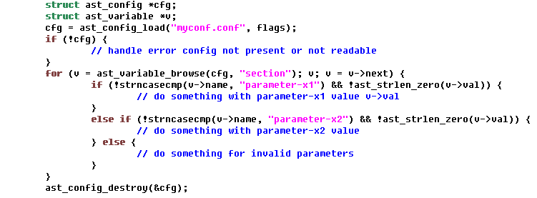
Asterisk module configuration.
05-Aug-09 / <number>

Slide 24
FreeSWITCH module configuration.
FreeSWITCH configuration is composed of a big chunk of XML
An XML configuration API is already there for you to use.
For simple things, no much difference than asterisk config
XML allows more advanced configuration setup.
Simple usage guide lines:
  Use switch_xml_open_cfg() to get a handle to the configuration chunk you want.
  Get the section (equivalent to asterisk category) through switch_xml_child()
  Retrieve variable values through switch_xml_attr_soft
05-Aug-09 / <number>

Slide 25
FreeSWITCH module configuration.
Assuming we have an application configuration like this:
<configuration name=”myconf.conf” description=“test config”>
<section>
<parameter name=“parameter-x1” value=“123”/>
<parameter name=“parameter-x2” value=“456”/>
</section>
</configuration>
05-Aug-09 / <number>

Slide 26
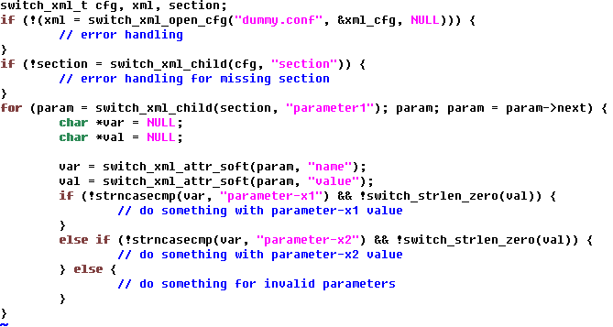
FreeSWITCH module configuration.
05-Aug-09 / <number>

Slide 27
Application return value.
Both FreeSWITCH and Asterisk applications return values to the user through dial plan variables.
Asterisk uses pbx_builtin_setvar_helper(chan, “var”, “value”);
FreeSWITCH uses switch_channel_set_variable(chan, ”var”, “val”);
05-Aug-09 / <number>

Slide 28
Interacting with the Asterisk CLI.
Asterisk has a very flexible and dynamic CLI.
Any Asterisk sub-system may register CLI entries.
Registering CLI entires involves:
  Defining your CLI handlers static char *handler(struct ast_cli_entry *e, int cmd, struct ast_cli_args *a);
  Create an array of the CLI entries (Use the helper macro AST_CLI_ENTRY).
  Call ast_cli_register_multiple to register the array with the Asterisk core.
  Handle CLI requests like CLI_INIT, CLI_GENERATE and CLI_HANDLER.
05-Aug-09 / <number>

Slide 29
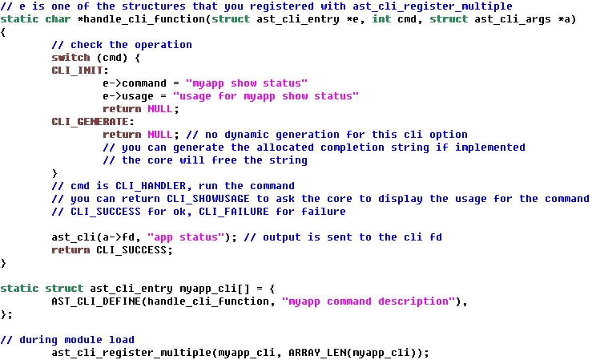
Interacting with the Asterisk CLI.
05-Aug-09 / <number>

Slide 30
Interacting with the FreeSWITCH CLI.
CLI commands exist as APIs.
An added benefit is availability of the function from other interfaces (ie mod_event_socket etc).
In general, your API can be used via switch_api_execute().
No dynamic completion yet.
Simple usage:
  Define your API function using SWITCH_STANDARD_API macro.
  Add your API interface to your module interface using SWITCH_ADD_API.
  Add command completion using switch_console_set_complete.
05-Aug-09 / <number>

Slide 31
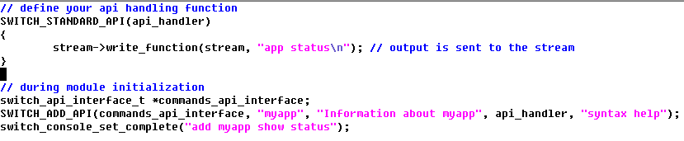
Interacting with the FreeSWITCH CLI.
05-Aug-09 / <number>

Slide 32
Asterisk events and actions.
The Asterisk manager is built-in.
The module needlessly has to care about event protocol formatting through \r\n.
The manager is, by definition, tied to the TCP event protocol implementation.
Every new output format for events has to be coded right into the core.
manager_custom_hook helps, but not quite robust solution.
Basically you can do 2 things with the manager API:
  Register and handle manager actions.
  Send manager events.
05-Aug-09 / <number>

Slide 33
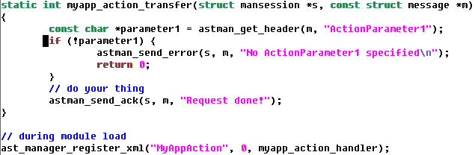
Registering Asterisk actions.
05-Aug-09 / <number>

Slide 34
Launching Asterisk events.
Manager session or HTTP session
enqueue
event
Read event queue
Write to session
05-Aug-09 / <number>

Slide 35
FreeSWITCH events.
Completely abstract API to the event sub-system is provided.
The core fires built-in events and applications fire custom events.
Modules can reserve and fire custom events.
mod_event_socket is a module that does what the Asterisk manager does.
Different priorities:
  SWITCH_PRIORITY_NORMAL
  SWITCH_PRIORITY_LOW
  SWITCH_PRIORITY_HIGH
05-Aug-09 / <number>

Slide 36
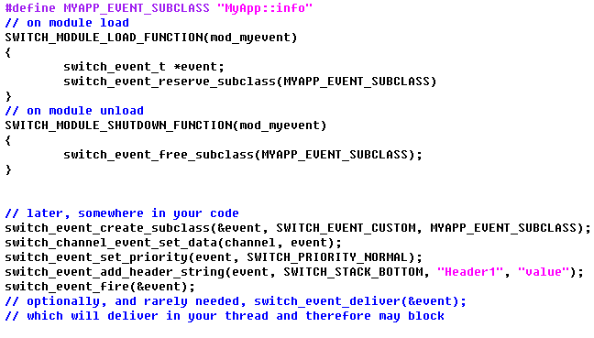
Firing FreeSWITCH events.
05-Aug-09 / <number>

Slide 37
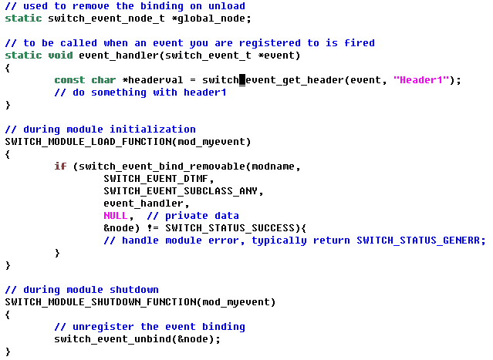
Listening for FreeSWITCH events.
05-Aug-09 / <number>

Slide 38
FreeSWITCH Actions???.
No need for actions, you already registered APIs.
The APIs may be executed through mod_event_socket.
APIs are the closest thing to manager actions that FreeSWITCH has.
APIs work both as CLI commands and “manager actions”, but are not limited to just that.
mod_event_socket
Your module
switch_api_execute()
FreeSWITCH CLI
05-Aug-09 / <number>

Slide 39
Conclusion.
We are in a race for scalability, feature set and adoption.
FreeSWITCH is in need of more features and applications on top of it.
Asterisk is in need of more core improvements to be a better media and telephony engine.
Open source is the clear winner of the competition we are seeing between this two open source telephony engines.
05-Aug-09 / <number>

Slide 40
References
src/include/switch_types.h
src/include/switch_loadable_module.h
src/include/switch_channel.h
src/include/switch_xml_config.h
http://docs.freeswitch.org/
http://wiki.freeswitch.org/wiki/Core_Outline_of_FreeSWITCH

Slide 41
Thank You!
Questions and Comments?
Contact e-mail: moy@sangoma.com
Presentation URL: http://www.moythreads.com/congresos/cluecon2009/

