Slide 1
tgt: Framework Target Drivers
FUJITA Tomonori
tomof@acm.org
NTT Cyber Solutions Laboratories
Mike Christie
mchristi@redhat.com
Red Hat, Inc
Ottawa Linux Symposium 2006

Slide 2
Outline
What is a target and target driver.
tgt design.
Problems.
Future work.

Slide 3
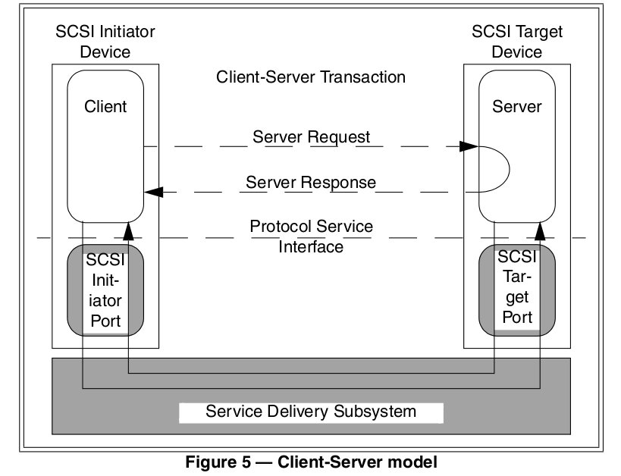
SCSI Client Server Model
Initiator device (client)
  Sends SCSI requests
Target device (server)
  Receives requests
  Sends responses
Notes:
- a target is device that is receives requests and sends responses
- it contains ports and logical units.

Slide 4
Target drivers allow a Linux box to provide device services
Current focus in tgt is SCSI Targets.
  Many SCSI Host Bus Adapters have a initiator and target mode.
  Most of the infrastructure can be used by other block layer drivers with minor modifications.

Slide 5
Monolithic Target Driver
Interact with hardware.
  Initialization, interrupt, etc
Handle transport protocol.
  FCP, iSCSI, SRP network packets and errors
Execute SCSI commands.
  Accessing local devices
Notes:
Monolithic targets drivers like IET, lpfc and qlogic.

Slide 6
Stop Reinventing the Wheel
tgt, SCSI subsystem and transport classes can provide support for common tasks.
  Linux SCSI and transport classes provide library functions for hardware and transport management.
  tgt provides library functions for executing requests.
  Drivers that were monolithic now only handle low level details.

Slide 7
Low Level Target drivers in tgt
Hardware drivers
  Handle the major part of the transport and interconnect processing.
  Target drivers directly access hardware.
Software drivers
  Handle the transport protocol processing and access low-level hardware through another subsystems like the networking or Infiniband stack.

Slide 8
How target drivers fit in.

Slide 9
Our key goal is implementing a great portion of tgt in user space
Command execution.
Device management.
The kernel-space tgt is just a connector between Low Level Target drivers and Transport Classes and user space.

Slide 10
tgt design
Transport libraries
Target driver libraries
management tool
Unix socket
tgtadm
tgt daemon
Single process
User Space
Kernel Space
Netlink socket
System calls
tgt API
Target driver
tgt core
Target driver
SCSI Mid layer
Target driver
Transport class
Disk drives
tgt core is integrated with SCSI-mid layer with minor modifications

Slide 11
Let's take a look at the details

Slide 12
Target Driver Initialization
During driver or device initialization we allocate a scsi_host structure.
If a HBA supports an initiator and target mode we sneak ourselves into the initiator setup.
scsi_host structure is bound to userspace target entity through hotplug events or tgt netlink events.

Slide 13
Kernel and User Space binding
tgt daemon
file-backed
logical unit
file
target entity
logical unit
file
target entity
User Space
Target driver A
scsi_host 0
Initiator
Kernel Space
scsi_host 1
Initiator
scsi_host 2
Initiator
Target driver B
An initiator is bonded to a target entity though the Linux SCSI scsi_host data structure.

Slide 14
tgt daemon (tgtd)
Contains SCSI state machine, IO execution, and device binding code.
Behavior can be extended by driver and transport libraries.
Single process design.
  Simplifies Task Management
  Potential Bottleneck

Slide 15
Sending SCSI Command to tgtd
tgt provides library functions to get a scsi_cmnd structure and pass it to user space.
tgt passes the following to users space
    SCSI command (SCSI control block)
    LUN buffer (represents logical unit number)
    tag (unique value to identify this SCSI command)
    task attribute
    buffer length (expected number of data bytes to transfer)

Slide 16
SCSI Read/Write Commands
tgtd uses mmap to map part of the device.
tgtd passes the address returned by mmap to the tgt kernel component.
tgt maps the data into the kernel using the kernel's BIO map functions and then asks the target driver to transfer the data.
When the target driver has completed the transfer the driver notifies tgt.
tgt runs the driver's the transfer response callback

Slide 17
Other Requests
tgtd builds a response in a malloced buffer.
tgtd passes the address to the tgt kernel component.
tgt maps the data into the kernel using the kernel's BIO map functions and then asks the target driver to transfer the data.
When the target driver has completed the transfer scsi_done is called and commands resources are releases.

Slide 18
Why go to all this trouble?
Drawbacks
  Requires a high performance interface.
    Currently using netlink.
      Cannot pass pointers.
      Passing Read/Write data buffers would require large memory copies.
    Looking into shared memory schemes.
      mmapped packet socket (AF_PACKET) and Relayfs are only for kernel to userspace traffic.

Slide 19
Why go to all this trouble?
More Drawbacks
  Taking a trip to userspace on every request can become expensive.
  Zero copy difficult to support for the software target driver model.
Benefits
  Reduced kernel code makes many kernel developers happy.
  Flexibility.

Slide 20
Target Driver Status
FC
  Qlogic Fibre Channel support being worked on.
  Worked based on Emulex's target mode reference driver is planned.
iSCSI
  Software iSCSI over TCP/IP and Infinniband has been started.

Slide 21
Target Driver Status Continued
XEN
  A target mode driver using the SRP protocol has been implemented.
SRP
  Virutual machine environments (IBM pSeries) support is in the -mm tree.

Slide 22
Difficulties Adding Target Drivers
Linux SCSI, Transport Classes and the Block Layer are designed for initiators.
  tgt attempts to reuse as much mainline code as possible so the kernel and userspace interfaces require many changes.

Slide 23
Future
tgtd only supports disks, but there are many virtualization possibilities.
  A tape drive by using a file
  A cdrom drive by using an iso image file
Accessing SCSI hardware directly (passthrough)
  Executes SCSI commands via SG_IO.
Benchmarking, testing, userspace cleanup and documentation.
Move tgtd back into the kernel and merge SCST.

Slide 24
Questions
???

