Slide 1





ROSCon Global 2026, New Features in ROS
ros2log new CLI and rcl_logging_implementation for Lyrical Luth
Tomoya Fujita
TriOrb.Inc
Fumiya Ohnishi
Keio University
1/20
Notes:
just a quick introduction for both of us and presentation opening

Slide 2
Overview
ROS 2 app(cpp)
ROS 2 app(python)
rclcpp
rclpy
rcutils (log level hash map)
ros2log new CLI
rcl
frontend
rosout
rcl_logging_interface
rcl_logging_
implementation
Filtered log display
Runtime log level control
Proposed as REP-0156
backend
rmw
spdlog
rsyslog
…
stdout
  Runtime dynamic loading of logging backends
  without rebuilding RCL or application code
Notes:
say we have 2 things here to present. the one is ros2log Fumiya is going to take this, and the other is rcl_logging_implementation that is new feature of lyrical I am going to talk about.

Slide 3
Overview
ROS 2 app(cpp)
ROS 2 app(python)
rclcpp
rclpy
rcutils (log level hash map)
ros2log new CLI
rcl
frontend
rosout
rcl_logging_interface
rcl_logging_
implementation
Filtered log display
Runtime log level control
Proposed as REP-0156
backend
rmw
spdlog
rsyslog
…
stdout
  Runtime dynamic loading of logging backends
  without rebuilding RCL or application code

Slide 4
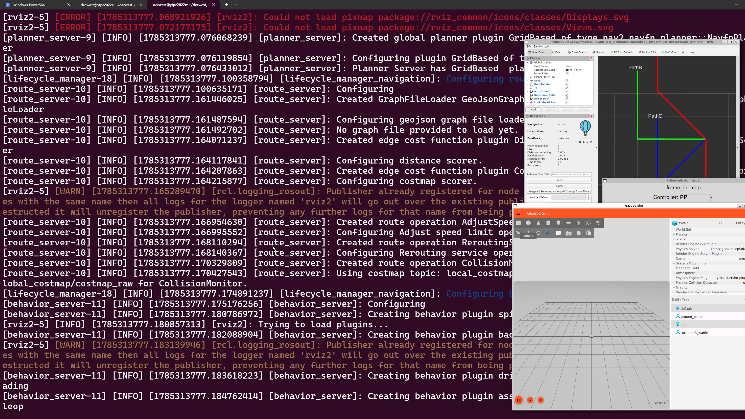
Background
All logs shown at once, hard to read…
Mixed log levels…
Notes:
2:18

Slide 5
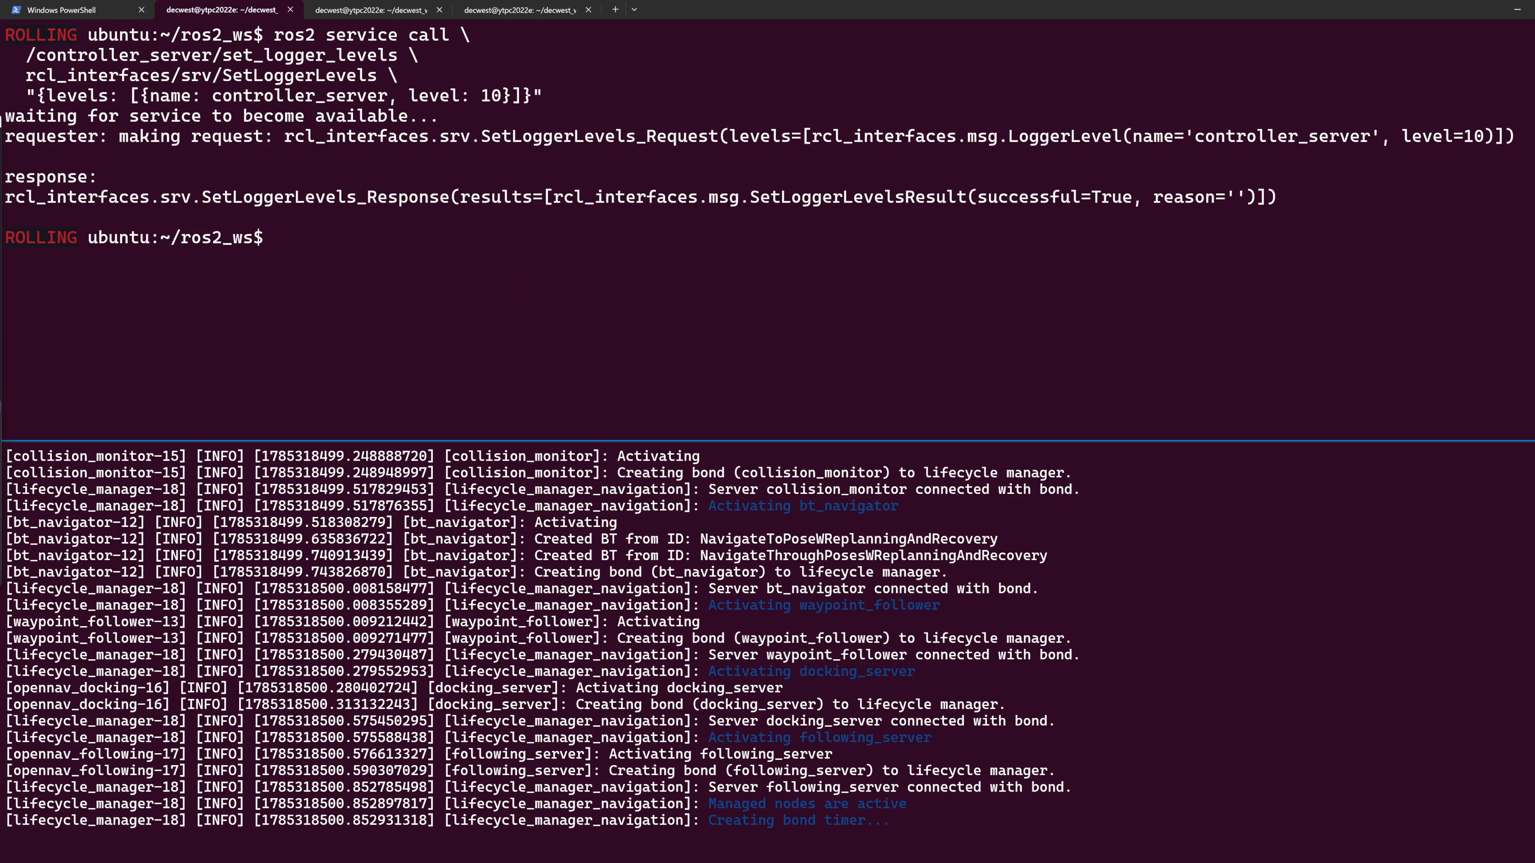
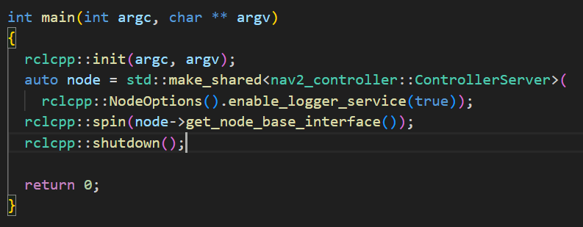
Background
Note: runtime log level change applies only to nodes created with
enable_logger_service=true
Python
node = Node('NodeWithLoggerService',
enable_logger_service=True)
C++
auto node = std::make_shared<rclcpp::Node>
("NodeWithLoggerService",
rclcpp::NodeOptions()
.enable_logger_service(true))
Changing log levels at runtime
  ☹ typing this by hand every time is tedious…
Python
node = Node('NodeWithLoggerService',
enable_logger_service=True)
C++
auto node = std::make_shared<rclcpp::Node>
("NodeWithLoggerService",
rclcpp::NodeOptions()
.enable_logger_service(true))
ros2 service call \
<node_name>/set_logger_levels \
rcl_interfaces/srv/SetLoggerLevels \
"{levels: [{name: <logger>, level: <level>}]}"
ros2 service call \
/controller_server/set_logger_levels \
rcl_interfaces/srv/SetLoggerLevels \
"{levels: [{name: controller_server, level: 10}]}"

Slide 6
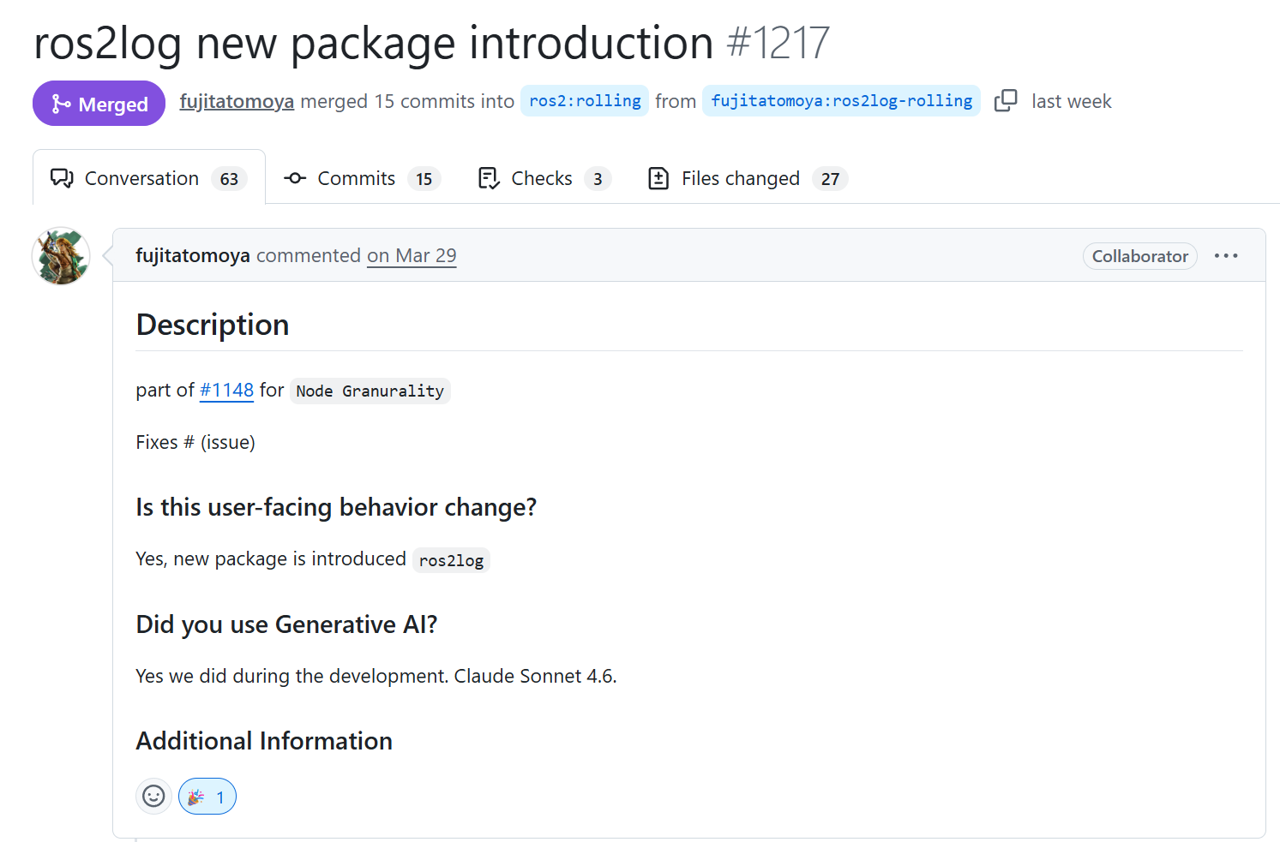
Our Contributions
Developed the CLI ros2log to unify ROS 2 log control
Proposed as REP-0156 in the official standardization process
Available from ROS 2 Lyrical onward 🚀

Slide 7
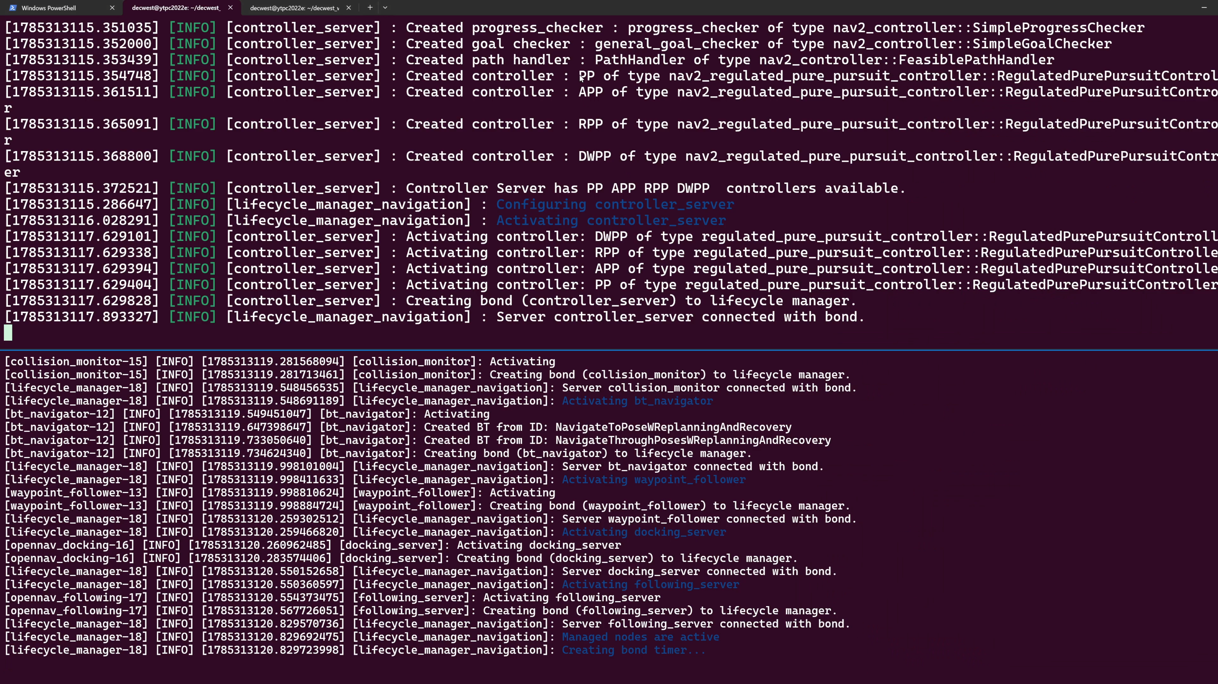
Usage Example
ros2 log watch --regex controller
Filter logs!

Slide 8
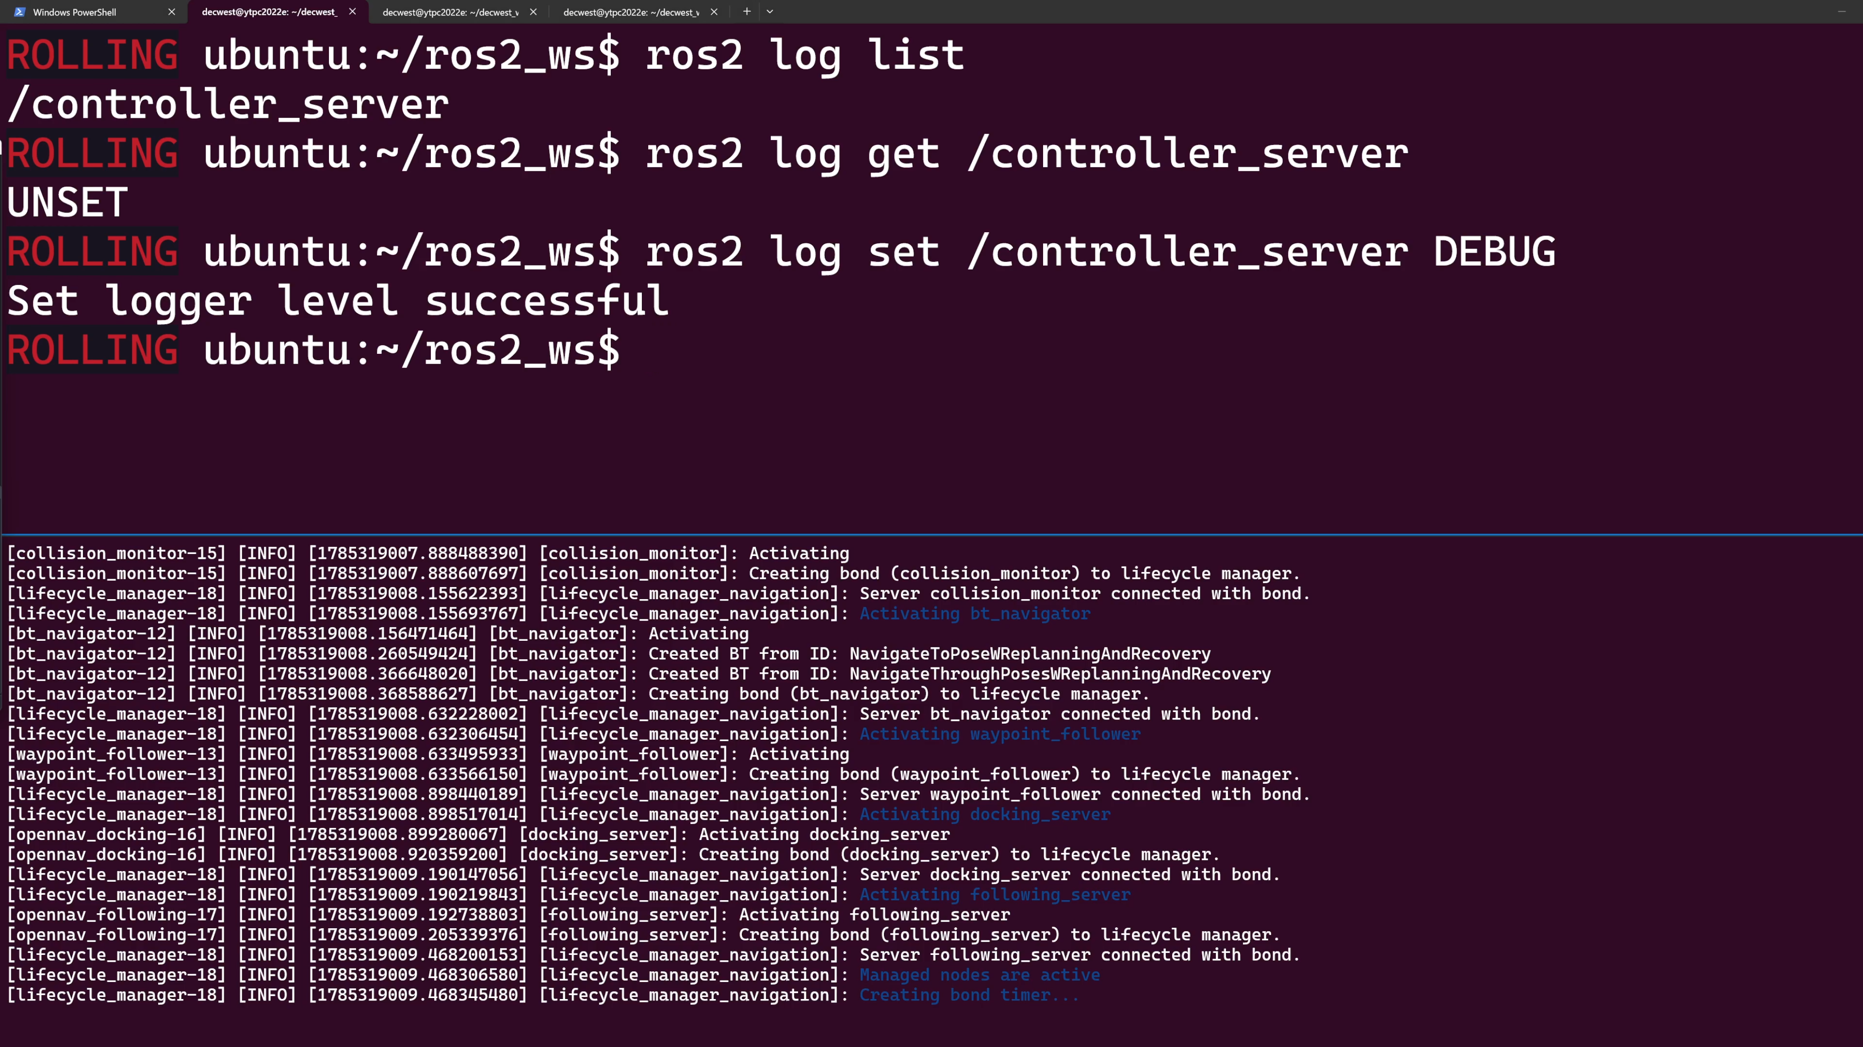
Usage Example
Old command →
ros2 service call \
/controller_server/set_logger_levels \
rcl_interfaces/srv/SetLoggerLevels \
"{levels: [{name: controller_server, level: 10}]}"
ros2 log set /controller_server DEBUG
Set log levels!

Slide 9
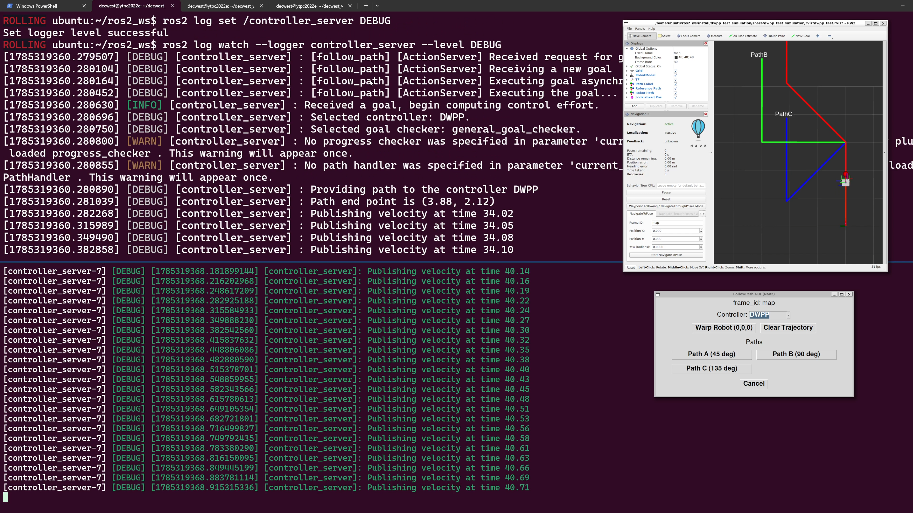
Usage Example
ros2 log watch --logger controller_server --level DEBUG
Filter logs!

Slide 10

ros2log core features defined by REP-0156
Command
  ros2 log <subcommand>
Subcommands
  watch [options]
    Subscribes to /rosout topic and prints logs filtered by [options]
    --level: log level
    --regex: regular expression
    --logger: logger name (node name in current impl.)
  levels
    Prints available log levels (UNSET, DEBUG, INFO, WARN, ERROR, FATAL)
  list
    Lists nodes that support runtime log level change
  get <node>
    Gets the current log level of <node>
  set <node> <level>
    Sets the log level of <node> to <level>
REP-0156
Documentation
Log filter
Log-Level control

Slide 11
Implementation Details
Where ros2log is developed
  ros2cli: https://github.com/ros2/ros2cli
  Implementation language: Python
    ros2cli is a Python CLI framework
Key points of implementation
  watch
    Subscribes to /rosout topic
    Content Filtered Topics are used
  list, get, set
    /node/get_logger_levels, /node/set_logger_levels services are used
    (available when a node is created with enable_logger_service=True)
    list: lists nodes that have get, set services
    get: wrapper of the get service
    set: wrapper of the set service
What are Content Filtered Topics?
Lets a subscriber receive only
messages matching content conditions
(uses DDS ContentFilteredTopic via the RMW layer)
Reduces reception overhead and traffic

Slide 12
Limitation & Future Work
About log filtering
  Logs not in the /rosout topic cannot be shown
    Launch system's own logs, OS/device syslog, past logs, etc.…
  ➡ `ros2 log watch` targets only runtime logs from /rosout
    Log storage format/destination/on-off may vary per run
    with logging backend and user settings
About log level control
  Hard to control loggers besides the root logger (i.e. child logger)
  Getting logger info via a `describe` subcommand: not implemented
  Reason: ROS 2 has no API to enumerate logger names
  ➡ Add an API to enumerate logger names, then support
  `describe` subcommand and child logger control
Node "my_node"
root logger
= node name
child logger
my_node.foo
child logger
my_node.bar
Child logger

Slide 13
What is “REP”?
ROS
Gazebo
Open-RMF
ROS Infrastructure
ros_control
REP (Robotics Enhancement Proposal)
  A document explaining the what, how, and why
  of enhancements to OSRA-governed projects
  Targets large changes spanning multiple PRs and repos
  Renamed in Oct. 2025 (was: ROS Enhancement Proposal)
Standardization process based on REP ^{[1]}
OSRA-governed
OSS projects
ROS PMC
approval requested
REP doc created &
merged to the
reps repository
Discuss
proposal
Discuss &
implement
All code merged
Process
Status
Draft
Accepted
Finalized
ros2log is here!
[1] REP 0001:2025, https://reps.openrobotics.org/rep-0001-2025/

Slide 14
Overview
ROS 2 app(cpp)
ROS 2 app(python)
rclcpp
rclpy
rcutils (log level hash map)
ros2log new CLI
rcl
frontend
rosout
rcl_logging_interface
rcl_logging_
implementation
Filtered log display
Runtime log level control
Proposed as REP-0156
backend
rmw
spdlog
rsyslog
…
stdout
  Runtime dynamic loading of logging backends
  without rebuilding RCL or application code

Slide 15
ROS 2 Logging Subsystem
ROS 2 provides a flexible and configurable logging subsystem.
Supports multiple logging backends.
  stdout: Logs are printed to the
  standard output (default ON to console)
  rosout: Logs are published to the
  /rosout topic (default ON)
  external: Default spdlog,
  or your own implementation.
A logger will only process log messages
with severity at or higher than a specified level
chosen for the logger.
Logger names represent a hierarchy.
ROS 2 app(cpp)
ROS 2 app(python)
rclcpp
rclpy
rcutils (log level hash map)
rcl
rosout
rcl_logging_interface
rcl_logging_spdlog
rmw
spdlog
stdout
Notes:
Just share the ROS 2 logging subsystem overview.
we have 3 backend sinks, rmw, spdlog and stdout.
and user can configure the appropriate logger level to filter out the log messages in core utility library.

Slide 16
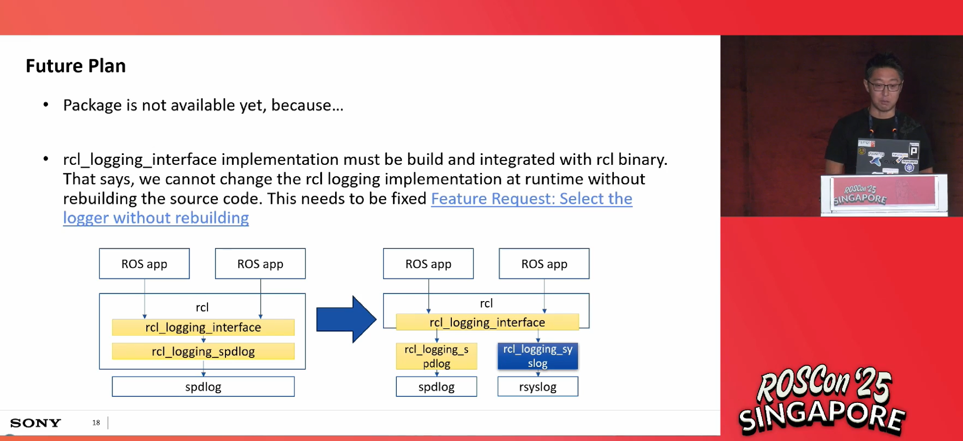


What was the pain?
rcl_logging_interface implementation must be build and integrated with rcl binary. That says, we cannot change the rcl logging implementation at runtime without rebuilding the source code. This needed to be fixed as Feature Request: Select the logger without rebuilding
Notes:
remember ROSCon 2025? explain the pain and plan.

Slide 17
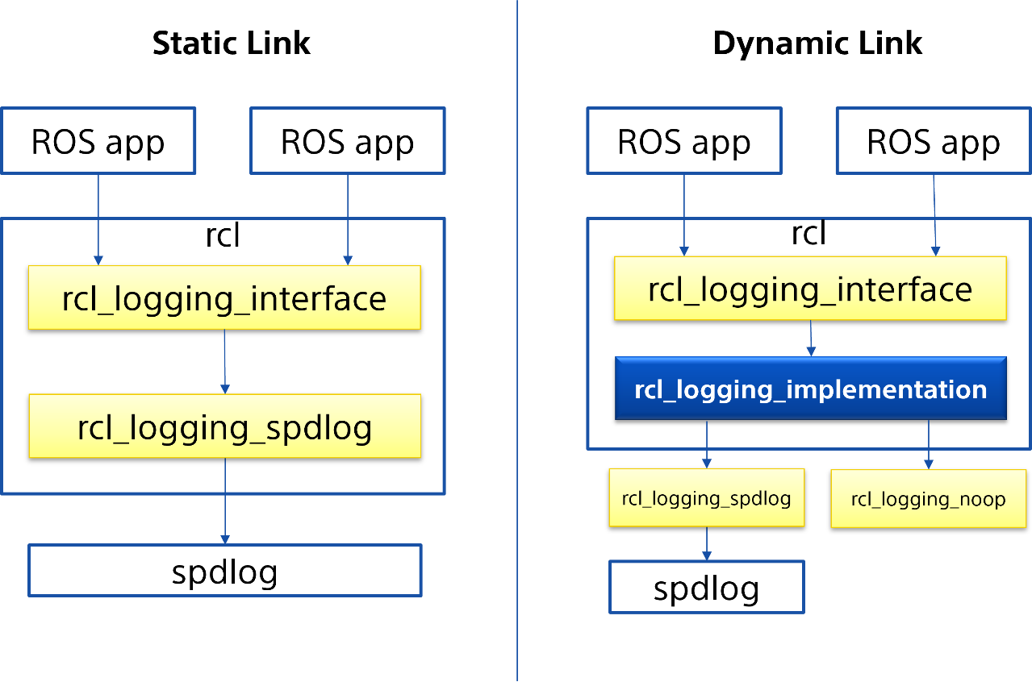
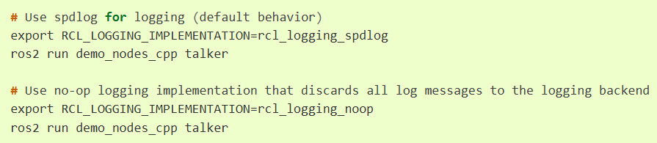
rcl_logging_implementation
is a package that enables runtime dynamic loading of logging backends in ROS 2, similar to how rmw_implementation works for middleware selection. This abstraction layer allows users to switch between different logging implementations (such as rcl_logging_spdlog and rcl_logging_noop) without rebuilding RCL or application code.
See more details for About-Logging#rcl-logging-implementation
RCL_LOGGING_IMPLEMENTATION
  Dynamic Loading (default, runtime)
    Switch logging implementation
    e.g) rcl_logging_noop
  Static Link (Build time)
    Bypass abstraction, No dlopen overhead
    Bind rcl to specific logging implementation
Notes:
introduce rcl_logging_implementation that dlopens the logging backend library that user can configure.
dynamic loading is the default behavior, but user can still set the environment variable to configure the logging backend statically linked without having the abstraction layer API binding.

Slide 18

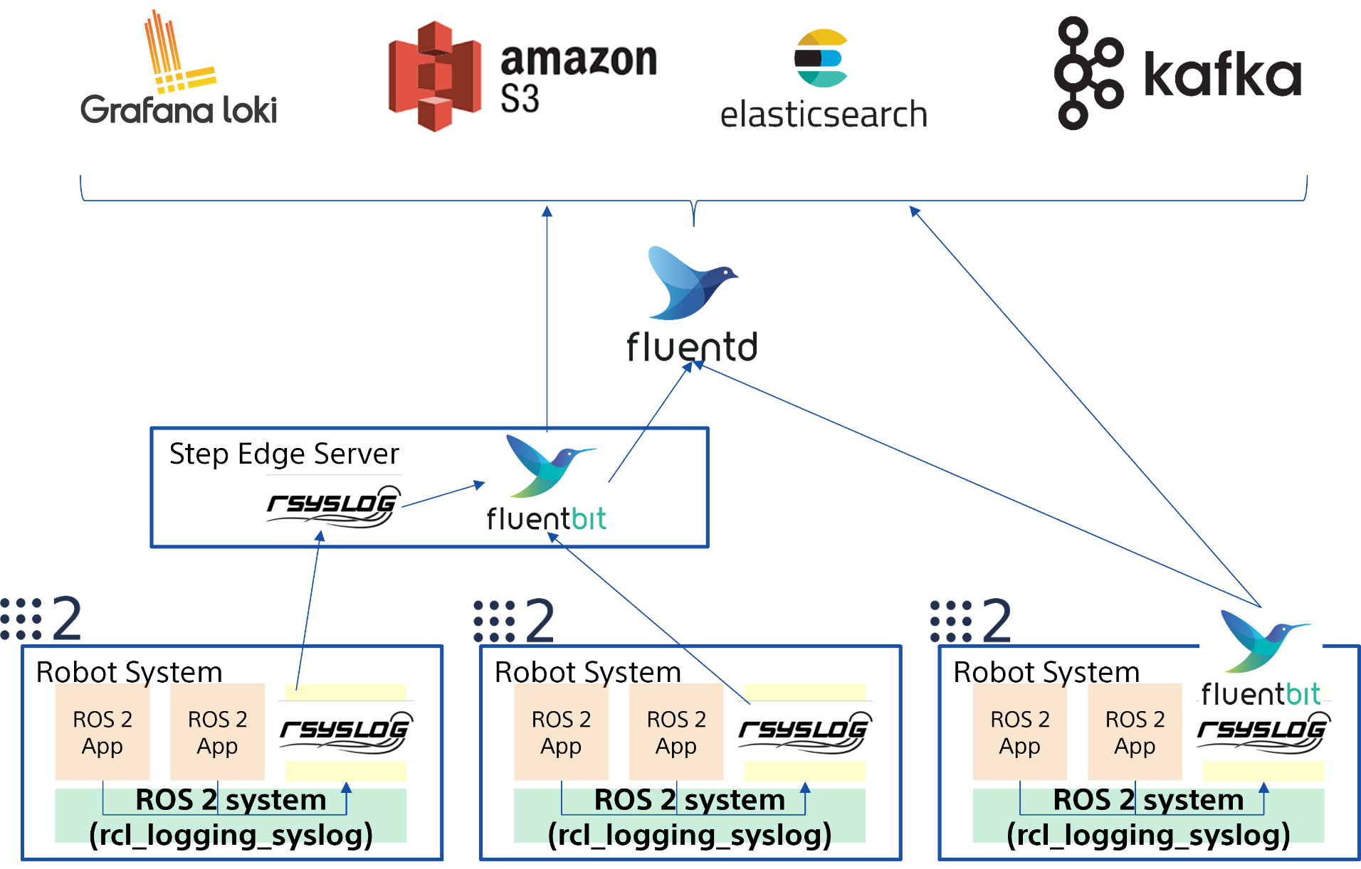
rcl_logging_syslog
Alternate implementation for rcl_logging_interface
ROS 2 rcl logging implementation built on top of syslog(3)
Connects with rsyslog and FluentBit etc...
rcl_logging_syslog
Notes:
with that, we can now configure the preferred logging backend as we like at runtime.
rcl_logging_syslog is introduced last year ROSCon 2025, and now this can be plugged in the rcl at runtime.
that also can support the logging pipeline as described here with FluentBit, Fluentd, Grafana Loki and so on.

Slide 19

How to use
We do not have to rebuild anymore !!!
apt install ros-lyrical-rcl-logging-syslog
export RCL_LOGGING_IMPLEMENTATION=rcl_logging_syslog
If you use docker, either binding -v /dev/log:/dev/log or enable rsyslogd in the container.
See more details for Installation Tutorial
Notes:
with having the abstraction layer, we can now install and go use different logging backend such as rcl_logging_syslog package.
there are some other logging backend packages are developed and available, you can look them up for the rosindex.

Slide 20
Summary
ros2log
  Developed new CLI ros2log to unify ROS 2 log control
    REP-0156 under proposal (Status: Draft)
  Future Work
    Add an API to enumerate logger names
    Support the `describe` subcommand and child logger control
    → Move REP-0156 to Finalized
ROS 2 logging subsystem
  rcl_logging_implementation has been completed
  maybe journald support?
  ROS 2 generic logging configuration
  translated into backend configuration
REP-0156
Documentation
rcl_logging_syslog

