Slide 1
Getting Started with Docker
Ref: https://docs.docker.com/get-started/

Slide 2
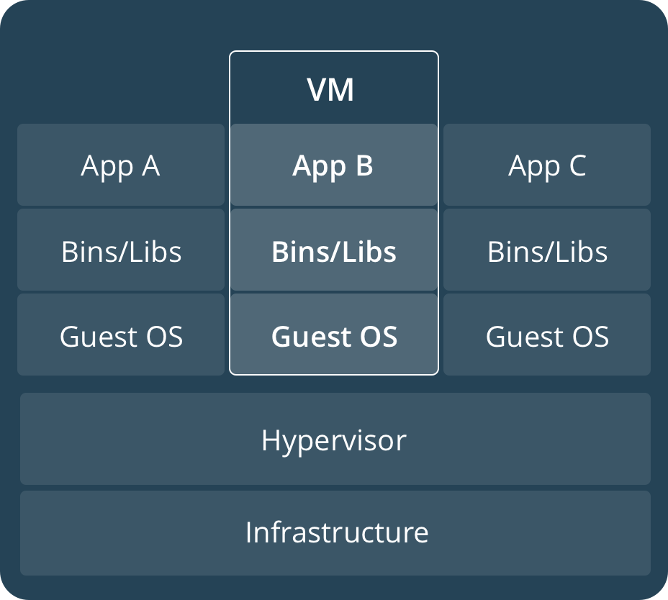
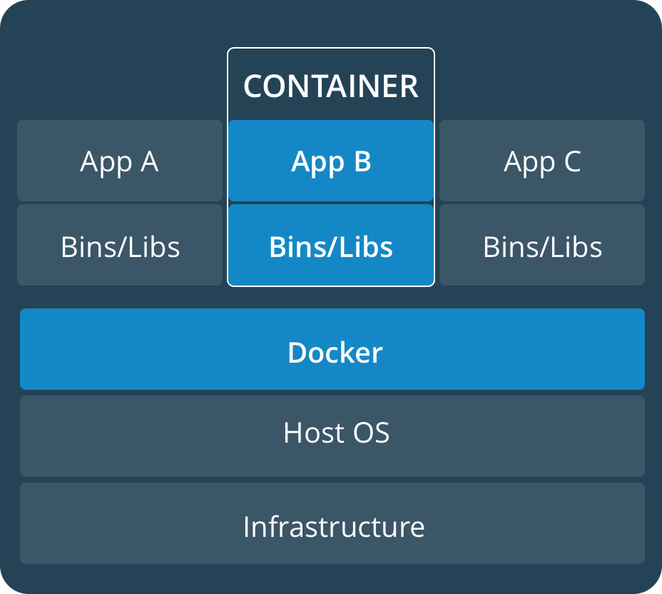
Part 1: Orientation
Virtual Machine diagram
Container diagram

Slide 3
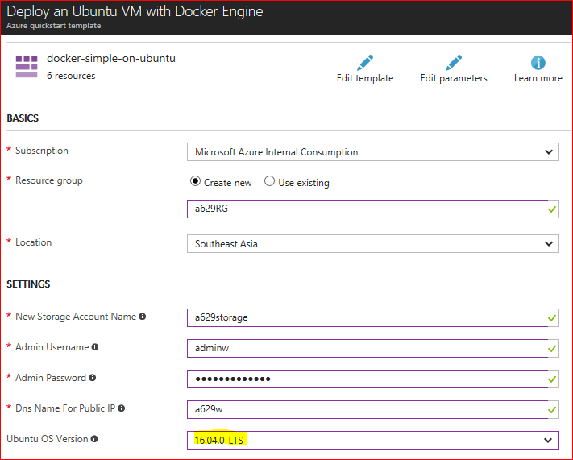
The Docker VM extension
Create a Docker environment in Azure using the Docker VM extension
Ref: https://docs.microsoft.com/en-us/azure/virtual-machines/linux/dockerextension

Slide 4
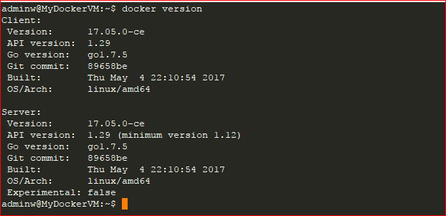
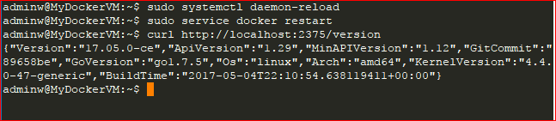
Docker commands
$ docker –version
$ docker version
$ sudo vi /lib/systemd/system/docker.service
...
ExecStart=/usr/bin/dockerd -H=fd:// -H=tcp://0.0.0.0:2375
…
$
$sudo systemctl daemon-reload
$ sudo service docker restart
$ curl http://localhost:2375/version

Slide 5
Docker Engine & Client
https://docs.docker.com/engine/installation/
https://docs.docker.com/docker-for-windows/install/
Only Docker Client
To install the Docker client for Windows, open https://get.docker.com/builds/Windows/x86_64/docker-latest.zip and copy the executable file named "docker.exe" from the "docker" subdirectory to a local folder.
To install the Docker client for macOS, open https://get.docker.com/builds/Darwin/x86_64/docker-latest.tgz and copy the executable file named "docker" from the "docker" subdirectory to a local folder.
To install the Docker client for Linux, open https://get.docker.com/builds/Linux/x86_64/docker-latest.tgz and copy the executable file named "docker" from the "docker" subdirectory to a local folder. (You can ignore the other files in the "docker" subdirectory

Slide 6
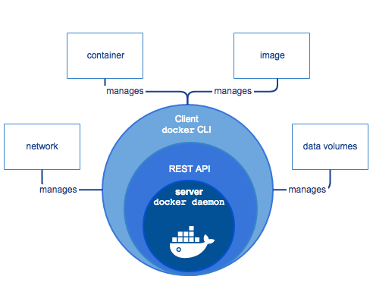
Docker Engine
Ref: https://docs.docker.com/engine/docker-overview/#what-can-i-use-docker-for

Slide 7
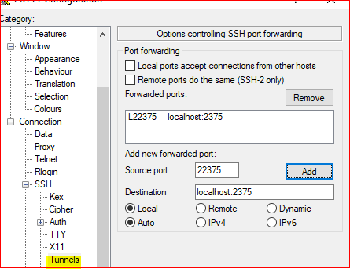
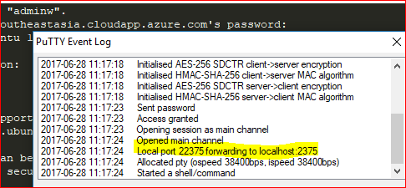
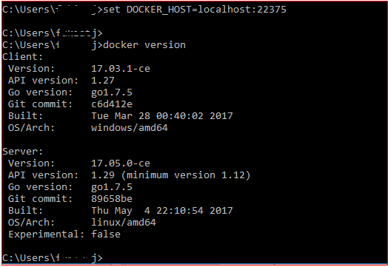
Connect to remote docker engine

Slide 8
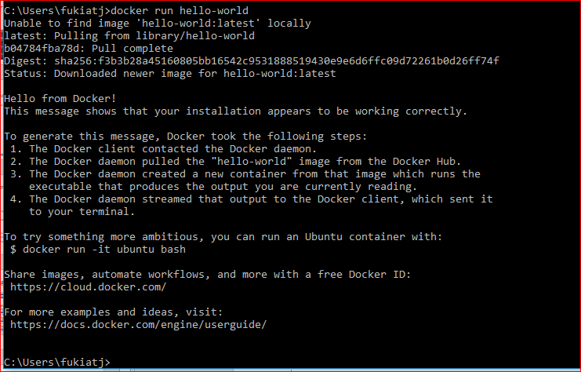
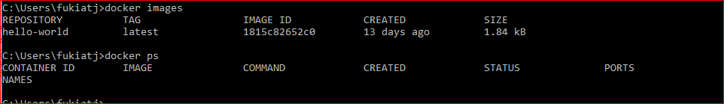
docker run hello-world

Slide 9
Get Started, Part 2: Containers
Stack
Services
Container
Ref: https://docs.docker.com/get-started/part2/

Slide 10
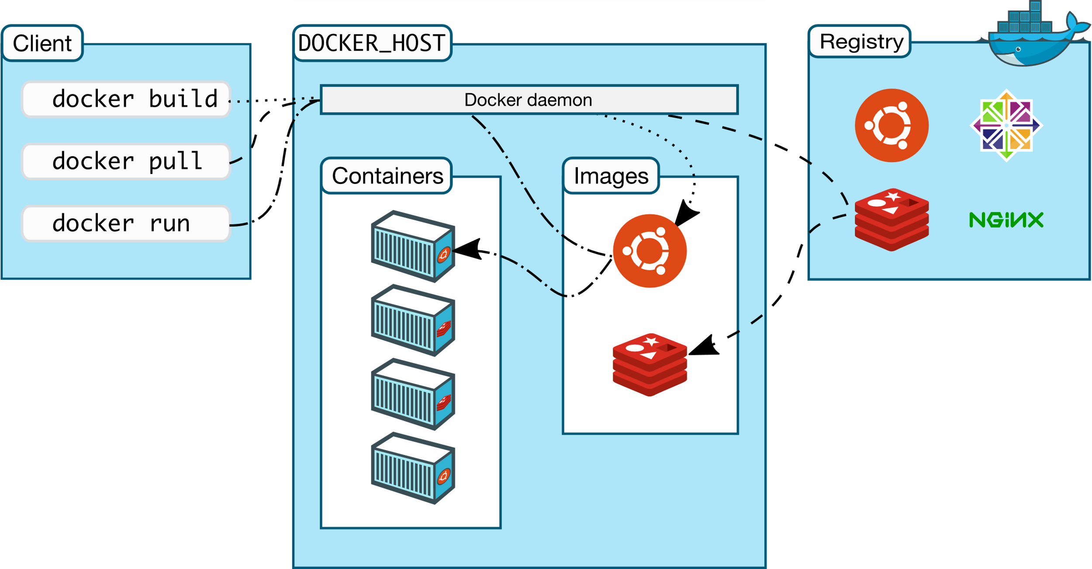
Docker architecture
Ref: https://docs.docker.com/engine/docker-overview/#what-can-i-use-docker-for

Slide 11
Development environment
Build the app
Dockerfile
The app itself
Run the app
Share your image
Log in with your Docker ID
Tag the image
Publish the image
Pull and run the image from the remote repository

Slide 12
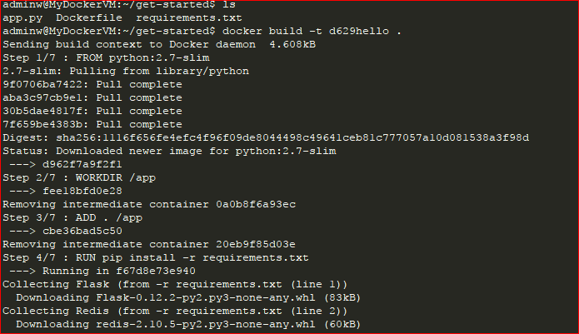

Docker build
docker build -t d629hello .

Slide 13
Docker run
docker build -t d629hello .
docker run -p 8001:80 d629hello
doker run –d -p 8001:80 d629hello
curl http://localhost:8001
docker ps
docker stop
docker ps -a
docker rm

Slide 14
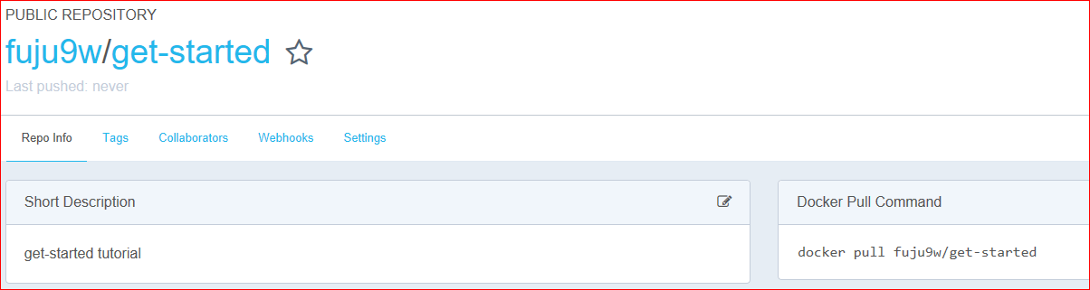
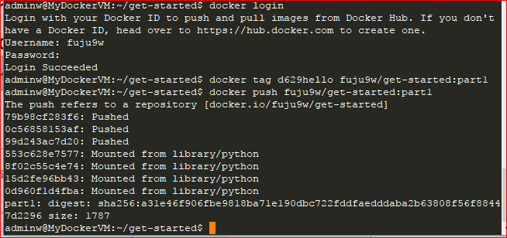
Share your image
docker login
docker tag d629hello fuju9w/get-started:part1
docker push fuju9w/get-started:part1
https://hub.docker.com/r/fuju9w/get-started/

Slide 15
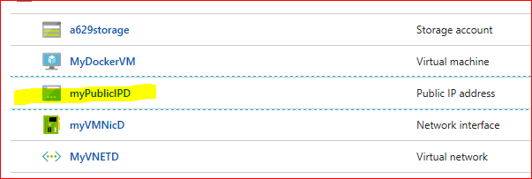
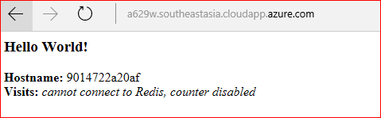
Pull and run the image from the remote repository
docker run -p 80:80 fuju9w/get-started:part1
curl http://localhost:80

Slide 16
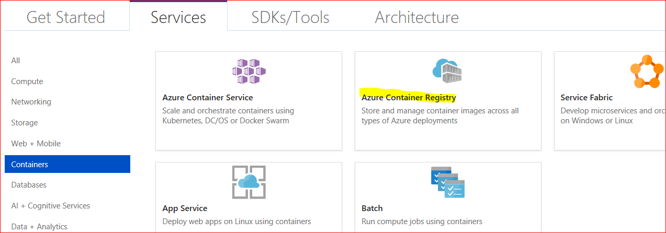
Azure Container Registry
https://docs.microsoft.com/en-us/azure/container-registry/container-registry-get-started-docker-cli

Slide 17
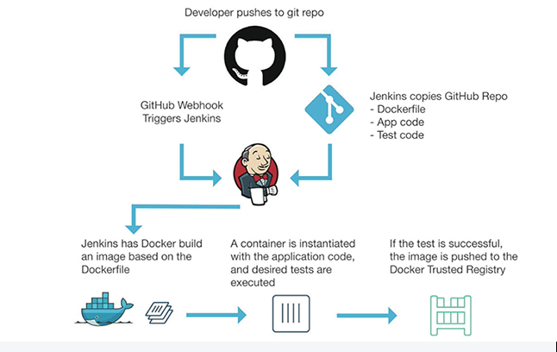
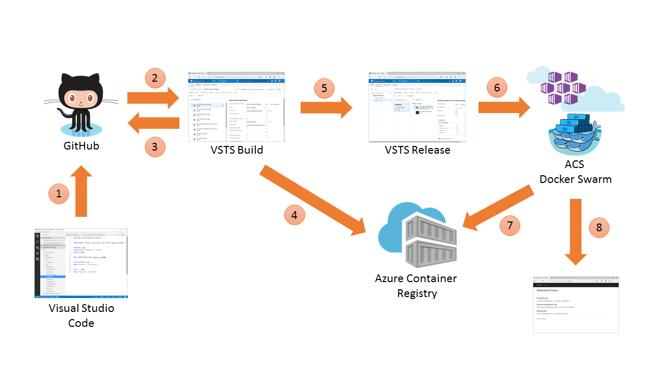
CD/CI Pipeline
https://www.docker.com/use-cases/cicd
https://docs.microsoft.com/en-us/azure/container-service/container-service-docker-swarm-setup-ci-cd
https://www.docker.com/use-cases/cicd
https://docs.microsoft.com/en-us/azure/container-service/container-service-kubernetes-jenkins

Slide 18
Get Started, Part 3: Services
Stack
Services
Container
Ref: https://docs.docker.com/get-started/part2/

Slide 19
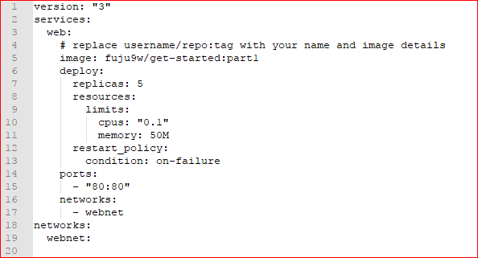
Get Started, Part 3: Services
docker-compose.yml
Codifies the way that image runs
Defines how Docker containers should behave in production
Ref: https://docs.docker.com/get-started/part3/#docker-composeyml

Slide 20
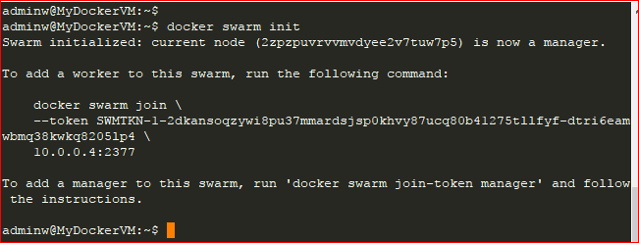
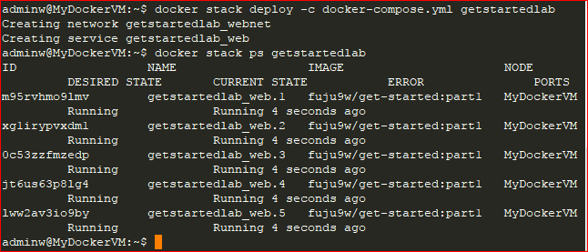
Run your new load-balanced app
docker swarm init
docker stack deploy -c docker-compose.yml getstartedlab
docker stack ps getstartedlab
curl http://localhost
docker stack rm getstartedlab
docker node ls
docker swarm leave --force

Slide 21
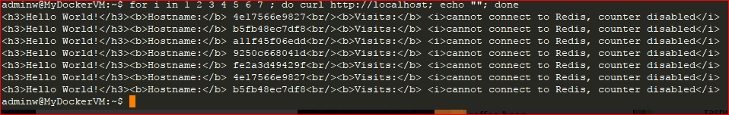
curl http://localhost
for i in 1 2 3 4 5 6 7
do
curl http://localhost
echo ' '
done

Slide 22
Docker stack :
docker stack ls # List all running applications on this Docker host
docker stack deploy -c <composefile> <appname> # Run the specified Compose file
docker stack services <appname> # List the services associated with an app
docker stack ps <appname> # List the running containers associated with an app
docker stack rm <appname> # Tear down an application

Slide 23
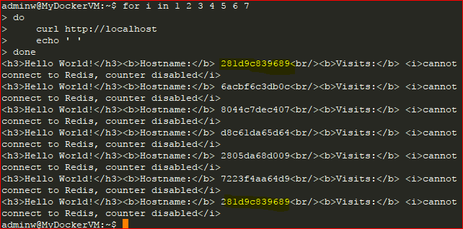
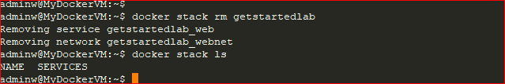
Scale the app
deploy:
replicas: 6
resources:
limits:
cpus: "0.1"
memory: 50M

Slide 24
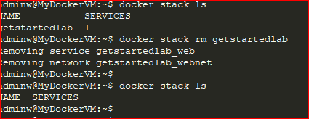
Take down the app and the swarm
docker stack rm getstartedlab

Slide 25
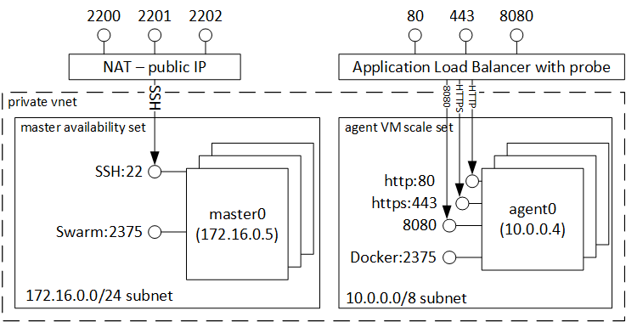
Get Started, Part 4: Swarms
swarm manager
workers
Ref: https://docs.microsoft.com/en-us/azure/container-service/container-service-intro

Slide 26
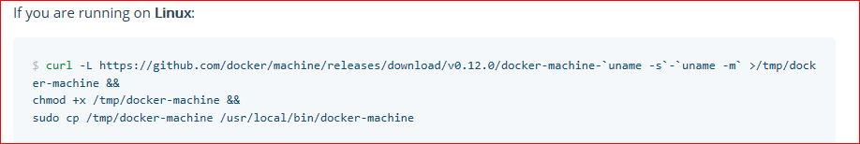

Install Docker Machine
Ref: https://docs.docker.com/machine/install-machine/

Slide 27
Set up your swarm
$ docker-machine create --driver virtualbox myvm1
$ docker-machine create --driver virtualbox myvm2
docker-machine create -d azure \
--azure-subscription-id $sub \
--azure-ssh-user ops \
-- azure-location southeastasia
--azure-open-port 80 \
worker01
Ref: https://docs.microsoft.com/en-us/azure/virtual-machines/linux/docker-machine

Slide 28
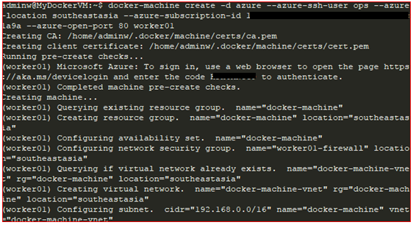
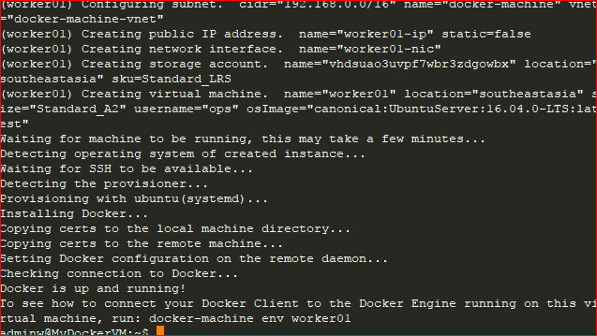
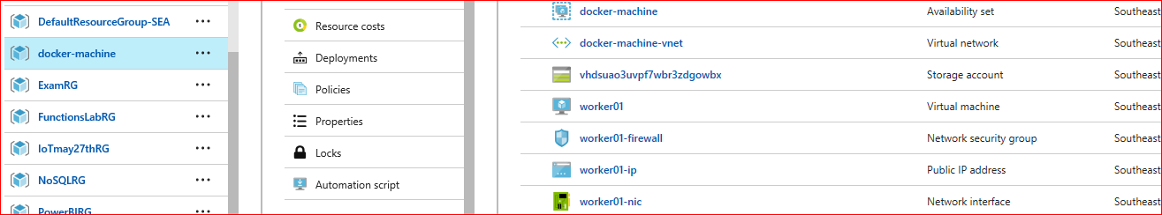
docker-machine create

Slide 29
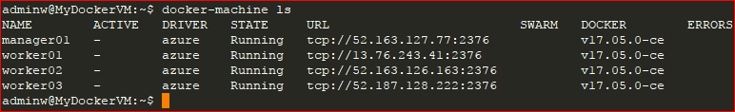
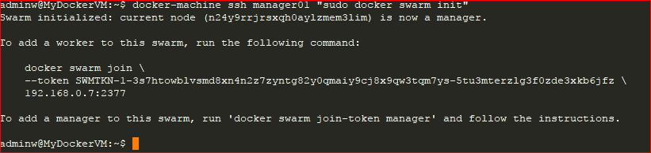

Setup
Manager:
docker-machine ssh manager01 “ sudo docker swarm init “
Docker-machine ssh worker01 “sudo docker swarm join
--token SWMTKN-1-3s7htowblvsmd8xn4n2z7zyntg82y0qmaiy9cj8x9qw3tqm7ys-5tu3mterzlg3f0zde3xkb6jfz \
192.168.0.7:2377 “

Slide 30
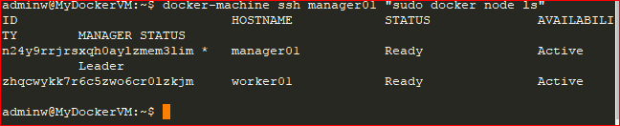
docker-machine ssh myvm1 "docker node ls"

Slide 31
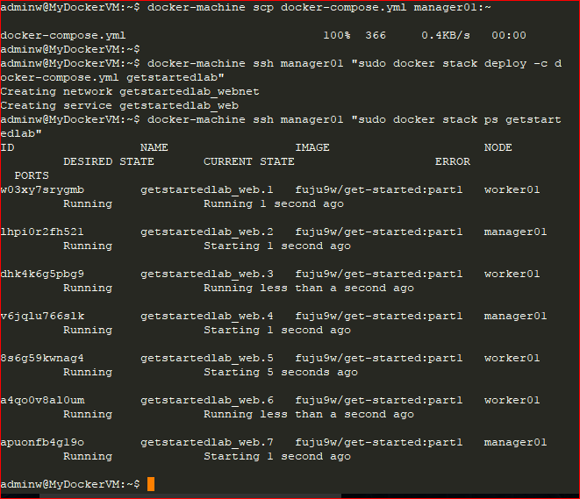
Deploy your app on a cluster
docker-machine scp docker-compose.yml manager01:~
docker-machine ssh manager01 “sudo docker stack deploy -c docker-compose.yml getstartedlab”
docker-machine ssh manager01 “sudo docker stack ps getstartedlab”

Slide 32
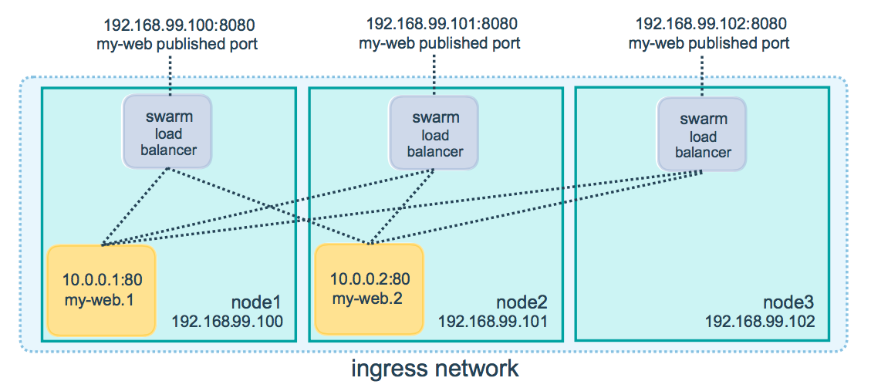
Accessing your cluster
Ref: https://docs.docker.com/get-started/part4/#accessing-your-cluster

Slide 33

Cleanup
docker-machine ssh manager01 “sudo docker stack rm getstartedlab”
** docker-machine rm $(docker-machine ls -q) # Delete all VMs and their disk images

Slide 34
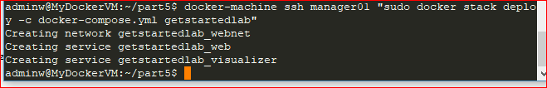
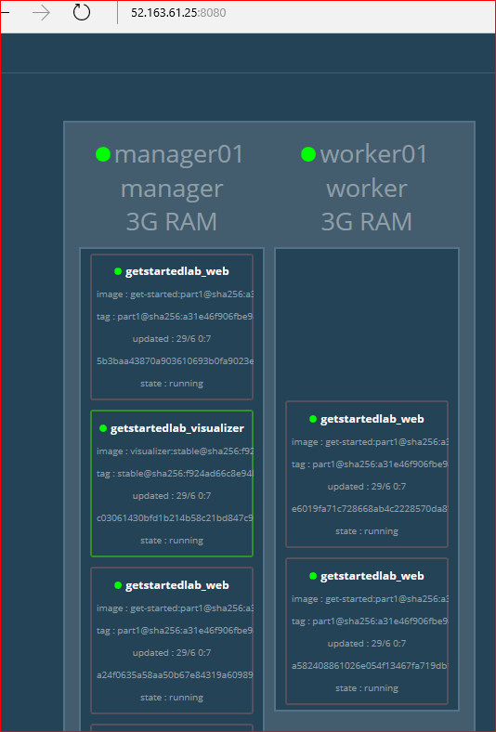
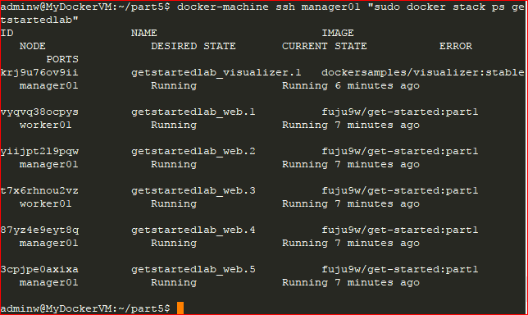
Get Started, Part 5: Stacks
docker-machine scp docker-compose.yml manager01:~
docker-machine ssh manager01 “sudo docker stack deploy -c docker-compose.yml getstartedlab"

Slide 35
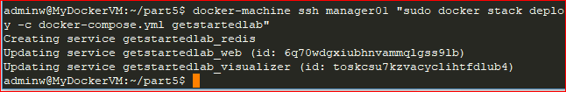
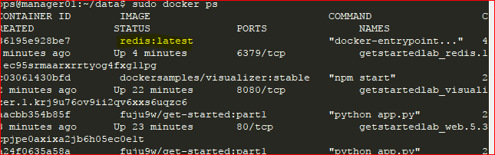
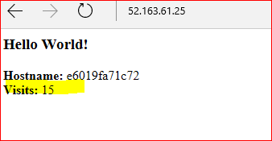
Persist the data
docker-machine ssh manager01 "mkdir ./data"
docker-machine scp docker-compose.yml manager01:~
docker-machine ssh manager01 "sudo docker stack deploy -c docker-compose.yml getstartedlab"

Slide 36
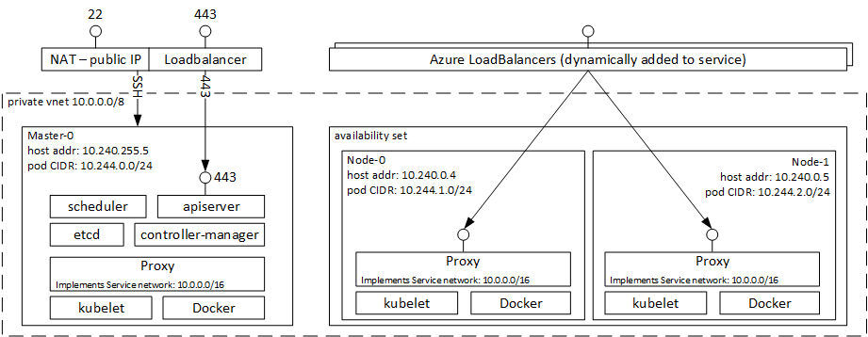
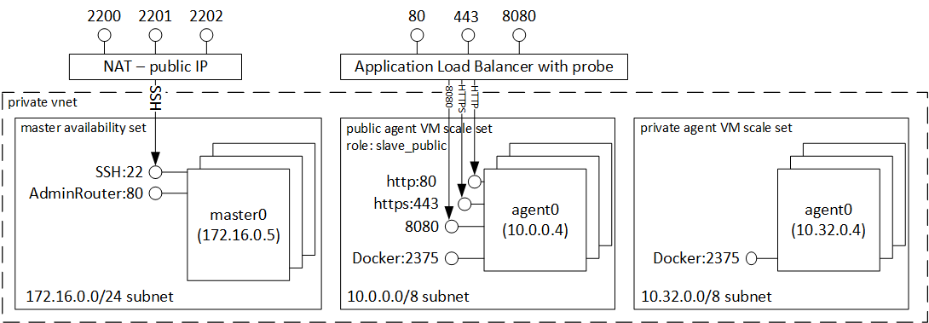
Get Started, Part 6: Deploy your app
https://docs.docker.com/get-started/part6/
Time to learn more about ACS ( Azure container Service )

Slide 37
Break

