Slide 1
Work summaries of this month
Fu kangwei

Slide 2


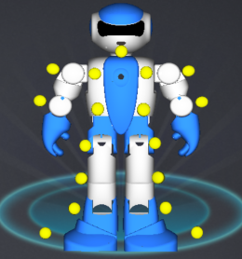
LEO Robot
Based on Android OS
17 Joints/Steering gears
One camera device
Supply API for further developing

Slide 3
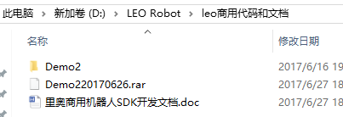
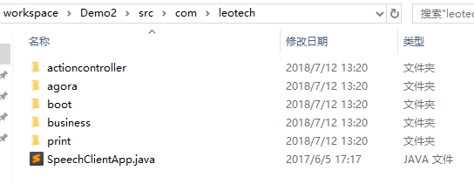
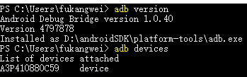
SDK and Demo
Obtain SDK from the server
Analyze the SDK code(13/15)
Learn the usage of ADB

Slide 4

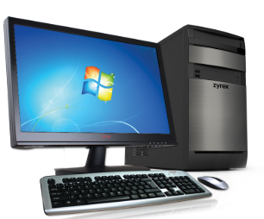
Compile and Run
Write code on Android studio
Compile code and get apk file
Send the apk to LEO by ADB
LEO runs the apk
Android Studio
Compile
apk file
ADB sends apk to LEO
Run
APK file
LEO runs apk
ADB

Slide 5

Two Methods
Method one : Install Neural Network on Server
Server
Train the dataset by TensorFlow/Keras
Obtain the model file
LEO gets images and sends them to server
Server loads model file and calculates human pose
Server controls the action of LEO
LEO
2016 Xing Shuda’s Method -- Apache server

Slide 6
Two Methods
Method two : Install Neural Network on LEO
Train the dataset
Install TensorFlow Lite on LEO
Train the dataset by TensorFlow
Obtain the “.pb” file(model file)
Send model file to LEO
LEO loads model file, and run the code
model file
Sends model file to LEO
Load model file and run
Difficulties : TensorFlow Lite and Effectiveness

Slide 7
THANKS!

