Slide 1
Work summaries of this month
Fu kangwei

Slide 2
New method VS. Old method
Old Method
Install neural network on robot
Install neural network on robot platform => Tensorflow Lite
Put model file into robot system
Robot analyses human posture by itself
Robot imitates human posture
Put model file
Analyse human posture by robot
Robot imitates human posture
Disadvantage: Effectiveness -- Robot's
poor capability

Slide 3
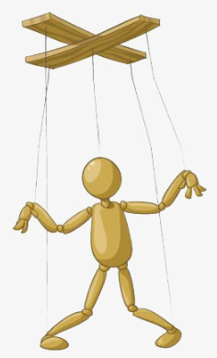
New method VS. Old method
New Method
PC device
Install neural network on PC device
Robot sends images to PC device by Internet
PC device analyses human posture and returns posture information to robot
Robot imitates human posture according to the information
Robot

Slide 4
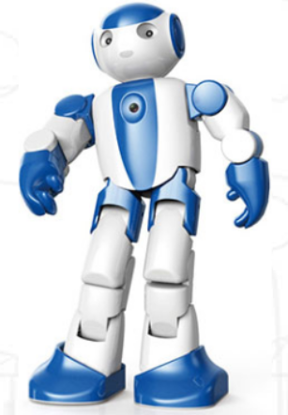
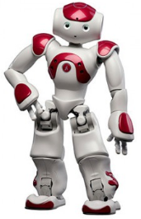
NAO Robot
LEO robot supplies poor SDK, it isn't suitable for the research
NAO Robot has camera and network device
Several flexible joint which is beneficial for action
Use python 2.7 for programing
Camera
Joint

Slide 5
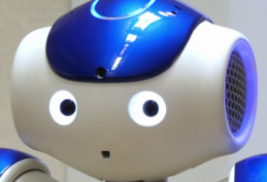
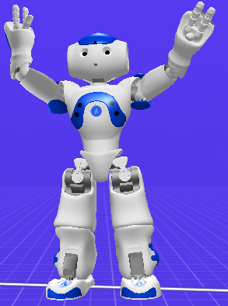

Completed Task
Install Naoqi software => SDK
Camera API and OpenCV: Obtain images of human => ALVideoDevice
Use Choregraphe to simulate NAO robot
Motion API: Control robot joints => ALMotion

Slide 6
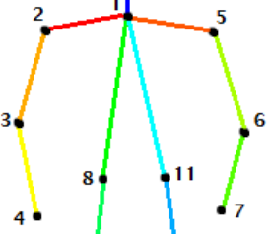
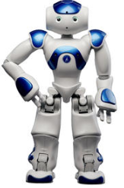
Future Work
Synchronize the posture of human and robot => algorithm
Analyse the real-time of action
Calculate the accuracy of imitation
synchronize
2
5
3
6
4
7
Difficulties: Python 3.6 => Python 2.7

Slide 7
THANKS!

