Slide 1
The summary of this week
Fu kangwei

Slide 2
Reason of abandoning the old research
Too large dataset(COCO, Train images 18G, Val images 1G, Test images 5G)
Too long training period(About 4, 5 days)
Research form 2D to 3D is difficult for me
It's hard to acquire the 2D-to-3D dataset(Not public)
Acquisition
Numpy, Tensorflow and Keras API
Deal with Python code Bugs

Slide 3
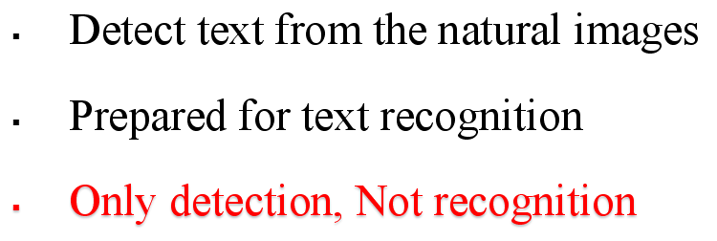
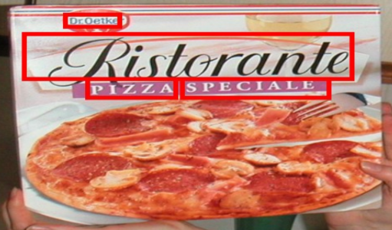
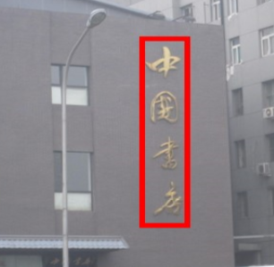
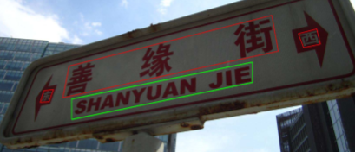
New Research -- Text Detection
Difficulties
Multi-oriented text in the images
All kinds of languages

Slide 4
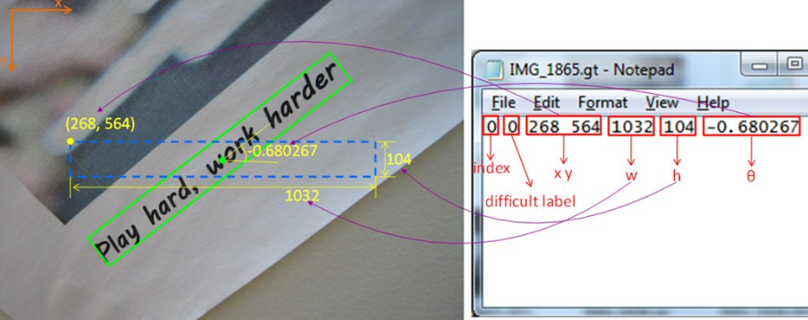
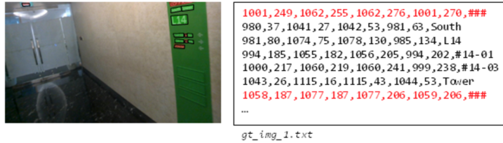
Dataset for Text Detection
MSRA-TD500(300 train images, 200 test images)
ICDAR2015 Incidental Scene Text(1000 train images, 500 test images)
ICPR MTWI 2018(10,000 train images, from taobao.com)
COCO-text(63,686 train images)
MSRA-TD500 dataset
ICDAR2015 and ICPR MTWI 2018 dataset

Slide 5
Papers
Text-Attentional Convolutional Neural Network for Scene Text Detection
Multi-Oriented Text Detection with Fully Convolutional Networks
EAST: An Efﬁcient and Accurate Scene Text Detector
Deep Direct Regression for Multi-Oriented Scene Text Detection
Read Papers
Arbitrary-Oriented Scene Text Detection via Rotation Proposals
Deep Matching Prior Network -- Toward Tighter Multi-oriented Text Detection
DeepText -- A Unified Framework for Text Proposal Generation and Text Detection in Natural Images
Detecting Text in Natural Image with Connectionist Text Proposal Network
Reading Papers

Slide 6



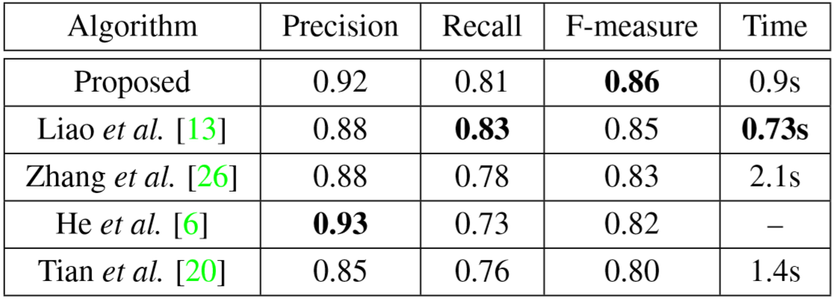
Comparative Standard
Precision
Recall
F-measure

Slide 7
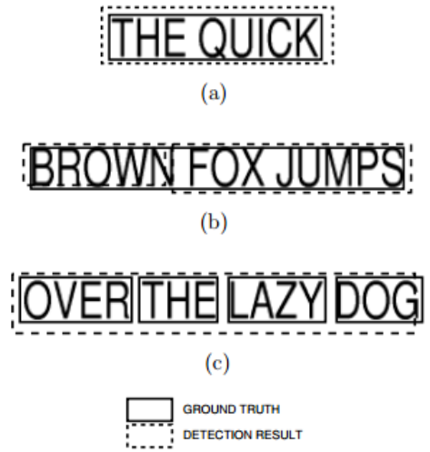


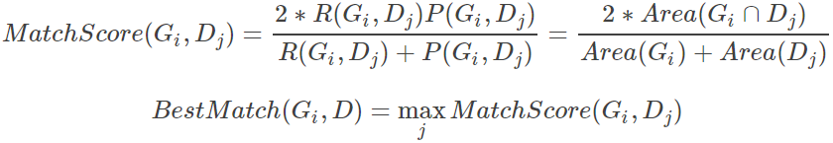
Comparative Standard
Matching of two bboxes(bounding box)
One-to-One match
Evaluation in ICDAR2003
G = Ground Truth
D = Detection Result
One-to-Many match
Many-to-One match
ICDAR2013 is the old method, the new one is ICDAR2013 -- DetEval

Slide 8

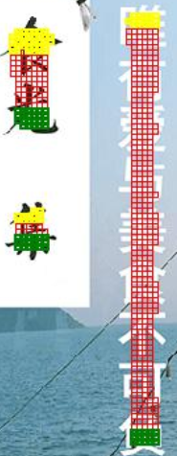

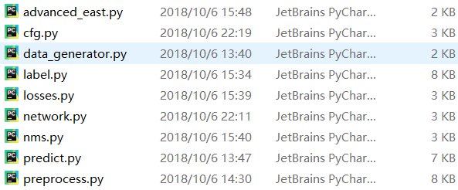
Research Code
EAST: An Efﬁcient and Accurate Scene Text Detector
Dataset: ICPR MTWI 2018
Training period: 4, 5 hours
Core code

Slide 9
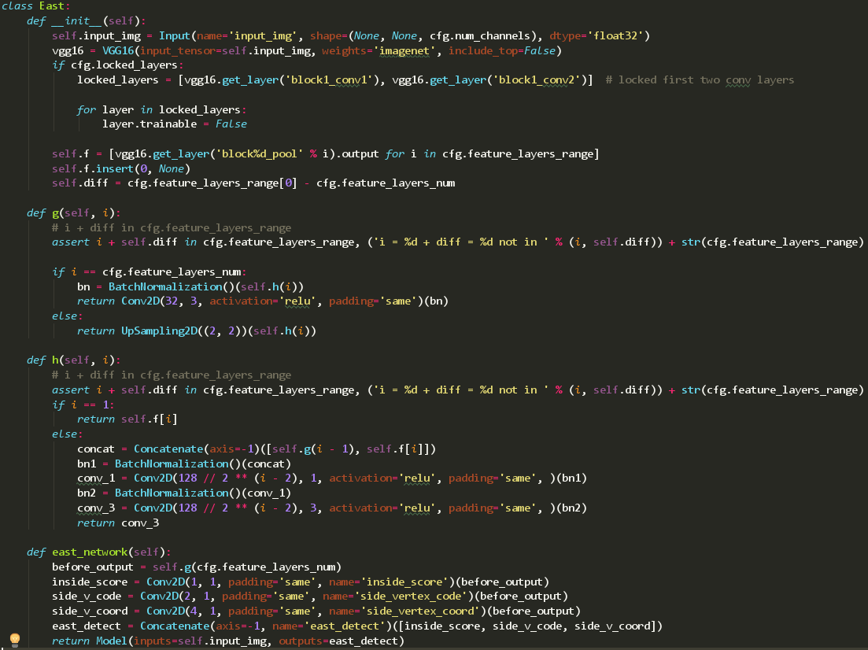
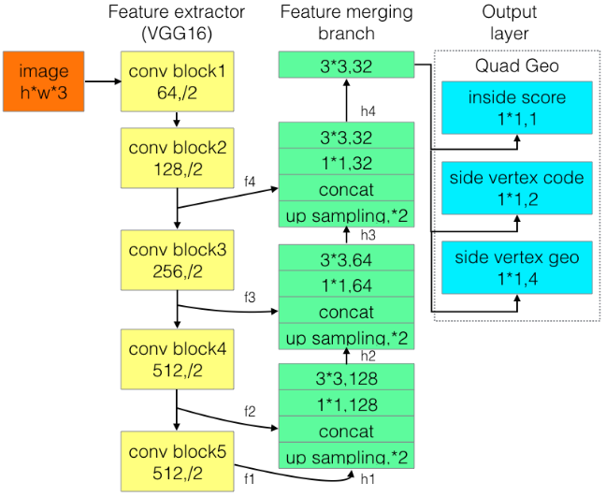
Networks Model
The analysis of network code is completed

Slide 10
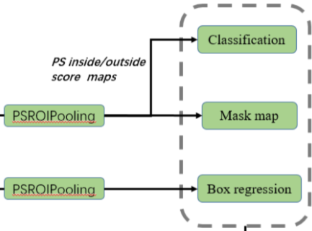
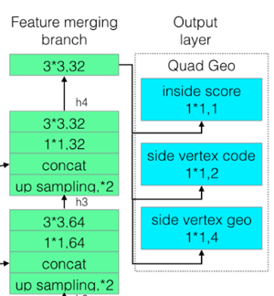
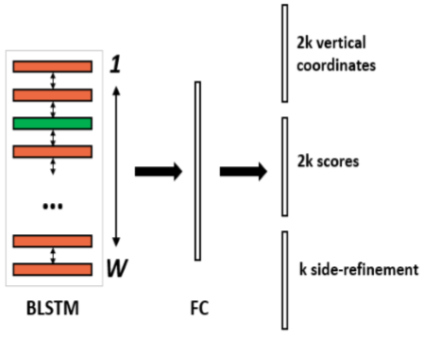
Loss Function
How to design the loss function?
How to put the loss function into the neural networks?
How to make neural network own several outputs?

Slide 11
THANKS!

