Slide 1
The summary of this week
Fu kangwei

Slide 2
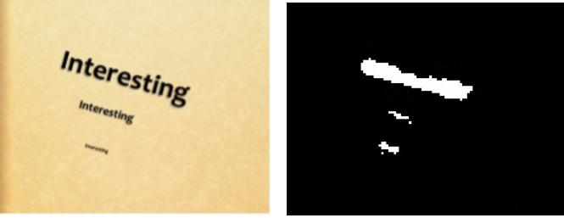
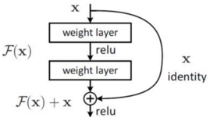
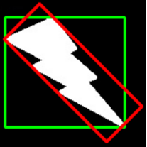
Text detection based on ResNet and FCN
FCN(Fully Convolutional Networks)
Use FCN for partitioning text area from images
ResNet: Deep Residual Learning
Use minAreaRect(最小外接矩形) to mark text area
Schematic
ResNet unit
minAreaRect(Red)

Slide 3
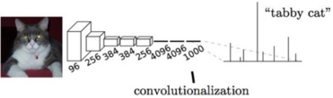
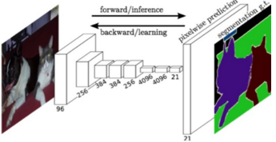
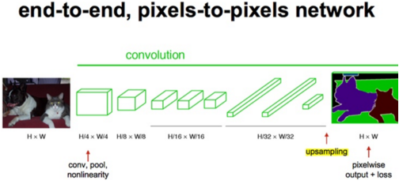
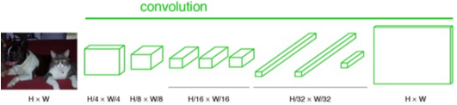
Fully Convolutional Networks
Traditional CNN -- conv + fully connected
FCN: fully connected -> conv
Upsampling(Deconvolution) -> Original Size
Classify each pixel
Traditional CNN
Schematic

Slide 4
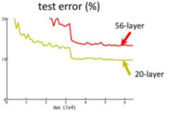
ResNet
Deal with Degradation problem(网络退化问题)
Traditional idea: go deeper, go better
Effect of 50 layers is not better than 30 layers
Use ResNet unit to solve this problem
Contained in Keras, Pytorch
Schematic
ResNet unit

Slide 5
minAreaRect
A kind of Image processing algorithm
Because of Multi-orientation, NMS is not suitable for text detection
Contained in OpenCV(cv2.minAreaRect)
minAreaRect(Red)

Slide 6
THANKS!

