Slide 1
The summary of this week
Fu kangwei

Slide 2
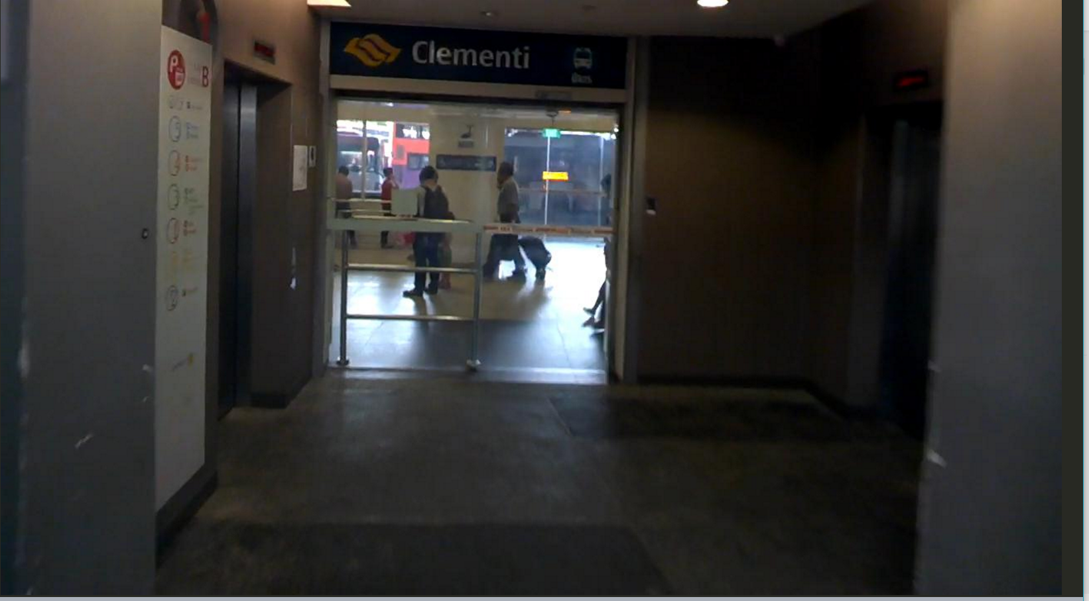


Original Image/Ground Truth
+
=

Slide 3

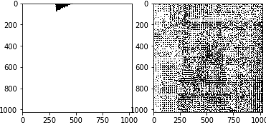
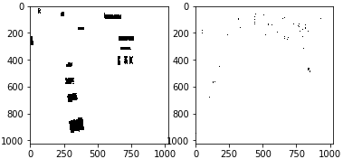
epoch 0 ~ 5
loss: 0.704473018
loss: 0.113636925

Slide 4
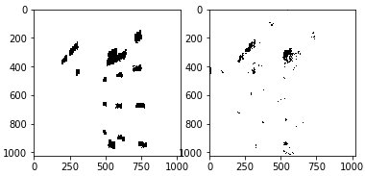
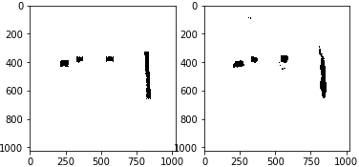
epoch 10 ~ 55
loss: 0.065741024
loss: 0.0180587023

Slide 5
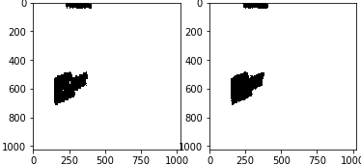
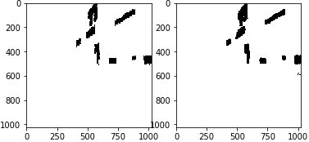
epoch 70 ~ 99
loss: 0.00829182378
loss: 0.00708857132

Slide 6
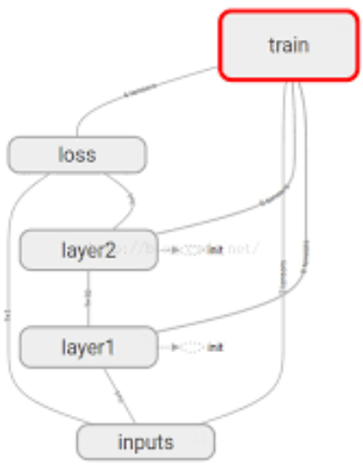
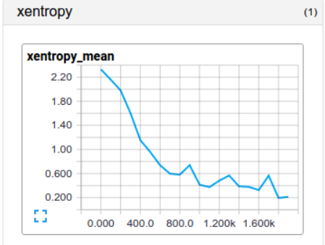
Next Target
TensorboardX
Test Dataset(500 images)
Unreasonable Step:
(1280, 720) resize (1024, 1024)
=> long training time, large memory usage

Slide 7
THANKS!

