Slide 1
EAST -- An Efficient and Accurate Scene TextDetector
Fu kangwei

Slide 2
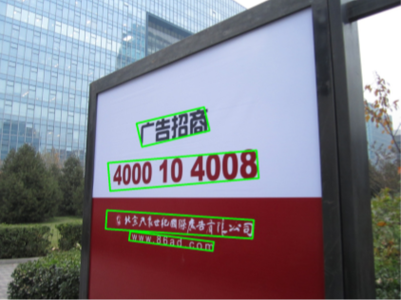
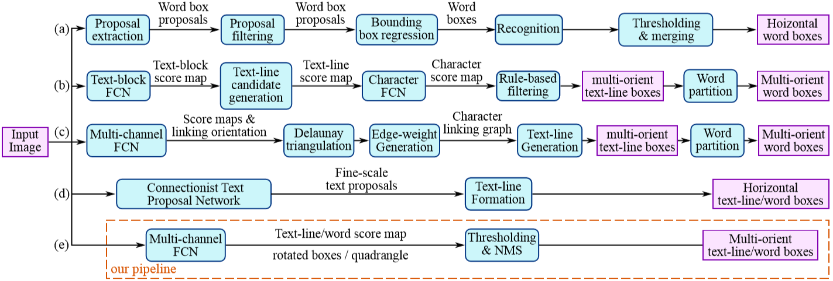
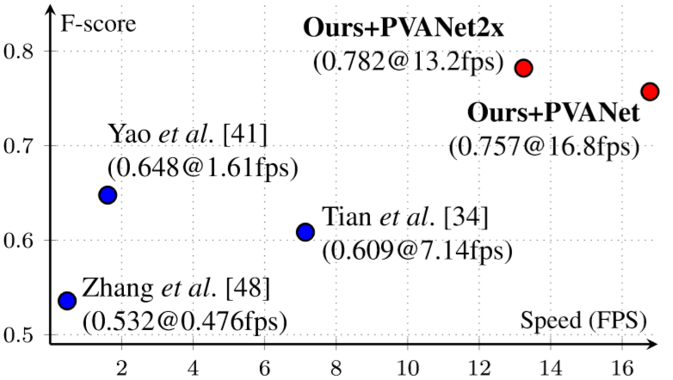
Abstract
Detect text from natural image
Multi-Orientation detector
DataSet: ICDAR 2015, COCO-Text and MSRA-TD500
Simple and powerful pipline(only two stages)

Slide 3
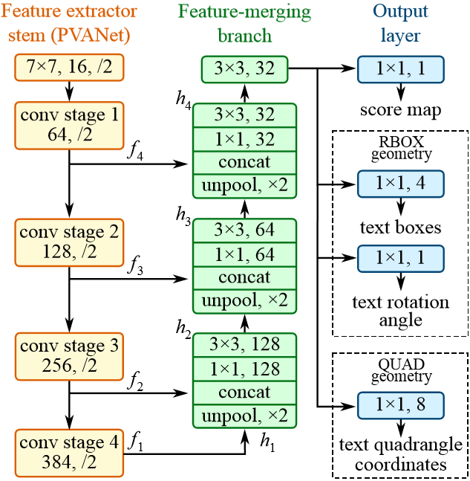
Introduction
Fully Convolutional Network (FCN)[Really, it is FPN]
Either rotated rectangles Or quadrangles
Non-Maximum Suppression(NMS)
Signiﬁcantly enhanced performance, Run much faster

Slide 4
Related Work
Stroke Width Transform (SWT)
Maximally Stable Extremal Regions (MSER)
Based on edge detection or extremal region extraction
CNN + ACF(Aggregate Channel Features)
Complex and ineffective(Only detect horizontal text lines)

Slide 5
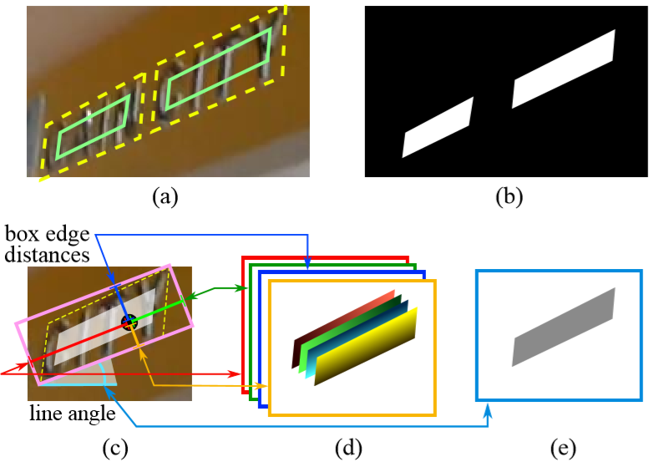
Methodology
(a) Text quadrangle (yellow dashed) and the shrunk quadrangle (green solid)
(b) Text score map
(c) RBOX geometry map generation
(d) 4 channels of distances of each pixel to rectangle boundaries
(e) Rotation angle

Slide 6
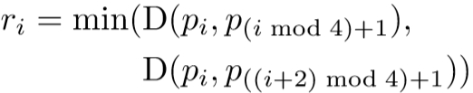
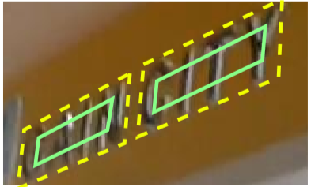

Score Map Generation for Quadrangle
For quadrangle Q = {p_{i}|i∈{1,2,3,4}}, where p_{i} = {x_{i},y_{i}} are vertices on the quadrangle in clockwise order, compute a reference length r_{i} for each vertex p_{i} as:
where D(p_{i},p_{j}) is the L₂ distance between p_{i} and p_{j}.
Shrink every edge by moving two endpoints inward along the edge by 0.3r_{i} and 0.3r_{(i mod 4)+1} respectively.

Slide 7
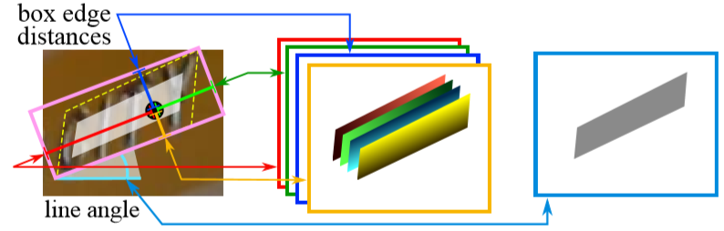
Geometry Map Generation
Firstly, generate a rotated rectangle that covers the region with minimal area
For each pixel which has positive score, calculate its distances to the 4 boundaries of the text box
Put the distances to the 4 channels of RBOX ground truth

Slide 8

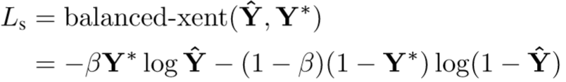
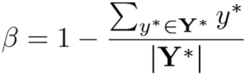
Loss Functions
Ls: the losses for the score map
Lg: the losses for the geometry map
λg: weigh the importance between two losses(set λg to 1)
Loss for Score Map
Yˆ: Prediction of score map
Y*: Ground truth
β： Balancing factor between positive and negative samples

Slide 9
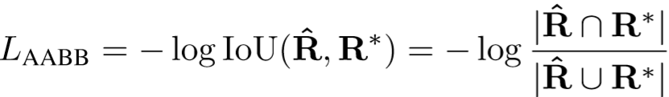





Loss Functions
Rˆ: The predicted AABB geometry
R*: The ground truth
λθ: Set to 10
θˆ: The prediction to rotation angle
θ*: The ground truth
d₁, d₂, d₃ and d₄represents the distance from a pixel to the top, right, bottom and left boundary of its corresponding rectangle

Slide 10



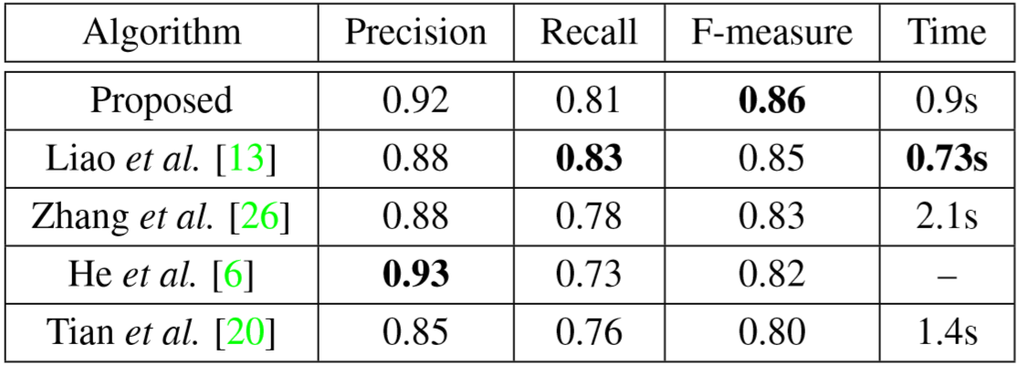
Comparative Standard
Precision
Recall
F-measure

Slide 11
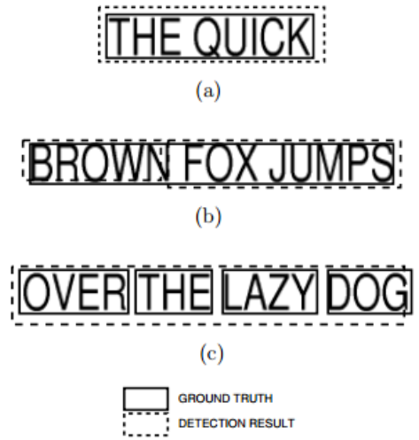


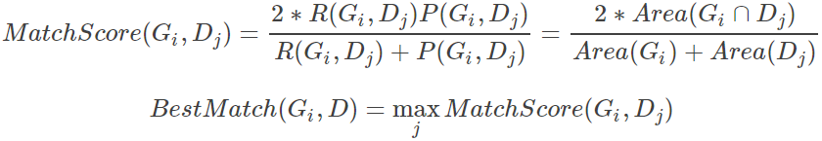
Comparative Standard
Matching of two bboxes(bounding box)
One-to-One match
Evaluation in ICDAR2003
G = Ground Truth
D = Detection Result
One-to-Many match
Many-to-One match

Slide 12
THANKS!

