Slide 1
The summary of this week
Fu kangwei

Slide 2
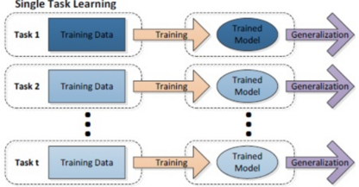
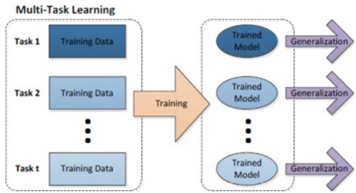
Multi-Tasking
Single-Tasking: Decompose into simple and independent sub-tasks
Multi-Tasking: Put multiple related tasks together and learn at the same time
Multi-Tasking is better than Single-Tasking

Slide 3
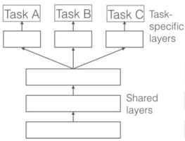
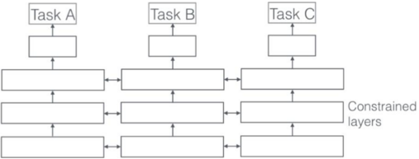
Reason -- Multi-Tasking defeat Single-Tasking
A number of factors shared between multiple tasks
Share information they learn during training
Better generalization(泛化) than Single-Tasking

Slide 4
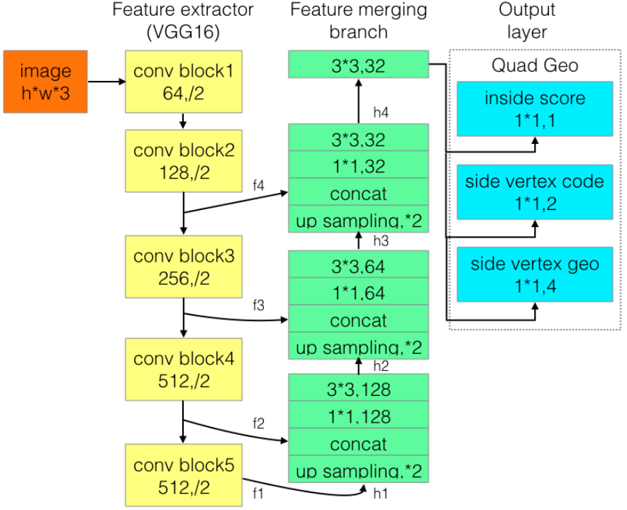
Multi-Tasking part in my research code
Understand principle of Multi-Tasking
Understand code of Multi-Tasking

Slide 5
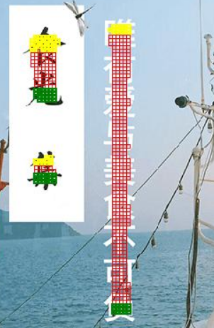
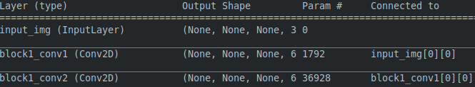
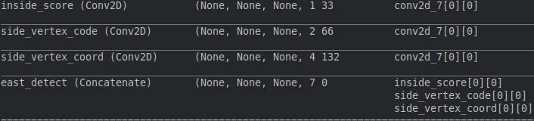
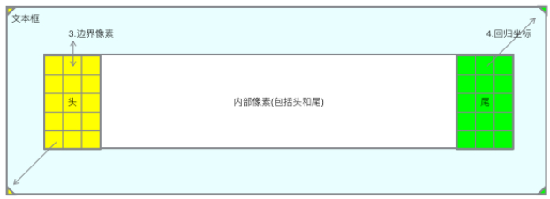
One input, Multi outputs
Input a image(3 channels)
Output predicted date(7 channels, for every sampling pixel)

Slide 6
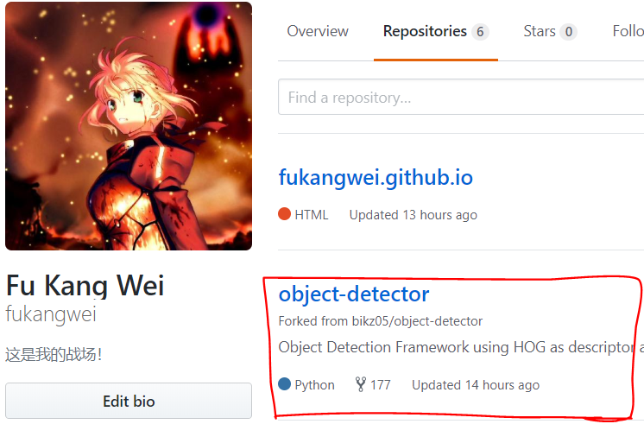
Target
Learn Latex and prepare writing paper
Organize my github repository
Organize my note blog

Slide 7
THANKS!

